Slide 1
Jin
About
Skills
Education
Projects
Experience
Contact
🌙
# ABOUT
Personal
CV Website
The First Assemssment
Jinheon Kwon

Slide 2


#
READING PATTERNS
02 / 07
▸
Users scan — they don't read every word.
F-Pattern Scan Simulator
▸
F-shaped pattern: most attention at the top.
▸
Important info placed at the top of each section.
▸
Details hidden inside — revealed on click.
▸
Fixed nav bar for instant section access.
▸
Full CV downloadable from the slide.
F-Shape Scan Pattern

Slide 3
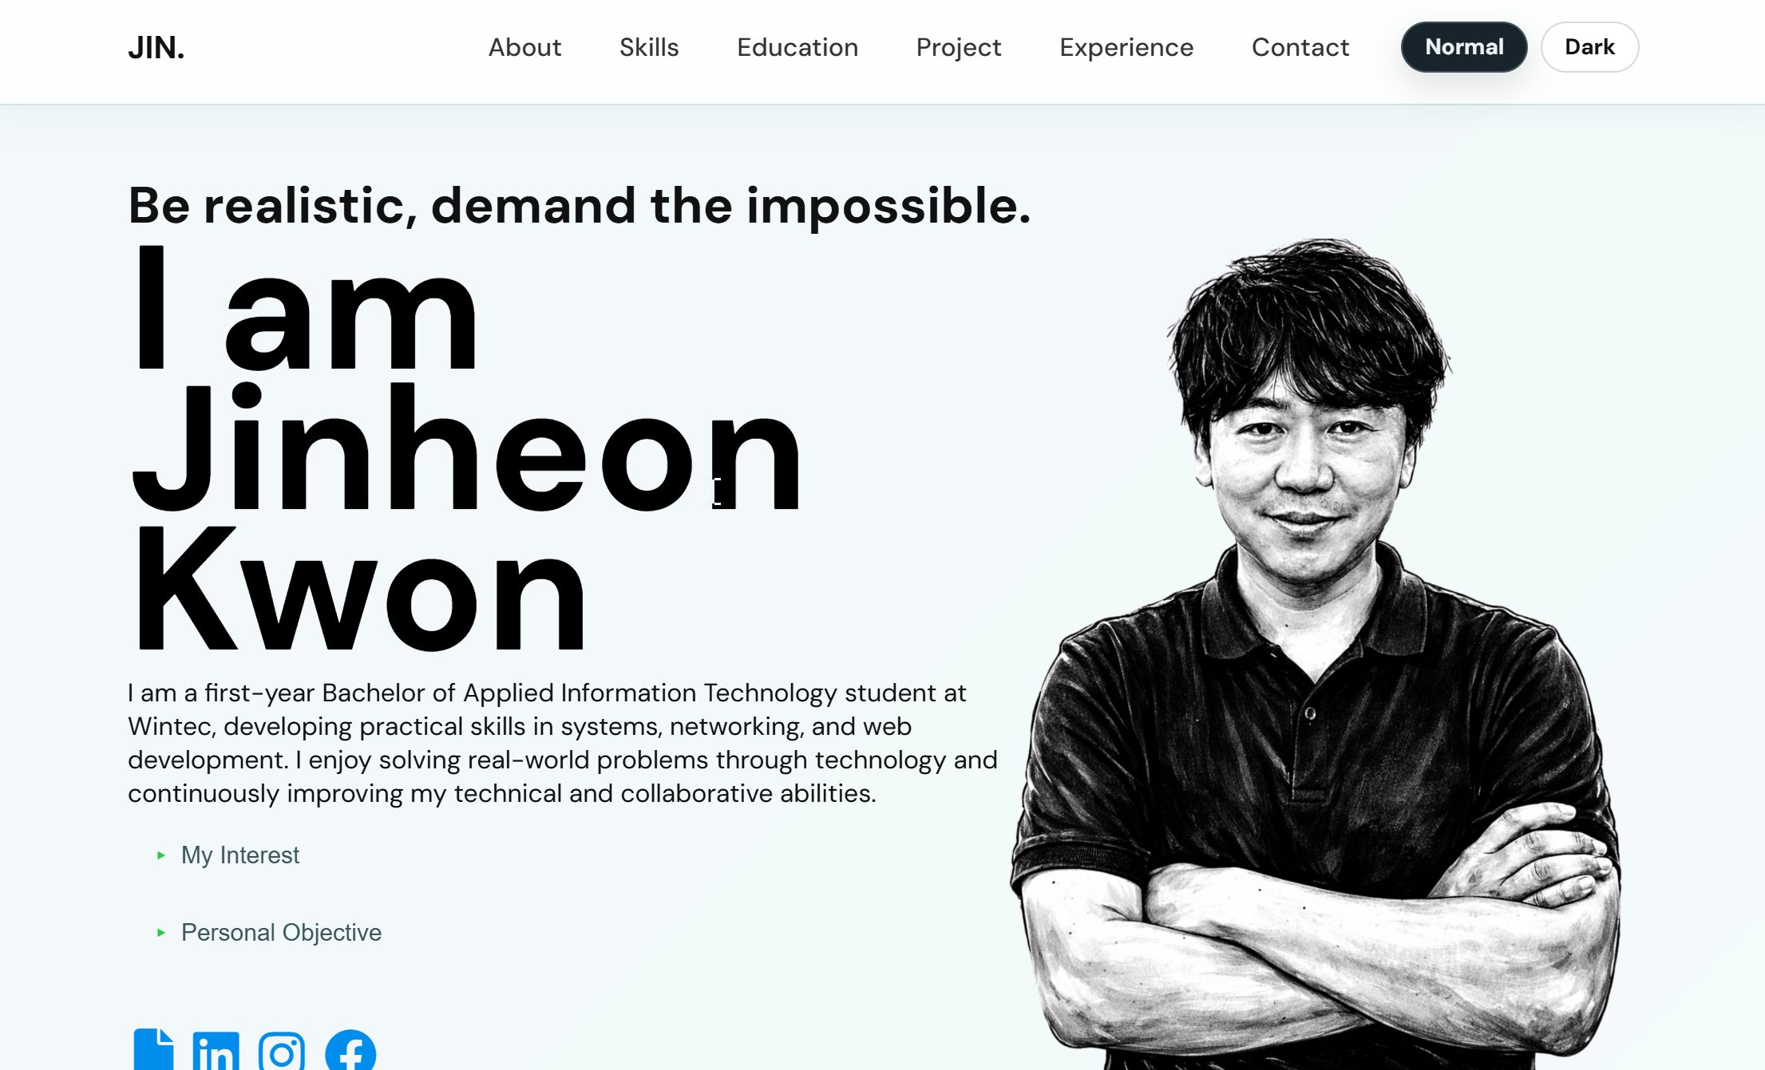
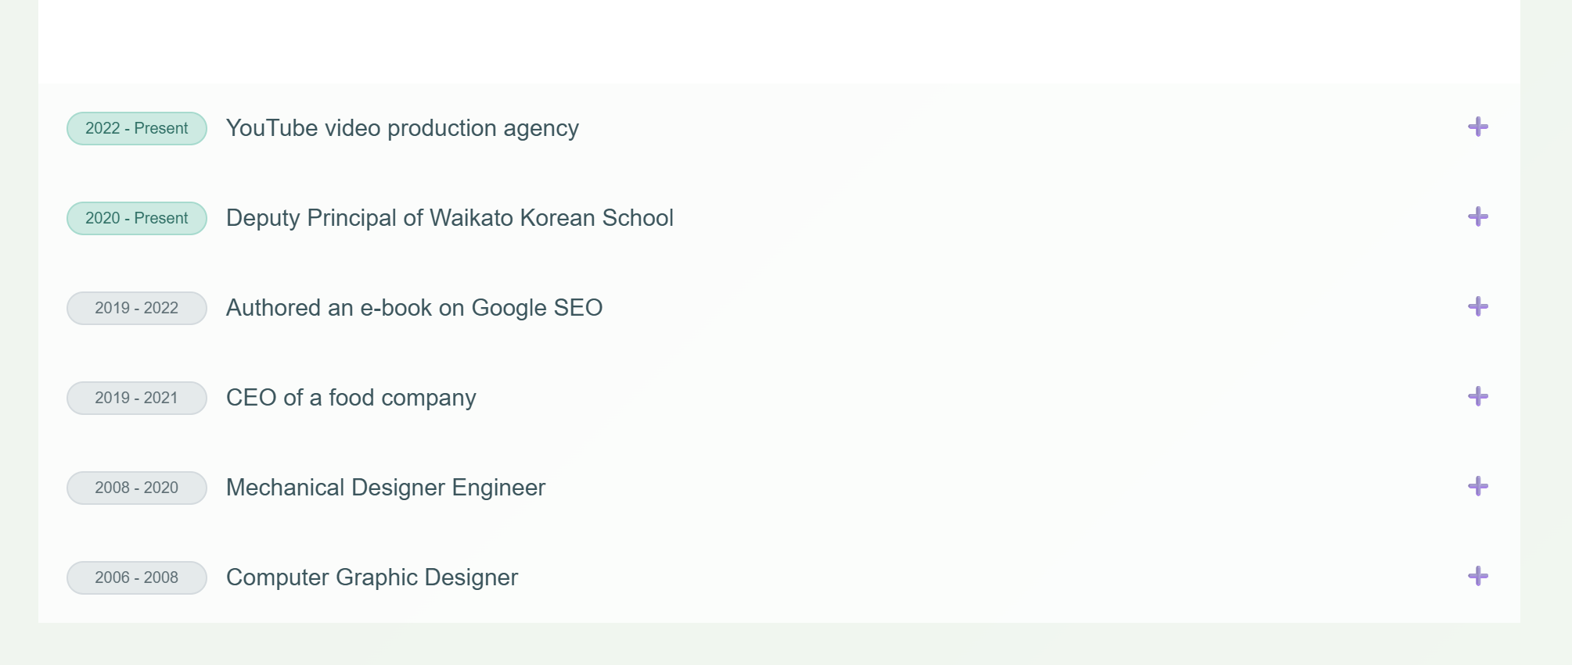

Slide 4

#
SIZE & IMPORTANCE
03 / 07
Size Signals Priority
Typography Scale
Main titles and headings are much larger than body text — users see what matters first.
Section Title
#ABOUT
#
H2 Sub-heading
Font Variation
Skill Name
Playfair Display + DM Sans. Two typefaces create contrast and keep readers engaged.
Body Text
Description paragraph
Progressive Disclosure
Caption · tag
Photo, short bio, and key info shown first. Details tucked behind accordion panels.
tag label

Slide 5
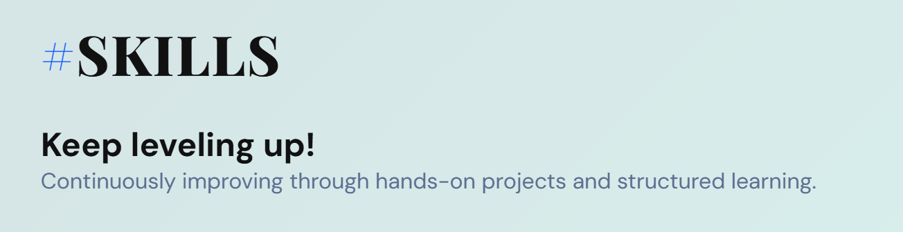
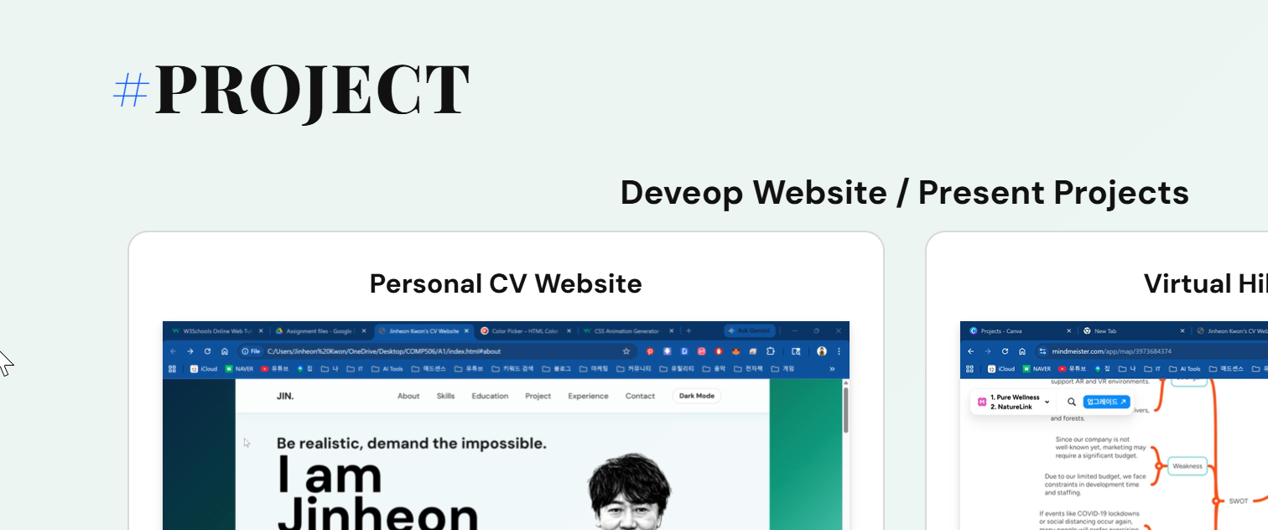
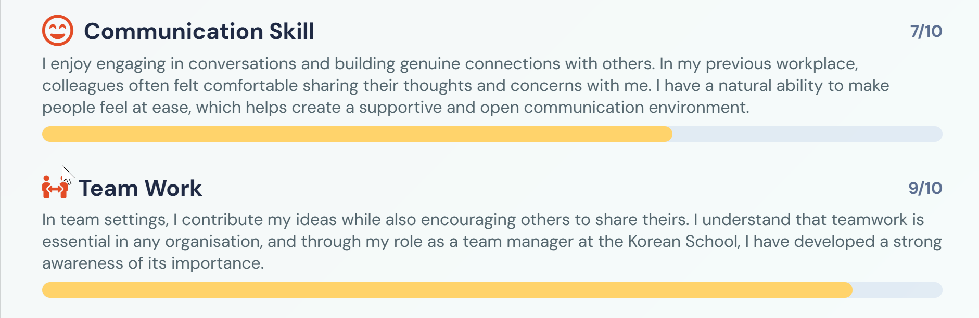
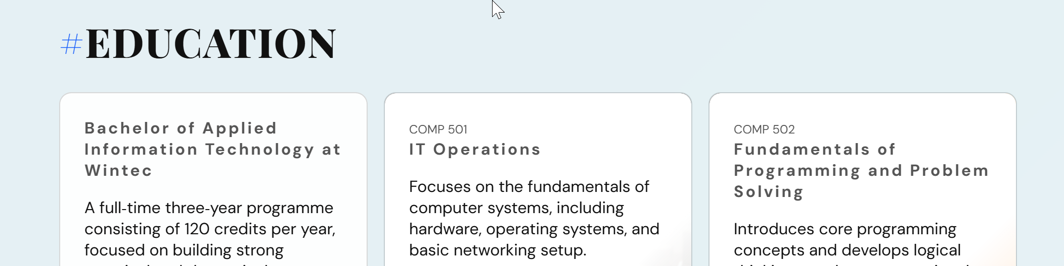

Slide 6

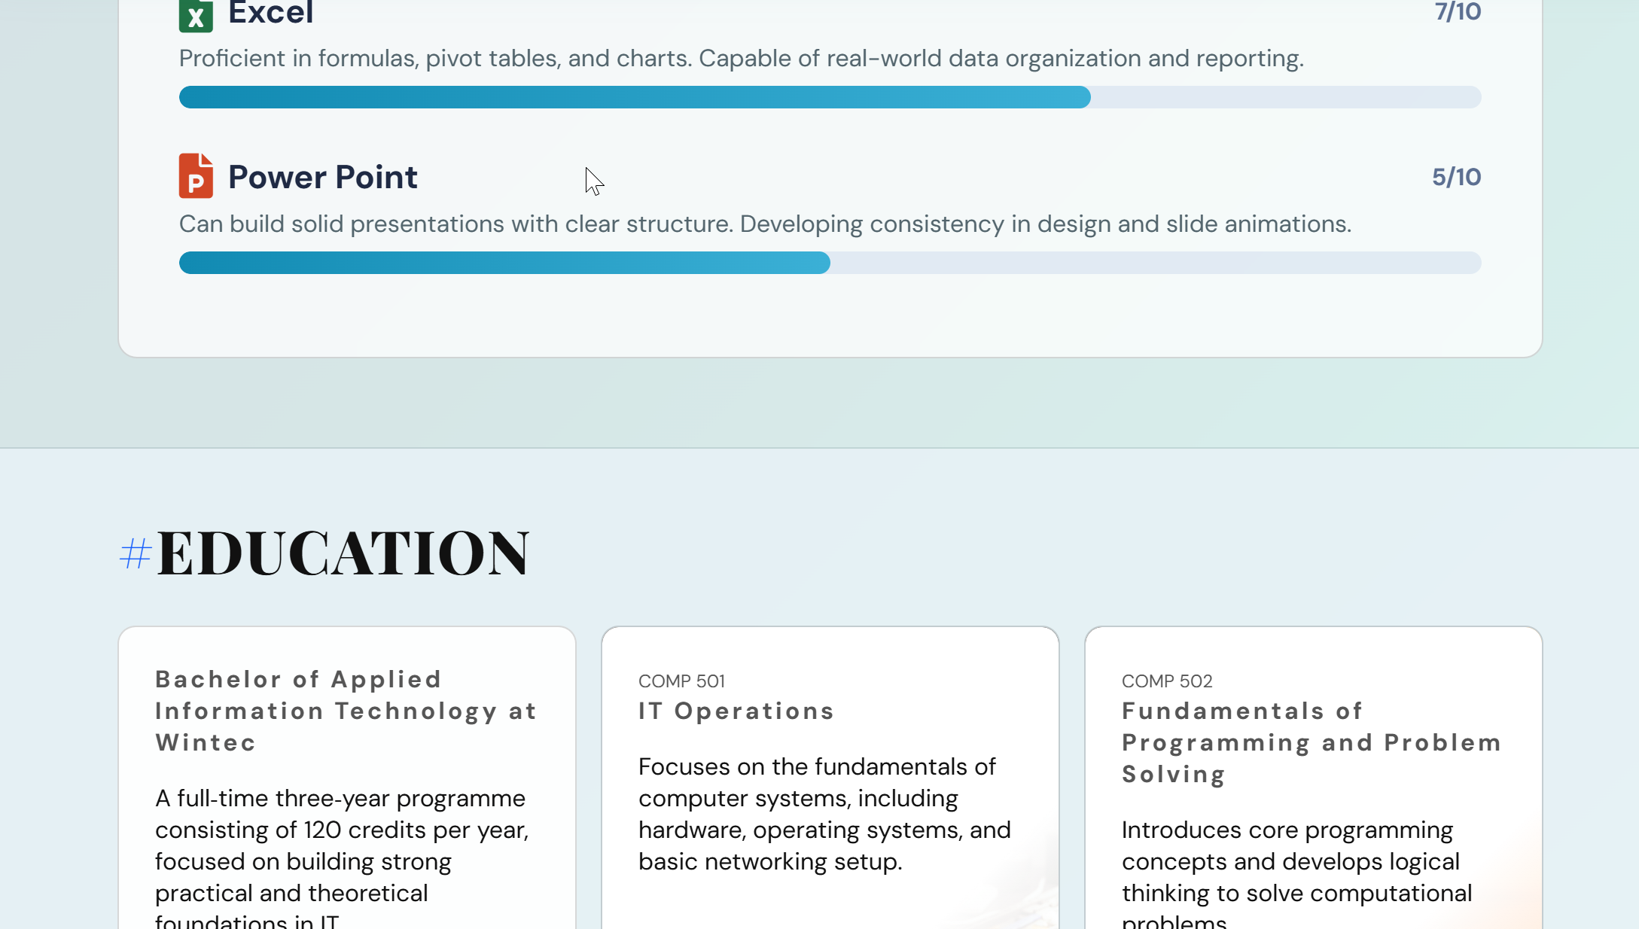
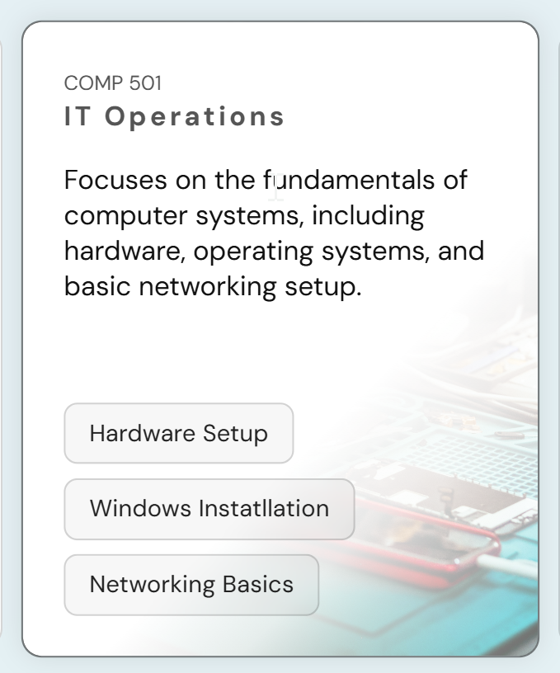
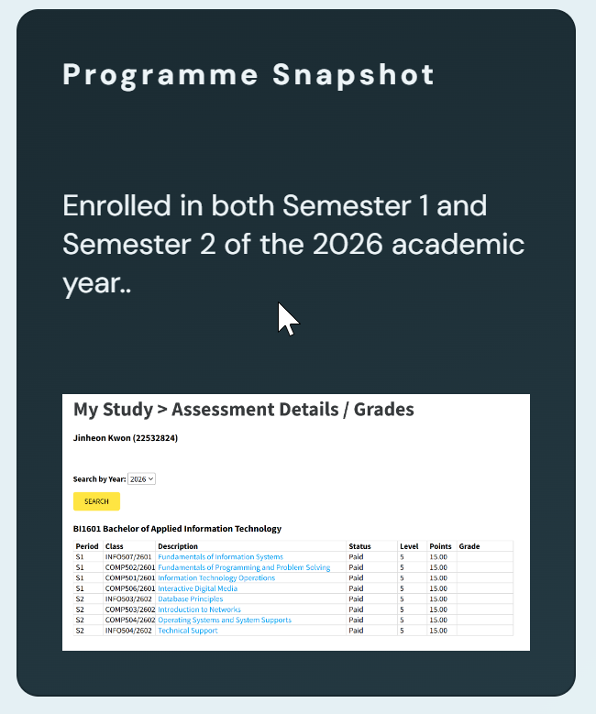
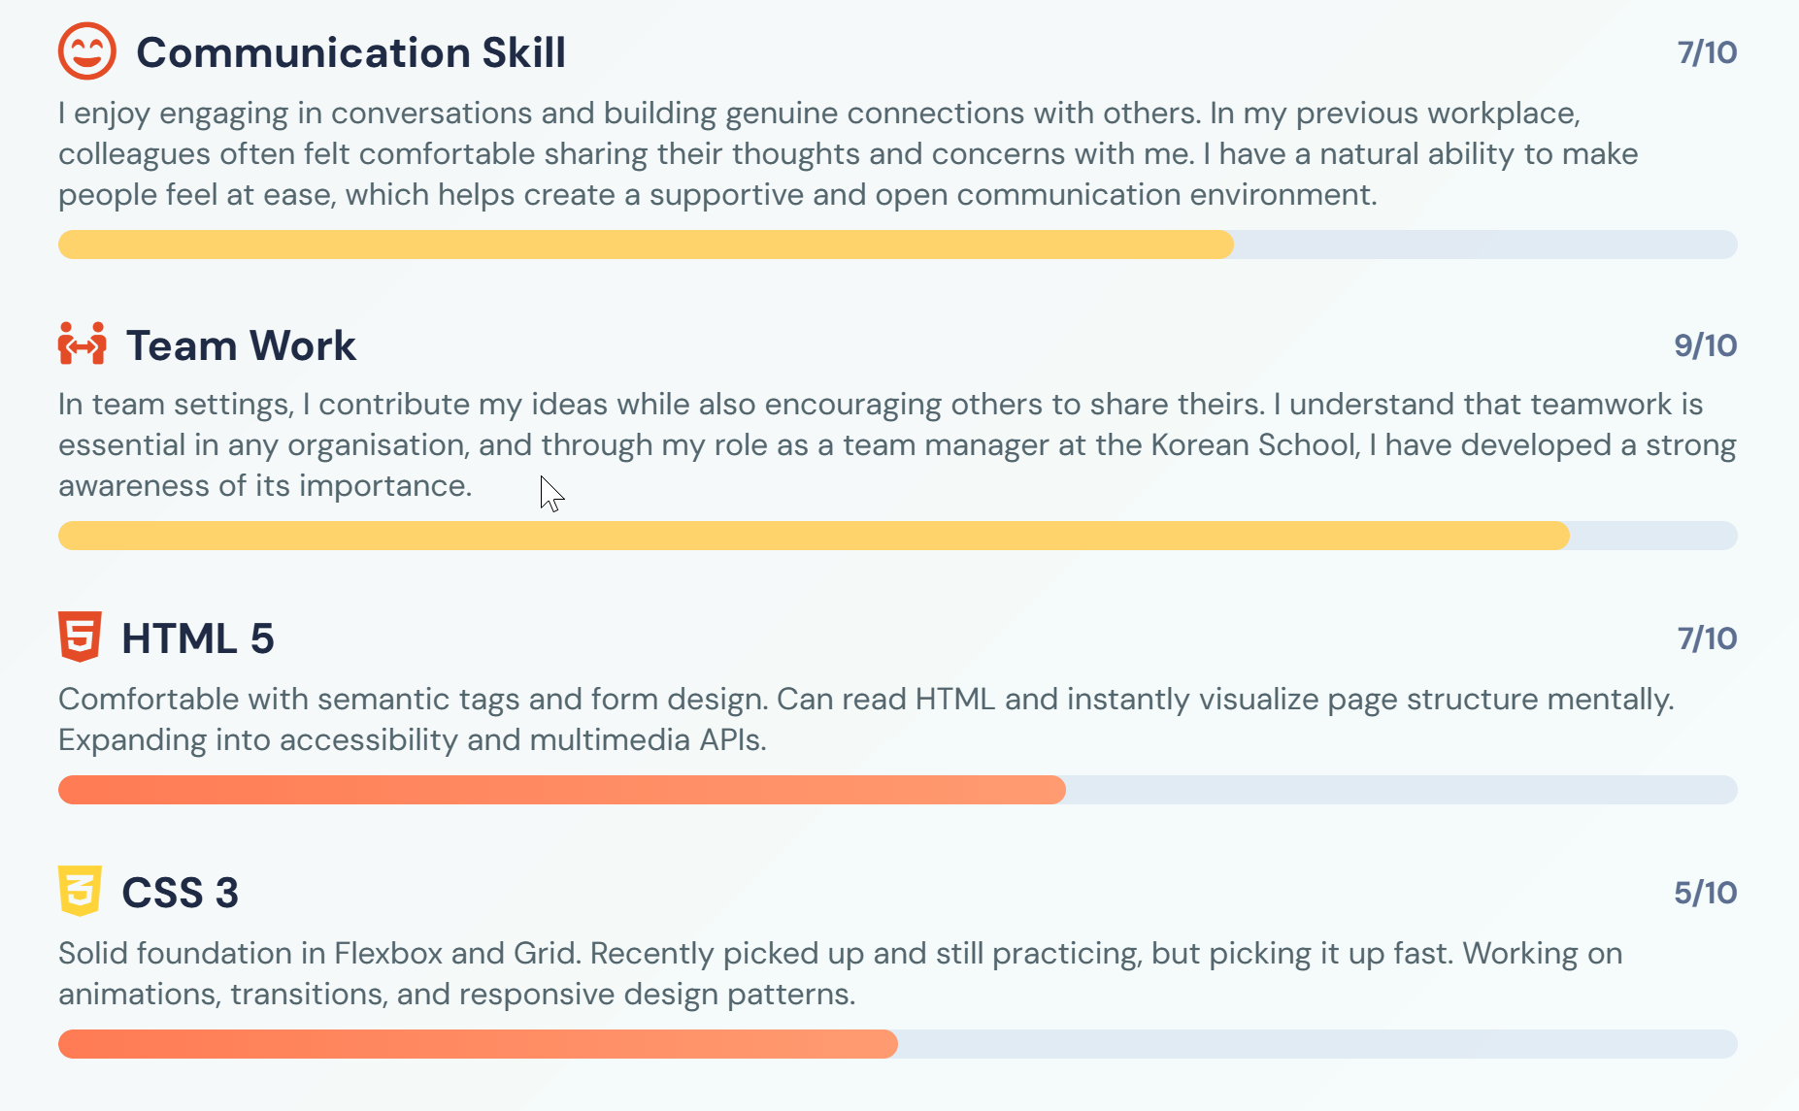
#
SPACE, TEXTURE & PROXIMITY
04 / 07
Space
Texture
Proximity
I added enough space between sections to keep the layout clean and easy to read.
This creates a calm and organised feeling.
I used textures such as soft backgrounds, cards, borders, shadows, and overlay effects.
These make the design more interesting without being too heavy.
For proximity, I grouped related information together.
For example, skills are placed in one section, and similar categories use similar colours.
scroll-margin
border-radius:12px
margin
box-shadow
padding
backdrop-filter
CSS Grid

Slide 7

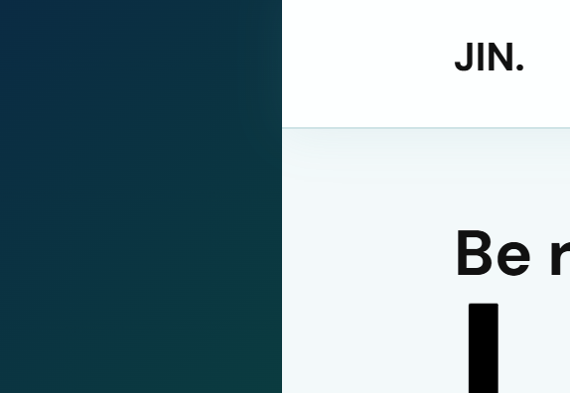


#
COLOUR THEME & ACCESSIBILITY
05 / 07
Deep Navy
Dark Green
Teal Green
Mint
Section BG
#0a2a43
#0b4f3c
#1aa87a
#9fffe8
#f6fbfc
Body Gradient Start
Body Gradient Mid
Body Gradient End
Accent / Highlight
Content Sections
Inspired by: Aston Martin · Rolex — elegance, sophistication, premium feel
Background colour
Dark Mode
Clear Buttons
This green colour is inspired by luxury brands such as Aston Martin and Rolex, which represent elegance and sophistication.
I used dark text on a light background.
I also added a dark mode, which helps reduce eye strain at night.
Clear buttons, readable headings, and simple text styles improve usability.

Slide 8
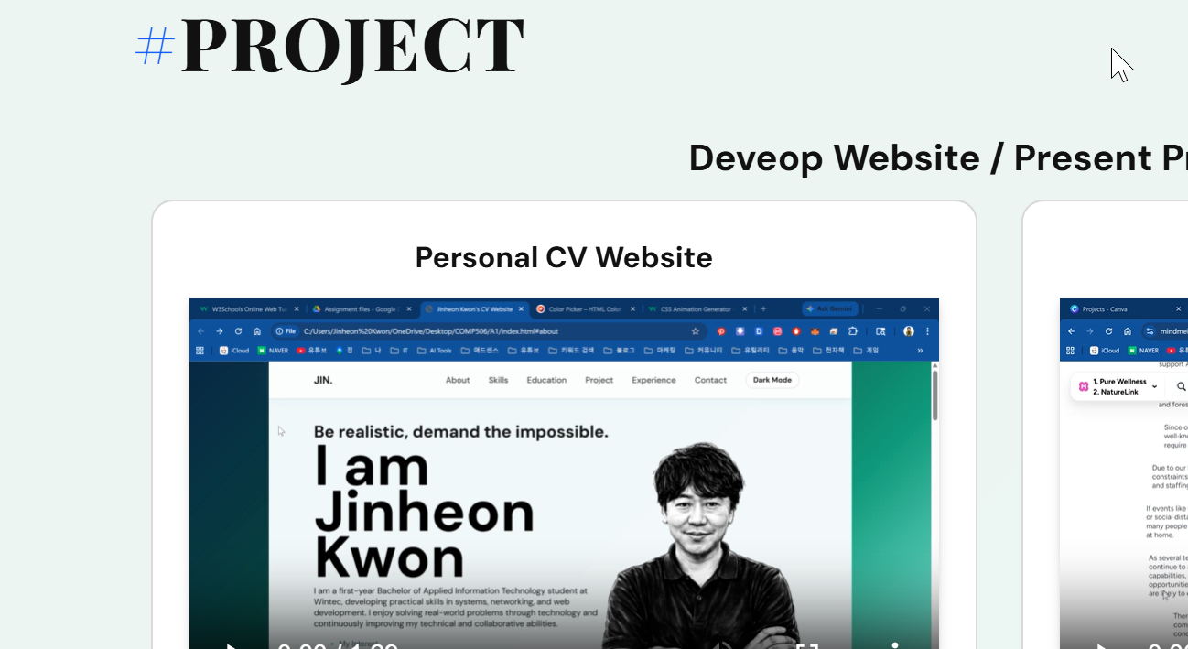
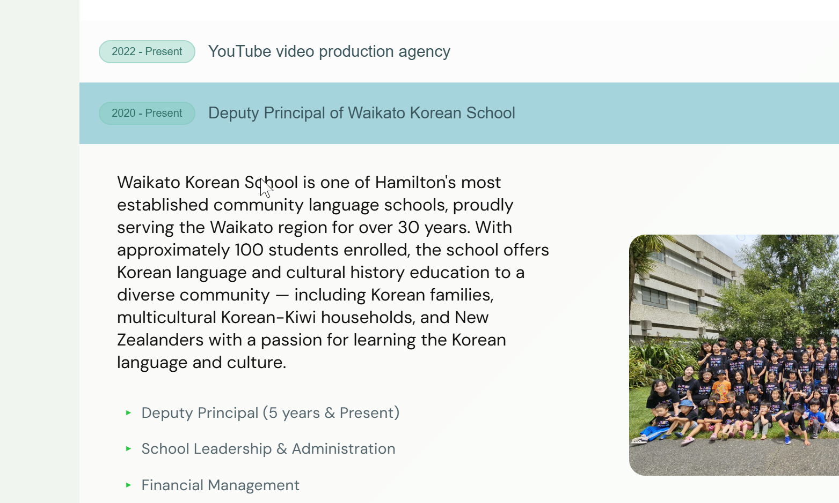
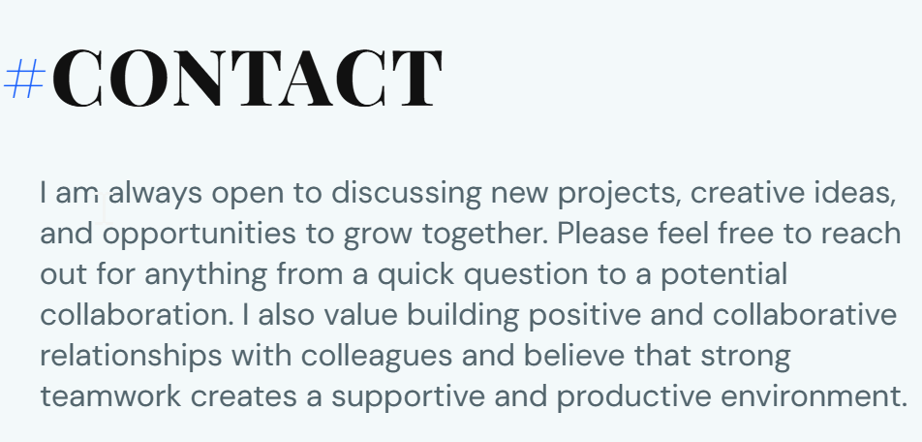
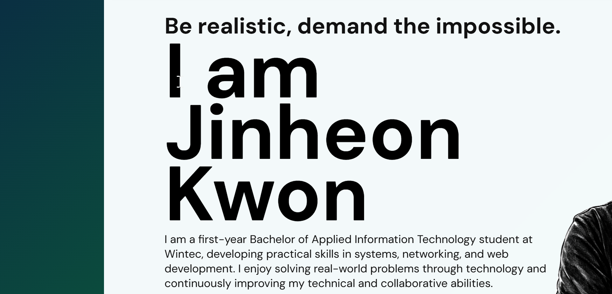

Slide 9

#
COLUMN LAYOUT
06 / 07
About — Flex 2-col
Education — CSS Grid 3-col
Contact — Flex 2-col
text-left + image-right
grid-template-columns: repeat(3,1fr)
info-left + form-right
↺
contact form

Slide 10
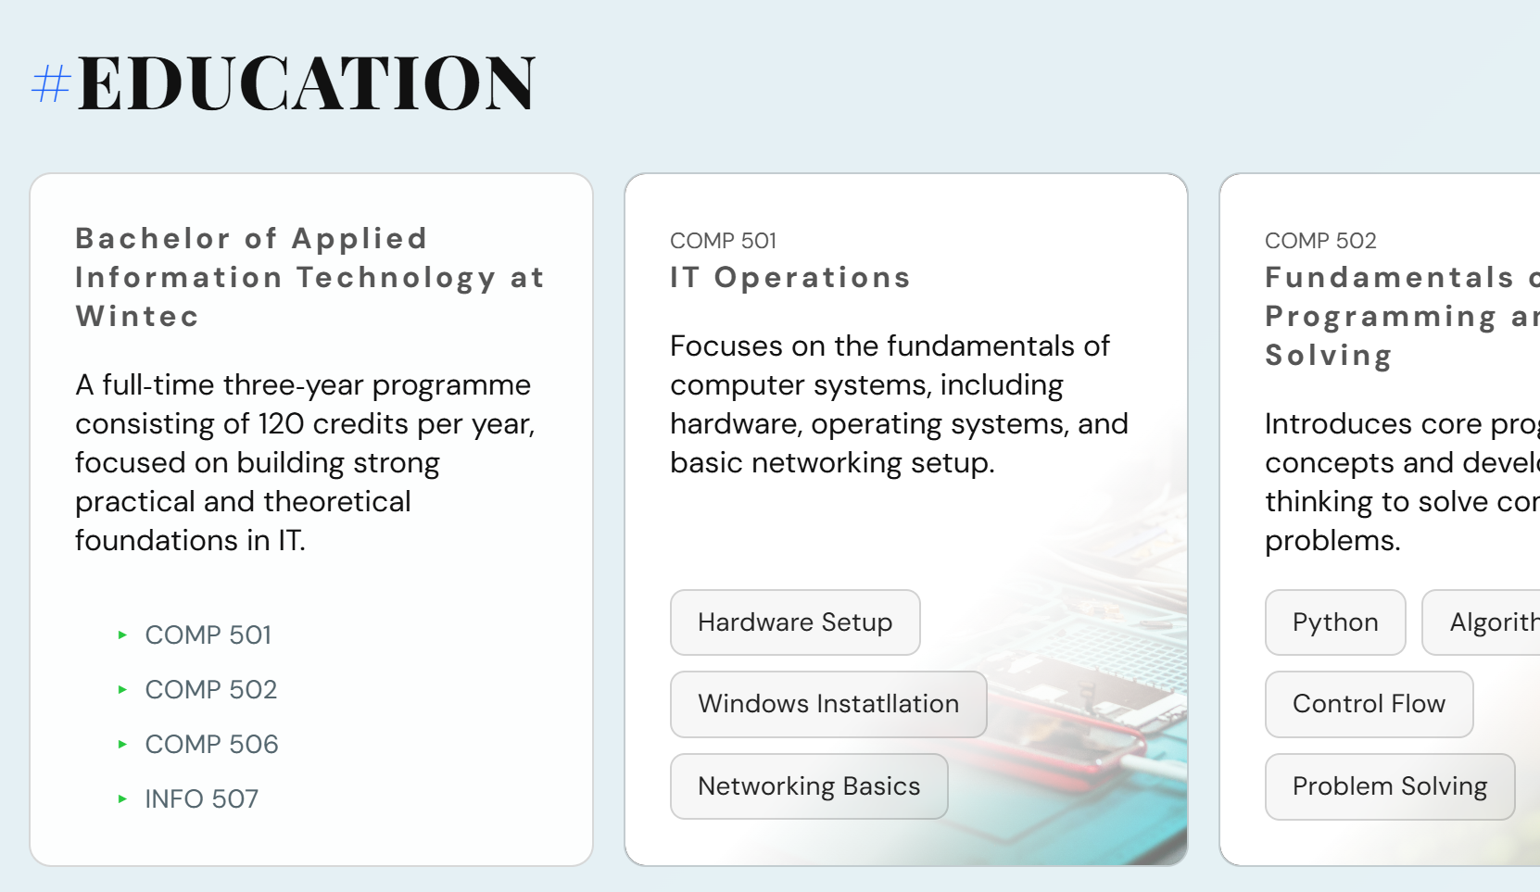
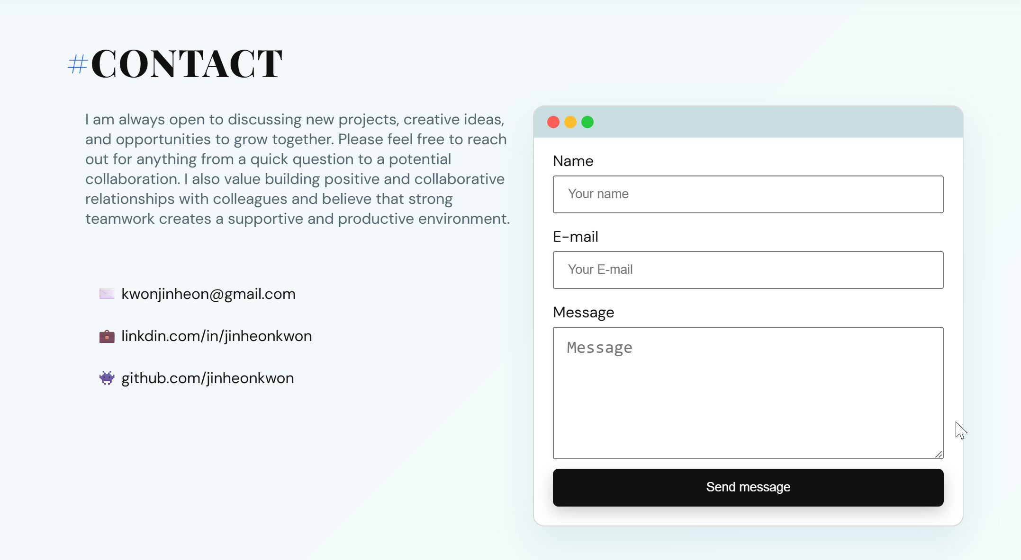
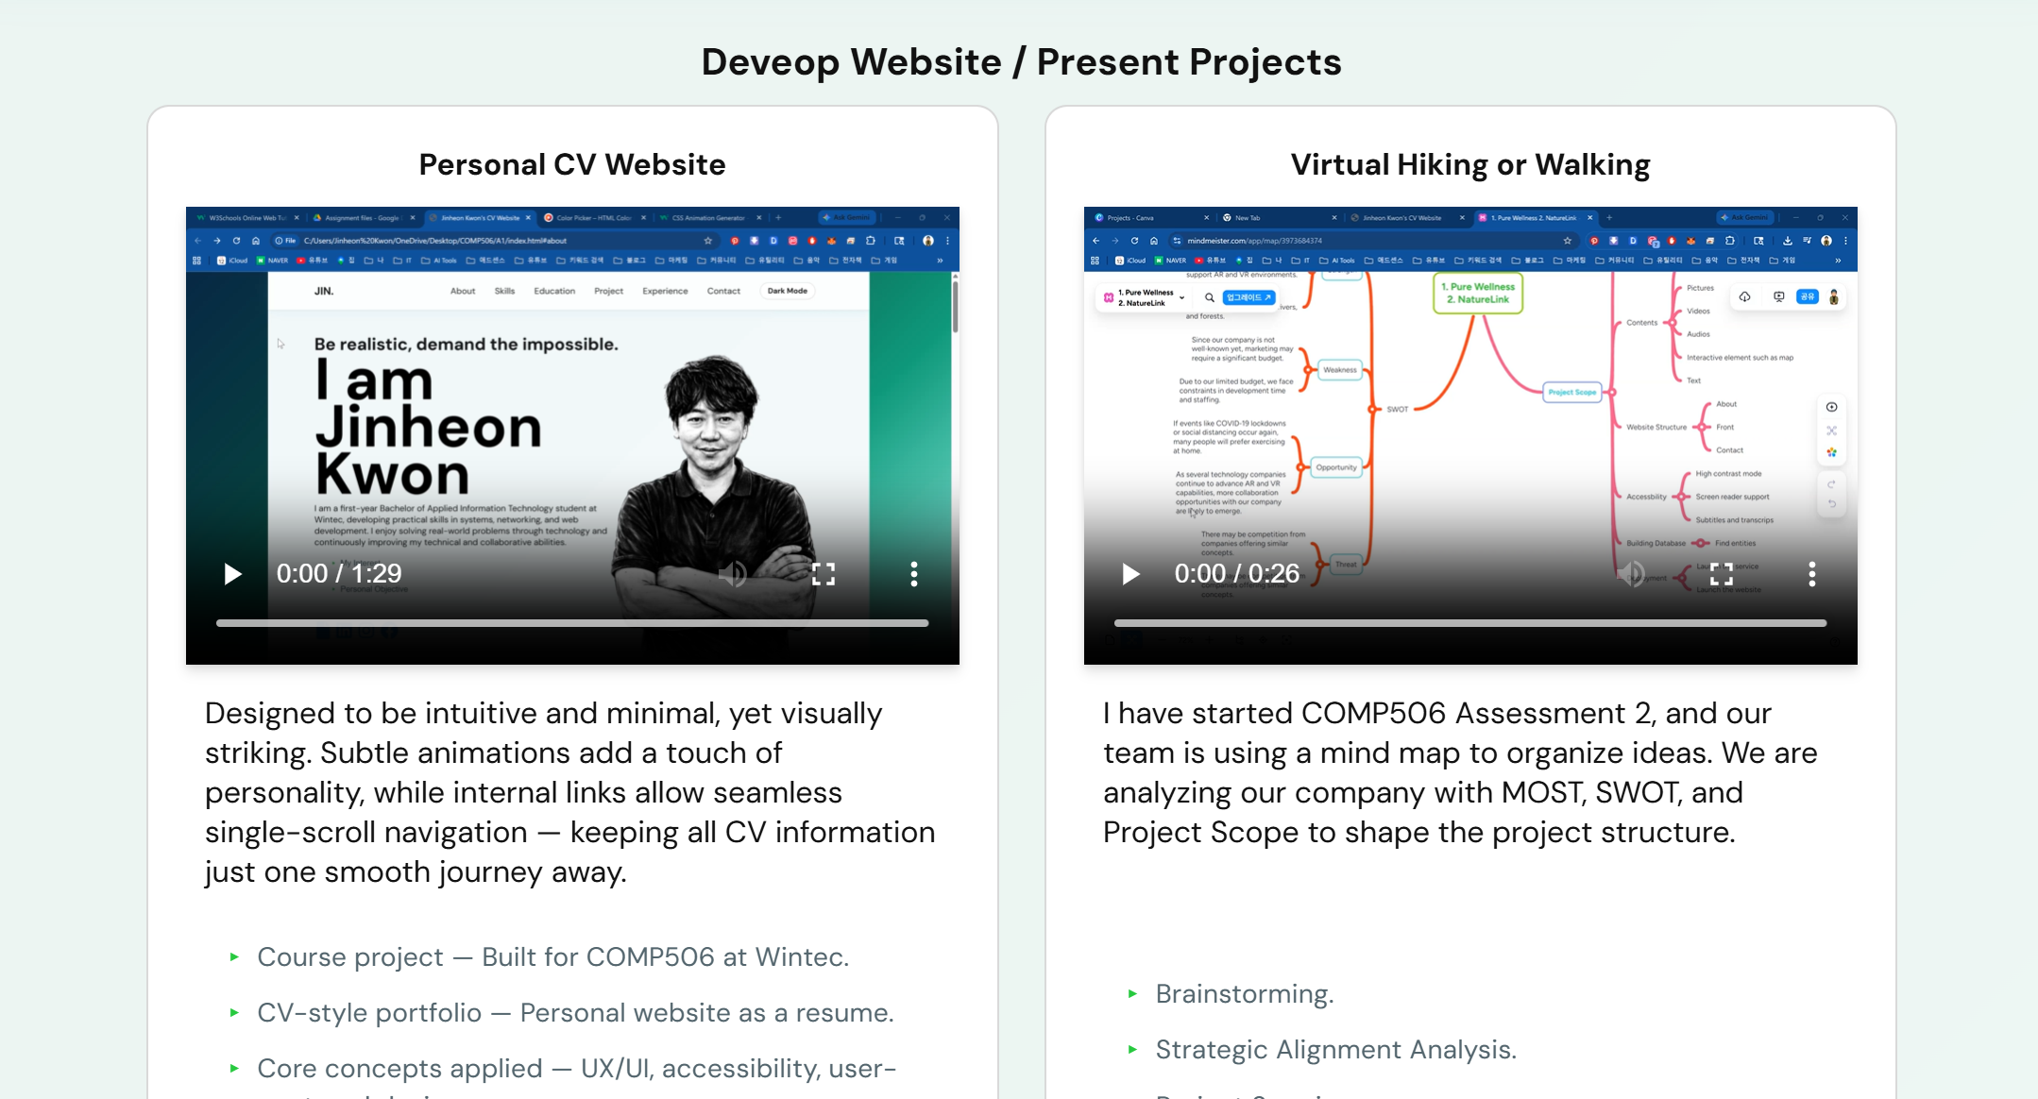

Slide 11

#
MENU STRUCTURE
07 / 07
Jin
About
Skills
Education
Projects
Experience
Contact
🌙
Experience Accordion
Mobile · max-width: 720px
2023–Now
Vice Principal · Waikato Korean School
−
2019–22
Mechanical Design Engineer · CAD/CATIA
+
About
Skills
Projects
Contact
🌙 Dark Mode

Slide 12
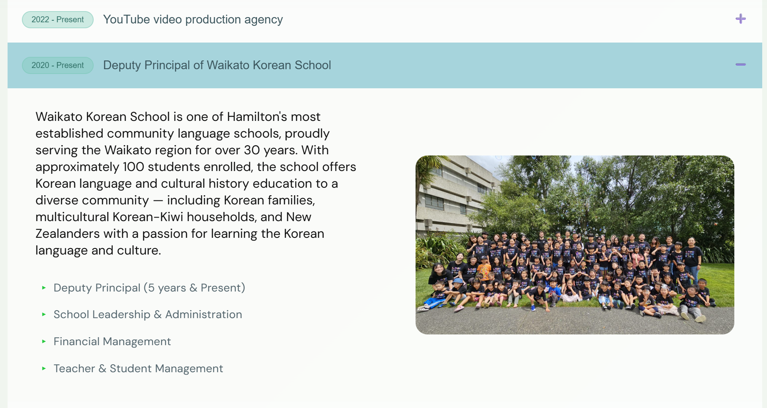
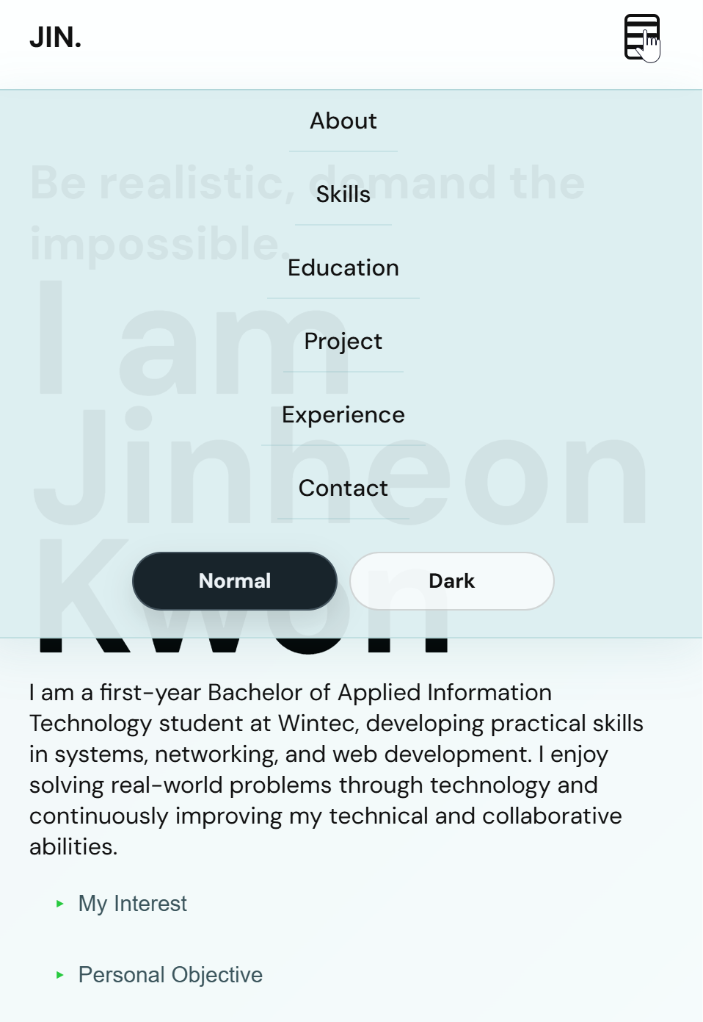
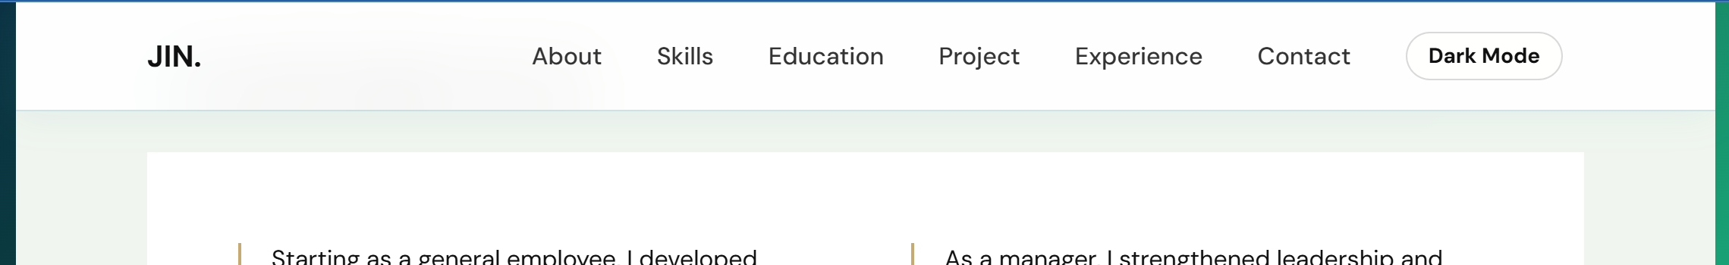

Slide 13
Thank You
Personal CV Website
Questions are welcome.
COMP506 · Interactive Digital Media · Wintec

