Slide 1
Project #2 DB implementation & query processing
12조
채현승 강예진 권순빈 최하경

Slide 2
목차
3NF 관계 스키마
R6
R7
R8
R9
R10

Slide 3
3NF 관계 스키마
userInfo | Id | Reputation | DisplayName | Age | CreationDate | LastAccessDate | WebsiteUrl | Location | AboutMe
posts | Id | CreationDate | Body | OwnerUserId | LastActivityDate
questionPosts | Id | PostId | AcceptedAnswerId | ViewCount | Title
questionTags | Id | Tags
answerPosts | Id | PostId | Accepted | ParentId
postHistory | Id | PostHistoryTypeId | PostId | CreationDate | UserInfoId | Text | Comment
postLinks | Id | CreationDate | PostId | RelatedPostId | LinkTypeId
badges | Id | UserInfoId | Name | Date
comments | Id | PostId | Score | CreationDate | UserInfoId
tags | Id | TagName
tagsPosts | Id | ExcerptPostId | WikiPostId
votes | Id | PostId | VoteTypeId | CreationDate
votesBookMark | Id | UserInfoId
votesBounty Amount | Id | BountyAmount
 |  |  |  |  | foreign key | primary key
Multivalue 제거하여 1NF 만족
3NF 만족
NULL REDUNDANCY 최소화

Slide 4
R6
사용자의 나이를 10대(10-19), 20대(20-29), 30대(30-39), 40대(40-49), 50대 이상(50~)으로 분류
나이대 별로 업로드 게시물의 총 조회수가 가장 높은 1명을 선발
총 5명의 사용자 정보 및 업로드 게시물의 총 조회 수를 출력
출력된 결과는 평판의 내림차순으로 정렬

Slide 5
R6
userInfo와 Agebest를 INNER JOIN한 결과로
R6에서 요구하는 모든 값을 출력
MAIN QUERY
SUBQUERY
SELECT *
FROM userInfo AS U
INNER JOIN (
(SELECT U.Id, SUM(Q.ViewCount) AS Totalhits
FROM userInfo AS U, posts AS P, questionposts AS Q
WHERE U.Id=P.OwnerUserId AND P.Id=Q.PostId AND (U.Age BETWEEN 10 AND 19)
GROUP BY U.Id
ORDER BY Totalhits DESC LIMIT 1)
UNION ALL
(SELECT U.Id, SUM(Q.ViewCount) AS Totalhits
FROM userInfo AS U, posts AS P, questionposts AS Q
WHERE U.Id=P.OwnerUserId AND P.Id=Q.PostId AND (U.Age BETWEEN 20 AND 29) GROUP BY U.Id
ORDER BY Totalhits DESC LIMIT 1)
UNION ALL
(SELECT U.Id, SUM(Q.ViewCount) AS Totalhits
FROM userInfo AS U, posts AS P, questionposts AS Q
WHERE U.Id=P.OwnerUserId AND P.Id=Q.PostId AND (U.Age BETWEEN 30 AND 39) GROUP BY U.Id
ORDER BY Totalhits DESC LIMIT 1)
UNION ALL
(SELECT U.Id, SUM(Q.ViewCount) AS Totalhits
FROM userInfo AS U, posts AS P, questionposts AS Q
WHERE U.Id=P.OwnerUserId AND P.Id=Q.PostId AND (U.Age BETWEEN 40 AND 49) GROUP BY U.Id
ORDER BY Totalhits DESC LIMIT 1)
UNION ALL
(SELECT U.Id, SUM(Q.ViewCount) AS Totalhits
FROM userInfo AS U, posts AS P, questionposts AS Q
WHERE U.Id=P.OwnerUserId AND P.Id=Q.PostId AND (U.Age BETWEEN 50 AND 999) GROUP BY U.Id
ORDER BY Totalhits DESC LIMIT 1)) AS Agebest
ON U.Id=Agebest.Id
ORDER BY U.Reputation DESC
10대에서 총 조회수가 가장 높은 1명 선발
평판의 내림차순 정렬

Slide 6
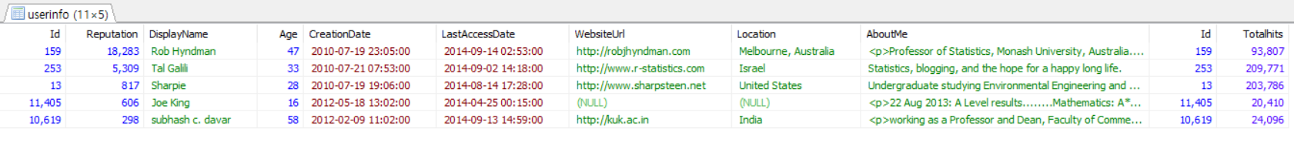
R6

Slide 7
R7
사용자 계정 생성 날짜시간을 2010년(=2010/1/1 00:00:00 ~ 2010/12/31 23:59:59), 2011년, 2012년, 2013년, 2014년으로 나눴을 때, 각 년도 별 생성 계정 수 출력
출력된 결과는 2010년, 2011년, 2012년 2013년, 2014년 순서(5 columns)

Slide 8
R7
SELECT *
FROM
( SELECT COUNT(*) AS "2010"
FROM userInfo AS U
WHERE Year(U.CreationDate)=2010
GROUP BY Year(U.CreationDate) ) AS y2010
CROSS JOIN
( SELECT COUNT(*) AS "2011"
FROM userInfo AS U
WHERE Year(U.CreationDate)=2011
GROUP BY Year(U.CreationDate) ) AS y2011
CROSS JOIN
( SELECT COUNT(*) AS "2012"
FROM userInfo AS U
WHERE Year(U.CreationDate)=2012
GROUP BY Year(U.CreationDate) ) AS y2012
CROSS JOIN
( SELECT COUNT(*) AS "2013"
FROM userInfo AS U
WHERE Year(U.CreationDate)=2013
GROUP BY Year(U.CreationDate) ) AS y2013
CROSS JOIN
( SELECT COUNT(*) AS "2014"
FROM userInfo AS U
WHERE Year(U.CreationDate)=2014
GROUP BY Year(U.CreationDate) ) AS y2014
5 columns로 반환하기 위해서
2014년도에 생성된 계정 수
MAIN QUERY
SUBQUERY

Slide 9
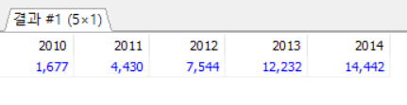
R7

Slide 10
R8
댓글 수가 10개 이상인 게시물
좋아요가 1개 이상인 게시물
위 두 조건을 만족시키는 게시물 출력
‘게시물 고유번호’, ‘좋아요 수’, ‘싫어요 수’, ‘점수(좋아요-싫어요)’로 구성된 결과 출력
가장 높은 점수를 획득한 게시물이 가장 위로 출력

Slide 11
R8
SELECT LIKEDISLIKE.Id, likeoverone, dislikecount, likeoverone-dislikecount AS score
FROM
(SELECT P.Id, COUNT(*) AS commentcount
FROM posts AS P
INNER JOIN comments AS C
ON P.Id = C.PostId
GROUP BY P.Id
HAVING commentcount >= 10) AS COMMENTCOUNT
INNER JOIN
(SELECT LIKEPOST.Id, likeoverone, dislikecount
FROM
(SELECT P.Id, COUNT(*) AS likeoverone
FROM posts AS P
INNER JOIN votes AS V
ON P.Id = V.PostId
WHERE V.VoteTypeId = 2
GROUP BY P.Id
HAVING likeoverone >= 1) AS LIKEPOST
INNER JOIN
(SELECT P.Id, COUNT(*) AS dislikecount
FROM posts AS P
INNER JOIN votes AS V
ON P.Id = V.PostId
WHERE V.VoteTypeId = 3
GROUP BY P.Id) AS DISLIKEPOST
ON LiKEPOST.Id = DISLIKEPOST.Id ) AS LIKEDISLIKE
ON COMMENTCOUNT.Id = LIKEDISLIKE.Id
ORDER BY score DESC
댓글 수가 10개 이상인 게시물
LIKEDILIKE 테이블
→ 좋아요 수가 1개 이상인 게시물에 대한 고유번호, 좋아요 수와 싫어요 수 출력
MAIN QUERY
SUBQUERY
SUB-SUBQUERY
점수에 대한 내림차순으로 출력

Slide 12
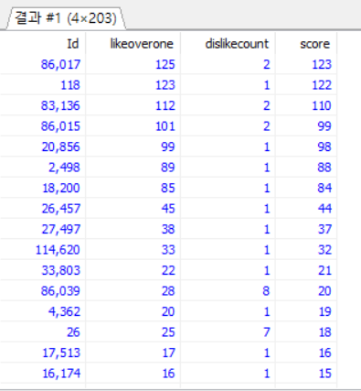
R8

Slide 13
R9
획득한 뱃지가 50개 이상인 사용자
그들이 1년마다 평균적으로 작성하는 게시물의 수
‘사용자 고유번호’, ‘획득한 뱃지 수’, ‘평균 게시물 작성’ 순서로 출력
획득한 뱃지 수의 내림차순으로 정렬

Slide 14
R9
SELECT getbadge.Id, cbadge, avPost
FROM
(SELECT U.Id, COUNT(*) AS cbadge
FROM userInfo AS U
LEFT OUTER JOIN badges AS B
ON U.Id = B.UserInfoId
UNION
SELECT U.Id, COUNT(*) AS cbadge
FROM userInfo AS U
RIGHT OUTER JOIN badges AS B
ON U.Id = B.UserInfoId
GROUP BY U.Id) AS getbadge
INNER JOIN
(SELECT postcount.Id, AVG(cPost) AS AVPOST
FROM (
SELECT U.Id, COUNT(*) AS cPost
FROM userInfo AS U
LEFT OUTER JOIN posts AS P
ON U.Id = P.OwnerUserId
UNION
SELECT U.Id, COUNT(*) AS cPost
FROM userInfo AS U
RIGHT OUTER JOIN posts AS P
ON U.Id = P.OwnerUserId
WHERE YEAR(P.CreationDate) =2010
GROUP BY U.Id
UNION ALL
SELECT U.Id, COUNT(*) AS cPost
FROM userInfo AS U
LEFT OUTER JOIN posts AS P
ON U.Id = P.OwnerUserId
UNION
SELECT U.Id, COUNT(*) AS cPost
FROM userInfo AS U
RIGHT OUTER JOIN posts AS P
ON U.Id = P.OwnerUserId
WHERE YEAR(P.CreationDate) =2011
GROUP BY U.Id
사용자 별 뱃지 개수
사용자 별 작성한 게시물 개수(2010년도)
MAIN QUERY
SUBQUERY
SUB-SUBQUERY
SUB-SUB-SUBQUERY

Slide 15
R9
UNION ALL
SELECT U.Id, COUNT(*) AS cPost
FROM userInfo AS U
LEFT OUTER JOIN posts AS P
ON U.Id = P.OwnerUserId
UNION
SELECT U.Id, COUNT(*) AS cPost
FROM userInfo AS U
RIGHT OUTER JOIN posts AS P
ON U.Id = P.OwnerUserId
WHERE YEAR(P.CreationDate) =2012
GROUP BY U.Id
UNION ALL
SELECT U.Id, COUNT(*) AS cPost
FROM userInfo AS U
LEFT OUTER JOIN posts AS P
ON U.Id = P.OwnerUserId
UNION
SELECT U.Id, COUNT(*) AS cPost
FROM userInfo AS U
RIGHT OUTER JOIN posts AS P
ON U.Id = P.OwnerUserId
WHERE YEAR(P.CreationDate) =2013
GROUP BY U.Id
UNION ALL
SELECT U.Id, COUNT(*) AS cPost
FROM userInfo AS U
LEFT OUTER JOIN posts AS P
ON U.Id = P.OwnerUserId
UNION
SELECT U.Id, COUNT(*) AS cPost
FROM userInfo AS U
RIGHT OUTER JOIN posts AS P
ON U.Id = P.OwnerUserId
WHERE YEAR(P.CreationDate) =2014
GROUP BY U.Id ) AS postcount
GROUP BY postcount.Id
) AS postaverage
ON getbadge.Id = postaverage.Id
WHERE (cbadge >= 50) AND NOT (getbadge.Id = 0)
ORDER BY cbadge DESC
ON getbadge.Id = postaverage.Id
WHERE (cbadge >= 50) AND NOT (getbadge.Id = 0)
ORDER BY cbadge DESC
→ Getbadge 테이블과 postaverage 테이블의 고유번호가 같으면서, badge의 개수가 50개 이상인 게시물을 내림차순으로 정렬
익명의 사용자
MAIN QUERY
SUBQUERY
SUB-SUBQUERY
SUB-SUB-SUBQUERY
연도별 사용자가
작성한 게시물의 개수
Postaverage

Slide 16
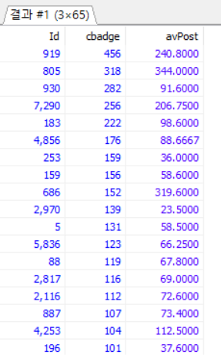
R9

Slide 17
R10
(자유주제) 주어진 데이터로부터 통계적인 의미가 있는 결과를 ‘한 가지’ 도출하시오.
주제 : 월별 댓글이 가장 많이 달린 게시물

Slide 18
R10
SELECT DATE_FORMAT(P.CreationDate, '%Y-%m') AS M, P.Id, P.Body,
maxcomment
FROM posts AS P
INNER JOIN
(SELECT P.Id, COUNT(*) AS maxcomment
FROM posts AS P
LEFT OUTER JOIN comments AS C
ON P.Id = C.PostId
UNION
SELECT P.Id, COUNT(*) AS maxcomment
FROM posts AS P
RIGHT OUTER JOIN comments AS C
ON P.Id = C.PostId
GROUP BY P.Id
ORDER BY maxcomment DESC ) AS commentcount
ON P.Id=commentcount.Id
WHERE P.Id != 0
GROUP BY M
게시글 별 댓글 수
월별로 그룹화
MAIN QUERY
SUBQUERY

Slide 19
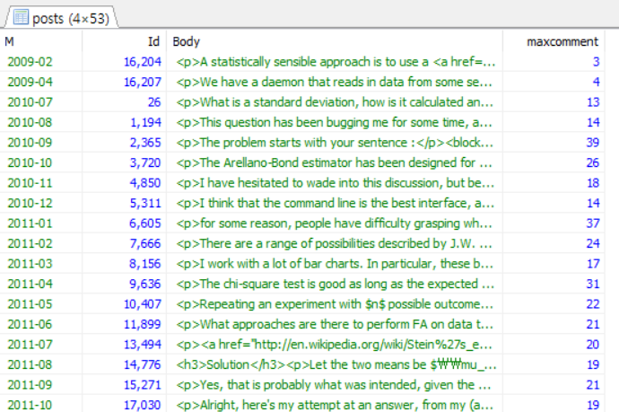
R10

Slide 20
R10
온라인 쇼핑몰에 적용 → 월별 가장 인기가 많았던 상품을 추출하여 쇼핑몰을 쇼핑하는데 정보를 사용
일반 커뮤니티 사이트에 적용 → 연말에 ‘월별 가장 인기가 많았던 게시물’과 같은 한 해에 대한 사이트 게시물에 대한 정산을 하는데 정보를 사용

Slide 21
감사합니다.

