Slide 1
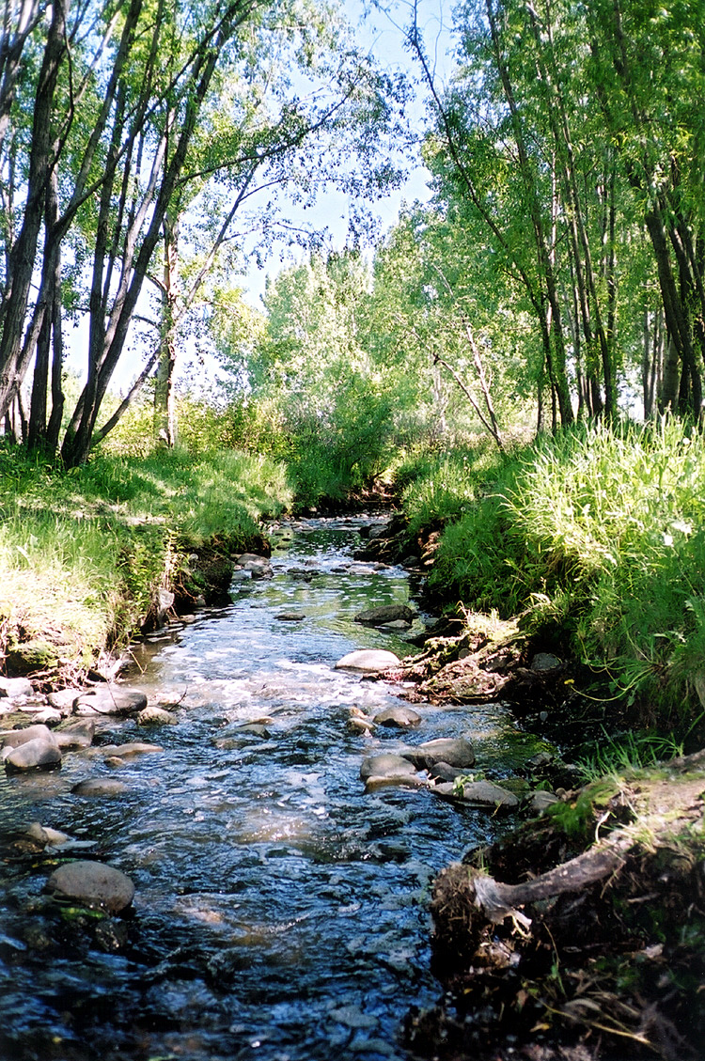
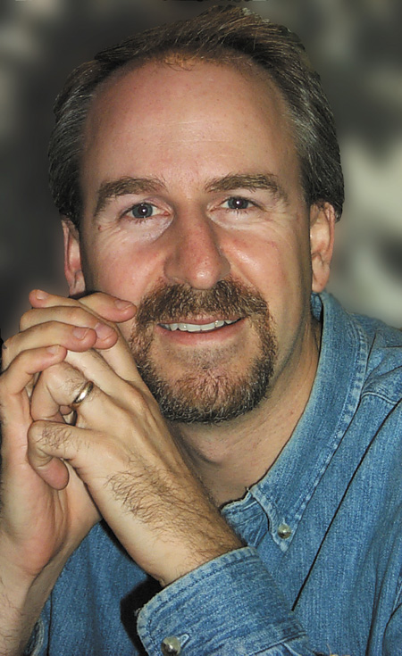

TRAIN 2001
A Conference Designed For Christian Workers and Leaders
November 2 & 3, 2001
Plenary Speaker
Phil Callaway
CHILDREN’S TRACK
YOUTH TRACK
ADULT TRACK
CHRISTIAN EDUCATION
RESOURCE CENTRE
NEW
Bethany Chapel
3333 Richardson Way SW
Calgary
LOCATION
FOR MORE INFORMATION
traincalgary@hotmail.com
Judy (403) 256-0453

