Slide 1

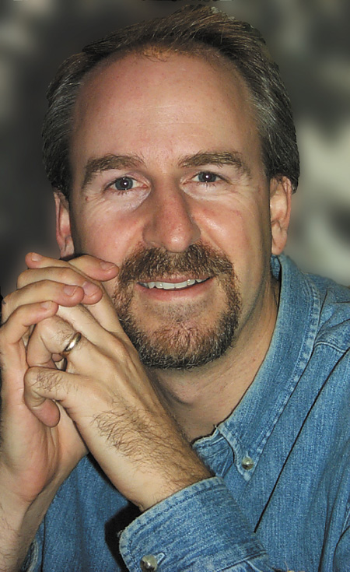

TRAIN 2001
A Conference Designed For Christian Workers and Leaders
November 2 & 3, 2001
Plenary Speaker
Phil Callaway
NEW
CHILDREN, YOUTH AND ADULT TRACKS
CHRISTIAN EDUCATION RESOURCE CENTRE
LOCATION
FOR MORE INFORMATION
traincalgary@hotmail.com
Judy (403) 256-0453
Bethany Chapel
3333 Richardson Way SW, Calgary

