Slide 1
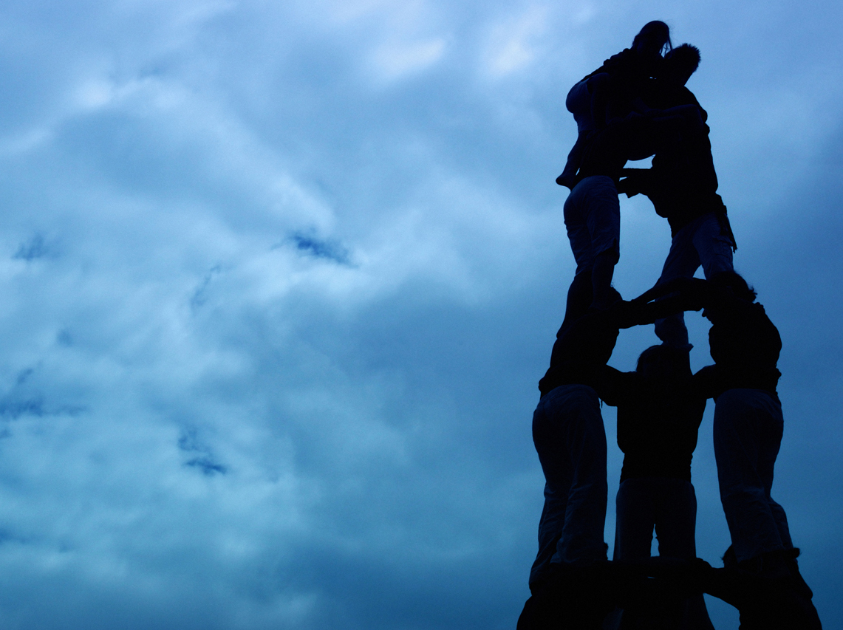


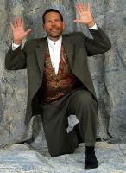
TRAIN 2006
Encourage
one another
and build
each other up.
I Thes. 5:11
November 3 & 4, 2006
Grace Baptist Church, Calgary
Engage in a TRAIN workout designed to shape up Christian Education leaders and workers in Christ’s Body. Exercise any of these ministry muscle groups: children, youth, family, women, small groups and leadership.
Guest speaker: Lou Leventhal – Illusions and Reality
(www.illusionsandreality.com)
At TRAIN 2006…
be amazed and inspired through Lou Leventhal’s entertaining performance on Friday night
develop ministry skills for serving and leading
be equipped with new materials and fresh ideas
be built up through worship and teaching
For more information, call Yvonne at (403) 239-9173 (Calgary) info@trainconference.com www.trainconference.com

