Slide 1







Modeling Intertemporal Trading of Emission Permits under Market Power
Presented by: Angeliki Mathioudaki, National Technical University of Athens
Join work with:
Koromilas Panagiotis National and Kapodistrian University of Athens & NCSR Demokritos | Dimos Sotirios National Technical University of Athens | Fotakis Dimitris National Technical University of Athens
Angela Mathioudaki
corelab.ntua.gr - TzellaMathioudaki
tmathiou@corelab.ntua.gr

Slide 2



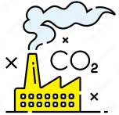
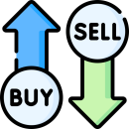






EU Emission Trading System
1 tn CO2 (eq.) $↔$ 1 EUA
31 countries, 12,000 installations
EU Free allocates a portion of EUAs
Total Emission Cap decreases annually (1.74%)
$$↔$$
Banks and brokers may participate
4 Phases from 2005 - Now Phase IV (2021 - )
EUAs are tradable and bankable
Financial Institutes or EU auctions
Auction
Free
Surrender
Auction
Trading
Phase I
(2005-2007)
Grandfathering
Overallocation
No banking
Phase II
(2008-2012)
Grandfathering
Annual cap -1.74%
Economic crisis
Surplus
Banking
Phase III
(2013-2020)
Benchmark
Backload Auctions
MSR (2017+)
Banking
Phase IV
(2021-2030 )
Cap -2.2%
12% "automatic set-aside" reserve mechanism

Slide 3
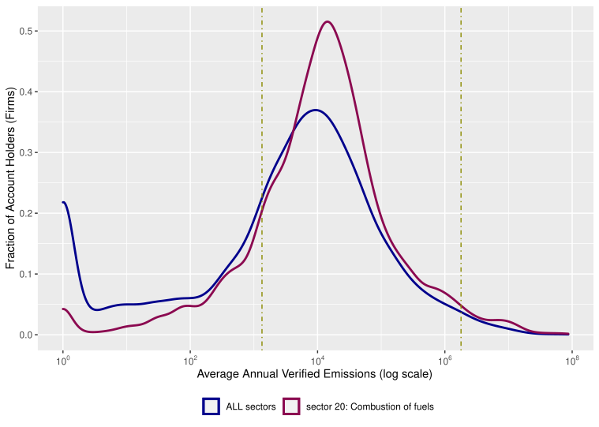

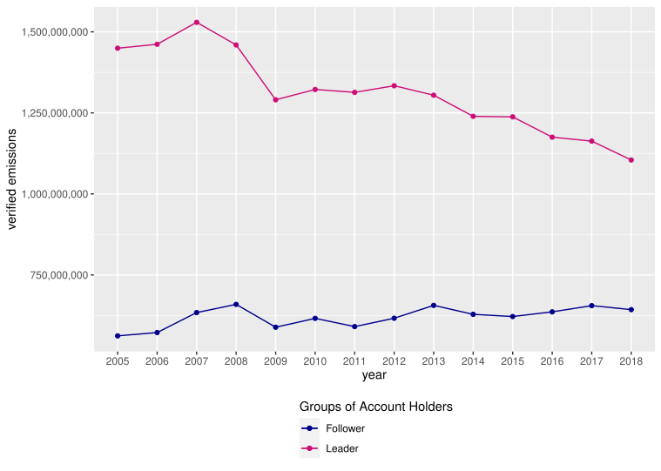

Motivation – Evidence from the EUTL
$∀$firm i and year $t ∈\left[2005, 2018\right]$
verified emissions
Small and large
in terms of emissions
Every EUA transaction is recorded
EU Transaction Log
All Sectors
Sector 20
Governmental
Market Power?
Regulated
Million+ until April of 2018
public data with 3 years delay
does NOT record prices
Financial
Previous Work:
Intertemporal Trading
Initial Allocation
Market Power
Output and permit market
Chaton et al (2015)
Small
Large
Chevalier (2011)
Hintermann (2017)
Andre et al (2020)
Abatement?
Chen at al (2018)
Α model capturing all is missing

Slide 4

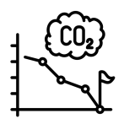


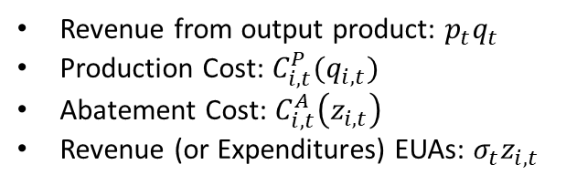
Model
Stackelberg Game
n firms
Output Product & Production Costs
Emissions & Initial Allocation
Abatement Costs
Market power only permit market
Leaders
i = m+1,..., n
Advanced Abatement tech
Generous Free Allocation
Followers
i = 1,..., m
NO Advanced Abatement tech
NO Generous Free Allocation
Goal: Max Profit
In 2 periods
Emission Reduction
$$\max_{i}{Π_{i}(z_{i,1},q_{i,1},{\overline{z}}_{i,1},z_{i,2},q_{i,2})}$$
Buy or Sell EUAs
Revenue from output product: $p_{t}q_{t}$
Production Cost: $C_{i,t}^{P}(q_{i,t})$
Abatement Cost: $C_{i,t}^{A}\left(z_{i,t}\right)$
Revenue (or Expenditures) EUAs: $σ_{t}z_{i,t}$
Banking EUAs
Production Reduction

Slide 5



Simplified Equilibrium Model – No Banking or Trading
No Trading
No Banking
No Trading = No Leaders & Followers
No Banking = No 2-period Model
Since no Trading – no price
$$z_{i,1}=z_{i,1}^{free}−{\overline{z}}_{i,1}$$
$$z_{i,2}=z_{i,2}^{free}+{\overline{z}}_{i,1}$$
&
$$MAC ≠0$$
$$MAC_{i,1}=β_{1}MAC_{i,2}$$
Followers:
$$MAC_{F}=σ$$
&
$$z_{F}^{}={z_{F}^{BAU}−z}_{F}^{free}−MAC^{−1}(σ)$$
Leaders:
$$MAC_{L}=σ_{}^{′}\left(z_{F}\right)\left(z_{L}−z_{L}^{free}\right)+σ(z_{F})$$
If Abatement cost = $σ$
Followers indifferent
Exploit the lower abatement costs of the leaders
If Abatement cost lower in period 1
Firms abate to store permits
Otherwise,
Firms reduce product

Slide 6



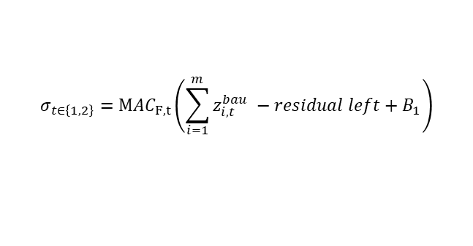
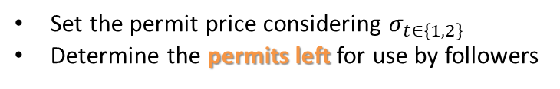
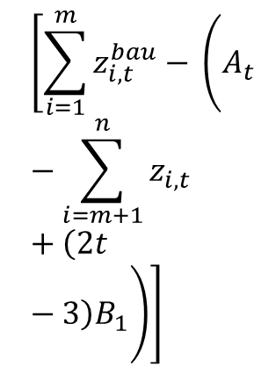
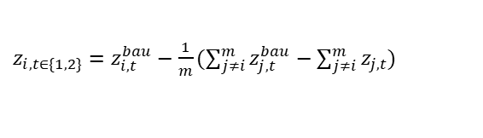
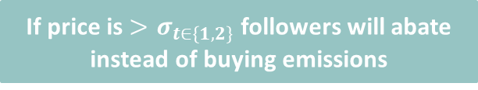

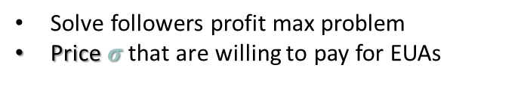
General Equilibrium model
$$\left[\sum_{i=1}^{m}{z_{i,t}^{bau}− }\left(A_{t}−\sum_{i=m+1}^{n}{z_{i,t}}+\left(2t−3\right)B_{1}\right)\right]$$
1. Followers
Inverse demand
2. Leaders
Permit decisions
Followers i = 1,..., m
Leaders i = m+1,…,n
Solve followers profit max problem
Price $σ$ that are willing to pay for EUAs
Set the permit price considering $σ_{t∈\left\{1,2\right\}}$
Determine the permits left for use by followers
Cap - $Z^{L}$
$$σ_{t∈\left\{1,2\right\}}={MAC}_{F,t}\left(\sum_{i=1}^{m}{z_{i,t}^{bau}} −residual left+B_{1}\right)$$
Residual = Leaders emission decision
How much abatement + extra free
If price is $>σ_{t∈\left\{1,2\right\}}$ followers will abate instead of buying emissions
$MAC_{L,t}=σ_{t∈\left\{1,2\right\}}\left(z_{F,t}\right)+$ ${σ′}_{t∈\left\{1,2\right\}}\left(z_{F,t}\right)·{(z}_{i,t}−z_{i,t}^{free}−{\overline{z}}_{i,t}−λ_{i}β_{1})$
$z_{i,t∈\{1,2\}}=z_{i,t}^{bau}−\frac{1}{m}(\sum_{j≠i}^{m}{z_{j,t}^{bau}}−\sum_{j≠i}^{m}{z_{j,t}})$
Multiplier λi free variable
Leaders can adjust the 2-period abatement
What others do
In equilibrium permit prices are equal in both periods – Banking Condition
In equilibrium, followers avoid abatement
Leaders handle total abatement
Followers must reduce output to meet compliance
Adjusting abatement to followers' permit demand across periods

Slide 7


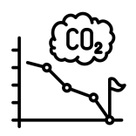
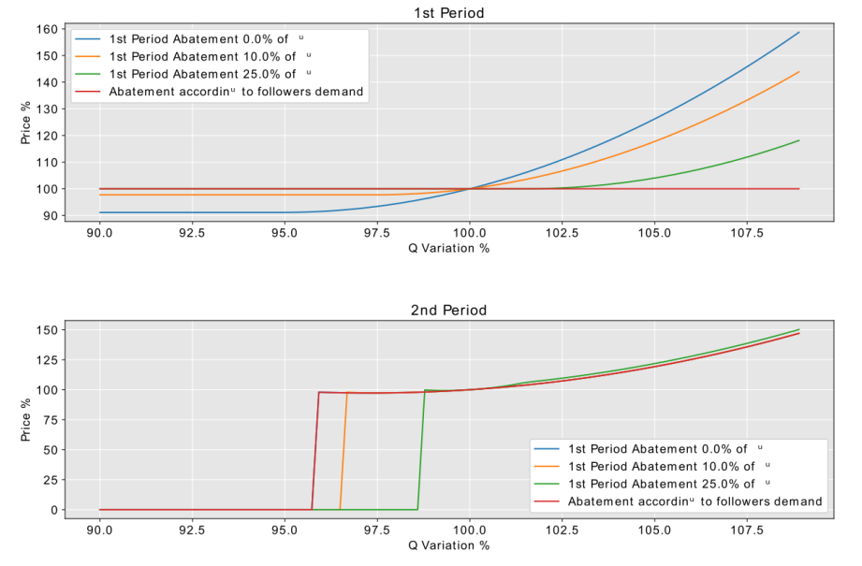
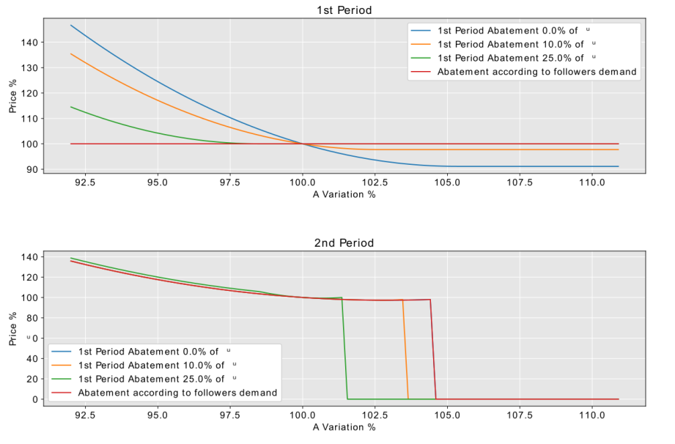
Simulations
% Changes Initial Allocation
Variables of interest:
Banking, Emissions, permit price
Banking & Emissions as expected
% Changes Output Product
10 Firms Electricity Sector
Estimate Tech coef. & BAU emissions
Define Free Allocation Rule
Realistic Data + EUTL
3 Leaders – 7 Followers
y = ax² + bx + c
Followers emit BAU emissions
Leaders fixed % of BAU emissions
% abatement:
0%, 10%, 25%, demand
Leaders abatement – Followers No
Product
Allocation
Variations in Initial Allocation:
Permit Prices:
Increased initial allocation results in surplus permits, increasing inter-temporal trading and lowering permit prices.
Higher abatement levels stabilize prices despite changes in initial allocation.
Greater allocations reduce permit prices, while lower allocations stabilize the system under high abatement.
Permit Prices:Permit prices rise with increased output product due to higher demand for permits.
Prices are more sensitive to product changes in lower abatement levels, with larger abatement normalizing prices over time.

Slide 8

Conclusions
1. We provided a model of an ETS including:
(a) Market Power – as Stackelberg Game
(b) Intertemporal Trading – 2Period Model
(c) Linkage between permit and output market
2. We conclude that Leaders control the overall emission abatement across periods
May push Followers to decrease their BAU emissions leading to decrease output product
Can affect Followers both in the permit and output market
3. We perform simulations based on realistic data to test model’s accuracy
Variations in Output and Allocation
How emissions, banking and price behavior change
Future Work:
Welfare Analysis – how different allocation techniques affect welfare?
Efficient allocation to minimize the effects of market power?

Slide 9


Thank You!
Questions?
Angela Mathioudaki
corelab.ntua.gr/~TzellaMathioudaki/
tmathiou@corelab.ntua.gr

