Slide 1
Large Scale Landmark Recognition via Triplet Network
Jifu Zhao
Statistics @ UIUC
04/26/2018, Urbana

Slide 2
Object Recognition
A well developed area in computer vision
With deep learning, machine can beat human

Slide 3
Object Recognition
A well developed area in computer vision
With deep learning, machine can beat human
Image: https://plot.ly/~botevmg/5.embed

Slide 4
Object Recognition
A well developed area in computer vision
With deep learning, machine can beat human
Large amount of training images are required
Example
CIFAR-10: 60,000 images in 10 classes.
ImageNet: 14,197,122 images in 1,000 classes.

Slide 5
Object Recognition
A well developed area in computer vision
With deep learning, machine can beat human
Large amount of training images is required
Example
CIFAR-10: 60,000 images in 10 classes.
ImageNet: 14,197,122 images in 1,000 classes.
What if limited amount of images are available?
One-Shot Learning

Slide 6
One-Shot Learning
One-shot learning
An object categorization problem in computer vision. Whereas most machine learning based object categorization algorithms require training on hundreds or thousands of images and very large datasets, one-shot learning aims to learn information about object categories from one, or only a few, training images.
Characteristics:
A few training images for each class
Potentially large amount of classes

Slide 7
One-Shot Learning
Characteristics:
A few training images for each class
Potentially large amount of classes
Applications
Face/Item Verification
Street-to-Shop

Slide 8
Landmark Recognition
Given a photo, can we recognize the correct landmarks it contains?

Slide 9
Landmark Recognition
Given a photo, can we recognize the correct landmarks it contains?

Slide 10
Data
On March 01 2018, Google released a new dataset for landmark recognition
1,225,029 training images with 14,951 landmarks
117,703 test images

Slide 11
Data

Slide 12
Data
On March 01 2018, Google release a new dataset for landmark recognition
1,225,029 training images with 14,951 landmarks
117,703 test images

Slide 13
Data
In our case
113,783 training images with 14,943 different landmarks
22,255 validation images with 7675 different landmarks
22,391 test images with 14436 different landmarks

Slide 14
Methodology
Idea 1: Random Guess
Extremely low accuracy

Slide 15
Methodology
Idea 1: Random Guess
Extremely low accuracy
Idea 2: Classical CNN for Multiclass Classification

Slide 16
Methodology
Idea 1: Random Guess
Extremely low accuracy
Idea 2: Classical CNN for Multiclass Classification

Slide 17
Methodology
Idea 1: Random Guess
Extremely low accuracy
Idea 2: Classical CNN for Multiclass Classification
Large amount of landmarks: 14,951 different classes
Imbalanced data: Some landmarks only have 1 training images

Slide 18
Methodology
Idea 1: Random Guess
Extremely low accuracy
Idea 2: Classical CNN for Multiclass Classification
Large amount of landmarks: 14,951 different classes
Imbalanced data: Some landmarks only have 1 training images
What can we do?
Try to learn a metric for similarity/distance

Slide 19
Goal
Negative
Anchor
Positive

Slide 20
Goal
Learning
Negative
Negative
Anchor
Anchor
Positive
Positive

Slide 21

Triplet Loss
Goal:
Learn new representation $f(∙)$ of the original image such that
$${\left\|f\left(a\right)−f(p)\right\|}_{2}^{2}≤{\left\|f\left(a\right)−f(n)\right\|}_{2}^{2}$$
Add some margin $α$
$${\left\|f\left(a\right)−f(p)\right\|}_{2}^{2}+α≤{\left\|f\left(a\right)−f(n)\right\|}_{2}^{2}$$
Learning
Negative
Negative
Anchor
Anchor
Positive
Positive

Slide 22
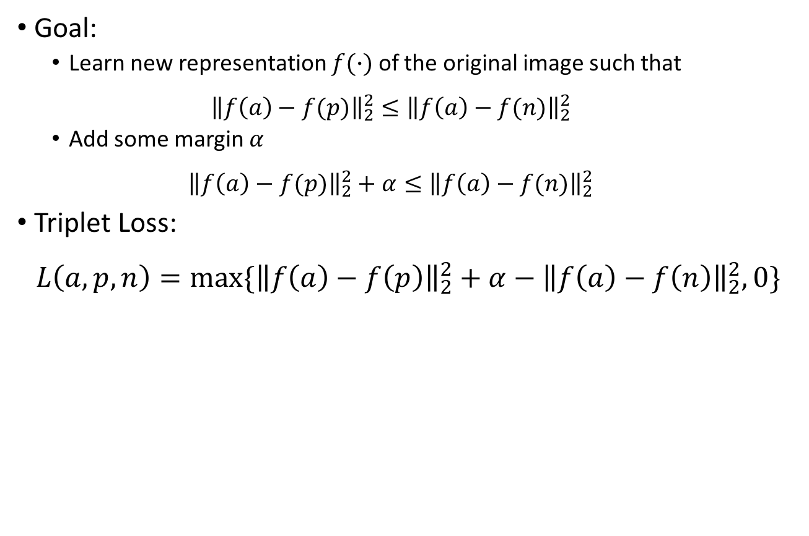
Triplet Loss
Goal:
Learn new representation $f(∙)$ of the original image such that
$${\left\|f\left(a\right)−f(p)\right\|}_{2}^{2}≤{\left\|f\left(a\right)−f(n)\right\|}_{2}^{2}$$
Add some margin $α$
$${\left\|f\left(a\right)−f(p)\right\|}_{2}^{2}+α≤{\left\|f\left(a\right)−f(n)\right\|}_{2}^{2}$$
Triplet Loss:
$$L\left(a, p, n\right)=max⁡\{{\left\|f\left(a\right)−f\left(p\right)\right\|}_{2}^{2}+α−{\left\|f\left(a\right)−f\left(n\right)\right\|}_{2}^{2}, 0\}$$
Learning
Negative
Negative
Anchor
Anchor
Positive
Positive

Slide 23
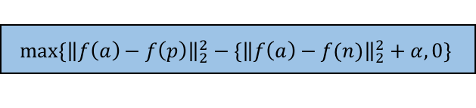
Triplet Network
Triplet Loss
$$max⁡\{{\left\|f\left(a\right)−f\left(p\right)\right\|}_{2}^{2}−\{{\left\|f\left(a\right)−f(n)\right\|}_{2}^{2}+α, 0\}$$
f(a)
f(p)
f(n)
L2
L2
L2
Neural Network
(e.g. CNN)
Neural Network
(e.g. CNN)
Neural Network
(e.g. CNN)
Shared Weights
Shared Weights
Input a
Input p
Input n

Slide 24
Training
Build CNN from scratch
Works with large training set, enough training time and advanced hardware

Slide 25
Training
Build CNN from scratch
Works with large training set, enough training time and advanced hardware
Fine-tuning with pre-trained models
VGG16, InceptionV3, and ResNet have been well trained
Lower layers usually encode more generic, reusable features
Higher layers encode more specialized features
Freeze lower layers and only train the top several layers

Slide 26
Prediction
Given a new image, how to predict its landmark?
K-Nearest Neighbors (KNN)
Final system
Image 1
KNN
Image 2
Image 3
L2
Image 4
Trained Neural Network
(e.g. CNN)
…….....
Image n - 3
Image n - 2
Image n - 1
Input Image
Image n

Slide 27
Results

Slide 28
Results

Slide 29
Results
With fine-tuned InceptionV3 Triplet Network, top 1 accuracy is 47%

Slide 30
Results
Query

Slide 31
Results
Query
Similar Images

Slide 32
Results
Query
Similar Images

Slide 33
Summary
landmark recognition with large amount of real-world images
Triplet network for metric learning
Fine-tuning to improve accuracy
However
A subset of images are used => Better performance with all images?
Top 1 accuracy 47% => Modern systems (FaceNet) > 95% accuracy
Future
Pre-process images
Train specific base network for landmark recognition
* Source code: https://github.com/JifuZhao/Landmark_Recognition

Slide 34
Questions
Thank you !

