Slide 1
AnatomyNet: Deep Learning for Fast and Fully Automated Whole-volume Segmentation of Head and Neck Anatomy RTOS Lab. Sang-hyun Kim

Slide 2
Introduction
Purpose
Atlas-based method.
정교한 아틀라스 생성이 필요하고, 환자 간의 해부학적 변화를 설명할 수 없음.
Atlas-free 3D convolutional deep learning framework.
빠르게 Head and Neck anatomy segmentation을 자동적으로 수행.

Slide 3
AnatomyNet
Main Challenges
Segmenting small anatomies.
Training with inconsistent data annotations.
Contribution
Squeeze-and-excitation(SE) residual block기반으로 U-Net model 확장.
Novel loss function = Dice score + focal loss.
Missing annotation problem → masking과 weighted loss function을 사용.

Slide 4
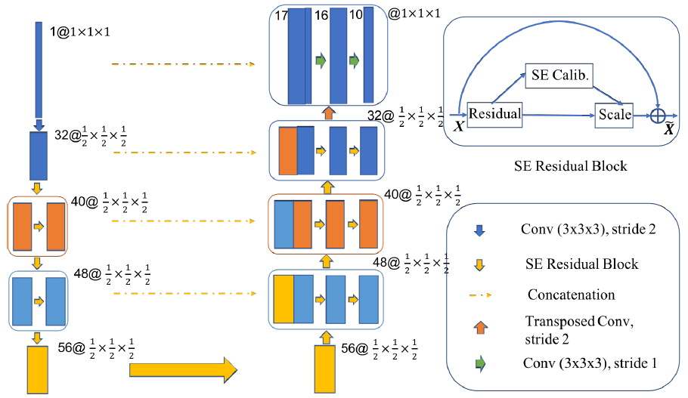
AnatomyNet ( Cont. )
Variant of 3D U-Net
기존 U-Net은 작은 물체의 정보 손실을 가져 올 수 있다.
→ 1개의 Down-sampling사용.

Slide 5

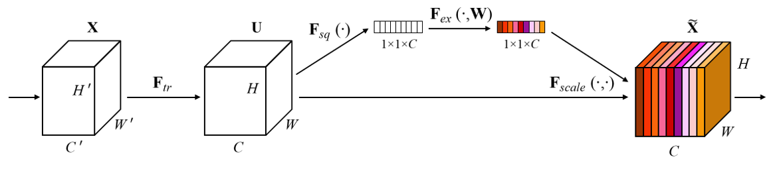
AnatomyNet ( Cont. )
2D Squeeze & Excite ( SE ) ( Cont. )
Squeeze: Global Information Embedding
각 채널들의 중요한 정보만 추출하는 과정. (GAP 사용)
H, W, C 크기의 feature map → 1 x 1 x C 크기로 변환.

Slide 6
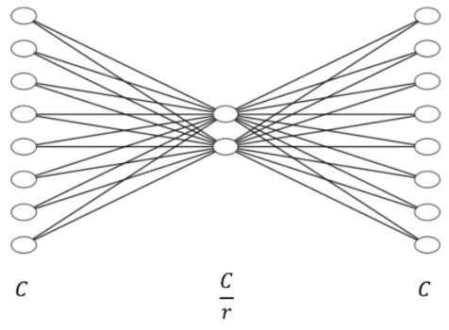


AnatomyNet ( Cont. )
2D Squeeze & Excite ( SE ) ( Cont. )
Excitation: Adaptive Recalibration
채널간 의존성(channel-wise dependencies)을 계산.
σ : ReLU function δ : Sigmoid function $W_{1}$, $W_{2}$ : Fully connected layer C : Feature map r : reduction ratio

Slide 7
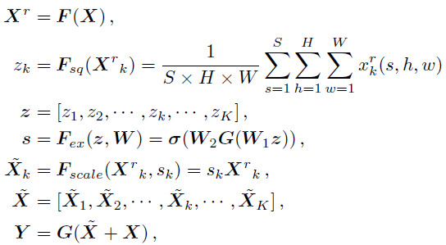
AnatomyNet ( Cont. )
3D Squeeze & Excite ( SE ) Residual Block ( Cont. )
CT image에서 3D feature들을 추출.

Slide 8

AnatomyNet ( Cont. )
Loss function
$L_{total}=L_{Dice}+λL_{Focal}$
$L_{Dice}$
Learns the class distribution alleviating the imbalanced voxel problem.
$L_{Focal}$
Learn poorly classified voxels better.

Slide 9
Conclusion
Novel Loss Function → focal loss + dice score.
3D SE residual block.
Notes:
1~4: x, y, width, height

