Slide 1

Robot for cleaning building facades
Henrik Leivestad
Knut Wilhelm Omholt Saatvedt
Christopher Wallem Veland

Slide 2
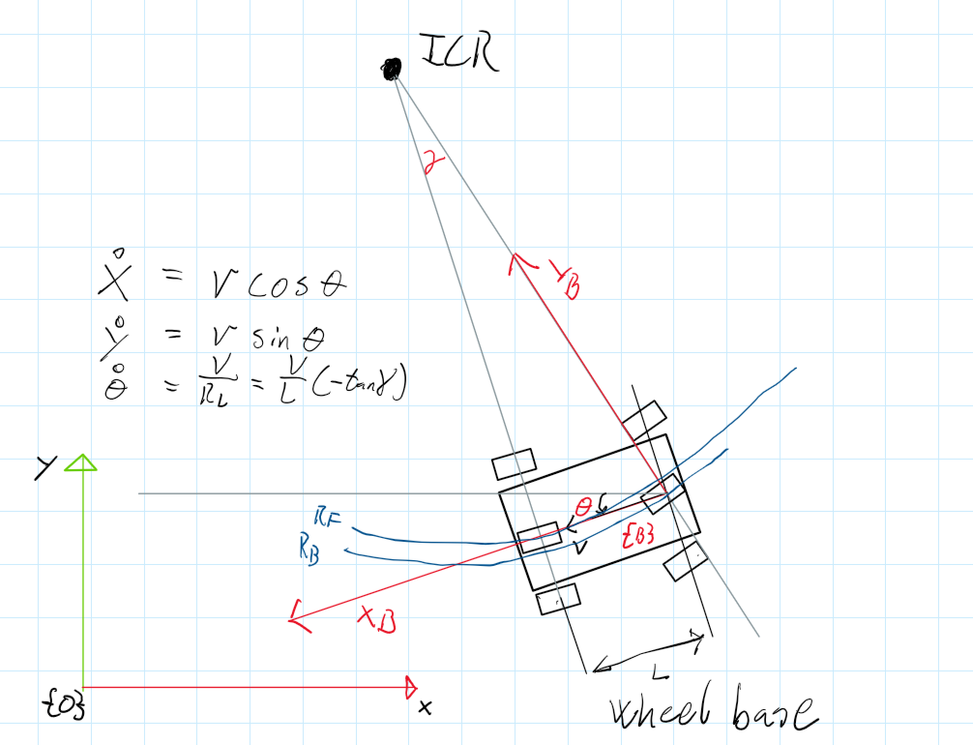
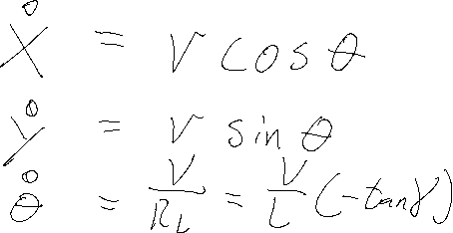
Bicycle model
Back Wheel drive
Back wheel steering
Bug2
P-Controller

Slide 3
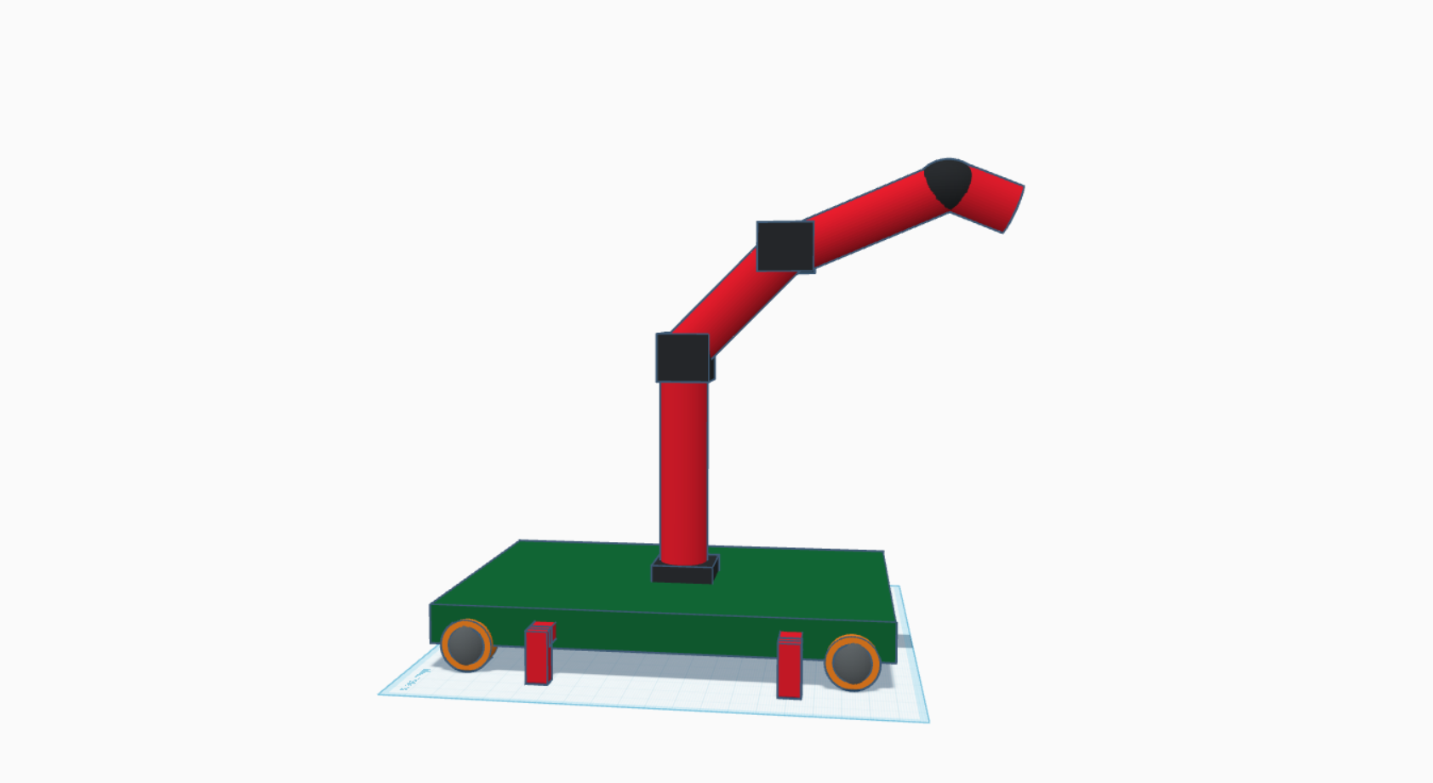
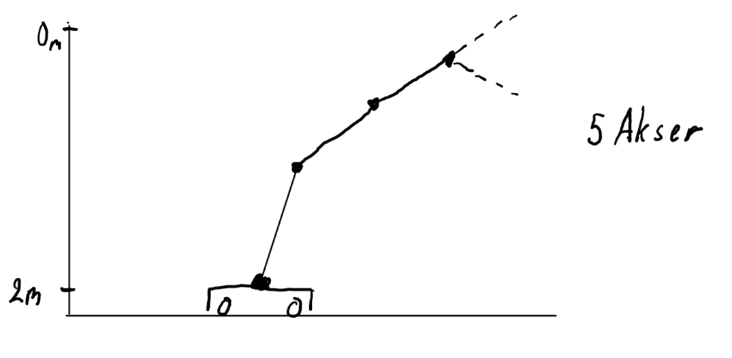

Slide 4
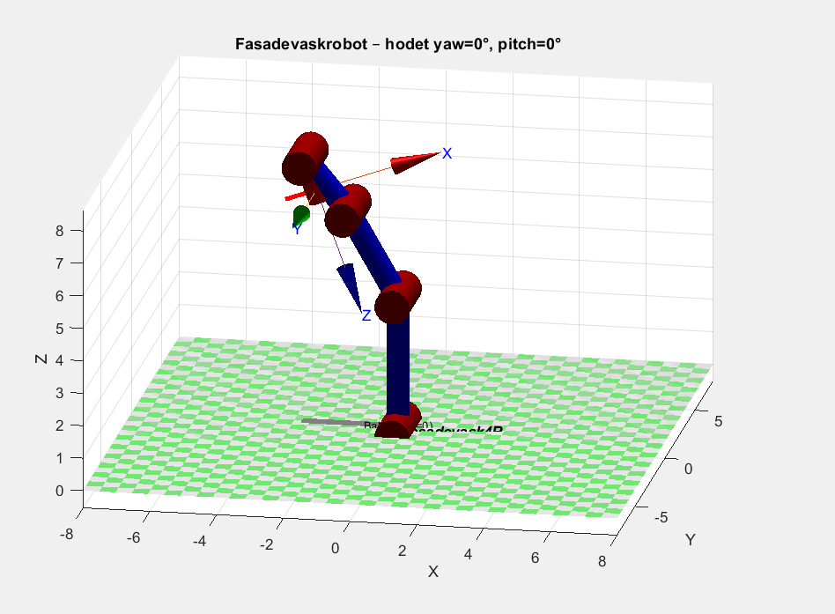
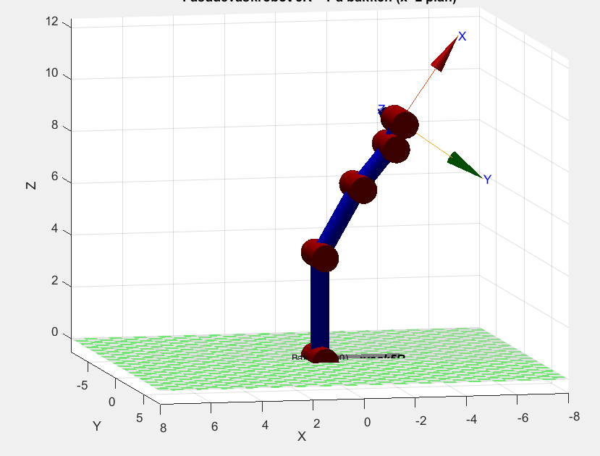
Modell

