Slide 1
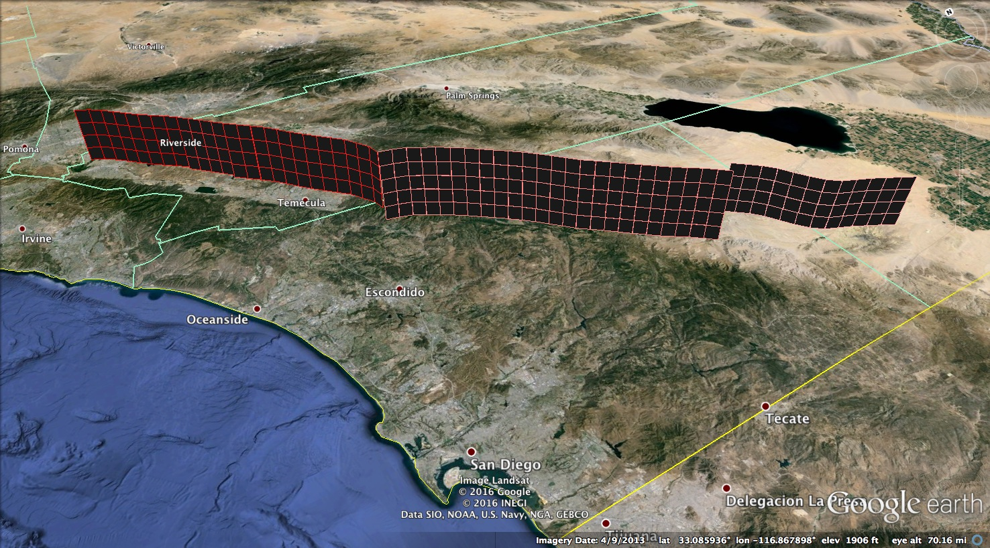
Elsinore Fault
fault element
Julian Section of Elsinore Fault
vertices

