Slide 1
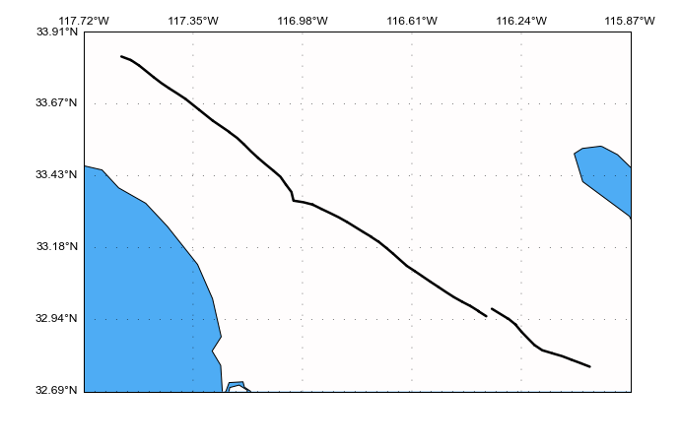
Strike direction
North
Strike angle = 309°
Elsinore Fault
San Diego, CA

