Slide 1

Investment Portfolio Data Pipeline
Kevin Wu

Slide 2

Overview
Data cleaning and transformation
Validation checks
Investment portfolio
Data analysis and insights

Slide 3
The Data
All data sourced using Polygon’s API
Each stock was stored in their separate dataframes
Clean data with minimal work
Convert Unix timestamp to normal format
Rounding decimal values

Slide 4

Data Verification
Compared against historical data downloaded from Nasdaq
Found minimal discrepancies
Negligible differences

Slide 5
Loading Data into SQL
Created CSV files from the dataframes
Create tables within my database for each dataframe
Bulk Insert the data into the tables
Table for each investment and some additional tables

Slide 6
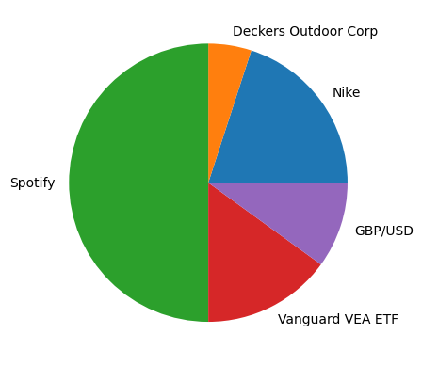
Investment Portfolio
50k on Spotify
20k on Nike
5k on Deckers Outdoor Corp
15k on Vanguards Developed Market ETF
10k on GBP/USD forex

Slide 7
Portfolio Analysis
Total Return: +142,853.91
2023: +69,150.50
2024: +73,703.41
Volatility: 1.21%
Sharpe Ratio: 5.21

Slide 8
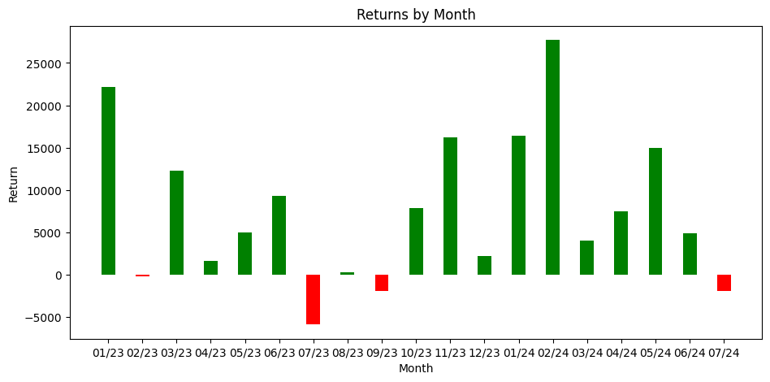
Cumulative Returns By Month

Slide 9
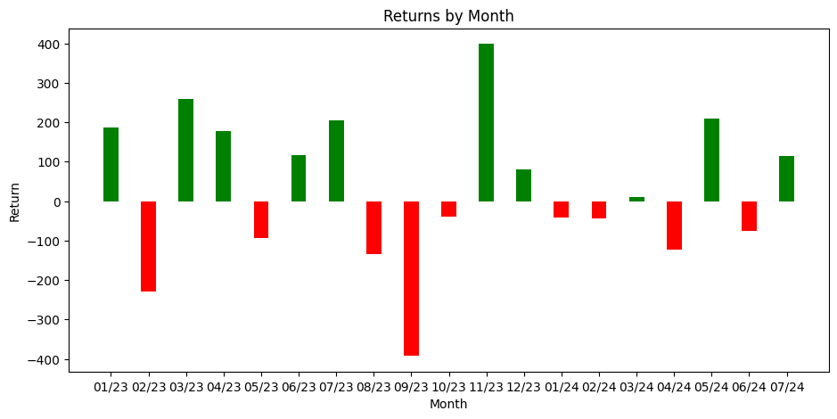
GBP/USD Forex
Total Return: +581.25
Percent Change: +5.8%

Slide 10
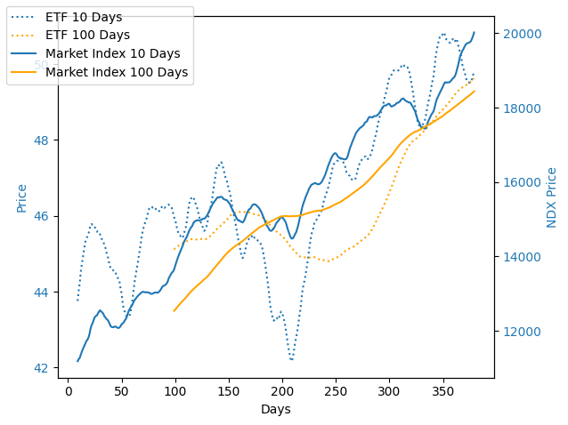
Vanguard Developed Market ETF
Total Returns: +2804.42
Volatility: .83%
Sharpe Ratio: 0.75
Beta: .48

Slide 11
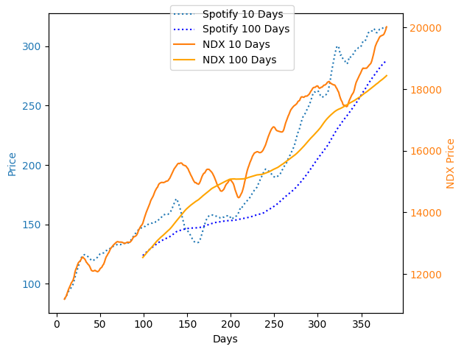
Spotify
Total Return: +140201.58
Volatility: 2.4%
Sharpe Ratio: 5.02
Beta: .92

Slide 12
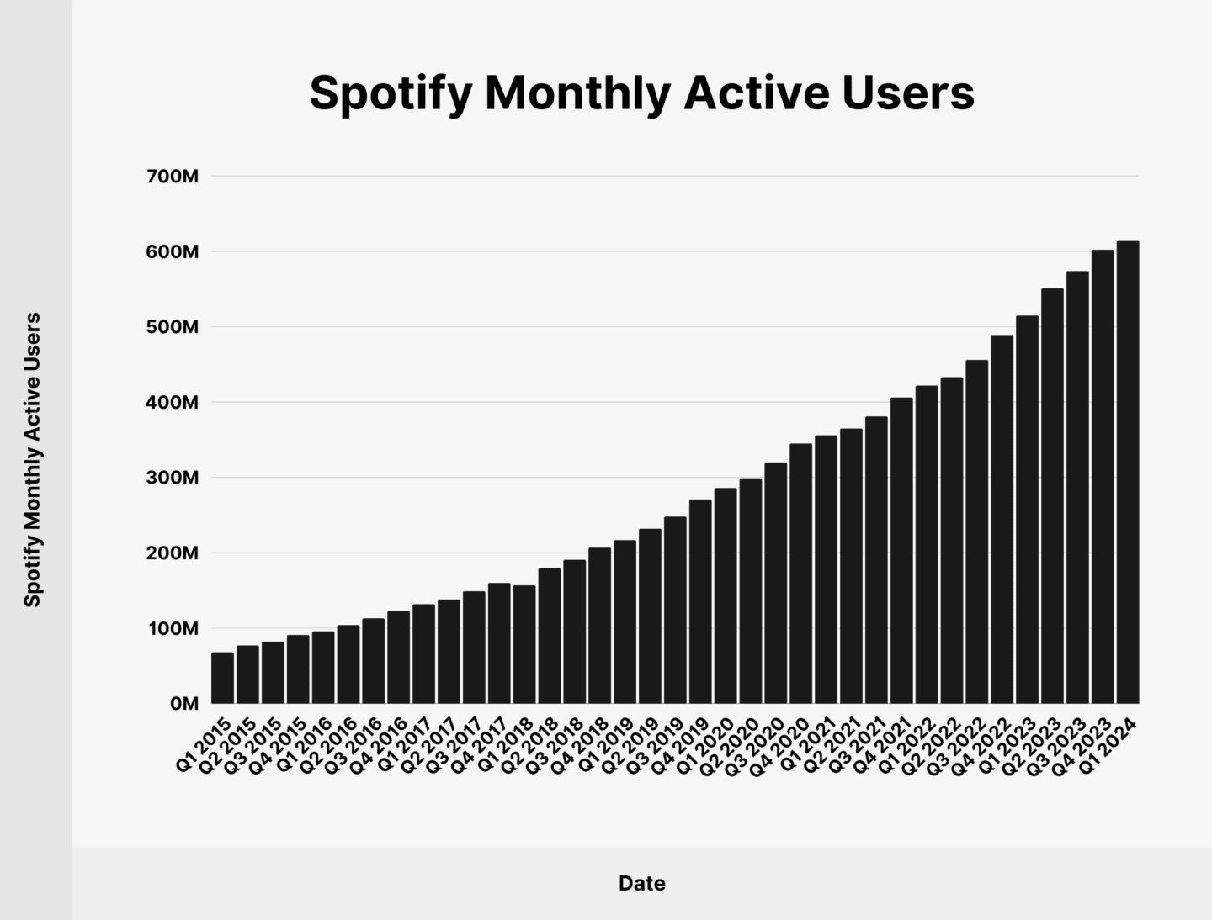
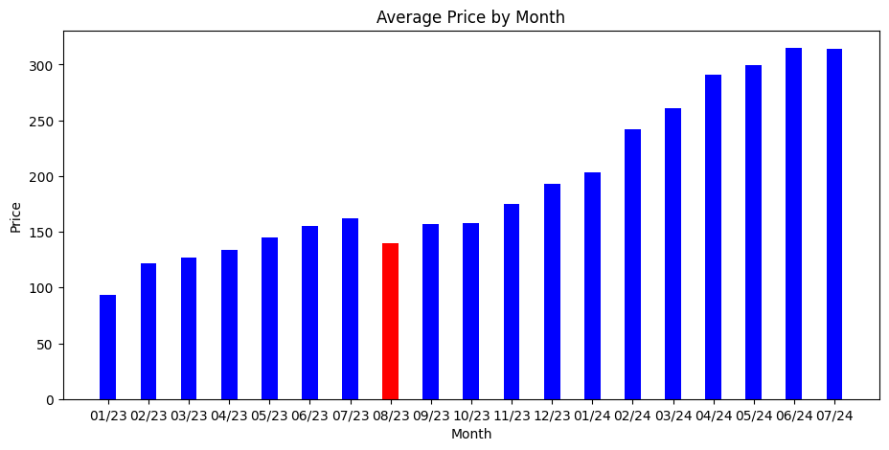
Monthly Users vs Stock Price

Slide 13
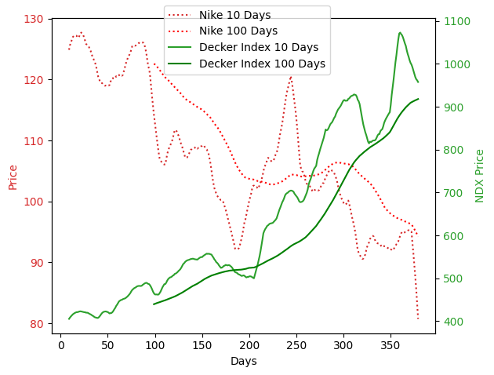
Nike/Deckers
Total Return: -7796.21/+7062.87
Volatility: 1.9%/2.16%
Sharpe Ratio: -0.98/2.75
Beta: 0.53/.710

Slide 14
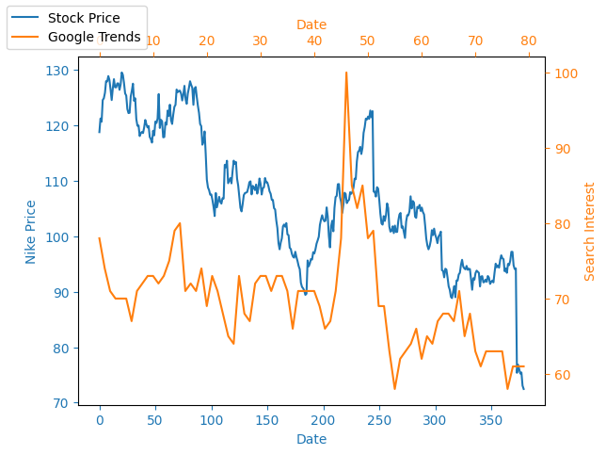
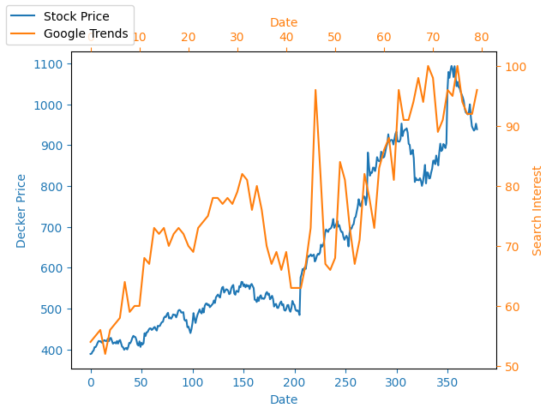
Google Trends Correlation

