Slide 1
SecureBank
Secure Coding – Team 8 – Phase 1
Swathi Shyam Sunder, Vivek Sethia,
Mai Ton Nu Cam, Korbinian Würl

Slide 2
Use Cases
Customer / Employee registration (including sending e-mail with TANs)
Customer / Employee login
Customer / Employee logout
Customer / Employee views bank account details of Customer
Customer / Employee views transaction history of Customer
Customer money transfer via HTML form (using TAN)
Customer money transfer via uploading transaction batch file (using TAN)
Employee approves transfers larger than 10.000 EUR
Employee approves registration of Customer or of other employee
Customer / Employee downloads transaction history of Customer as PDF document

Slide 3
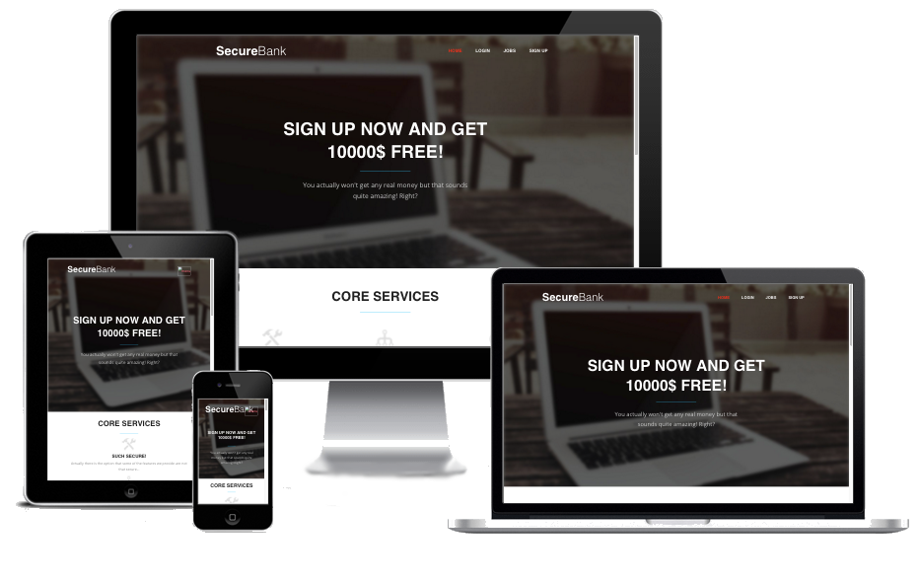
Live Demo

Slide 4
Time Tracking – Korbinian Würl
Subject | Time
Project Setup - Basic Structure | 1.00
Project Setup – Service Container | 2.00
Project Setup – Routing Service | 1.50
Project Setup – Templating Service | 2.00
Project Setup – Example files | 0.50
Session Service | 2.00
Auth Service - Basic | 1.00
Form Helper | 2.00
Templating Extensions | 2.00
Auth Service UserProviders | 2.00
Auth Service Testing & Fixes | 2.00
FlashBagService | 1.50
Template Style modifications | 0.50
Bugfixes for Base Services & Helpers | 1.50
Landingpage – stripping down base template to minimum | 1.00
Landingpage – Creating unique content | 2.00
VM Installation - PDFLib | 2.00
VM Installation - App downgrade to PHP 5.3 | 1.50
VM Installation - App | 1.00
Bugfixes for Textparser | 2.00
Final Bugfixes | 2.00
Presentation | 2.00
Gesamt | 33.00

Slide 5
Time Tracking – Mai Ton Nu Cam
Subject | Time
E-Mail Service | 1.5
Transaction Code Generation | 2
Login and registration forms | 1.6
Login and registration models | 0.5
Form validation functions | 1
Find function for DB | 1.5
Add function for DB | 1.7
Fill model function for DB | 1
Password encryption | 1.5
Error handling for login/registration | 0.5
Redirect function | 1
Controller for login and registration | 2
Parsing text file with C | 2
PHP execution of C program | 1.3
File upload | 1
Combining text parser with MySQL part | 2
C Bugfixing | 2
Error handling of C program in PHP | 0.5
Fixed text parser for CSV use | 0.5
General bug fixing | 2
Presentation | 1
Total | 28.1

Slide 6
Time Tracking – Swathi Shyam Sunder
Subject | Time
UI Template – Selection & Integration into the Project | 1.00
Customer Pages - Profile | 1.00
Customer Pages – Transaction History | 1.00
Employee Pages – Customer List | 2.00
Admin Pages – Employee List | 2.00
Employee Pages – Customer Detailed View | 2.00
Employee Pages – List of Pending Transactions | 1.00
PDO Implementation – Creation of common functions | 2.00
PDO Implementation – Change of all queries & modifications in database tables | 2.00
Bug Fixing for Employee Dashboard | 1.00
Customer Account Creation after employee approves registration | 1.00
Synchronization of actions when multiple employees perform actions on same registration/transaction | 1.50
Update of Account Balance on all relevant Customer/Employee operations | 2.00
Money Transfer via File Upload – Testing for Transaction code validity (C, MySQL) | 2.00
Money Transfer via File Upload – Addition of Transaction to DB (C, MySQL) | 2.00
Money Transfer via File Upload – Update of Account Balance on all relevant actions (C, MySQL) | 2.00
Update Function for DB in Repository | 1.50
Code Refactoring – User & Transaction Repository | 2.00
Debugging in C | 1.00
Final Testing & Bug Fixing | 2.00
Presentation | 1.00
Total | 33.00
Subject | Time

Slide 7
Time Tracking – Vivek Sethia
Subject | Time
Initial Design of Application work-flow | 1.00
Database Design with tables & constraints | 2.00
Layout for all Customer & Employee pages | 2.00
Customer Pages – Account Overview | 1.00
Customer Pages – Bank Statement | 1.00
Customer Pages – Money Transfer through HTML Form | 2.00
Customer Pages – PDF Download of Transaction History & Bank Statement | 1.50
Employee Pages - Dashboard | 2.00
Employee Pages – PDF Download of all / specific customer pending transactions & completed transactions | 2.00
Admin Pages – Approve/Reject Employee registrations | 2.00
Employee Pages – Approve/Reject Customer registrations | 1.50
Employee Pages – Approve/Reject Customer transactions | 2.00
Overall Application styling | 2.00
Bug fixing in styles and UI template | 2.00
Bug fixing in PDF functionality | 2.00
Final Testing & Bug Fixing | 2.00
Presentation | 1.00
Total | 29

Slide 8
Use Case Description (1)
Name | Login Customer/Employee
Goal | User can login with his e-mail and password
Actors | User
Pre-conditions | User registered at the website and was approved
Main Course of Execution | User clicks on Login, enters his credentials and clicks Sign In
Alternate Courses | -
Exceptions | No real exceptions, only error messages for User
Post-conditions | User is redirected to Overview page
Data formats used | HTML form

Slide 9
Use Case Description (2)
Name | Registration Customer/Employee
Goal | User can register a customer/employee account
Actors | User, Employee
Pre-conditions | User doesn‘t exist yet
Main Course of Execution | User clicks on Register/Jobs, fills out the HTML form and clicks Sign Up
Alternate Courses | -
Exceptions | No real exceptions, only error messages for User
Post-conditions | User gets an e-mail confirming his registration and with further information on how to proceed
Data formats used | HTML form

Slide 10
Use Case Description (3)
Name | Logout Customer/Employee
Goal | User can logout
Actors | User
Pre-conditions | User is logged in
Main Course of Execution | User clicks on his name in right upper corner and selects logout
Alternate Courses | -
Exceptions | -
Post-conditions | User gets redirected to login page
Data formats used | -

Slide 11
Use Case Description (4)
Name | Customer transfers money via file upload
Goal | User can upload a text file containing several transactions he wants to make
Actors | User, Employee
Pre-conditions | User is logged in
Main Course of Execution | User chooses Make Transfer from the side bar and selects the Tab via file upload. Then he selects a file from his computer and clicks Submit.
Alternate Courses | -
Exceptions | No real exceptions, only error messages for the Customer
Post-conditions | User gets redirected to Make Transfer page with a success or error notification
Data formats used | Plain text file with CSV

Slide 12
Use Case Description (6)
Name | Customer/Employee downloads PDF document of transactions
Goal | User can upload a text file containing several transactions he wants to make
Actors | Customer, Employee
Pre-conditions | Actor is logged in
Main Course of Execution | Customer downloads PDF from Transaction History, Employee downloads transactions from Pending transactions or from Customer detailed page.
Alternate Courses | Download link does not appear when no transactions exist
Exceptions | -
Post-conditions | PDF File opens in a new tab with download and other options
Data formats used | HTML, PDFLib

Slide 13
Use Case Description (7)
Name | Employee approves transactions of customer > 10.000 EUR
Goal | Employee is able to approve transactions of customers
Actors | Customer, Employee
Pre-conditions | Employee is logged in
Main Course of Execution | Employee clicks on Pending Transactions on the sidebar and clicks on Approve button corresponding to the transaction to approve.
Alternate Courses | Employee clicks on the Reject button
Exceptions | If selected transaction is already approved/rejected, error message is displayed
Post-conditions | Account Balance is updated in the from & to accounts of the transaction.
Data formats used | HTML, MySQL

Slide 14
Use Case Description (8)
Name | Employee/Customer views bank account details of Customer
Goal | Employee/Customer is able to view bank account details of customer
Actors | Customer, Employee
Pre-conditions | Actor is logged in
Main Course of Execution | Customer clicks on Home to view own account details. Employee clicks on Customers on the sidebar and clicks on specific customer to view account details.
Alternate Courses | -
Exceptions | -
Post-conditions | User is able to view the bank account details
Data formats used | HTML, MySQL

Slide 15
Use Case Description (9)
Name | Employee/Customer views transaction history of Customer
Goal | Employee/Customer is able to view transaction history of customer
Actors | Customer, Employee
Pre-conditions | Actor is logged in
Main Course of Execution | Customer clicks on Transaction History on sidebar to view own transaction history. Employee clicks on Customers on the sidebar and clicks on specific customer to view transaction history.
Alternate Courses | -
Exceptions | -
Post-conditions | User is able to view the transaction history of customer.
Data formats used | HTML, MySQL

Slide 16
Use Case Description (10)
Name | Customer transfers money via HTML Form
Goal | User can transfer money by entering details in the HTML form
Actors | Customer, Employee
Pre-conditions | Customer is logged in
Main Course of Execution | User chooses Make Transfer from the side bar and selects the Tab via file upload. Then he selects a file from his computer and clicks Submit.
Alternate Courses | Customer enters incorrect details or invalid transaction code
Exceptions | No real exceptions, only error messages for the Customer
Post-conditions | User gets redirected to Make Transfer page with a success or error notification
Data formats used | HTML Form

Slide 17
Superuser
E-mail: admin@admin.de
PW: admin

