Slide 1

Gnosis Solutions
Crowd Intelligence Grocery Shopping Mobile App
Notes:
Speak on our app.

Slide 3
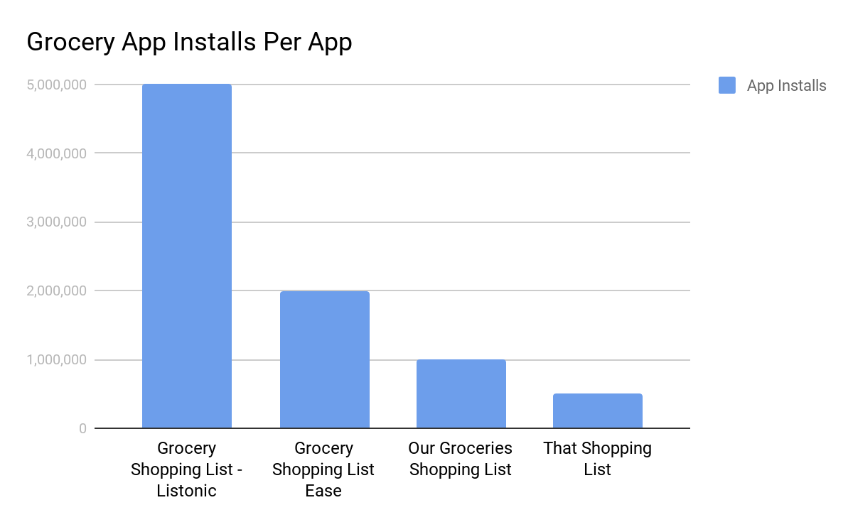
The Market
Our mobile app proposal operates in the mobile application market. This market has many grocery list applications that are very similar to what we are trying to accomplish.
Notes:
Graphics,
Minimize bullets,
Chris

Slide 4

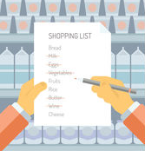

Solution Overview
Use shoppers’ lists to crowdsource data collection on local grocers and provide services via this information.
Notes:
In short, the we want to create a consolidated source of information on local grocers and provide services where current applications are lacking which is for example the ability to compare prices of local grocers, and the ability to cut down on time spent searching through the store by knowing where each item is located on your list. In order to make this information more readily available to the public, we will build a collective database of each store’s products, placement of the products, and prices, through user contributed information on these products. Our solution to this goal is an application which will serve as the vehicle through which we will collect and analyze the data to improve the user’s experiences shopping.
Animate the order of introducing the graphic, one by ione

Slide 5
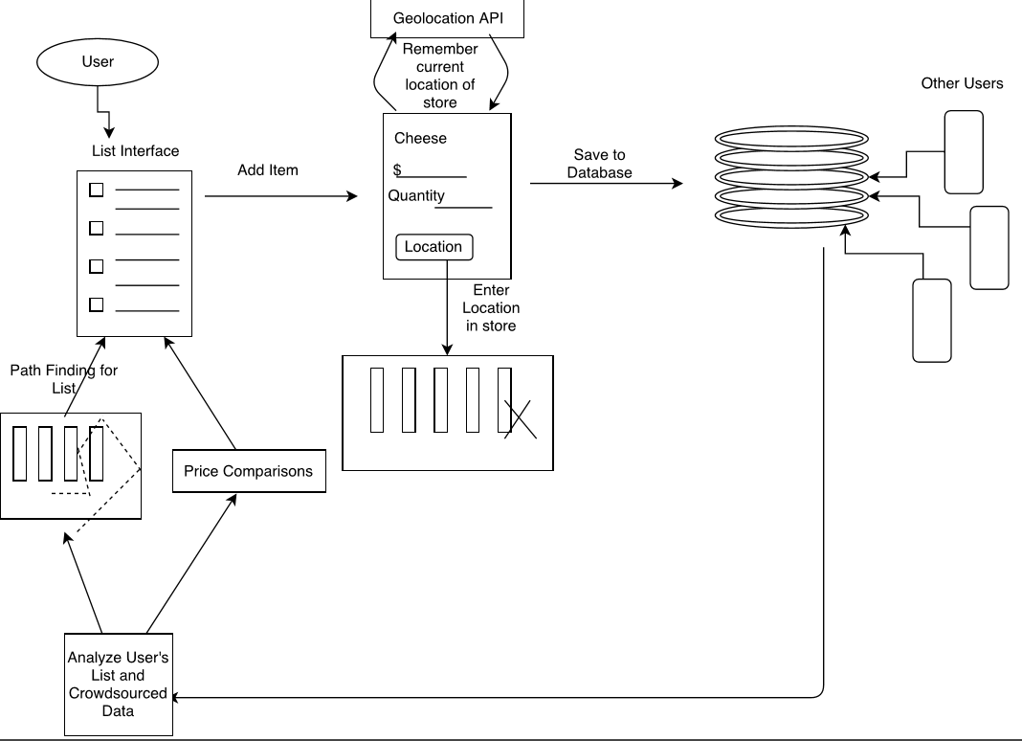
Solution Workflow Diagram
1.
2.
Build list creation UI for grocery items
Items entered on shopping list by all users will be stored on remote database
Analyzing store data, and user’s list, provide helpful services to tackle list efficiently.
3.
Figure 1.
Notes:
The app will go hand in hand with the user’s shopping experience in two parts, the preparation phase before heading to the store where list creation happens, and the actual shopping.
To accommodate the first phase, we will have designed a list making interface so that the user can have an electronically stored list that is easy to edit, save, and share.
Crowdsourcing applications involve an incentive to motivate users to contribute and part of our incentive will be this easy to manage list UI.
Once the user arrives at the store, they will need to check off and remove items from the list that they have collected. It is at this step that we will ask the user to enter details they found out about their item on site.
This includes the price of the item and the location of the item within the store
This information will be stored in a database, along with the store it was found at, and once sufficient data is built about each store, we can improve future shopping experiences by analyzing their list and providing services powered by our new found data of the stores.
As of now these services will be price comparisons of your list items between stores, and ordering their list based on a pathfinding feature that will display the best order to tackle their list within the store
Animate this slide, in order of steps,
Show where user’s end is,

Slide 6
Key Requirements Overview
Figure 2.
Notes:
React native deploys on both android and ios platforms which allows users to interact with the firebase data solution to pass data back and forth.

Slide 7
Key User Requirements
All of the following Requirements were identified through in-person interviews with our sponsor and reading the project description.
User Requirements:
This mobile app solution must provide a way of allowing users to record data about grocery items.
This software must have a nice flow with easy to use elements.
Notes:
Chris
Talk about aqcuisition graphics!
Mention managing of data remotely
Animate,

Slide 8
Key Functional / Nonfunctional Requirements
Functional Requirements:
The application must take in data given by the user and appropriately archive it into a crowdsourced database.
The data stored by the system, given by the users, must be accessible even when offline with data since last online time.
Nonfunctional/Performance Requirements:
Data storage system must be able to update data on users device as well as the data storage system in real time upon request or by time interval.
Battery life should not be significantly impacted as a result of using our software over time or short term.
Notes:
Chris
Animate,

Slide 9
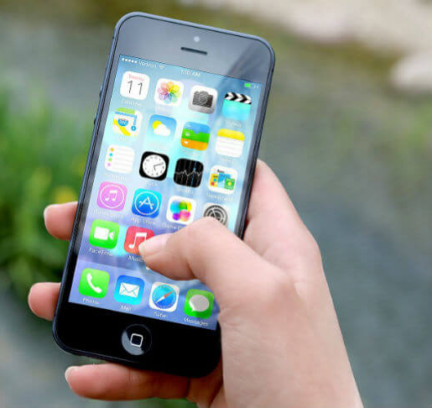
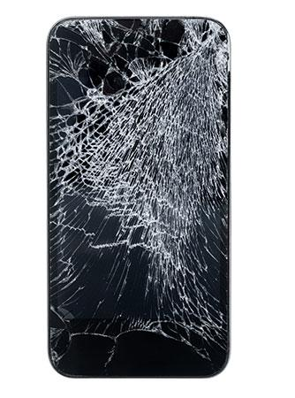
Key Environmental Constraint
Notes:
Visuals of howsuer with interface
Remember to wrap up how these requirements / constraints are NOT final and are subject to change.

Slide 10


Risks
Technical Risks:
Platform dependencies
User Risks:
Users may not want to switch to a different grocery list application.
May not build a sufficient database of crowdsourced items.
Trust our users to provide quality data.
Notes:
Kalen
How is platform dependency a risk
Graphics,
“User’s may not” line
“If it looks too complicated users may not want to switch”
“There may be issues with memory size”
Take away bullet points,
Ex, show grocery store app other
Show pic of memory,

Slide 11
Feasibility
Our platform and tool choices have risk but they prove to have the exact features we need to make this project meet all the requirements.
The integration of the different technologies prove a challenge but are doable.
Prototyping front-end and back-end communication will guarantee confidence with these two platforms.
Notes:
Kalen
Take out bullet points,
Graphics,
Go into greater detail
Breif clear example of integration

Slide 12
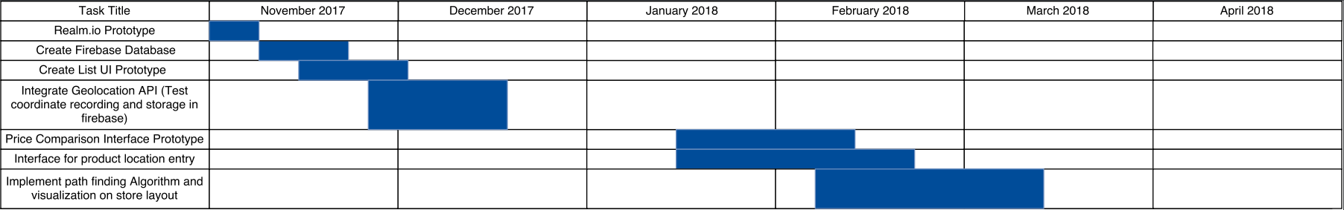
Timeline
Winter Break
Buffer room
Now
Beta Testing
Notes:
Here is our timeline of tasks and the order in which we will be completing them. We had a slight hiccup with our first database technology that we had spent time prototyping and only switched to firebase recently so we have only just begun getting our firebase database up and running., our next step will be to create the list interface and test the remote syncing capabilities with firebase, After we are sure the syncing and storage works, we can integrate our geolocation API and test that it is stored correctly and works correctly with remembering real world coordinates. After winter break we will begin work on building the price comparison interface prototype, followed by the interface to enter product locations within the store. Once we ar able to input product locations we will get to work on implementing a path finding algorithm and visualization of that
Light blue = darker
Show it is done in middle of march,
Put in beta testing timeline as well,
Put in buffers, such as build in a buffer encase for issues, then move on to how it coordinates with next task, talk about the room we have set ourselves, understand real world buffer
Display realm prototyping time, mark it as ended

Slide 13



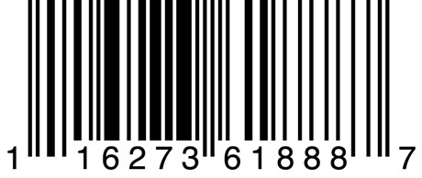

Conclusion
Give customers an consolidated source of knowledge on local grocers via a shared database on stores and their products
Notes:
Thomas
Strong conclusion
Graphics, pop things up and summarize our technologies as well,
Emphasize ease of use with UI,
Emphasize the data management
Show what user’s will do with the list

