Slide 1

Gnosis Solutions
Crowd Intelligence Grocery Shopping Mobile App
Notes:
Speak on our app.

Slide 2
Our Team and Mentor
Christopher Simcox - Database/Connections Lead
Kristoffer Schindele - Front End Developer
Thomas Back - Front End Lead
Kalen Wood-Wardlow - Team Leader
Our Client and Mentor: Dr. Michael Leverington
Notes:
Kalen
Introduce Team, Client/Mentor and Project name
Animate the order of introducing the graphic, one by ione

Slide 3
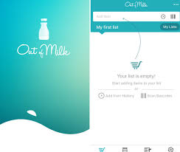
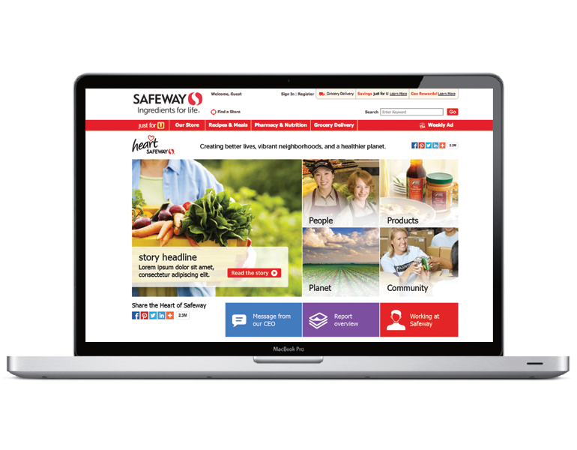
Problem Statement
What options are available to grocery shoppers to shop smarter and more efficiently?
Notes:
I want to present you the question of what resources exist for grocery shoppers to shop smarter and more efficiently? They could sign up for individual stores rewards programs in which they receive deals and price off items, but they can do little to research the prices within local stores through their site, or what products are contained locally. In the way of applications there are curbside pickup programs, but the price is only known when you’ve purchased the items, besides this list making applications catered towards groceries exist, such as out of milk, which allow s virtual list to be built tht is more customizable and saveable than a written list.

Slide 4
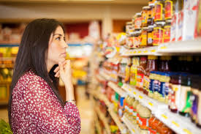


Problem Statement
Shoppers frequent these stores weekly and are quite familiar with layout and expected products.
Crowdsourcing
Notes:
For the lack of insight on being able to conduct research about specific grocers and what theirs tore contains, most people develop a favorite tore they frequent mainly because they are familiar with the layout and what is offered at this store.

Slide 5
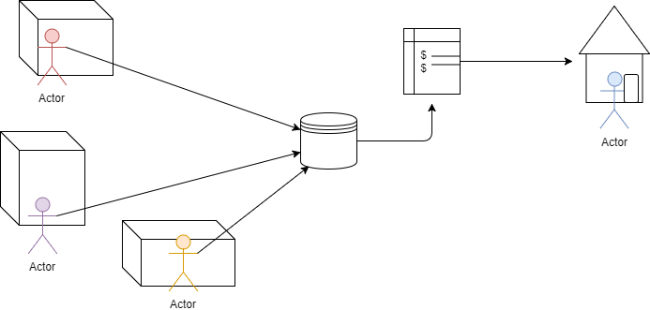
Solution Statement
Create a useful shopping list application to serve as an organization tool for users, while collecting the information of products on their list to build a grocery product database.
Notes:
In short, the we want to create a consolidated source of information on local grocers and provide services where current applications are lacking which is for example the ability to compare prices of local grocers, and the ability to cut down on time spent searching through the store by knowing where each item is located on your list. In order to make this information more readily available to the public, we will build a collective database of each store’s products, placement of the products, and prices, through user contributed information on these products. Our solution to this goal is an application which will serve as the vehicle through which we will collect and analyze the data to improve the user’s experiences shopping.
Animate the order of introducing the graphic, one by ione

Slide 6
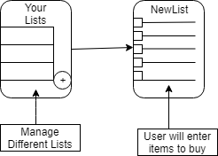
Solution Workflow: Step 1- List Creation
User will set phase to preparation phase
User will create a new list
Desired items will be entered and the list will be saved
Figure 1. List Creation Phase
Notes:
The app will go hand in hand with the user’s shopping experience in two parts, the preparation phase before heading to the store where list creation happens, and the actual shopping.
To accommodate the first phase, we will have designed a list making interface so that the user can have an electronically stored list that is easy to edit, save, and share.
Crowdsourcing applications involve an incentive to motivate users to contribute and part of our incentive will be this easy to manage list UI.
Once the user arrives at the store, they will need to check off and remove items from the list that they have collected. It is at this step that we will ask the user to enter details they found out about their item on site.
This includes the price of the item and the location of the item within the store
This information will be stored in a database, along with the store it was found at, and once sufficient data is built about each store, we can improve future shopping experiences by analyzing their list and providing services powered by our new found data of the stores.
As of now these services will be price comparisons of your list items between stores, and ordering their list based on a pathfinding feature that will display the best order to tackle their list within the store
Animate this slide, in order of steps,
Show where user’s end is,

Slide 7
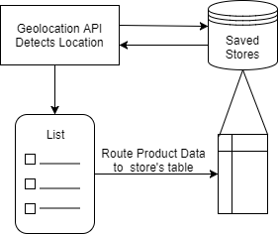
Solution Workflow: Step 2- Shopping Mode
User will set shopping mode on and head to store of their choice
Once at store Geolocation tools will recognize store and route product data to that store’s table
Figure 2. List Creation Phase
Notes:
The app will go hand in hand with the user’s shopping experience in two parts, the preparation phase before heading to the store where list creation happens, and the actual shopping.
To accommodate the first phase, we will have designed a list making interface so that the user can have an electronically stored list that is easy to edit, save, and share.
Crowdsourcing applications involve an incentive to motivate users to contribute and part of our incentive will be this easy to manage list UI.
Once the user arrives at the store, they will need to check off and remove items from the list that they have collected. It is at this step that we will ask the user to enter details they found out about their item on site.
This includes the price of the item and the location of the item within the store
This information will be stored in a database, along with the store it was found at, and once sufficient data is built about each store, we can improve future shopping experiences by analyzing their list and providing services powered by our new found data of the stores.
As of now these services will be price comparisons of your list items between stores, and ordering their list based on a pathfinding feature that will display the best order to tackle their list within the store
Animate this slide, in order of steps,
Show where user’s end is,

Slide 8
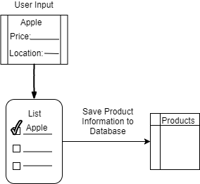
Solution Workflow: Step 3-Save Product Info
When a user marks an item off their list, they will be prompted to enter location and price of item., or update price and location if change occured.
Entry for product with price and location will be stored on cloud database (or entry will be updated if different)
Figure 3. List Creation Phase
Notes:
The app will go hand in hand with the user’s shopping experience in two parts, the preparation phase before heading to the store where list creation happens, and the actual shopping.
To accommodate the first phase, we will have designed a list making interface so that the user can have an electronically stored list that is easy to edit, save, and share.
Crowdsourcing applications involve an incentive to motivate users to contribute and part of our incentive will be this easy to manage list UI.
Once the user arrives at the store, they will need to check off and remove items from the list that they have collected. It is at this step that we will ask the user to enter details they found out about their item on site.
This includes the price of the item and the location of the item within the store
This information will be stored in a database, along with the store it was found at, and once sufficient data is built about each store, we can improve future shopping experiences by analyzing their list and providing services powered by our new found data of the stores.
As of now these services will be price comparisons of your list items between stores, and ordering their list based on a pathfinding feature that will display the best order to tackle their list within the store
Animate this slide, in order of steps,
Show where user’s end is,

Slide 9
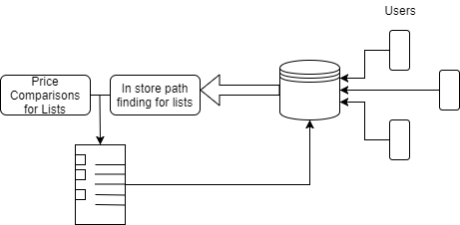
Solution Workflow: Step 4-Provide Services
With sufficient data, the preparation phase offers services
Services include price comparisons for lists based on nearby stores; Shortest path for items in list
Notes:
The app will go hand in hand with the user’s shopping experience in two parts, the preparation phase before heading to the store where list creation happens, and the actual shopping.
To accommodate the first phase, we will have designed a list making interface so that the user can have an electronically stored list that is easy to edit, save, and share.
Crowdsourcing applications involve an incentive to motivate users to contribute and part of our incentive will be this easy to manage list UI.
Once the user arrives at the store, they will need to check off and remove items from the list that they have collected. It is at this step that we will ask the user to enter details they found out about their item on site.
This includes the price of the item and the location of the item within the store
This information will be stored in a database, along with the store it was found at, and once sufficient data is built about each store, we can improve future shopping experiences by analyzing their list and providing services powered by our new found data of the stores.
As of now these services will be price comparisons of your list items between stores, and ordering their list based on a pathfinding feature that will display the best order to tackle their list within the store
Animate this slide, in order of steps,
Show where user’s end is,

Slide 10
Implementation overview for DR2
Figure 2.
Notes:
React native deploys on both android and ios platforms which allows users to interact with the firebase data solution to pass data back and forth.

Slide 11
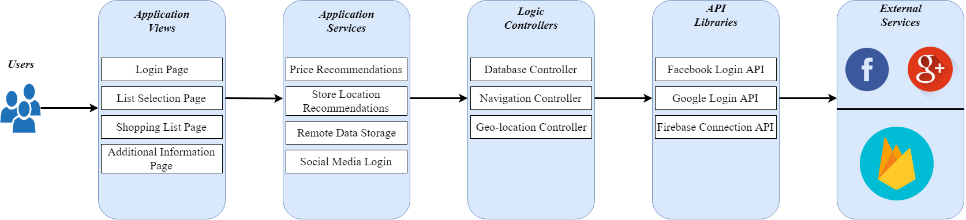
Architecture overview for DR2
Figure 3.
Notes:
Chris
Talk about aqcuisition graphics!
Mention managing of data remotely
Animate,

Slide 12
Challenges and Resolutions
Cross platform UI/UX differences
Solution: Test on both iOS and Android devices when developing.
Geolocation estimations
Solution: 3km radius for stores to recommend and __km for store radius’s for when user is within a store.
Notes:
Chris
This section is replacing the risks and feasiblity
Since we are in “thick” of implementation we can include actual coding challenges we’ve faced
Ex: Database, integration with fb and google sign in, UX challenges
Challenges were that facebook and google integration required extra configuration not outlined in setup guides. So sitting down for a good amount of time and working together on figuring out the issues to get them to work. We realized that the added benefit of letting these two big authentication power houses, Facebook and Google, take over vastly outweigh the possibility of handling authentication ourselves. Our final challenge overall the hardest one was learning react native and how the framework actually functions in order to provide a seamless cross platform experience. Although there are some differences between the platforms we have adjusted our code to support both platforms with consistent styling and functionality.

Slide 13
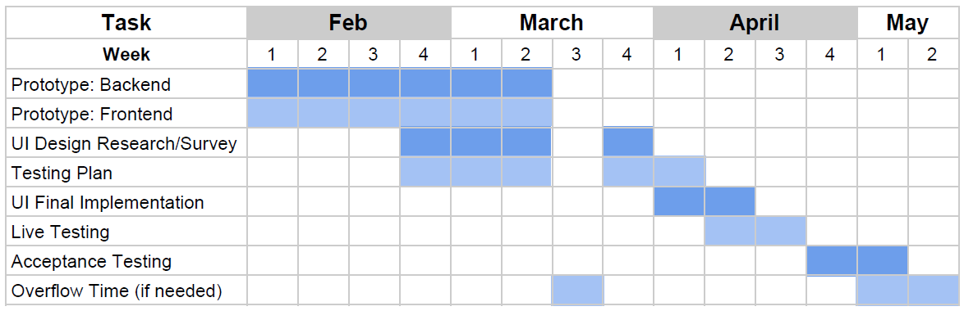
Timeline
Notes:
Kris
Fully functional prototype is on schedule to be finished before Spring break, with the break serving as overflow time to address any persisting challenges as well as get ahead on UI design and testing.
Design of both the testing plan and the UI design have already begun, with the final steps of both processes wrapping up after design decisions have had some time to stew over the break. After which, final UI implementation will continue after the testing plan is complete and into final user testing.
The final step is going to be polishing the app for the last weeks of April and preparing it for final acceptance testing and demo for the client in May.

Slide 14
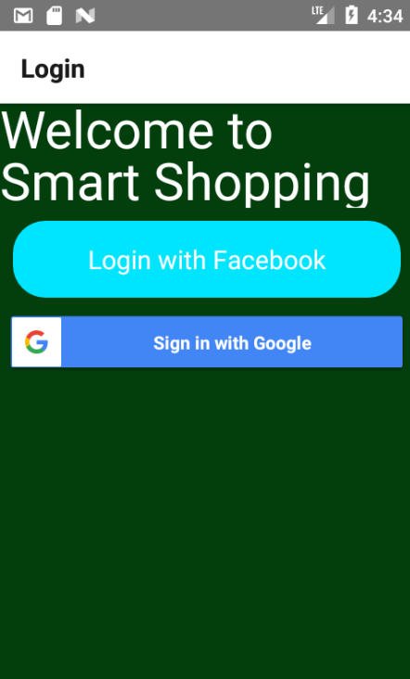
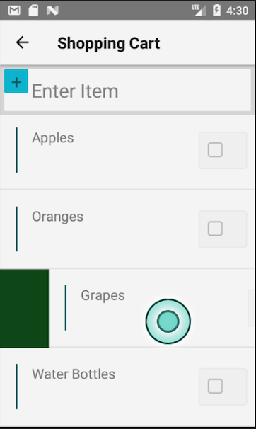
Progress, progress
Database
User Interface
Login Options
Notes:
Kris

Slide 15
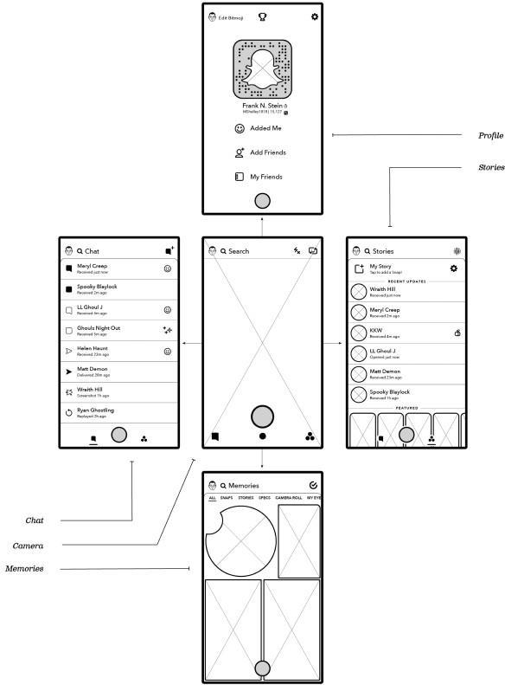
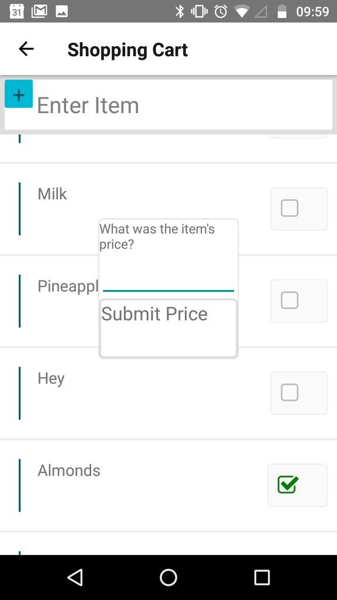
UI Design
“It should be so easy to use, they won’t want to put it down.”
Notes:
Kris
Screenshots of current UI as well as diagrams of desired UI strategy.
Cite similarities to snapchat interface, and the public reaction to snapchat’s changes during mid February. Emphasize the modularity of each page, and that each page focuses on providing one service to the user (list overview, single list editing, app settings, login).

Slide 16
Future Steps
UI Design/Survey
Testing Plan
Finish Prototype
Notes:
Kris → Kalen
UI Design/Survey
UI design will consist of iteratively designing similar layouts and exposing a select beta tester base consisting of specific types of users to these layouts. The feedback from each of these iterations will determine both the variety and direction of subsequent designs until we’ve honed in on a design that provides an un-obstructive experience for the optimal set of users.
Optimal set of users → largest number of users from different age groups that are likely to use the app.
Testing Plan:
Development of an optimal testing plan has already begun. We’d like to focus on a test that could be quickly administered to many users and tests the most vital features in the shortest amount of use time. We’re not going to focus on exhaustively testing the app through user exposure because it puts a burden on the user that would be unrealistic for actually using the app.
Additionally, we’ll be testing edge cases internally, as well as developing benchmarks for normal performance, as a slow app isn’t going to keep the user’s attention.
Finish Prototype:
Emerge from alpha stages with an app that provides: sign-in/login, touchable user interface, list creation, list item creation, asynchronous data read/write access, geolocation recognition.

Slide 17



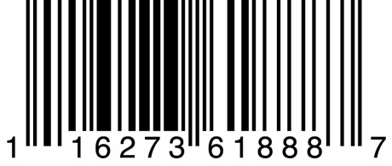


Conclusion
Give customers an consolidated source of knowledge on local grocers via a shared database on stores and their products
Notes:
Thomas
Strong conclusion
Graphics, pop things up and summarize our technologies as well,
Emphasize ease of use with UI,
Emphasize the data management
Show what user’s will do with the list
In conclusion given our powerful tools, our app smart shopping looks to create a simple easy to use application that will have a simple to use UI that will improve the effiencieny of users shopping expierience.

