Slide 1
Gnosis Software
Kalen Wood-WarDlow, Thomas Back, Christopher Simcox, Kristoffer Schindele

Slide 2
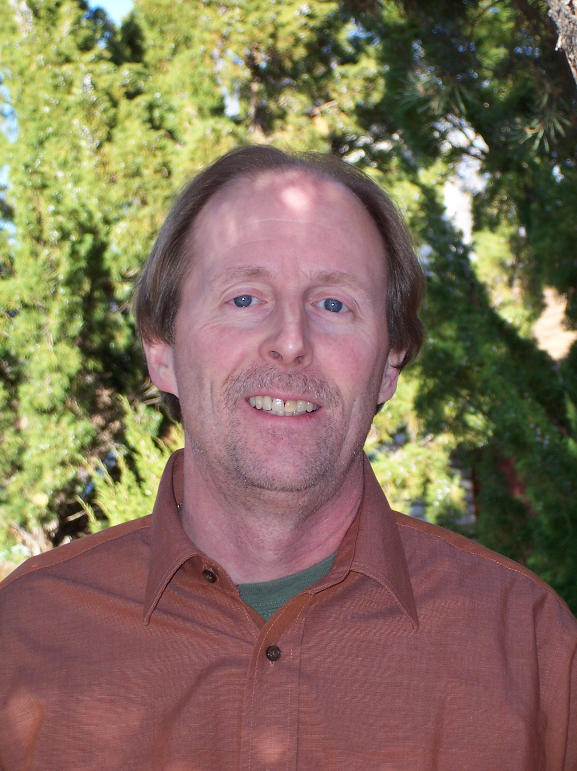
Our Sponsor: Michael Leverington
Former Lecturer at University of Nevada, Reno
Lecturer for CS480, CS122, CS 249 at NAU
Sponsored Office Door Capstone Project for last year

Slide 3
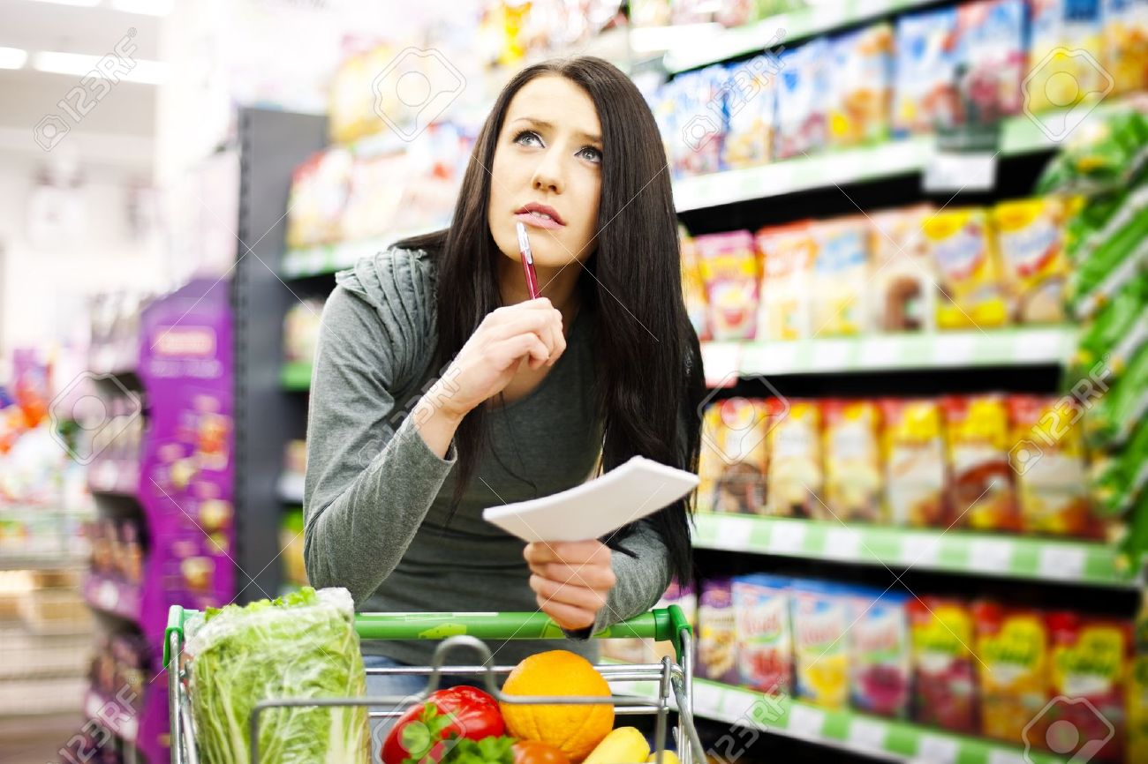
The Problem
Most shoppers frequent the same store they are familiar with, rather than stop at a more convenient and unfamiliar store.
Most grocery store list apps have no intelligence aspect to capitalize on the fact that usually know the layout of their store and could share it.
Do not provide help once you have assembled your list and have entered the store.
If more accessible information existed about products and locations of products in store, people could shop more efficiently.

Slide 4

Our Solution

Slide 5
Development Plan
For extracting concrete requirements we will be drafting requirements progressively each week as to also refine them.
The main pieces of the project are mostly building a mobile application that also has a local database.
Mobile application
Best platform will be researched with all aspects of development time, testing time, universal deployment, reliability and useability. To ensure best solution possible.
Database
Database creation will be designed with future online integration in mind.
We will also be using best practices from material design and our research from existing usability and user interface testing.

Slide 6
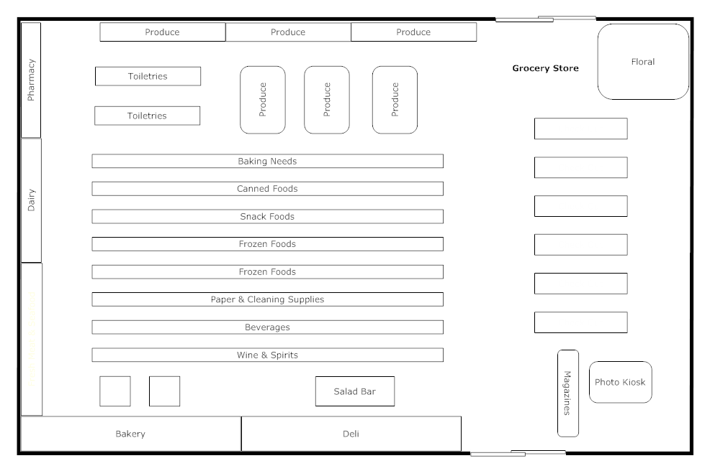
Stretch Goals

Slide 7
Conclusion
Crowdsourcing is a great new way to gather information for everyone to use.
A simple, and easy to use app is the best way to gain and maintain a larger user base.

