Slide 1
From SBOMs to F-Bombs:
Vulnerability Analysis, SCA Tools, &
False Positives & Negatives
Kevin W. Wall <kevin.w.wall@gmail.com> , Oct 31, 2023
Copyright © 2023 – All rights reserved.
This work is licensed under a
Creative Commons Attribution-NonCommercial-ShareAlike 4.0 International License
as specified at
http://creativecommons.org/licenses/by-nc-sa/4.0/
Notes:
Hello, and welcome to my talk. After seeing my title, I want to ensure you that this talk is rated PG and I’m not planning to be dropping any F-bombs. Although I must confess, addressing the patching of the vulnerabilities in Apache Commons FileUpload dependencies that resulted on my language most definitely being R-rated, which is what lead me to that title in the first place.
Also, just so I don’t get censored by OWASP or my company or any colleagues, I need to say that the views expressed in this talk are mine alone and not those of my employer or the OWASP Foundation. Also, I don’t necessarily expect most of you to agree with them as several of the expressed opinions are definitely not part of the traditional AppSec party line.

Slide 2
Who is This Knucklehead?
20+ years systems programming, 20+ years in AppSec.
Previously developed several proprietary systems libraries, including one for AppSec.
OWASP ESAPI involvement (ESAPI dates back to 9/2007)
Involved in ESAPI since June, 2009.
Redesigned and re-implemented symmetric encryption
Have been ESAPI co-lead since 2011.
Buzzword free talk. No mention of ChatGPT or quantum computing! (Unless you consider SBOM a buzzword! :)
Notes:
My analysis experience goes back to the days of the obtuse “multiple undisclosed vulnerabilities” that Oracle was famous for (or should I say infamous?) when describing what they updated in their security releases. I learned back then to reverse engineer the patched jar files and then provide details to my InfoSec management to help them decide how critical it was to patch immediately or whether it could be deferred for a while.
Actual number for vulnerabilities in dependencies probably is less than 10%. Williams claims:
62% of time, dependent libraries never loaded at all!
Only 9% of running application is 3rd party libraries.
CVE-2023-24998 addressed a DoS vulnerability in Apache Commons FileUpload.
Why the F-bombs? 1) The CVSS was 7.5, which is nuts for DoS, and 2) in my opinion, they screwed up the patch in multiple ways. It’s a Band-Aid that really doesn’t do much. We’ll revisit that part of the CVE fix later.

Slide 3
Why This Talk?
I predate Software Composition Analysis (SCA) tools:
Manually analyzing patches to check if they allow exploitable paths since 2010.
Jeff Williams (CTO of Contrast Security) gives talk confirming my suspicion that majority of SCA findings are false positives.
Vulnerabilities in dependencies exploitable < 29% of the time.
Matched my observation of my analysis doing secure code reviews for previous employers.
Agreed with my experience in writing up 11 ESAPI Security Bulletins.
CVE-2023-24998 – my breaking point. Lots of F-bombs. 😡
Notes:
My analysis experience goes back to the days of the obtuse “multiple undisclosed vulnerabilities” that Oracle was famous for (or should I say infamous?) when describing what they updated in their security releases. I learned back then to reverse engineer the patched jar files and then provide details to my InfoSec management to help them decide how critical it was to patch immediately or whether it could be deferred for a while.
Actual number for vulnerabilities in dependencies probably is less than 10%. Williams claims:
62% of time, dependent libraries never loaded at all!
Only 9% of running application is 3rd party libraries.
CVE-2023-24998 addressed a DoS vulnerability in Apache Commons FileUpload.
Why the F-bombs? 1) The CVSS was 7.5, which is nuts for DoS, and 2) in my opinion, they screwed up the patch in multiple ways. It’s a Band-Aid that really doesn’t do much. We’ll revisit that part of the CVE fix later.

Slide 4
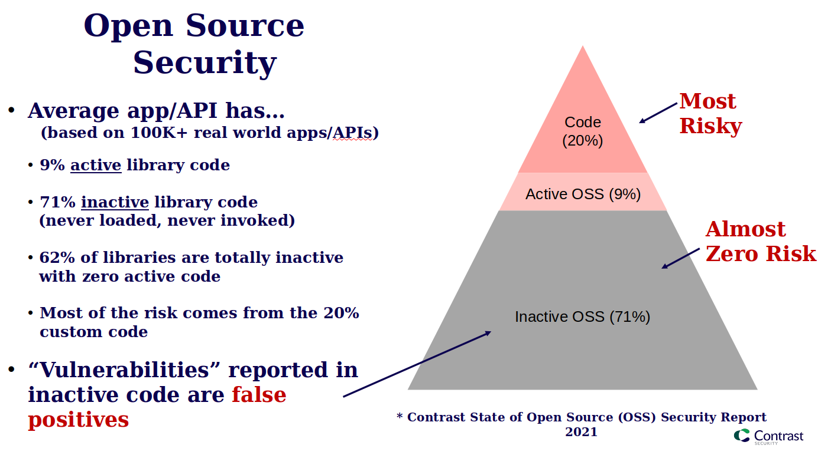
SCA Bandages for Open Sores Security?
See References for link.
Notes:
This slide content is from Jeff Williams, CTO of Contrast Security. (I won’t blame him for the bad pun on this slide title however; that’s all my doing.)
However, given all the false positives that static SCA tools produce, I thought it was appropriate,
The reason why I’ve included this slide is as a source of the 2nd bullet from the previous slide. It is based on lots of data collected by Contrast Security.

Slide 5
Where We’ve Gone Astray
We treat vulnerabilities in libraries same as we do in end products.
Try to measure the severity the same way for both (i.e., CVSS).
We conflate severity with risk. CVSS measures severity, not risk.
We treat risk as one-size-fits-all.
Not referring to risk appetite or risk acceptance here.
Act as only option is patch everything now or accept risk and try to patch later.
Why not patch selectively? (Only patch what the application uses!)
Why not sandbox the application or use virtual patching with WAF, etc.?
Notes:
As as a culture, humans tend to overreact to new risks. And while SCA tools were a thing before Log4Shell (you all remember OWASP Dependency Check, right?) that was the watershed moment that changed everything. Most companies were unprepared for the fallout. But it was “lesson learned”, right? The mantra became “never again”, so we all started scanning dependencies with a vengeance and insisting that everything be patched, especially vulnerabilities that were High.
So how did we determine what a “High” risk vulnerability was? Simple, we believed whatever the SCA scores told us and most of them just used the CVSSv3 base scores from NVD, which is not without problems.
We ignored impact to development teams and that, in fact, most of the vulnerabilities in dependencies were not exploitable in our applications.
In doing this, the pendulum swung from one extreme to the other.

Slide 6
Why Libraries and End Products Should be Treated Differently
Some definitions:
Libraries: Think of them as any SDKs (e.g., DLLs, shared libraries, jars, etc.)
Can treat web services (e.g., SOAP and RESTful APIs) as libraries.
End products: executables, web servers, DBMS, appliances, etc.
Dynamic vs static behavior.
Extensible vs (mostly) non-extensible.
Vulnerability severity estimates:
CVSS sucks, but IMO,
It’s treated as a risk score even though First.org and NVD states that should not be.
It sucks worse for libraries: actual worst case scenario CVSS portrays is rare for libraries.
Conjecture: Average CVSS scores for libraries increasing much faster than they are for end products resulting in an increasing rate of CVEs that are rated “High” by NVD.
Notes:
[First: Highlight bullet points, then…] So let’s take a quick detour and compare CVSS base sores on 2 different CVEs. The next slide will highlight:
CVE-2023-24998 – DoS in Apache Commons FileUpload; CVSSv3 – 7.5 (High)
CVE-2023-0669 – Pre-AuthN remote command injection in the product Fortra GoAnywhere MFT. Discovered in 0day attacks; CVSSv3 – 7.2 (High)
Does it make sense to you that a DoS vulnerability in a library that has no evidence of every being actually exploited scores higher than an RCE vulnerability in a product that was subject of multiple 0day attacks? Intuitively, no. But if you look at the CVSS vector string for the Commons FileUpload vulnerability, you will see it was calculated using an absolute worst case scenario as per the First.org’s CVSS User Guide.

Slide 7
Special Instructions for CVSS and Libraries
Quoting the FIRST.org's notes from § 3.7 of their CVSS User Guide:
When scoring the impact of a vulnerability in a library, independent of any adopting program or implementation, the analyst will often be unable to take into account the ways in which the library might be used. While specific products using the library should generate CVSS scores specific to how they use the library, scoring the library itself requires assumptions to be made. The analyst should score for the reasonable worst-case implementation scenario.
As such, this tends to skew the CVSS values for libraries higher than end-products.
Notes:
Emphasis is mine here.
Now I understand why this is recommended. I think it’s at least partly because these CVSS scores are used as a severity to either compute risk ratings or, as I previously mentioned, often incorrectly just treated as a risk rating itself. So, I’m sure that FIRST did not want the risk calculations to be vastly underestimated. (CVSS 1.0 was released in Feb 2005, and the 9/11 attacks were still fresh in people’s minds.) So they set up this worst case scenario as guard rails. I also think it’s easier to reason about worst case scenarios than average case ones.
But the worst case scenario by comparison also rarely happens.

Slide 8
Detour: Comparing CVSSv3 scores
CVE-2023-24998 – DoS in Apache Commons FileUpload
Type: Library
Vector: CVSS:3.1/AV:N/AC:L/PR:N/UI:N/S:U/C:N/I:N/A:H
Base score: 7.5 (High)
CVE-2023-0669 – Pre-Authentication RCE in product Fortra GoAnywhere MFT
Type: Product
Vector: CVSS:3.1/AV:N/AC:L/PR:H/UI:N/S:U/C:H/I:H/A:H
Base Score: 7.2 (High)
PR is “Privileges Required”; ‘N’ means ‘None’ and ‘H’ means ‘High’.
Notes:
A few things to note here. First off, NIST is not biased here. They scored both of these by the book, using the worst case assumptions as noted on the previous slide.
Secondly, the Forta CVE had 0day attacks observed in the wild.
The ‘Privileges Required’ being ‘High’ here significantly lowers the overall CVSSv3.1 base score. Had it been a ‘Low’ instead of a ‘High’, the base score would have been 8.8 rather than 7.2. And had it been ‘None’ the way it was for the Apache Commons FileUpload, it would have resulted in a base score of 9.8 (Critical), all other things being equal. So CVSS is telling us here is that ease of exploit is very important to the overall score. (But working 0day exploits, eh?)
Lastly, CVSS also includes a Temporal Score and an Environmental Score, neither of which NVD includes, but may very be important to your organization.

Slide 9
SBOMs: How They Can Help
Software Bill of Materials (SBOM) mandated for federal government in Executive Order 14028, signed by President Biden on 5/17/2021.
Required to be in electronically accessible format.
Can be used to construct ledger of all the “ingredients” (dependencies) of how software product is constructed.
Motivation: Assist in identifying which software artifacts are affected by a specific CVE.
Help you pass required compliance checklists, e.g., FedRAMP
Notes:
These dependency “ingredients” usually have a unique software component name, a package URL repository of where it was downloaded from, the file type, a human readable version of the dependency, and various message digests (i.e., secure hashes) presenting a message integrity code of the dependency. (The secure hashes include MD5 and SHA1 [both known to be broken] as well as SHA-256, SHA-384, and SHA-512.)
The idea if one of these lists of “ingredients” are later found to contain some particular “poison” [air-quotes], that is, a known unpatched vulnerability, then we can later discover which software products are affected by searching all of our software artifacts using something like Dependency Tracker, to tell which products need to have their libraries updated (i.e., a new updated, patched version).
This also would work with vulnerabilities yet to be discovered.

Slide 10
SBOM Promise: What We Expect Them To Do
“The idea behind such a thorough inventory is that companies can better track the nuts and bolts of their software—including whether it houses security vulnerabilities like the Log4j software flaw—and more quickly respond to them.”
— The Wall Street Journal, “AI Is Generating Security Risks Faster Than Companies Can Keep Up”, 2023-08-10, https://www.wsj.com/articles/ai-is-generating-security-risks-faster-than-companies-can-keep-up-a2bdedd4
Notes:
I recently ran across this statement in an article about AI and how—in the short term at least—it is causing more security problems than it is solving. This particular blurb was in the context of SBOMs, and they are not wrong. Can we all admit that this is our hope and it’s how we sold our management on our shiny new Software Composition Analysis and/or SBOM tool of choice?
In fact, I think this likely unfulfilled promise is the major reason why SBOMs made their way into President Biden’s Executive Order 14028.
The promise is partly empty though, because there’s a major underlying faulty assumption made by SCA tools and conveyed by SBOMs. I’ll talk about that next.

Slide 11
SCA & SBOMs: Where They Fall Short
Lots of false positives:
Leads to wasted resources patching things that are not exploitable.
Leads to waivers that could come back to bite you.
Some false negatives (example later).
Unsure how common this is. Needs research!
Incomplete solution:
Tracks the affected software artifact but not (by itself) where the artifact is deployed.
Would like to know what servers and installation paths for efficient patching.
Notes:
The big problem if you have a few thousand software projects, is keeping everything completely patched according to some regular patch schedule. That is extremely difficult. This is because:
The list of dependencies (direct + transitive) is often huge even on a per project basis. Over a few hundred per application seems typical.
There typically are 20k+ new CVEs per year, so it’s hard to keep up to say nothing of those from private vulnerability databases.
Library owners don’t deploy patched releases as quickly or as regularly as we’d like.
Sometimes patching will break things or devs fear they may break things because of inadequate regression tests.
As a result, over time, an enormous backlog of dependency patching results.
However, that pyramid slide shows us that ~62% of those libraries never even get loaded, which means that most vulnerabilities reported in dependencies are not even exploitable because the vulnerable code is never loaded! That is, they are false positives.

Slide 12
Approaches Analyzing CVEs: In Open Source
Look what’s been fixed:
Often specific commit IDs are mentioned in CVE notes or its references.
Or use ‘git diff’ across previous and patched release branches or tags
Check if PoC exploit is available and test against your code, tweaking as needed.
Follow call tree of affected components through your dependencies:
Lots of recursive greps.
Gradually go up the dependency tree.
When you get to top, you have list of potentially vulnerable components in your dependencies.
Then look for exploitable paths through these vulnerable components.
Notes:
Sometimes identifying what has been fixed is a huge challenge.
Ever see a description of a patch that says something like “Multiple undisclosed vulnerabilities were patched in several classes”? Yeah, you’ve seen it because for years shortly after Oracle acquired Sun Microsystems, that’s how Oracle used to describe the patches in their release notes.
At least back then you could extract the jar and generally tell what had been changed based on the modification dates of the .class files in the jar (typically, Java’s rt.jar).
But thanks to SBOMs (to make reproducible hashes), those random modification timestamps are pretty much gone.
Fortunately OpenJDK at least reports details, so there’s that.

Slide 13
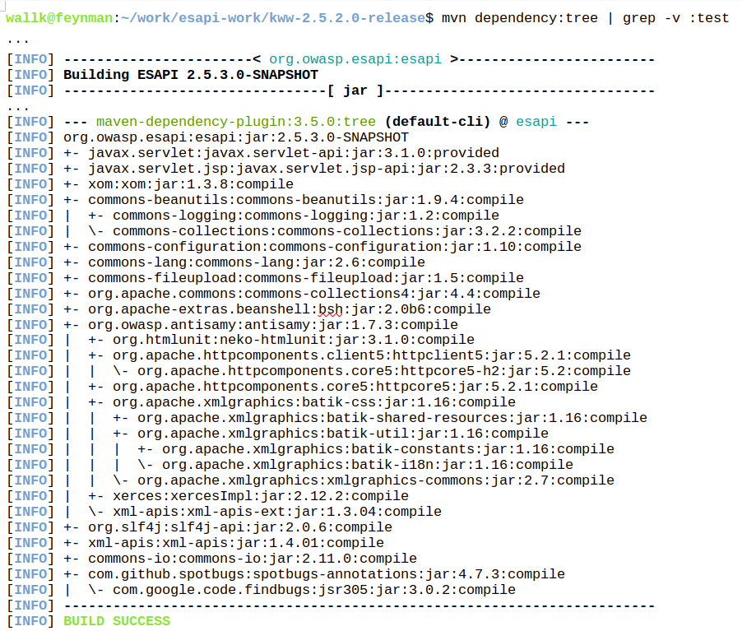
Example – Analyzing CVE-2023-24998 in ESAPI (1/2)
Notes:
General steps involved are:
Identify library / version currently in use and download its source.
If library is direct dependency, done. Otherwise, work your way up the transitive dependency tree to your application code and download source code of appropriate dependency version for each.
Start recursively grepping for affected methods or classes in library associated with CVE of interest.
Don’t forget to check configuration files for reflection use.
Beware interfaces and subclasses!
Recursively grep next library level up for all previous results (methods and/or classes).
Continue process until arriving at your application or library.
Starting at your application or library, draw a reachability tree to trace possible exploitable paths.
Do deep dive of all possible paths to see if any exploitable ones exist.
If exploitable path(s) exist, write up analysis notes.

Slide 14
Example – Analyzing CVE-2023-24998 in ESAPI (2/2)
😐- Oh bother. (Snyk tells me I need to upgrade FileUpload jar.)
😃- Woohoo! ESAPI doesn’t call FileUploadBase.
🤨- Really? FileUploadBase is an abstract base class? Couldn’t you enumerate all the affected classes instead of making me look?
😡- Wait? It’s not enough to just upgrade? Grrr.
🤬- [After analyzing their fix] What, this doesn’t fix the DoS, it just makes it slightly harder to exploit. F-bombs ensue.
Rather than limiting # of files uploaded per HTTP session, they just limited the maximum # uploaded per HTTP request.
Notes:
My descent from blessed to cursed, in 5 steps. [Read steps; pause at #3 to note below.]
Step 3: Remember where I mentioned “Beware interfaces and subclasses” on the previous slide? Yeah, that could have bit me here, but writing up Security Bulletin #11 for ESAPI required a much deeper analysis. I usually write those up even if ESAPI is not affected to describe workarounds to suppress the blaring SCA alarms.
However, as it turned out in this case, ESAPI was calling Apache Commons FileUpload’s ServletFileUpload class which extends their FileUpload class which in turn extends that abstract class FileUploadBase. So ESAPI was affected.

Slide 15
Combating the SCA Noise: Prevent your SBOMs from Becoming F-bombs
Noise in the small – the individual project’s perspective.
For libraries, may require more than just updating to some version.
Difficult to squeeze into a 2-week sprint without dropping something else.
Noise in the large (enterprise level squawking) – the blue team’s perspective.
See a backlog of possibly thousands of unpatched libraries or products.
We need to do better! What will that require?
Notes:
For direct dependencies at least, developers can usually easily figure out if their application is vulnerable, but even when it’s not, InfoSec still tells them that the “must patch” regardless (unless, perhaps patch is only in the next ‘major’ version). But this analysis is much harder for transitive dependencies and patching is potentially riskier. Could break things, (What’s percentage code coverage in your regression tests???)
From your blue team’s PoV, the best way to make the problem disappear to to force patching of everything and this is often expected in cadence with their normal OS patching or product release.
OS vulnerability patching is more mature and centralized.
By comparison, regular vulnerability patching application dependencies is only a decade old at best (or since Dec, 2019 for those who waited for the Log4Shell debacle to react).

Slide 16
Gaps in SCA Tools
Credibility gap: “The sky is falling”. Sowing FUD.
Overwhelmed with false positives.
Most from transitive dependencies, so very little control.
Most have their privately researched vulnerabilities they report as well.
The false negative gap from partial remediation.
Can happen when a patch that is not “secure-by-default” is applied.
Notes:
I personally find the private vulnerability databases of the SCA vendor tools an anathema It’s like they are using that as a competitive advantage to the disadvantage of their customers and ultimately, the whole FOSS user community.
There is little to no transparency regarding the details. Specifically, there is no way to vet their research.
There’s reason to believe that the major SCA tool vendors have a large commonality across their private vulnerability DBs, but there are also likely lots of differences. Do they think we are going to license an SCA tool from each vendor?
A least one of them also reports retracted CVEs. Ran across one of those that the CNA retracted from AntiSamy but was still in a private vulnerability DB.
On the plus side, both Snyk and Sonatype’s NexusIQ are starting to provide experimental “reachability” metrics to help rule out false positives. Perhaps others are as well.

Slide 17
Example of False Negative in SCA Tools: CVE-2023-24998
From https://nvd.nist.gov/vuln/detail/CVE-2023-24998
Current Description: Apache Commons FileUpload before 1.5 does not limit the number of request parts to be processed resulting in the possibility of an attacker triggering a DoS with a malicious upload or series of uploads. Note that, like all of the file upload limits, the new configuration option (FileUploadBase#setFileCountMax) is not enabled by default and must be explicitly configured.
Base Score: 7.5 HIGH
Vector: CVSS:3.1/AV:N/AC:L/PR:N/UI:N/S:U/C:N/I:N/A:H
Notes:
This CVE, by the way, was the source of all of my F-bombs! There are several issues with it.
For those of you in the back of the room, let me read the NVD Description of this CVE. Listen to it and see if you recognize the problem.
I’ll give you a few seconds to ponder it. I’m sure if your looked at it long enough, it would jump out at you.
So as a developer, my first problem is that the FileUploadBase class that it refers to is an abstract base class, so if you grep your code to see if you are affected, are not going to find it. That was the cause of my first expletive. C’mon Apache: Help a fellow developer out. Show me all of the potentially affected concrete classes in your CVE description.

Slide 18
Example of False Negative in SCA Tools: Highlighted CVE-2023-24998
From https://nvd.nist.gov/vuln/detail/CVE-2023-24998
Current Description: Apache Commons FileUpload before 1.5 does not limit the number of request parts to be processed resulting in the possibility of an attacker triggering a DoS with a malicious upload or series of uploads. Note that, like all of the file upload limits, the new configuration option (FileUploadBase#setFileCountMax) is not enabled by default and must be explicitly configured.
Base Score: 7.5 HIGH
Vector: CVSS:3.1/AV:N/AC:L/PR:N/UI:N/S:U/C:N/I:N/A:H
Notes:
Look closer at the highlighted area. (Read again, out loud.)
This patch is NOT secure by default. What does that mean exactly?
Well suppose you are using something like Dependabot or Renovate or Snyk to watch for vulnerabilities in unpatched dependencies in your applications and you have it create PRs for your repo to update to the patched version. You merge the patch (possibly automatically if your workflows all pass). But you are STILL VULNERABLE because these tools will not add a call to setFileCountMax() at appropriate places in your code.
Furthermore, the SCA tools only are looking at dependencies from your pom.xml or build.gradle, etc. They have no clue that anything else needs to be done. They are assuming patching makes it secure by default!

Slide 19
Suggestions and Takeaways: What Can We Do As Developers?
Lazy vs. diligent approaches.
Take pride in doing things right.
Be precise in your CVE descriptions.
Include all the affected classes, not just the base-level (i.e., super) classes.
Remediation should be secure-by-default.
If not possible because of backwards compatibility issues, then at least try to show a very prominent notice and/or provide a test for developers to confirm they’ve remediated it correctly.
Breaks OS level patching of libraries if not secure-by-default.
Partner with an AppSec engineer or security researcher.
Notes:
If you are a developer of a security library and you aren’t responsive to patching vulnerabilities in your own library, then stop calling yourself a security library.
Also, if you are a security library or a library in the (say) top 10k libraries, you need to keep your library updated even if it is not exploitable.
If this is not possible, you need to provide a detailed security bulletin to explain the situation.
Looking at you OpenSAML. In top 2200 in MvnRepo, but last release (2.6.4) was in 2015 and still uses ESAPI 2.0.1, which was released on 7/25/2011! 2.0.1 wasn’t even the newest release in 2015.
The next two slides use ESAPI as an example to show what I think is an indication of how badly we are failing to drive home this point. (Of course, ESAPI could just be an anomaly.)

Slide 20
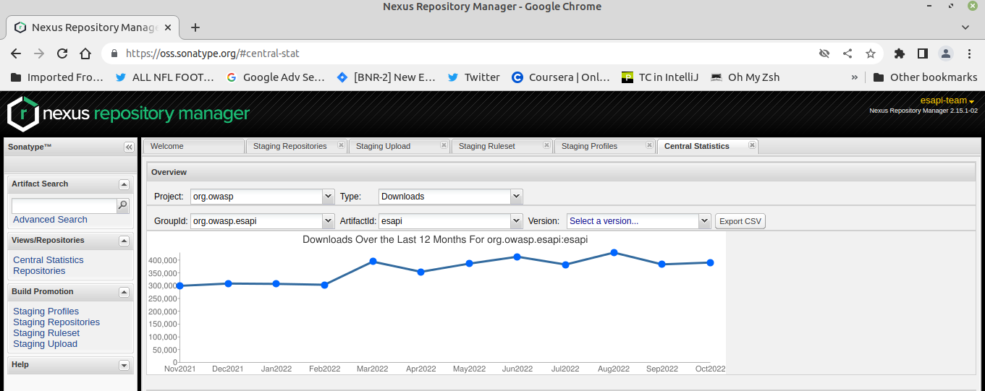
Evidence That Many Are Not Patching (1/2)
Notes:
This is a screenshot from Maven Central made on 11/27/2022, the date I released ESAPI version 2.5.1.0. It shows the historical downloads of all the ESAPI versions for a 12 month period, from Nov 2021 through Oct 2022. Note at this point, the previous version, 2.5.0.0, was just over 4 months old.
The next slide is the bottom part of this same screenshot and it shows a breakdown by versions of (new) downloads), but only for the previous month (Oct 2022).
We could fix this problem if we were just allowed to delete old versions from these code repositories, but Maven Central does not allow that, so there is no way to prevent Maven, Gradle, Ivy and other tools that work with Central to prevent them using old pinned versions. Maybe those tools could scream warnings for direct dependencies at least that you are using an old version the first time you download it, but that is not the default behavior. They “all download artifacts from a release repository once. They don't come back to a release repository and check for a newer version.” All later retrievals are from your local cache. [Reference 2]

Slide 21
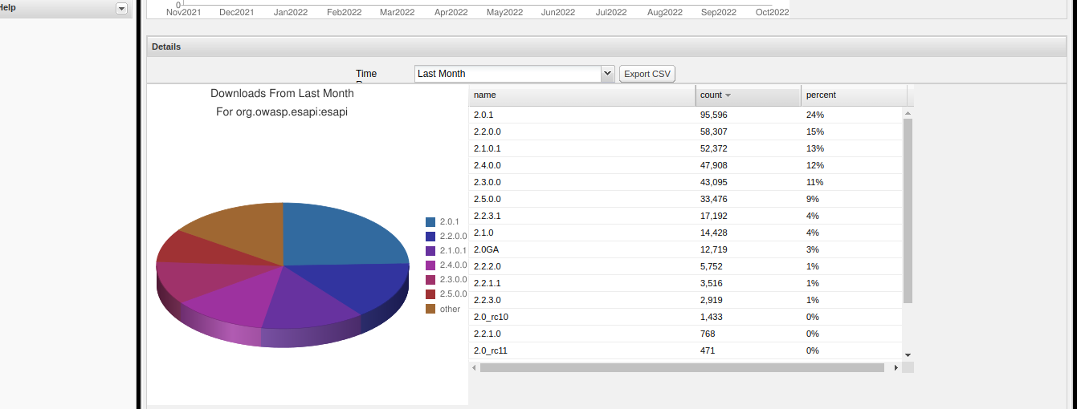
Evidence That Many Are Not Patching (2/2)
Notes:
For Oct 2022: This is a snapshot just after 2.5.1.0 was released, but 2.5.0.0 was released 4 full months earlier and it only amounts to 9% of the downloads. But contrast, the 2.0.1 version was released in 7/2011 and accounts for 24% of the downloads and the 2.2.0.0 release was released in 6/2019 and was 15%!
Moral: If you use another library, then try to use the most recent library.
If you develop a library that others use, do NOT just abandon it.
Try to find someone else to take it over.
Try to set up with Dependabot or Snyk, etc. to create PRs and get someone to approve them and merge them and periodically do a release.
If you can no longer support a project, then ARCHIVE the damned project so that others know that it is abandoned and new projects don’t start using it.

Slide 22
AppSec Engineer Perspective
Take responsibility.
Less hype: Help the community first, not yourself.
Help developers who need to remediate; don’t worry about divulging information to attackers.
Eat our own dog food – Don’t treat vulnerabilities in your software differently.
Suggest workarounds (e.g., when is it safe to exclude a transitive dependency, is there some data validation I can perform that might make some function call safe, etc.?).
Notes:
There are too many of AppSec wannabes who want to get a name for themselves. They discover a vulnerability, and then provide little to no details on how to reproduce the problem. They cause “noise” in the system.
I realize that many pen testers don’t know how to code in some particular language X, but if you don’t, help the dev team to write up a GitHub issue, possibly a CVE description, provide workarounds, and ideally, create a PR for them to remediate the issue.
Realize doing the right thing is mostly a thankless job. (If you know that, you won’t be disappointed when you don’t get it.)
Maybe we need a “helpfulness” reputation system for AppSec people. IDK.

Slide 23
Aside: Possible Alternatives to CVSS Base Scores
Consider including Temporal and Environmental components to CVSS rather than only relying on Base scores.
Likely need help from SCA tool vendors to support this.
CISA’s Known Exploited Vulnerabilities (KEV) - https://www.cisa.gov/known-exploited-vulnerabilities
FIRST’s Exploit Prediction Scoring System (EPSS) - https://www.first.org/epss/
Notes:
CISA is the US government’s Cybersecurity & Infrastructure Security Agency.
Designed to help prioritize remediation efforts.
Criteria: An assigned CVE ID & active exploitation.
Active exploitation: “reliable evidence that execution of malicious code was performed by an actor on a system without permission of the system owner”.
981 entries as of August 6, 2023, most against standalone executables software; a minority are libraries.
FIRST is Forum of Incident Response and Security Teams. It is the organization that came up with CVSS.
Even if SCA tools didn’t want to abandon use of CVSS entirely, they could augment their threat priorities with one of these. Just a thought.

Slide 24
Suggestions and Takeaways: What Can We Do As DevOps / DevSecOps?
Incorporate your SCA scans into your CI/CD pipelines.
Especially important for QA environment as you need the heads up.
Consider dynamic SCA scans to focus on the loaded / used libraries.
If CVE is not in CISA’s KEV Catalog, consider weighting CVSS scores from NVD.
Weight 1st level (direct) dependencies the most, then 2nd level transitive dependencies, the 3rd level transitive dependencies, etc., OR
Consider something like Exploit Prediction Scoring System (EPSS).
Stop blocking releases that only patch some known vulnerabilities.
Alternative is no patches at all.
Notes:
I realize that the problem with some of these suggestions is that they might require intensive manual effort unless your SCA tool vendor steps up and adds some type of “reachability analysis”; however, that needs to be weighed against the effort you are forcing on all your development teams to needlessly patch and re-run their regression tests and hope that patching some transitive dependency is not going to break something. (In other words, stop locally optimizing what is best for your production engineering, security, and operations team and consider the impact vs effort from a more holistic perspective.)

Slide 25
Suggestions and Takeaways: What Can We Do As SCA Tool Providers?
Stop using your private DB vulnerabilities that have not been publicly and externally vetted unless you only wish to consider them Informational.
Is your goal to make sales or help secure the world? FUD does not help secure the world.
When NVD reports a vulnerability as “withdrawn by the CNA” stop reporting it! NVD and the issuing CNA have more context than you. If you insist on still reporting it, do so with appropriate notice or mark it as Informational.
Notes:
Don’t worry OWASP, I’m not going to call out any specific vendors. After all, some of them may be our sponsors. :)
If you do want to include findings from your private vulnerability databases, include things like commit IDs or PRs or git diffs where these claims can be substantiated and stop hyping the severity of the risk. The who CVSS system already does that, so please don’t make it worse.
If your SCA product doesn’t already include “reachability analysis” (which requires you to look at source code usage, not just dependency trees), than seriously consider adding it. Even better, develop runtime SCA monitoring!
Consider issuing warnings for patched libraries that are not secure-by-default. (Admittedly, this is tough w/out NVD’s help.)

Slide 26
Suggestions and Takeaways: What Can NIST and CNAs Do?
Distinguish between end products vs reusable components.
Libraries need an alternative to CVSS scoring, or consider a multiple values (average vs worst case scenarios). Come up with something!
NIST should provide justification when overriding CNA recommendations.
Consider weighting CISA’s Known Exploited Vulnerabilities (KEV) Catalog as an aspect of severity scoring.
Scores would automatically adjust over time. Could even go down.
Insist on precise descriptions of the attack surface in the Details section.
Ideally, standardized machine parsable (e.g., XML or JSON) format.
Must mention all affected functions, methods, and/or classes. Be specific!
Special treatment of patches that are not secure-by-default (for the given CVE).
Notes:
Last bullet:
When the patch is not secure-by-default, then If the actual vulnerability is in (say) some super class or an abstract class, then all CTORs and/or inherited methods for all subclasses should be required to be mentioned as well.
If the patch is secure-by-default, while that is a “nice to have”, it is not as critical.
RECOMMENDATION: If a patch to a CVE is not secure-by-default, consider requiring a separate, prominent section (that can be checked via your API calls) where the additional instructions must be placed to describe what must be done to make it secure.

Slide 27
References
Jeff Williams; “What about Transitive Dependencies?” LinkedIn post (2023-07-27) - https://www.linkedin.com/posts/planetlevel_what-about-transitive-dependencies-i-hear-activity-7090447433146515456-n4GW
Question “Can I change a component on Central?”, https://web.archive.org/web/20201112013316/https://central.sonatype.org/articles/2014/Feb/06/can-i-change-a-component-on-central/ (posted 2014-02-06, retrieved 2023-09-02).
GitHub Security Advisory: DoS vulnerabilities persist in ESAPI file uploads despite remediation of CVE-2023-24998, https://github.com/ESAPI/esapi-java-legacy/security/advisories/GHSA-7c2q-5qmr-v76q
Notes:
This only includes references that I didn’t already provide links for in the main part of the talk.

Slide 28
Questions?
Ask me now, or drop me an email at kevin.w.wall@gmail.com
Or, if you don’t mind waiting a bit, DM me as @KevinWWall on OWASP Slack or Twitter (although the latter may take a while).
NOTE: Slide deck, with speaker’s notes, available at:
https://github.com/kwwall/presentations/tree/master/SBOMs_to_F-Bombs
Notes:
I rarely go to Twitter any more. Maybe only once a month, So use that only if you don’t mind waiting for an answer.
So, questions?

