Slide 1

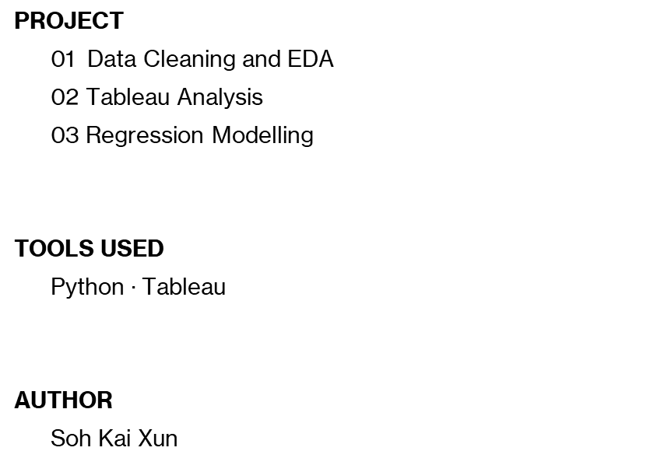
House Price Analytics
Research Question: Which features influence house sale prices the most?
PROJECT
01 Data Cleaning and EDA
02 Tableau Analysis
03 Regression Modelling
TOOLS USED
Python $∙$ Tableau
AUTHOR
Soh Kai Xun

Slide 2
Dataset & Data Preparation
Dataset Information
Data Preparation
Source: House Prices Advanced Regression Techniques (Ames Housing Dataset) from Kaggle
Size (after cleaning): 1456 rows, 106 columns
Target variable: Sale Price
Number of houses analysed: 1456
Average sale price: $180.2k
Median sale price: $163.0k
Duplicated values: 0
Total missing values before cleaning: 7829
Total missing values after cleaning: 0
Outliers removed (GrLivArea > 4000): 4
Ordinal columns numerically encoded: 10
Total data inconsistencies found: 4
Note: Data imputation was applied on 259 missing values for LotFrontage, 8 in MasVnrArea and 1 in Electrical. The remaining missing values were identified as structural missingness and were imputed correspondingly.
Data inconsistencies were addressed where appropriate, while certain inconsistencies were retained where correction was not deemed necessary alone (Further details are provided in the data_cleaning_report.docx)

Slide 3
Project Objective
Objective: To identify property characteristics and key factors affecting property prices, to provide actionable insights for prospective buyers to make informed purchasing decisions.
Connecting the Dots:
What drive sale price?
How does location matter?
How do size and house age associate with quality?

Slide 4
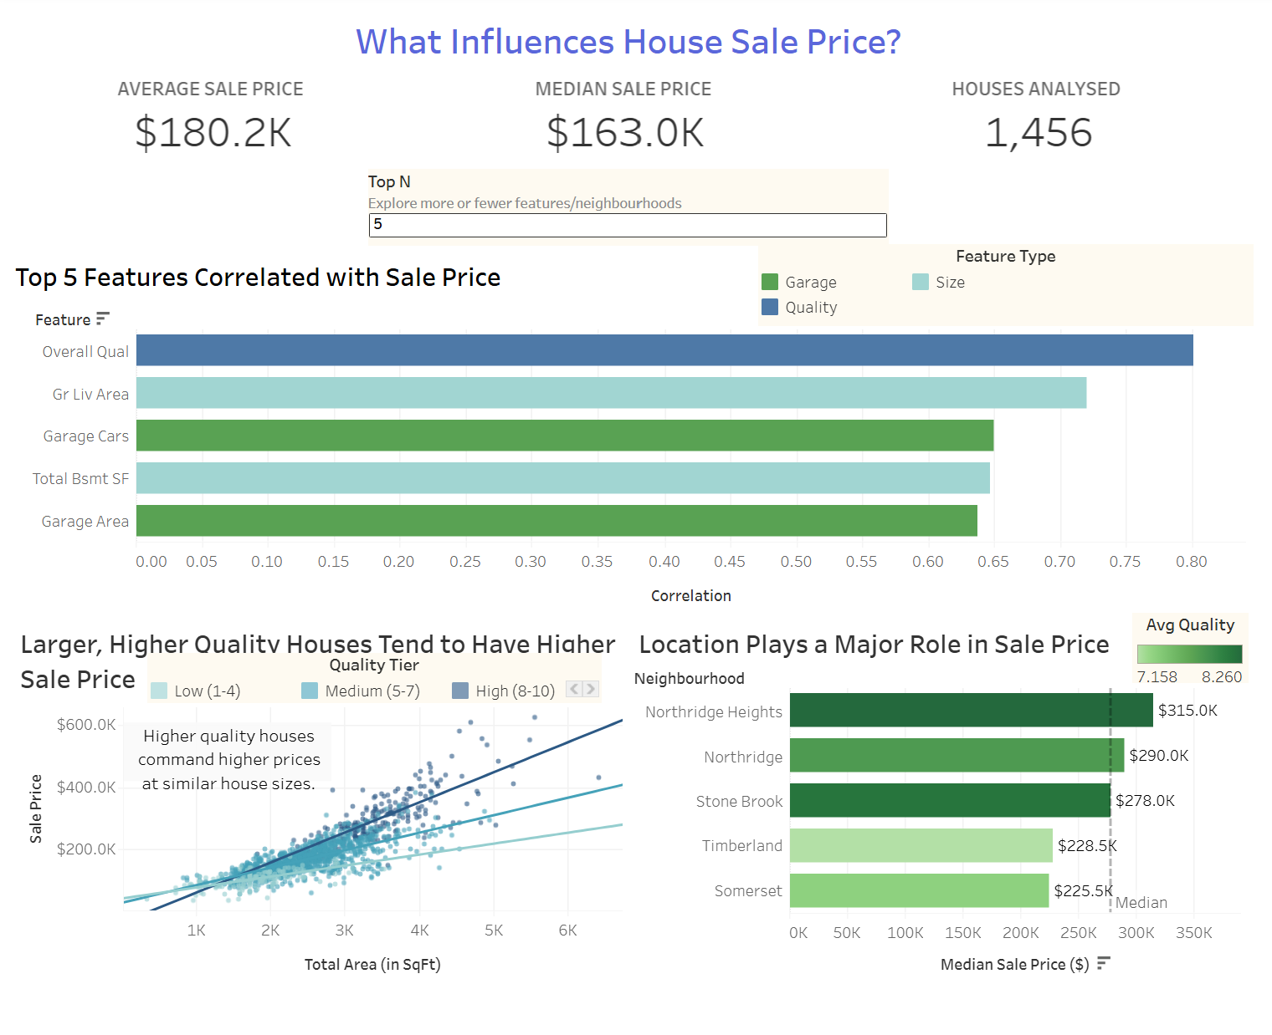
Dashboard 1
Quality and location matter more than size
_______________________
Overall quality is the top price driver, having the strongest correlation than any size metric.
Within the top 5 neighbourhoods, Northridge Heights sells for ~40% more than Somerset, while selling 13% more than Stone Brook despite having a similar average quality.
House size still matters, but quality influences price at any given size

Slide 5
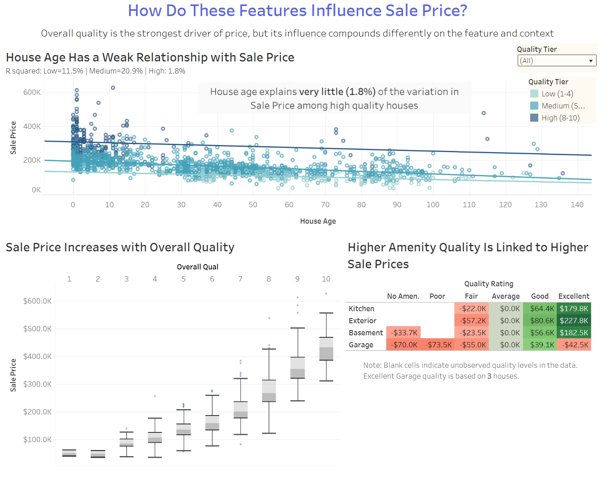
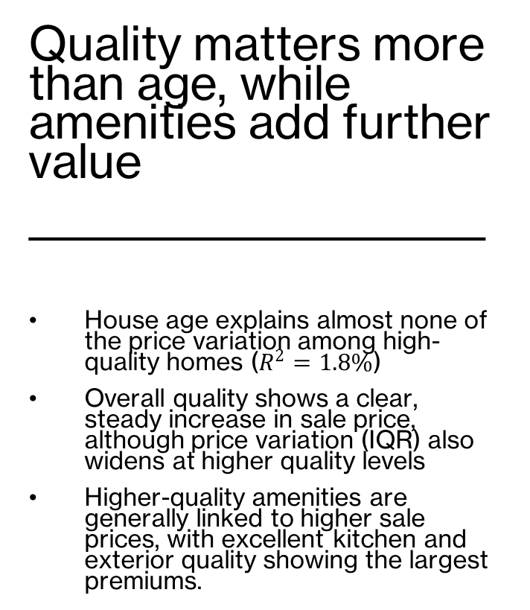
Dashboard 2
Quality matters more than age, while amenities add further value
_______________________
House age explains almost none of the price variation among high-quality homes ($R^{2}=1.8\%$)
Overall quality shows a clear, steady increase in sale price, although price variation (IQR) also widens at higher quality levels
Higher-quality amenities are generally linked to higher sale prices, with excellent kitchen and exterior quality showing the largest premiums.

Slide 6
Housing Price Storyboard
1
2
3
4
What makes a house valuable?
Quality is the strongest price driver
Location matters too
No single factor explains price.
It’s a combo

Slide 7
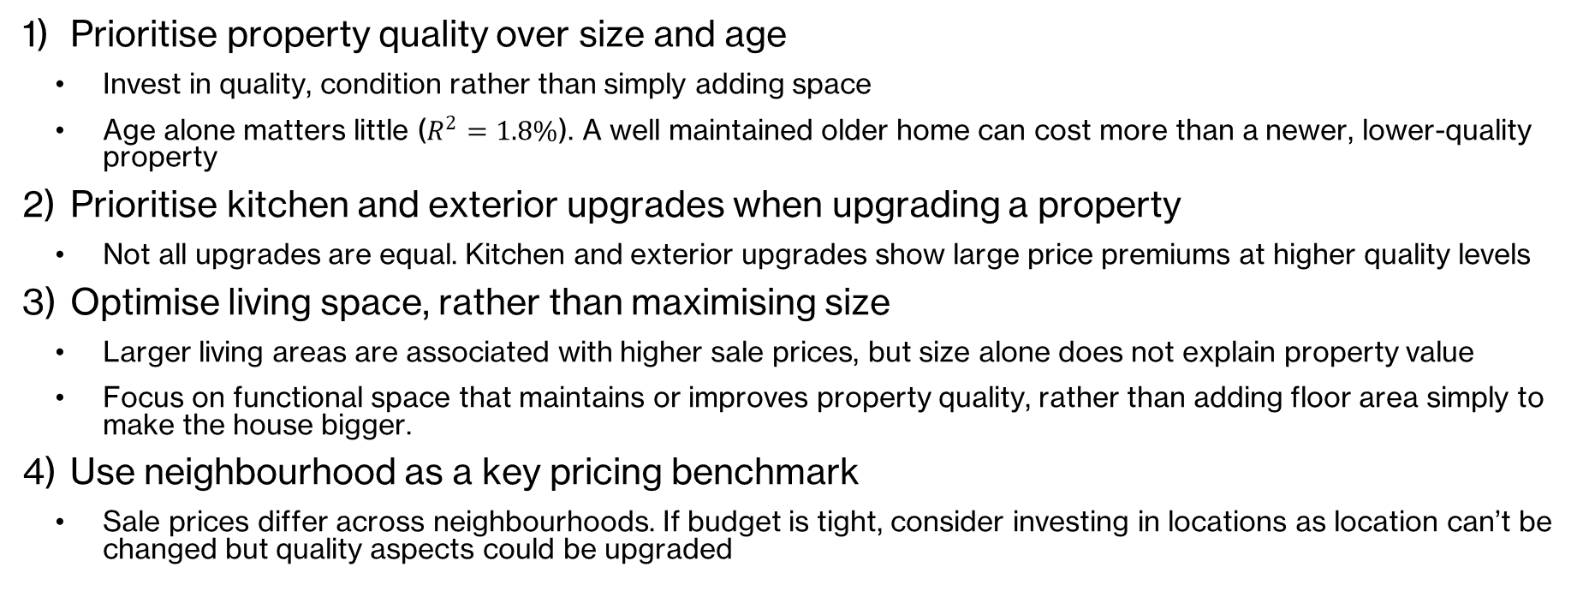
Recommendations
Prioritise property quality over size and age
  Invest in quality, condition rather than simply adding space
  Age alone matters little ($R^{2}=1.8\%$). A well maintained older home can cost more than a newer, lower-quality property
Prioritise kitchen and exterior upgrades when upgrading a property
  Not all upgrades are equal. Kitchen and exterior upgrades show large price premiums at higher quality levels
Optimise living space, rather than maximising size
  Larger living areas are associated with higher sale prices, but size alone does not explain property value
  Focus on functional space that maintains or improves property quality, rather than adding floor area simply to make the house bigger.
Use neighbourhood as a key pricing benchmark
  Sale prices differ across neighbourhoods. If budget is tight, consider investing in locations as location can’t be changed but quality aspects could be upgraded

Slide 8
Data Split & Evaluation Strategy
Train Data
Train models with 5 Fold CV
Tune Hyperparameters with 5 Fold CV
Select Best Hyperparameters
80%
Original
Dataset
Retrain Best Model
20%
Test Data
Final Test Evaluation (once only)

Slide 9
Data Cleaning & Preprocessing
Missing Value Imputation
Categorical Encoding
Imputation statistics were calculated from the training data only to prevent data leakage
The same values were then applied to both training and test data.
  LotFrontage: Neighbourhood median; overall median as fallback (Properties within the same neighbourhood have similar lot configurations
  MasVnrArea: Overall Median
  Electrical: Mode (most frequent category)
One-hot encoding: All nominal variables except Exterior1st, Exterior2nd, and Neighborhood
Target encoding: Exterior1st, Exterior2nd, and Neighborhood due to their high cardinality
Out-of -Fold (OOF) encoding: K-fold target encoding was used to prevent target leakage by ensuring each training observation was encoded without using its own target value.

Slide 10
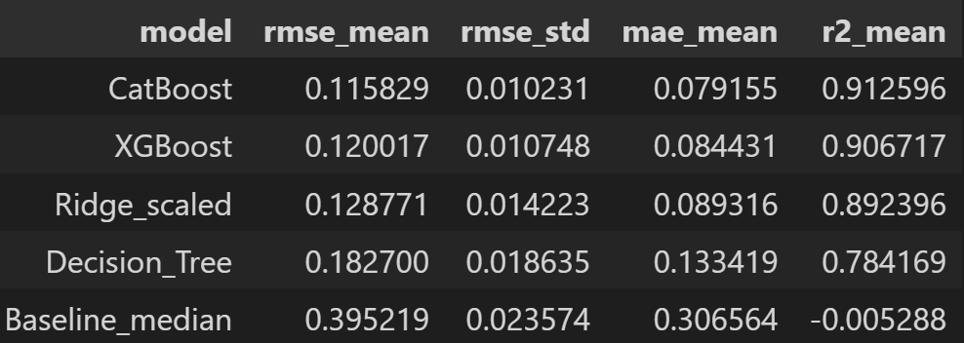
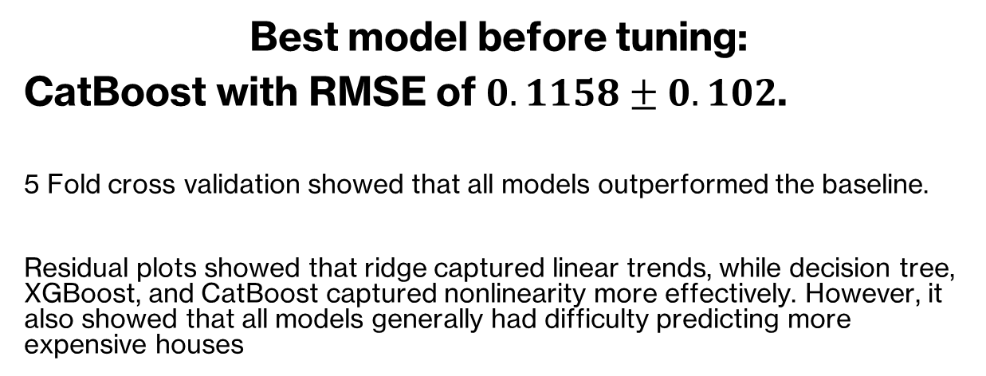
Model Training
Decision Tree
Ridge regression
XGBoost
CatBoost
Best model before tuning:
CatBoost with RMSE of $0.1158±0.102$.
5 Fold cross validation showed that all models outperformed the baseline.
Residual plots showed that ridge captured linear trends, while decision tree, XGBoost, and CatBoost captured nonlinearity more effectively. However, it also showed that all models generally had difficulty predicting more expensive houses

Slide 11
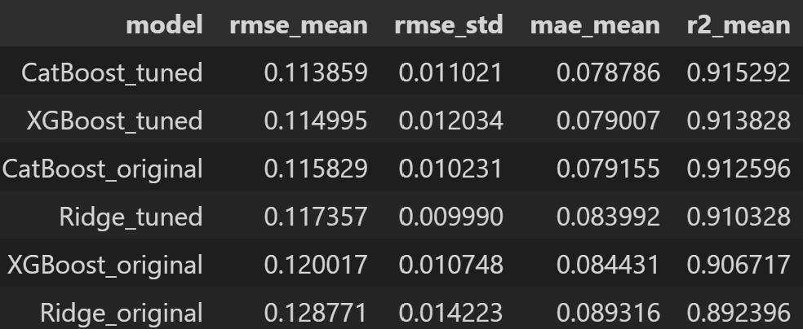
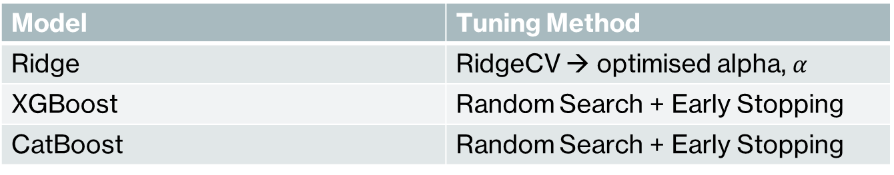
Hyperparameter Tuning
TUNING APPROACH
Model | Tuning Method
Ridge | RidgeCV → optimised alpha, $α$
XGBoost | Random Search + Early Stopping
CatBoost | Random Search + Early Stopping
Note: 5 Fold CV was used to evaluate configurations.
MODEL PERFORMANCE
WINNER:
CatBoost

Slide 12
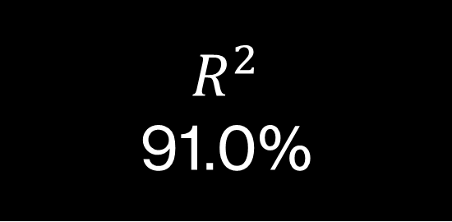
Final Model Performance
Tuned CatBoost
RMSE
$19558.28
MAE
$13578.08
$$R^{2}$$
91.0%
RMSE (log)
0.1194

Slide 13
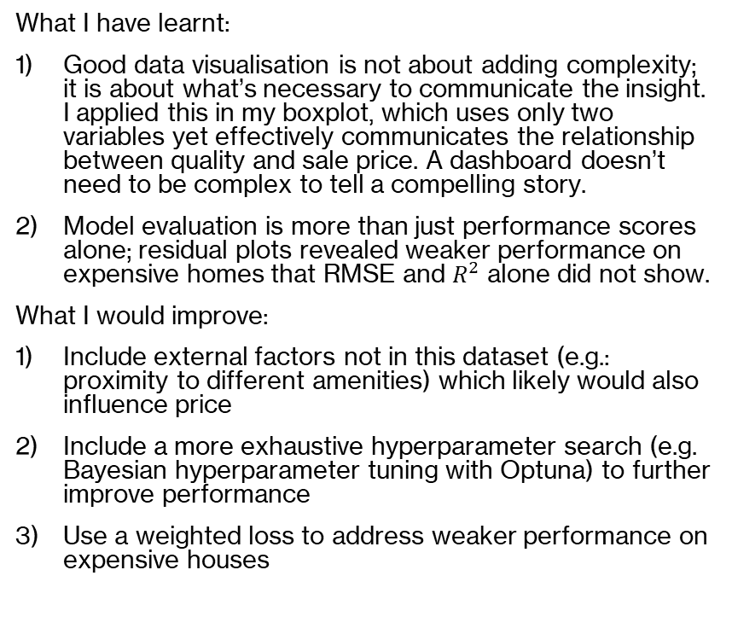
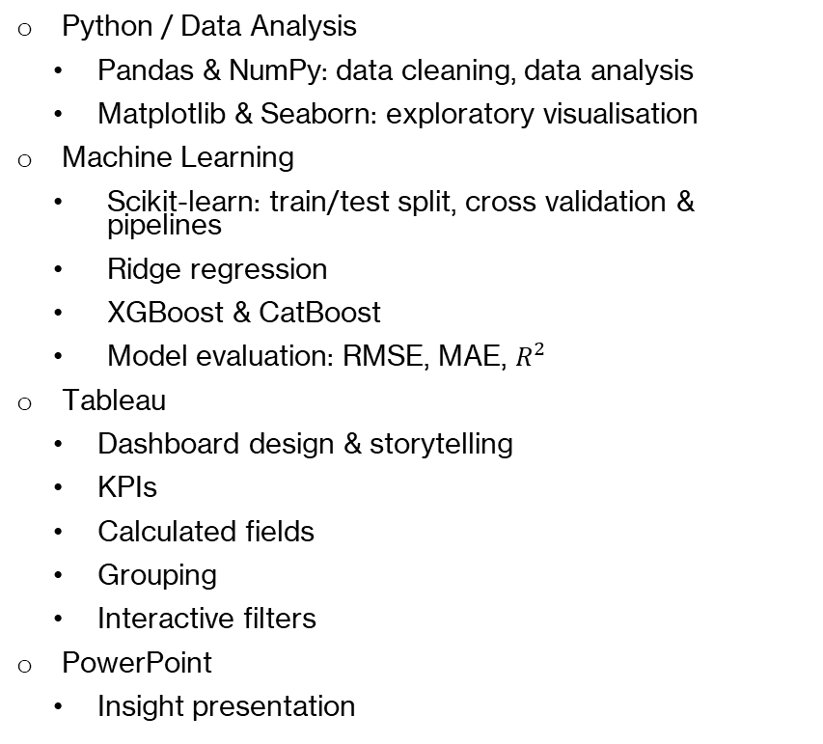
Tools Used & Reflection
Tools & Techniques
Reflection
Python / Data Analysis
  Pandas & NumPy: data cleaning, data analysis
  Matplotlib & Seaborn: exploratory visualisation
Machine Learning
  Scikit-learn: train/test split, cross validation & pipelines
  Ridge regression
  XGBoost & CatBoost
  Model evaluation: RMSE, MAE, $R^{2}$
Tableau
  Dashboard design & storytelling
  KPIs
  Calculated fields
  Grouping
  Interactive filters
PowerPoint
  Insight presentation
What I have learnt:
Good data visualisation is not about adding complexity; it is about what’s necessary to communicate the insight. I applied this in my boxplot, which uses only two variables yet effectively communicates the relationship between quality and sale price. A dashboard doesn’t need to be complex to tell a compelling story.
Model evaluation is more than just performance scores alone; residual plots revealed weaker performance on expensive homes that RMSE and $R^{2}$ alone did not show.
What I would improve:
Include external factors not in this dataset (e.g.: proximity to different amenities) which likely would also influence price
Include a more exhaustive hyperparameter search (e.g. Bayesian hyperparameter tuning with Optuna) to further improve performance
Use a weighted loss to address weaker performance on expensive houses

