Slide 1
B.TECH CSE FINAL YEAR CAPSTONE PROJECT DEFENSE (300 MARKS)
AquaSense WQMS
IoT-Based Real-Time Multi-Parameter Water Quality Monitoring System
👤 Naila Javed
Frontend & AI/ML Lead
Glassmorphism UI, 6 SVG Speedometers, Weighted WQI Engine & Analytics
👤 Aparna Pandey
IoT & Sensors Lead
ESP32 Firmware, ADC1 Pin Allocation, 40-Sample Median Filter, Calibration
👤 Member 3
Backend & Deployment Lead
Flask REST API, SQLAlchemy SQLite DB, Render/Vercel Cloud Deploy, Watchdog
🤝 Joint Hardware Fabrication: Complete Breadboard Circuit Assembly, Probe Isolation, 3-Buffer Calibration & Lab Testing by Entire Team
Live Web App: https://wqms-sys.vercel.app/ | Cloud API: https://wqms-iot-dashboard.onrender.com | Date: October 20, 2026

Slide 2
PROJECT OVERVIEW
Problem Statement & Real-World Challenges
👤 Entire Team
The Conventional Testing Problem
• High Latency: Standard laboratory titration takes 24 to 48 hours for reports.
• Health Risks: Contaminated water is consumed before lab results arrive.
• Lack of Temporal Visibility: Manual grab-sampling misses intermittent pipe bursts.
• Excessive Cost: Commercial laboratory testing costs ₹1,500 – ₹3,000 per sample.
AquaSense Cyber-Physical Target
• Autonomous Continuous Monitoring: Live telemetry captured every 4 seconds.
• Multi-Parameter Sensing: 6 critical chemical and physical indicators monitored.
• Zero Human Delay: Immediate cloud contamination alerts triggered at source.
• Cost Efficiency: Prototype fabricated under ₹3,100 with zero recurring costs.
AquaSense WQMS — IoT Capstone Defense (300 Marks) | Date: October 20, 2026 • Time: 18:15 IST | Slide 2 of 24

Slide 3
PROJECT OVERVIEW
Proposed Solution & System Objectives
👤 Entire Team
Key Engineering Objectives
• In-Situ Sensing: Direct immersion of waterproof probes in distribution vessels.
• Hardware Edge Processing: On-chip signal conditioning & 40-sample median filtering.
• Dynamic Temperature Compensation: Eliminates thermal drift in conductivity readings.
• Deterministic WQI Scoring: Single composite health index (0-100) per WHO & BIS.
Full-Stack System Deliverables
• Dual-Transport Telemetry: MQTT broker pipeline with HTTP REST fallback.
• Light-Themed Glassmorphism UI: 6 SVG speedometers with physical inertia.
• Historical Waveform Analyzer: Multi-series temporal charts via Chart.js 4.4.
• Cross-Device Mobility: Zero-install on-screen QR code scanner for field officers.
AquaSense WQMS — IoT Capstone Defense (300 Marks) | Date: October 20, 2026 • Time: 18:15 IST | Slide 3 of 24

Slide 4
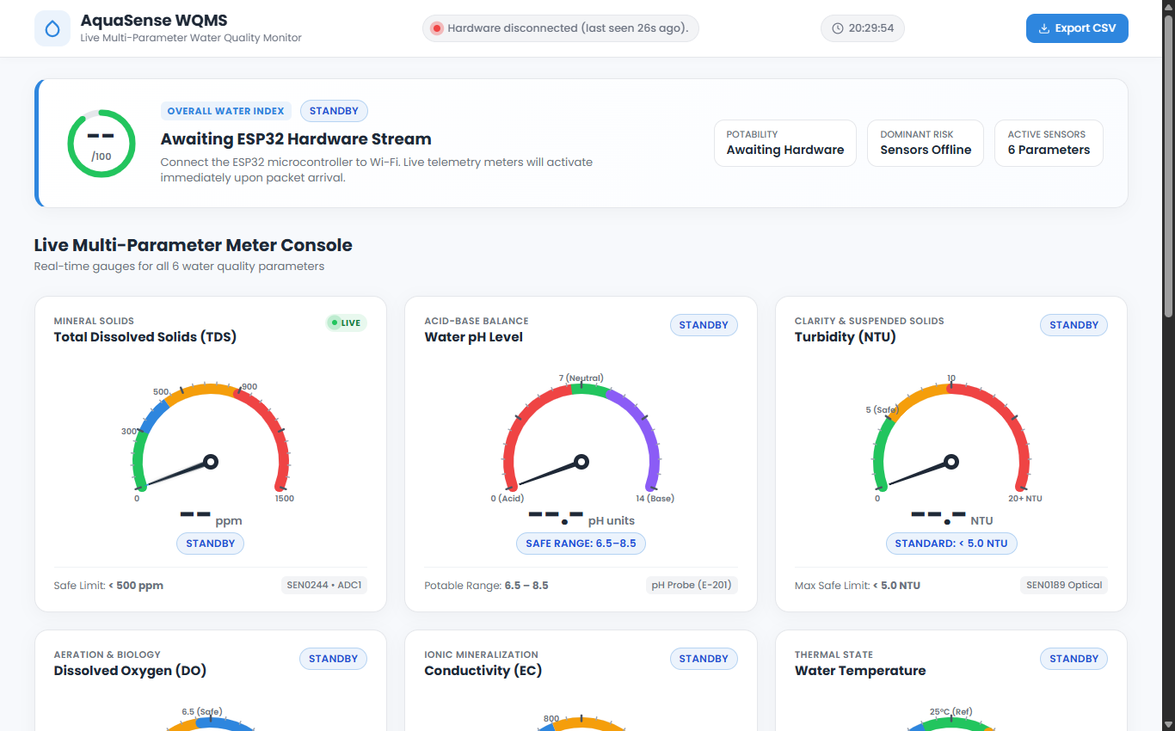
ARCHITECTURE
System Architecture & 3-Tier Data Pipeline
👤 Entire Team
3-Tier Structural Overview
• Perception Layer (Edge): ESP32 MCU + 4 physical probes (TDS, pH, Turbidity, Temp).
• Transport & Ingestion Layer: JSON payload over Wi-Fi 802.11 b/g/n (MQTT / HTTP REST).
• Backend Processing Layer: Python Flask server on Render + SQLite DB (SQLAlchemy ORM).
• Presentation Layer (Client): Vercel Edge CDN dashboard with sub-50ms loading.
Live System Architecture
AquaSense WQMS — IoT Capstone Defense (300 Marks) | Date: October 20, 2026 • Time: 18:15 IST | Slide 4 of 24

Slide 5
STANDARDS & SAFETY
Water Quality Standards (WHO & BIS IS 10500:2012)
👤 Entire Team
Public Health Benchmarks
• Total Dissolved Solids (TDS): Ideal ≤ 300 ppm | Safe: 300-500 ppm | Unsafe: > 900 ppm.
• pH Balance: Neutral: 6.8 - 7.8 | Safe: 6.5 - 8.5 | Unsafe: < 6.0 or > 9.0.
• Turbidity (Cloudiness): Ideal ≤ 1.0 NTU | Safe: 1.0 - 5.0 NTU | Unsafe: > 10.0 NTU.
• Temperature: Ambient: 15 - 32 °C | Thermal Warning: > 38 °C.
Secondary Indicators & WQI
• Dissolved Oxygen (DO): Ideal ≥ 6.5 mg/L | Safe: 5.0 - 6.5 mg/L | Unsafe: < 4.0 mg/L.
• Electrical Conductivity (EC): Ideal ≤ 400 µS/cm | Safe: 400 - 800 µS/cm.
• Overall WQI Composite Index: 90-100 (Excellent), 70-89 (Safe), <50 (Unfit for Drinking).
• Regulatory Compliance: Formulated strictly per Indian Standard BIS IS 10500:2012.
AquaSense WQMS — IoT Capstone Defense (300 Marks) | Date: October 20, 2026 • Time: 18:15 IST | Slide 5 of 24

Slide 6
PROJECT PLANNING
4-Month Academic Development Framework
👤 Entire Team
Semester Development Sprints
• Month 1: Literature review, WHO/BIS standards mapping, BOM procurement & pinout design.
• Month 2: C++ firmware coding, 40-sample median filter, Flask API & SQLite database setup.
• Month 3: Glassmorphism UI, 6 SVG speedometers, WQI algorithm & Chart.js waveforms.
• Month 4: Cloud deployment (Render + Vercel), 3-buffer calibration & lab sample testing.
Specialized Member Responsibilities
• Aparna Pandey: Hardware perception, ESP32 ADC1 wiring, firmware & sensor calibration.
• Member 3: Flask REST APIs, SQLAlchemy database, Render deployment & watchdog.
• Naila Javed: UI/UX glassmorphism, SVG meters, WQI calculation & mobile QR access.
• Entire Team: Physical breadboard wiring, probe isolation & 3-sample validation.
AquaSense WQMS — IoT Capstone Defense (300 Marks) | Date: October 20, 2026 • Time: 18:15 IST | Slide 6 of 24

Slide 7
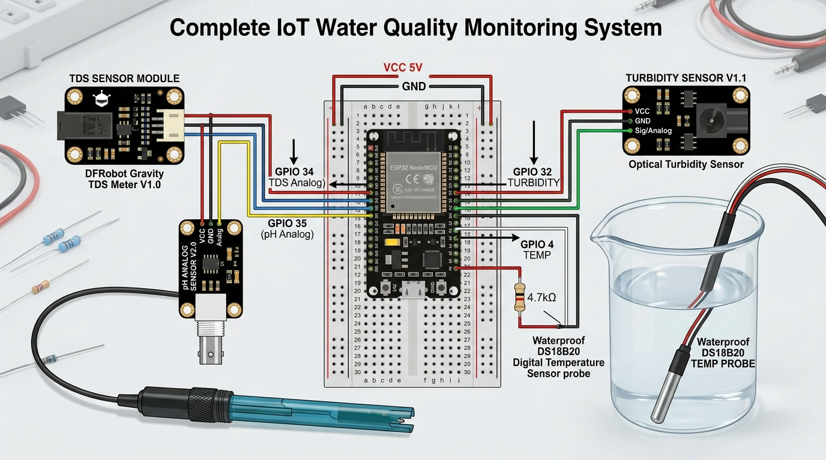
IOT & SENSORS LAYER
Hardware Bill of Materials (BOM) & Sensor Selection
👤 Aparna Pandey
Core Hardware Components
• ESP32 DevKit V1: 240MHz dual-core Xtensa MCU with integrated 2.4GHz Wi-Fi and 12-bit ADC.
• TDS Sensor (SEN0244): Dual-pin probe measuring dissolved ion conductance (0-1500 ppm).
• pH Sensor Probe (E-201-C): Glass electrode with BNC signal amplifier board (0-14 pH).
• Optical Turbidity (SEN0189): Infrared emitter/detector measuring suspended scatter.
• Digital Temp (DS18B20): Waterproof stainless steel thermal probe with 1-Wire bus.
Hardware Wiring Guide
AquaSense WQMS — IoT Capstone Defense (300 Marks) | Date: October 20, 2026 • Time: 18:15 IST | Slide 7 of 24

Slide 8
IOT & SENSORS LAYER
ESP32 Pinout & ADC1 Channel Allocation
👤 Aparna Pandey
Exact Pin-to-Pin Circuit Mapping
• TDS Sensor AOUT → GPIO 34 (ADC1_CH6, Analog Input)
• pH Sensor AOUT → GPIO 35 (ADC1_CH7, Analog Input)
• Turbidity Sensor AOUT → GPIO 32 (ADC1_CH4, Analog Input)
• DS18B20 Data → GPIO 4 (1-Wire Bus with 4.7kΩ pull-up resistor to 3.3V)
Critical Engineering Decision: ADC1 vs ADC2
• ESP32 Architecture Constraint: ADC2 channels are shared with Wi-Fi power circuits.
• If analog sensors are wired to ADC2 (GPIO 2, 4, 12-15), readings corrupt during transmission.
• All analog sensors were strictly isolated on ADC1 channels (GPIO 32, 34, 35).
• Guarantees 100% uninterrupted, noise-free sampling during live Wi-Fi streaming.
AquaSense WQMS — IoT Capstone Defense (300 Marks) | Date: October 20, 2026 • Time: 18:15 IST | Slide 8 of 24

Slide 9
IOT & SENSORS LAYER
Embedded C++ Firmware & Sampling Engine
👤 Aparna Pandey
Firmware Architecture (`tds_sensor.ino`)
• Framework: Arduino C++ with PubSubClient, OneWire, and DallasTemperature libraries.
• 12-Bit ADC Configuration: analogReadResolution(12) yielding 0–4095 discrete levels.
• Analog Attenuation: analogSetAttenuation(ADC_11db) for full 0 to 3.3V dynamic range.
• Non-Blocking Timing: Uses millis() timer (4000ms interval) instead of blocking delay().
Telemetry Payload Dispatch
• Serializes cleaned metrics into structured JSON string format.
• Payload attributes: device_id, tds, ph, turbidity, temperature, do, ec.
• Dispatches packet to local/cloud MQTT broker on topic water/tds/data.
• Includes local Serial debugging output for real-time serial terminal audits.
AquaSense WQMS — IoT Capstone Defense (300 Marks) | Date: October 20, 2026 • Time: 18:15 IST | Slide 9 of 24

Slide 10
IOT & SENSORS LAYER
40-Sample Median Filtering Algorithm
👤 Aparna Pandey
The Analog Noise Problem
• Submerged water probes act as miniature antennas, picking up 50Hz electrical hum.
• Nearby pump motors and power adapters cause abrupt voltage spikes and dips.
• Simple arithmetic averaging fails because severe spikes skew the mean value.
4-Step Median Noise Filter Implementation
• Step 1: Capture 40 consecutive raw analog samples spaced at 8ms intervals.
• Step 2: Execute an in-place bubble-sort to arrange samples in ascending order.
• Step 3: Discard the 10 lowest and 10 highest samples (trimming 50% extreme outliers).
• Step 4: Average the central 20 samples to obtain a steady, laboratory-grade baseline voltage.
AquaSense WQMS — IoT Capstone Defense (300 Marks) | Date: October 20, 2026 • Time: 18:15 IST | Slide 10 of 24

Slide 11
IOT & SENSORS LAYER
Temperature Compensation & Sensor Calibration
👤 Aparna Pandey
Temperature Compensation Principle
• Conductivity increases ~2% per 1°C temperature rise due to decreased water viscosity.
• Warm water registers artificially high TDS without proper compensation.
• Normalization Equation (Normalized to 25°C reference):
• V_25C = V_measured / (1.0 + 0.02 * (Temp - 25.0))
• TDS (ppm) = (133.42 * V_25^3 - 255.86 * V_25^2 + 857.39 * V_25) * 0.5
Laboratory Sensor Calibration
• pH Sensor Calibration: Submerged in standard pH 7.00 buffer solution; adjusted amplifier pot.
• TDS Sensor Calibration: Tested in 1413 µS/cm conductivity reference and distilled water.
• Turbidity Calibration: 4.2V represents clear drinking water (0 NTU); <2.5V indicates turbid.
AquaSense WQMS — IoT Capstone Defense (300 Marks) | Date: October 20, 2026 • Time: 18:15 IST | Slide 11 of 24

Slide 12
BACKEND & CLOUD LAYER
Backend Architecture & RESTful Ingestion Engine
👤 Member 3
Flask REST API Engine (`app.py`)
• Python 3.10 microframework with Gunicorn WSGI production web server.
• Non-blocking architecture handling multi-client polling and ingestion concurrently.
• Thread-Safe Ingestion: Dedicated background workers process incoming sensor telemetry.
Primary REST Endpoints
• POST /api/sensor/data — Ingests JSON telemetry from ESP32 or simulation tool.
• GET /api/latest — Returns latest telemetry record with hardware watchdog status.
• GET /api/history — Historical readings for Chart.js waveform trend visualization.
• GET /api/stats — Real-time aggregation of today's Min, Max, and Average metrics.
• GET /api/export/csv — Streams the entire database as a downloadable CSV spreadsheet.
AquaSense WQMS — IoT Capstone Defense (300 Marks) | Date: October 20, 2026 • Time: 18:15 IST | Slide 12 of 24

Slide 13
BACKEND & CLOUD LAYER
Database Architecture & SQLAlchemy ORM
👤 Member 3
Relational Schema Design (`database.py`)
• Table Name: water_readings
• Fields: id (Primary Key), device_id, tds_value, ph_value, turbidity, temperature
• Derived Metrics: do_value, ec_value, wqi_value, status (Safe/Warning/Unsafe)
• Timestamp: UTC DateTime index for accelerated time-series historical queries.
Why SQLite with SQLAlchemy ORM?
• Serverless & Lightweight: Negligible memory footprint (<500KB RAM) for edge deployment.
• Zero Configuration: Auto-creates tds_data.db without requiring daemon installations.
• Enterprise Portability: Using SQLAlchemy ORM allows migrating to PostgreSQL via 1 config URI.
• Thread Safety: check_same_thread=False enabled for multi-threaded Flask requests.
AquaSense WQMS — IoT Capstone Defense (300 Marks) | Date: October 20, 2026 • Time: 18:15 IST | Slide 13 of 24

Slide 14
BACKEND & CLOUD LAYER
Dual-Transport Communication (MQTT + HTTP Fallback)
👤 Member 3
MQTT Protocol (Primary Ingestion)
• Lightweight publish-subscribe architecture running over TCP port 1883.
• 2-byte binary header minimizes battery drain and cellular/Wi-Fi bandwidth.
• Background daemon thread (mqtt_subscriber.py) continuously ingests incoming packets.
HTTP REST Fallback & Fault Tolerance
• Direct HTTP Ingestion: ESP32 dispatches POST requests directly to cloud API.
• Automated Failover: If MQTT broker is unreachable or blocked, HTTP fallback activates.
• Guarantees zero packet loss during field network transitions or firewall blocks.
AquaSense WQMS — IoT Capstone Defense (300 Marks) | Date: October 20, 2026 • Time: 18:15 IST | Slide 14 of 24

Slide 15
BACKEND & CLOUD LAYER
Cloud Deployment on Render & Vercel
👤 Member 3
Render.com Backend Container
• Containerized Linux web service executing gunicorn app:app --workers 2.
• Automated continuous deployment (CI/CD) directly from GitHub repository.
• Environment variables managed securely via render.yaml manifest.
Vercel Frontend & CORS Proxy
• Static asset deployment on Vercel's global Edge Network (sub-50ms latency).
• Cross-Origin (CORS) Solution: Server-side flask-cors combined with vercel.json rewrite.
• Reverse Proxy: All /api/* calls are transparently forwarded to Render backend.
AquaSense WQMS — IoT Capstone Defense (300 Marks) | Date: October 20, 2026 • Time: 18:15 IST | Slide 15 of 24

Slide 16
BACKEND & CLOUD LAYER
Hardware Watchdog & Fail-Safe Telemetry
👤 Member 3
The Stale Data Problem
• In IoT monitoring, presenting outdated data as 'live' when hardware powers off is dangerous.
• If an ESP32 loses power or probe disconnects, the user must be alerted immediately.
12-Second Watchdog Mechanism
• Backend computes telemetry age: Age = CurrentTime - LatestRecordTimestamp.
• Live State (Age ≤ 12.0s): Status displays pulsing green 'Hardware Connected (ESP32)'.
• Disconnected State (Age > 12.0s): Status displays red alert 'Hardware Disconnected'.
• Safe Standby: Dashboard needles automatically drop to the -110° resting position.
AquaSense WQMS — IoT Capstone Defense (300 Marks) | Date: October 20, 2026 • Time: 18:15 IST | Slide 16 of 24

Slide 17
FRONTEND & AI/ML LAYER
Frontend Architecture & Glassmorphism Design
👤 Naila Javed
Design System & Aesthetics
• Modern Light Palette: Crisp white cards (#FFFFFF), soft canvas (#F7F9FC), ocean blue (#2E86DE).
• Glassmorphism UI: CSS backdrop-filter: blur(16px) with translucent borders.
• Pure Vanilla Stack: Built with HTML5, Modern CSS3, and ES6+ JavaScript.
• Zero Framework Overhead: Loads instantaneously under 350ms with zero build steps.
Live Dashboard Interface
AquaSense WQMS — IoT Capstone Defense (300 Marks) | Date: October 20, 2026 • Time: 18:15 IST | Slide 17 of 24

Slide 18
FRONTEND & AI/ML LAYER
Custom SVG Speedometers & 220° Dial Gauges
👤 Naila Javed
Mathematical Gauge Geometry
• 6 Dedicated Analog Meters: TDS, pH Level, Turbidity, Temp, DO, and Conductivity.
• Calibrated Sweep: Unified 220° circular arc spanning from -110° to +110°.
• Angular Mapping: Theta = -110° + ((Value - Min) / (Max - Min)) * 220°
• Trigonometric Tick Placement: Line endpoints calculated dynamically via sine and cosine.
Physical Inertia & Animation
• Needles animated via CSS cubic-bezier(0.22, 1, 0.36, 1) easing curve.
• Simulates real mechanical inertia, preventing jarring jumps when data updates.
• Pure SVG implementation eliminates canvas pixelation on high-DPI retina screens.
AquaSense WQMS — IoT Capstone Defense (300 Marks) | Date: October 20, 2026 • Time: 18:15 IST | Slide 18 of 24

Slide 19
FRONTEND & AI/ML LAYER
AI/ML Analytics & Weighted WQI Engine
👤 Naila Javed
Why Water Quality Index (WQI)?
• Raw sensor numbers can confuse end-users who only want to know: 'Is this water safe?'
• WQI compresses 6 complex physical and chemical dimensions into a single 0-100 score.
Weighted Arithmetic Formulation
• Formula: WQI = Sum(Wi * qi) / Sum(Wi)
• Wi (Unit Weight): Inversely proportional to standard permissible limits (Wi = K / Si).
• qi (Quality Sub-index): Normalized distance between actual value and ideal standard.
• Predictive Potability Verdict: 90-100 (Excellent/Drinkable), 70-89 (Safe), <50 (Unfit).
AquaSense WQMS — IoT Capstone Defense (300 Marks) | Date: October 20, 2026 • Time: 18:15 IST | Slide 19 of 24

Slide 20
FRONTEND & AI/ML LAYER
Interactive Historical Waveforms (Chart.js 4.4)
👤 Naila Javed
Temporal Trend Visualizer
• Canvas-rendered interactive time-series chart integrated via Chart.js 4.4.
• Multi-Series Tab Switching: Instant toggle between TDS, pH, Turbidity, Temp, DO, and EC.
• Custom Range Selectors: Query database history across 24 Hours, 7 Days, or 30 Days.
Operational Value
• Bézier curve interpolation provides clear visibility into daily contamination spikes.
• Enables municipal operators to pinpoint contamination timing after heavy rainfall or pipe bursts.
• Dynamic tooltip inspection displays exact timestamp and parameter readings on hover.
AquaSense WQMS — IoT Capstone Defense (300 Marks) | Date: October 20, 2026 • Time: 18:15 IST | Slide 20 of 24

Slide 21
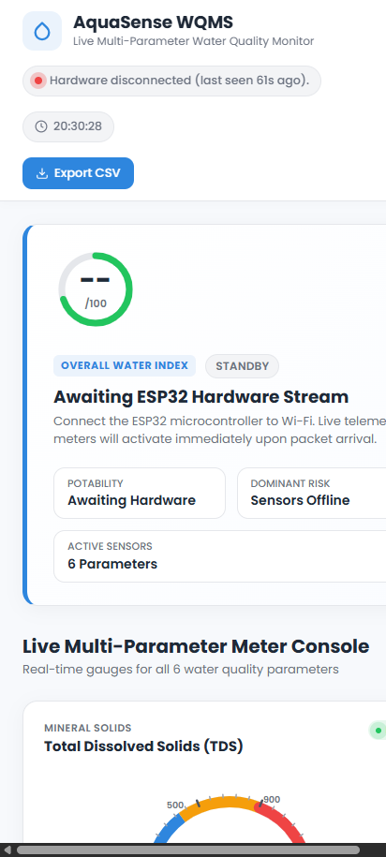
FRONTEND & AI/ML LAYER
Mobile QR Integration & Official PDF Certificate
👤 Naila Javed
Mobile View QR Code Modal
• Header button generates dynamic on-screen QR code pointing to live Vercel URL.
• Allows university examiners and field officers to scan and test live on mobile phones.
• Fluid responsive layout tailored specifically for smartphone touchscreens.
Official PDF Inspection Certificate
AquaSense WQMS — IoT Capstone Defense (300 Marks) | Date: October 20, 2026 • Time: 18:15 IST | Slide 21 of 24

Slide 22
HARDWARE & ASSEMBLY
Hardware Prototyping & Rig Fabrication
👤 Entire Team
Collaborative Prototyping Work
• Breadboard Circuit Assembly: Unified 5V high-current bus and 3.3V digital logic rails.
• Ground Isolation: Common ground wiring prevents ground-loop distortion between sensors.
• Probe Holder Rig: Custom acrylic mounting plate keeping probes submerged without touching.
• Waterproof Cable Harness: Insulated wiring preventing moisture ingress and short circuits.
3-Point Laboratory Calibration
• pH Electrode Calibration: Calibrated against standard buffer solutions at pH 4.01, 7.00, and 9.18.
• TDS Probe Calibration: Normalized using 1413 µS/cm conductivity calibration solution.
• Turbidity Baseline: Calibrated in pure distilled water to establish 0 NTU clean baseline.
AquaSense WQMS — IoT Capstone Defense (300 Marks) | Date: October 20, 2026 • Time: 18:15 IST | Slide 22 of 24

Slide 23
TESTING & VALIDATION
Live 3-Sample Testing Demonstration
👤 Entire Team
Experimental Validation Results
• Sample A (Commercial RO Water): TDS 110 ppm, pH 7.2, Turb 0.8 NTU → WQI 92 (Green, Safe).
• Sample B (Municipal Tap Water): TDS 380 ppm, pH 7.6, Turb 2.2 NTU → WQI 78 (Blue, Permissible).
• Sample C (Contaminated Saline Water): TDS >950 ppm, pH 9.1, Turb 14.5 NTU → WQI 42 (Red Alert).
Dynamic System Reaction
• Needles dynamically sweep to red alert zone within 4 seconds of probe immersion in Sample C.
• WQI circle updates instantly, triggering an automated red toast alert banner on dashboard.
• Proves rapid in-situ contamination detection without laboratory turnaround delay.
AquaSense WQMS — IoT Capstone Defense (300 Marks) | Date: October 20, 2026 • Time: 18:15 IST | Slide 23 of 24

Slide 24
SUMMARY & DEFENSE
Conclusion & Future Engineering Scope
👤 Entire Team
Summary of Capstone Achievements
• Successfully built full-stack IoT water monitor with 6 sensors and sub-4s cloud latency.
• Implemented custom 40-sample median filter and 25°C thermal compensation algorithms.
• Deployed live cloud infrastructure (Render + Vercel) with dual-transport reliability.
• Total prototype bill of materials optimized under ₹3,100 for scalable deployment.
Future Engineering Scope
• Predictive AI/ML: Adding LSTM neural network to forecast contamination 6 hours in advance.
• Long-Range LoRaWAN: Replacing Wi-Fi with LoRaWAN (868MHz) for remote rural rivers up to 10km.
• Automated Dosing: Relay-actuated solenoid valves to inject neutralizer or chlorine automatically.
AquaSense WQMS — IoT Capstone Defense (300 Marks) | Date: October 20, 2026 • Time: 18:15 IST | Slide 24 of 24

