Slide 1
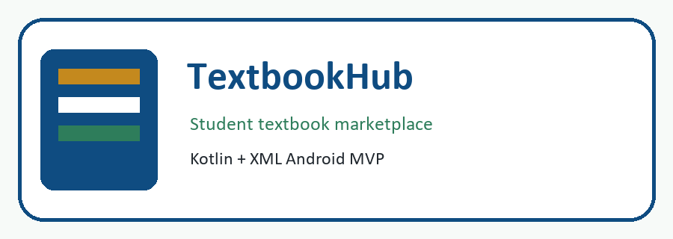
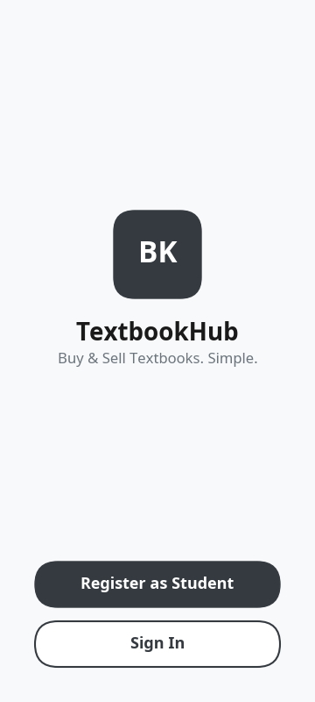
SS4 Final Project Presentation
TextbookHub
Student textbook marketplace app
Kagiso Mmatloa
24301339
MADA372
Welcome screen
Slide 1 | 0:00 - 0:45
Kagiso Mmatloa | 24301339 | MADA372
Notes:
Good day. My name is Kagiso Mmatloa. My student number is 24301339. This is my SS4 final presentation for Mobile Application Development A. My app is called TextbookHub.

Slide 2
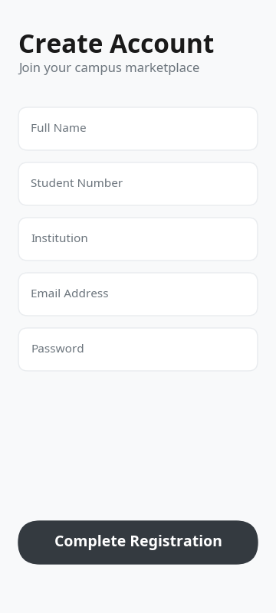
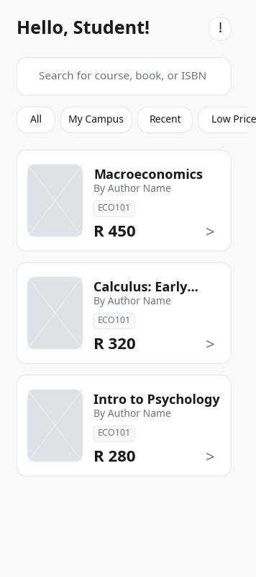
TextbookHub SS4
Project Goal and Intended Users
Project goal
Intended users
Contextual relevance
Help students buy and sell second-hand textbooks in a simple, affordable, and student-focused way.
Students in higher education institutions who need affordable textbooks or want to sell used textbooks.
Textbooks are expensive. TextbookHub creates a local marketplace experience for student needs.
Core app features
Register and sign in
Browse textbook listings
Search and filter books
View book details
Inquire, message, and sell
Register
Browse
Slide 2 | 0:45 - 1:45
Kagiso Mmatloa | 24301339 | MADA372

Slide 3
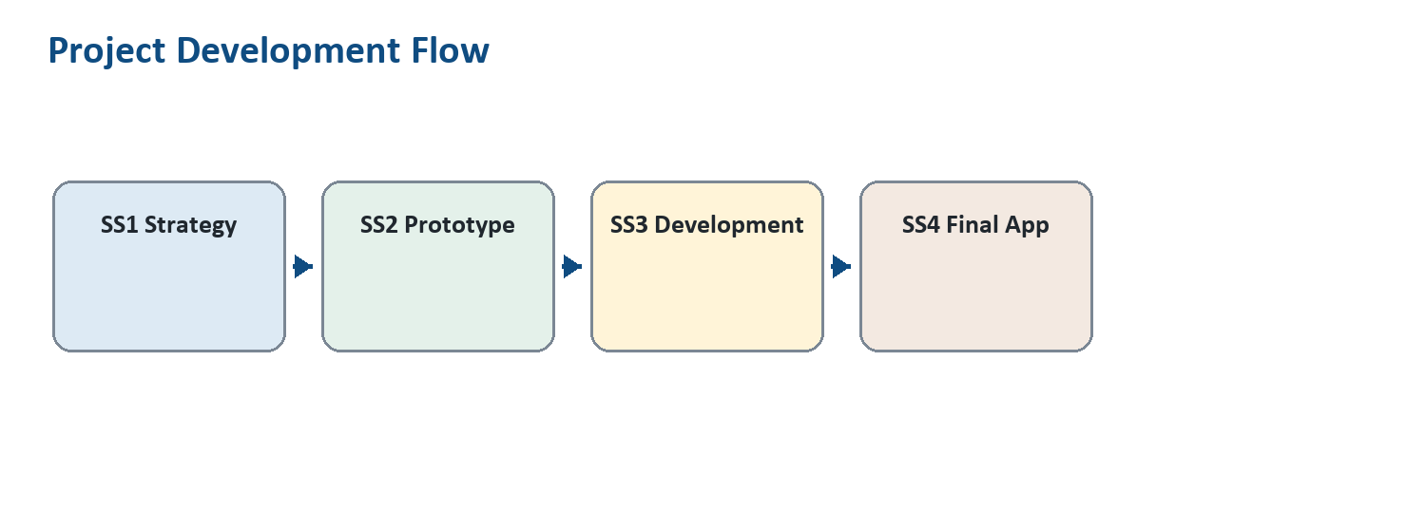
TextbookHub SS4
Development Journey: SS1 to SS4
SS1: Strategy
Problem statement, MVP scope, user needs, requirements, and DevOps plan.
SS2: UX/UI Design
Wireframes, prototype screens, sitemap, branding, and visual style.
Project development flow
SS3: Application Development
SS4: Finalisation
Android Studio implementation using Kotlin, XML layouts, navigation, and marketplace screens.
Refined functionality, documentation, presentation, GitHub evidence, and deployment preparation.
Slide 3 | 1:45 - 3:00
Kagiso Mmatloa | 24301339 | MADA372

Slide 4
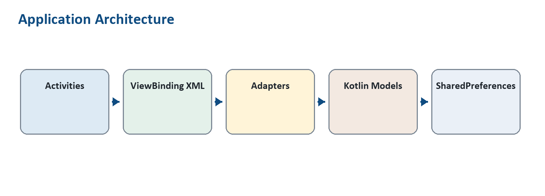
TextbookHub SS4
System Specification and Architecture
Technology stack
Android Studio, Kotlin, XML layouts, Material Components, RecyclerView.
Binding and data
ViewBinding connects Kotlin code to UI. BookCatalogViewModel holds catalogue/search logic.
Kotlin/XML architecture
Coding highlights
Book data class: title, author, edition, price, description, image
ListAdapter and DiffUtil for efficient RecyclerView updates
Validation on login, registration, sell listing, search, and chat
Activities and intents for structured navigation
Slide 4 | 3:00 - 4:15
Kagiso Mmatloa | 24301339 | MADA372

Slide 5
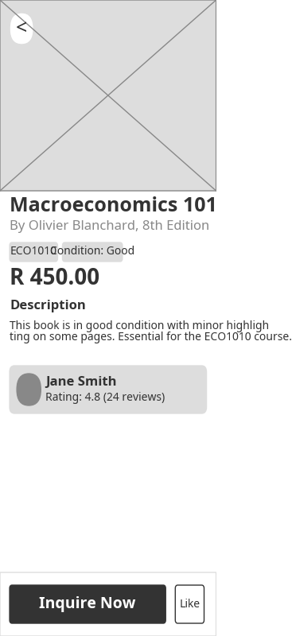
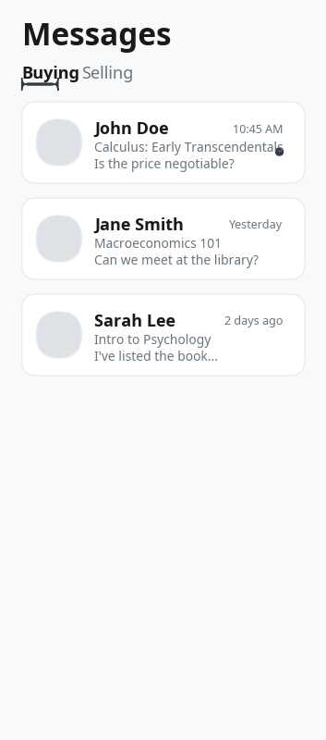
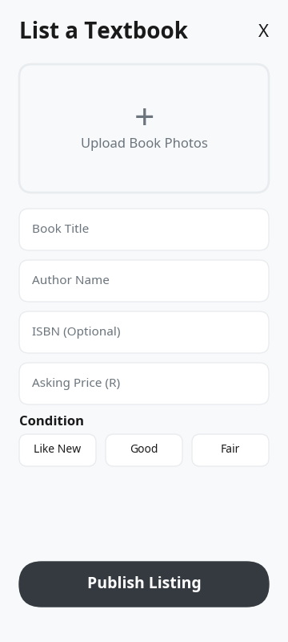
TextbookHub SS4
Key Features at a Glance
Registration
Home and search
Book detail
Messages
Sell book
Slide 5 | 4:15 - 5:00
Kagiso Mmatloa | 24301339 | MADA372

Slide 6
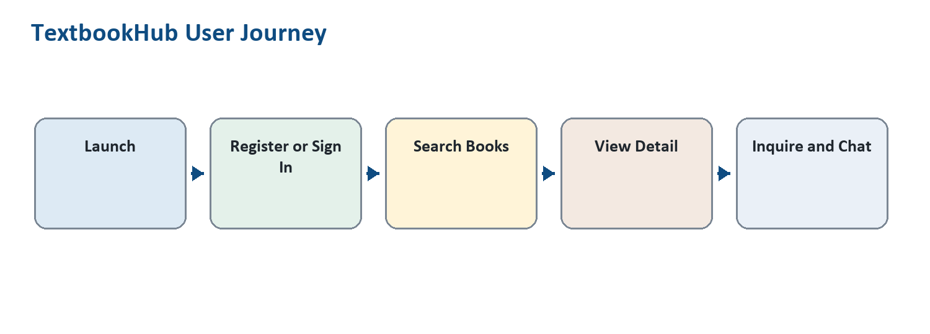
TextbookHub SS4
Documentation Summary
Project report
Design evidence
Rubric alignment
Includes project scope, goals, architecture, flow diagrams, key features, references, and GitHub evidence.
SS2 UI screenshots are included as visual references for implemented screens.
Kotlin, XML UI, ViewBinding, code quality, deployment, and presentation requirements are addressed.
User journey: launch, register/sign in, search, detail, inquiry/chat
Slide 6 | 5:00 - 5:45
Kagiso Mmatloa | 24301339 | MADA372

Slide 7
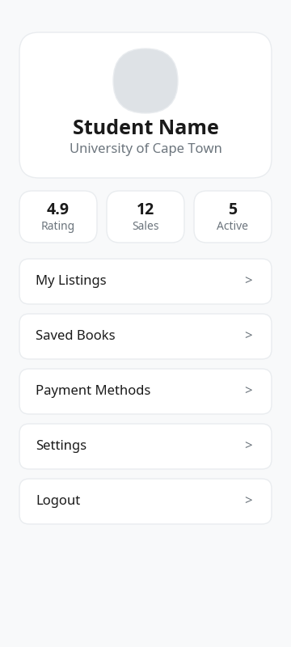
TextbookHub SS4
Live Demo Part 1: Start Flow
Say this
I will show the welcome screen, registration, STADIO institution dropdown, validation, and saved profile details.
Marks covered
Project goal, intended users, navigation, input validation, and profile functionality.
1. Welcome
2. Register
3. Profile info
Slide 7 | 5:45 - 7:00
Kagiso Mmatloa | 24301339 | MADA372

Slide 8
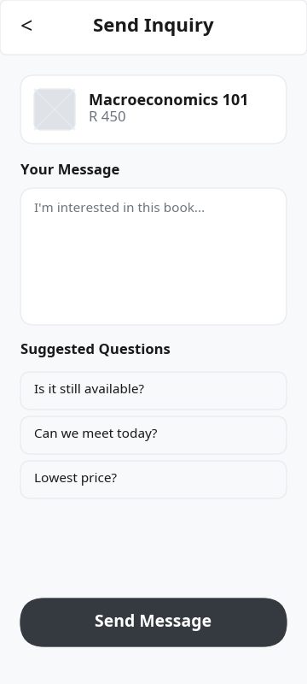
TextbookHub SS4
Live Demo Part 2: Marketplace Flow
Demo checklist
Search by title, author, course, condition, or description
Open a listing to show expanded textbook details
Use Inquire Now to move into the interaction screen
1. Search catalogue
2. View book details
3. Contact seller
Slide 8 | 7:00 - 9:00
Kagiso Mmatloa | 24301339 | MADA372

Slide 9
TextbookHub SS4
Live Demo Part 3: Interaction Flow
Messages and chat
Open a message, type a reply, and show empty-message validation.
Sell book
Show book photo upload, required fields, price validation, and condition selection.
Profile and notification
Show saved registration info and the notification button.
Messages
Sell book
Profile
Slide 9 | 9:00 - 11:15
Kagiso Mmatloa | 24301339 | MADA372

Slide 10
TextbookHub SS4
GitHub and Deployment Evidence
GitHub repository
Build output
https://github.com/kxcy77/TextbookHub
The Android project builds successfully as a debug APK through Gradle/Android Studio.
Version control evidence
Amazon preparation
Main and development branches. Meaningful commits showing documentation, navigation, profile, binding, and rubric improvements.
Final release requires signed APK/AAB, screenshots, app description, and Amazon Developer Console listing evidence.
Professional evidence for SS4 deployment and hosting marks
Slide 10 | 11:15 - 12:15
Kagiso Mmatloa | 24301339 | MADA372

Slide 11
TextbookHub SS4
Conclusion
TextbookHub meets the MVP requirements for a student textbook marketplace.
Technical proof
Register and sign in
Browse and search textbook listings
View expanded book details
Contact sellers and reply in chat
Upload book photos and manage profile information
Kotlin, XML layouts, ViewBinding, RecyclerView, ViewModel logic, input validation, and navigation.
Final alignment
SS1 strategy, SS2 design, SS3 development, and SS4 finalisation are connected.
Thank you
Slide 11 | 12:15 - 13:00
Kagiso Mmatloa | 24301339 | MADA372

