Slide 1
Online Exam portal
Admin
Login
CRUD Student
Assign course to Student
CRUD Course
CRUD Question
View Score
Logout
Student
Login
Send password to email
View Courses
Take Exam
View Score
Logout

Slide 2
Online Exam portal – DB Design
admin_users
Username pwd
students
stud_id – PK first_name Last_name Email password
student_assignment
stud_id – FK Course_id - FK Exam_taken
question_bank
Course_id – FK Question_id - PK Question Option_1 Option_2 Option_3 Option_4 answer
score
Stud_id - FK Course_id – FK Score
batch
Course_id – PK Course_name

Slide 3
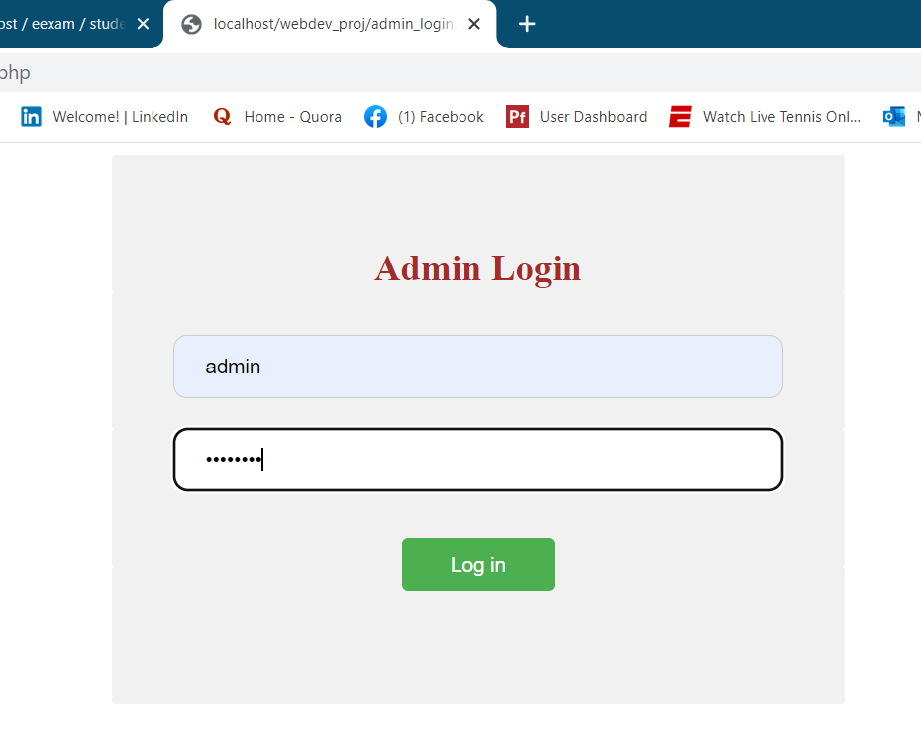
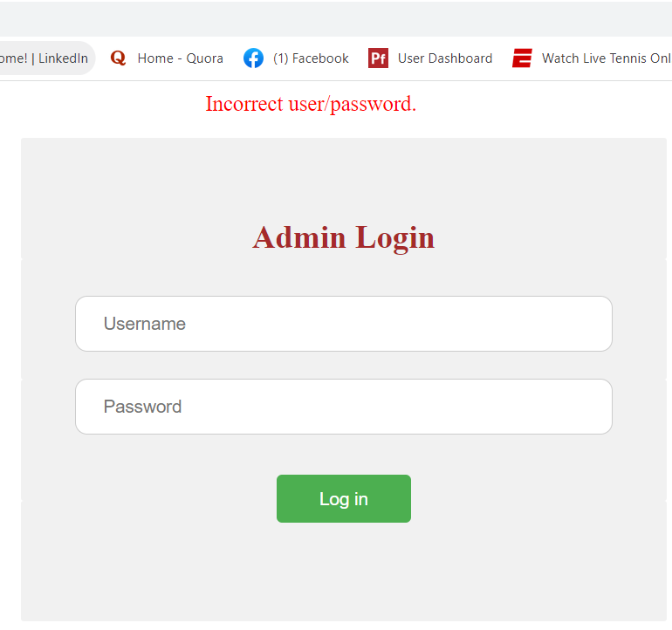
Admin Login

Slide 4
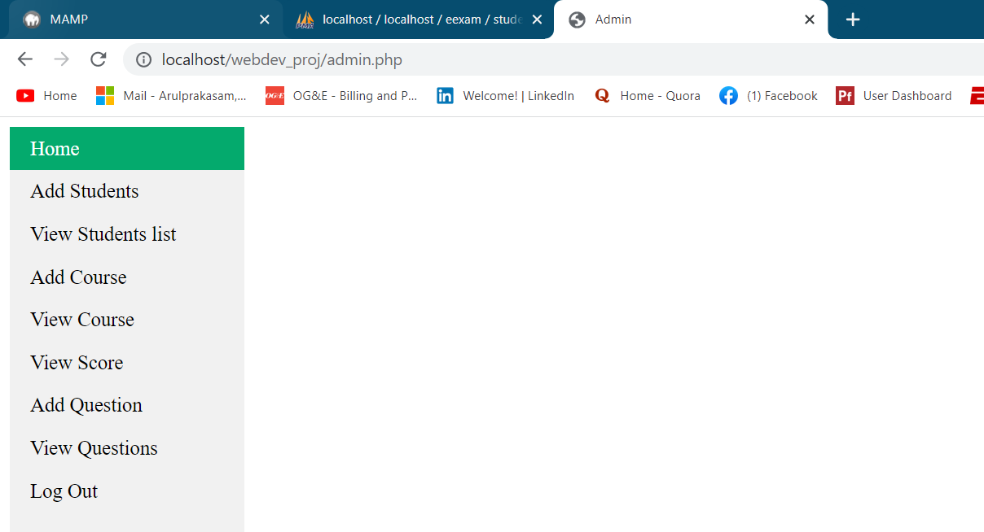
Home Page

Slide 5
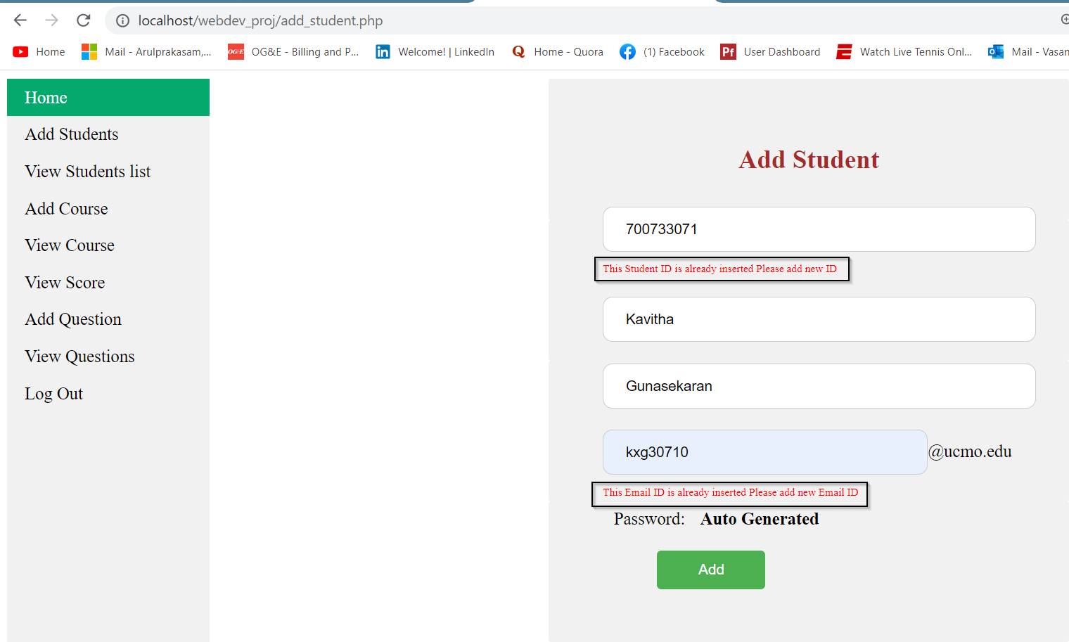
Add Student to DB
Implemented
Jquery, json

Slide 6
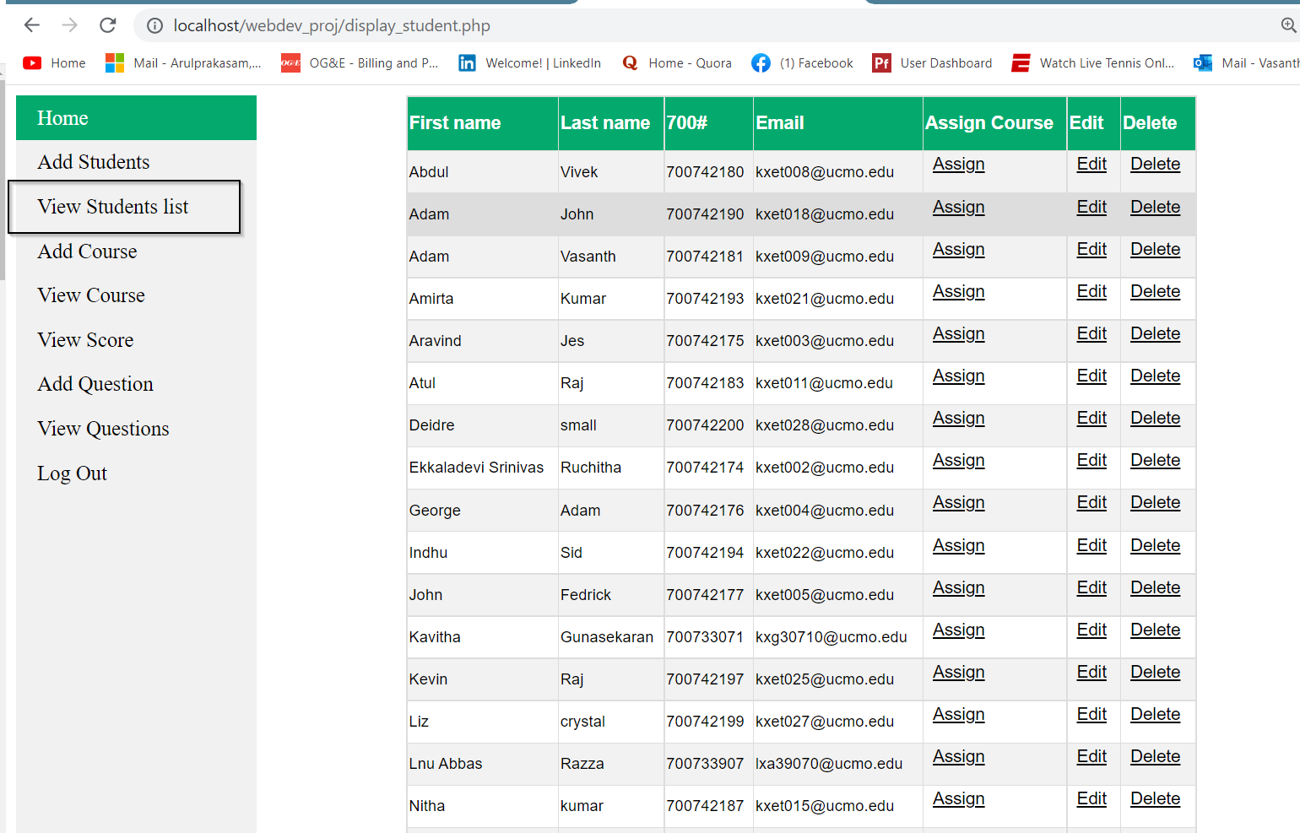
Java Script Sort for all the column

Slide 7

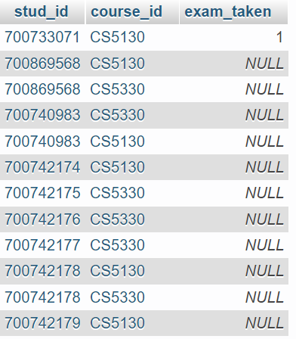
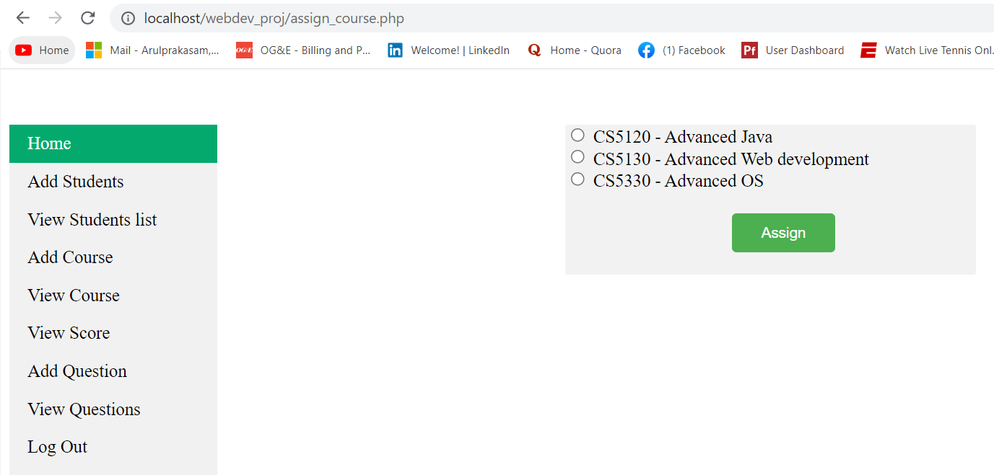
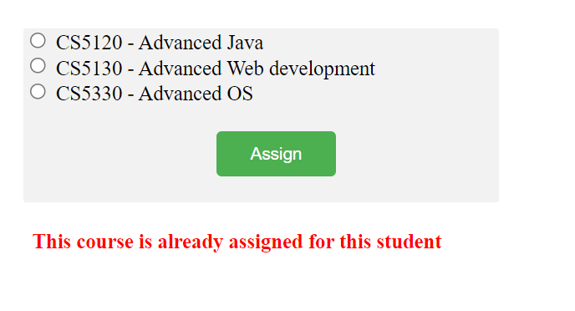
Double post is avoided here

Slide 8
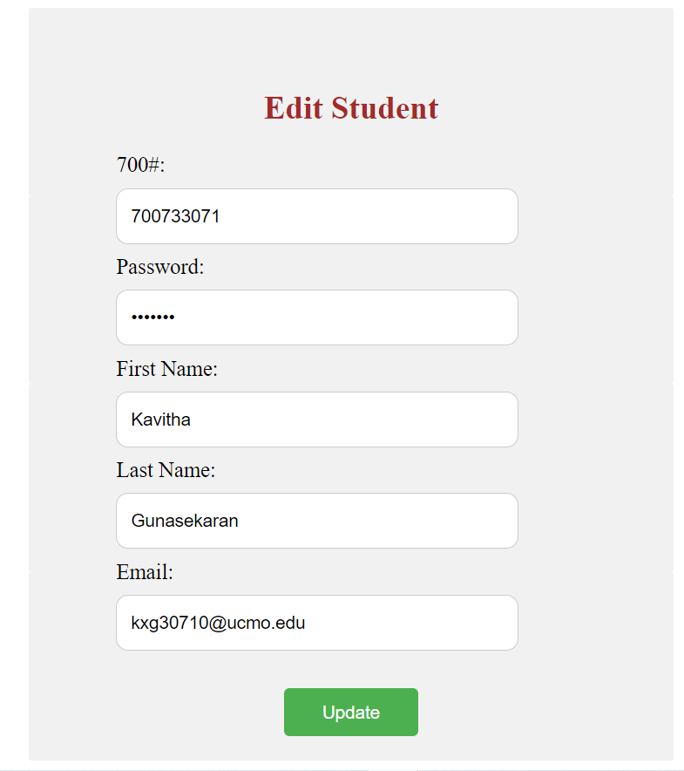
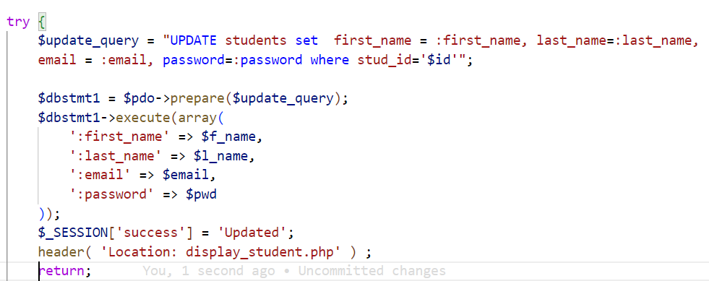

Double post is avoided here

Slide 9



Log file to show the exact error to the developer/support and hide it from admin user

Slide 10
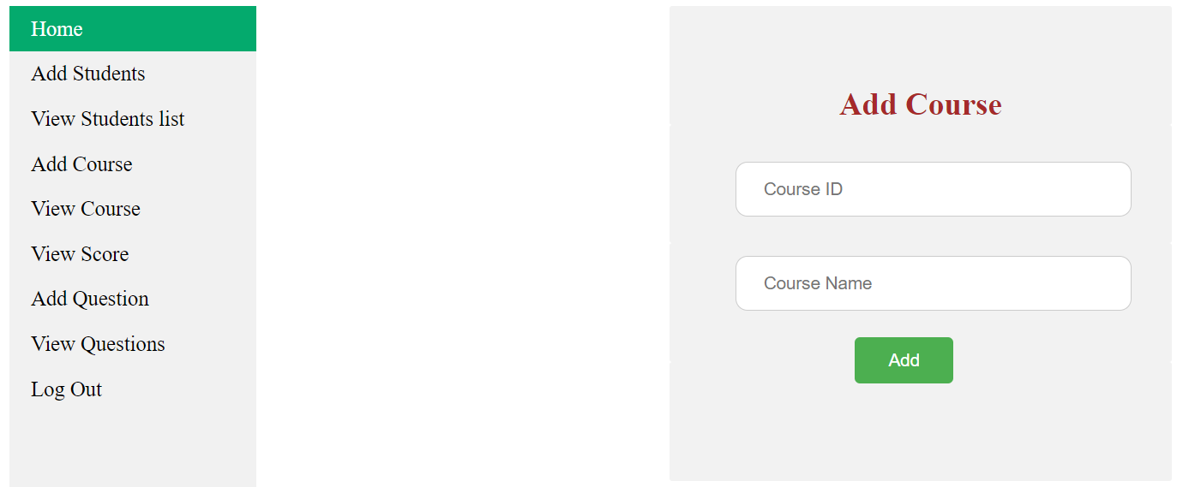
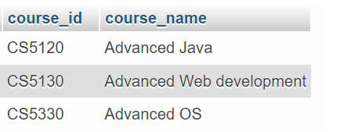


Slide 11
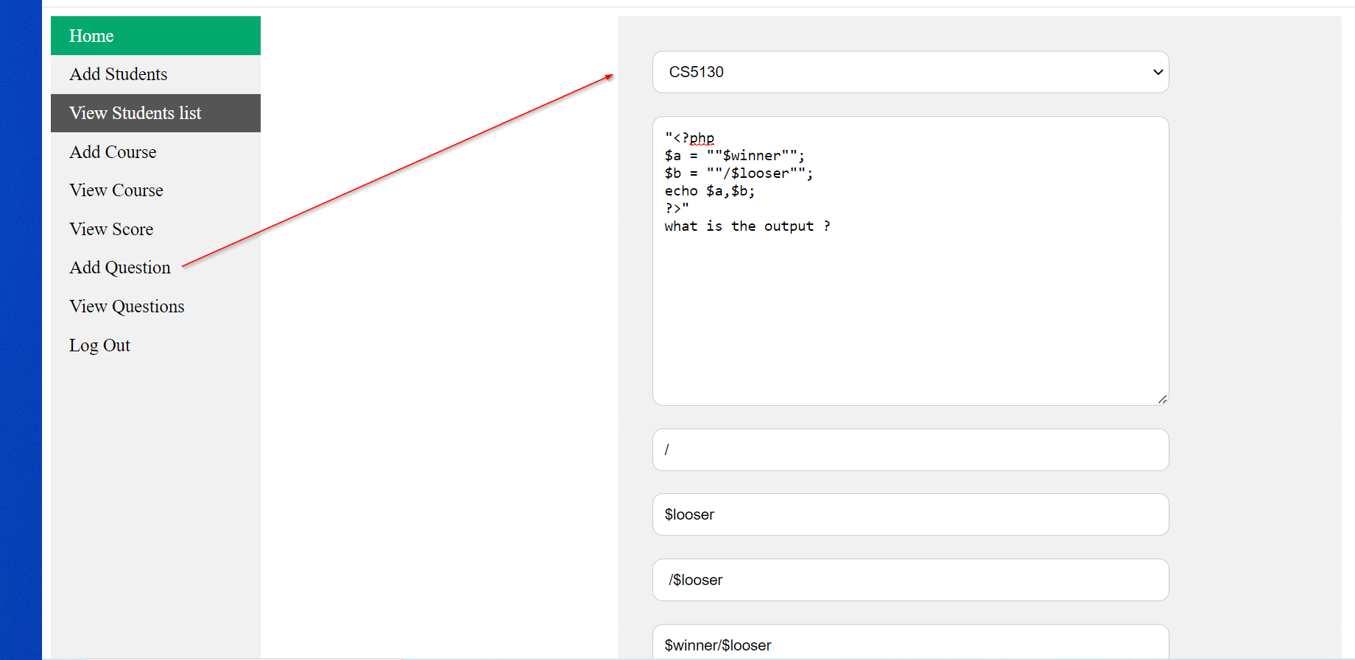


Slide 12


login check is implemented for all the pages to avoid direct page access. Session is used.

Slide 13
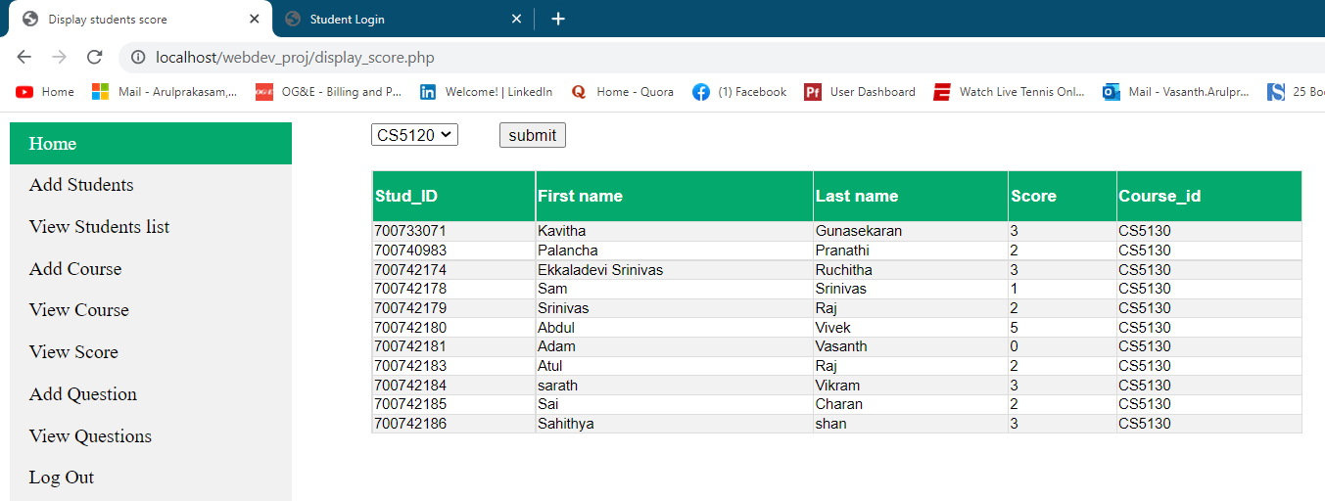

Slide 14
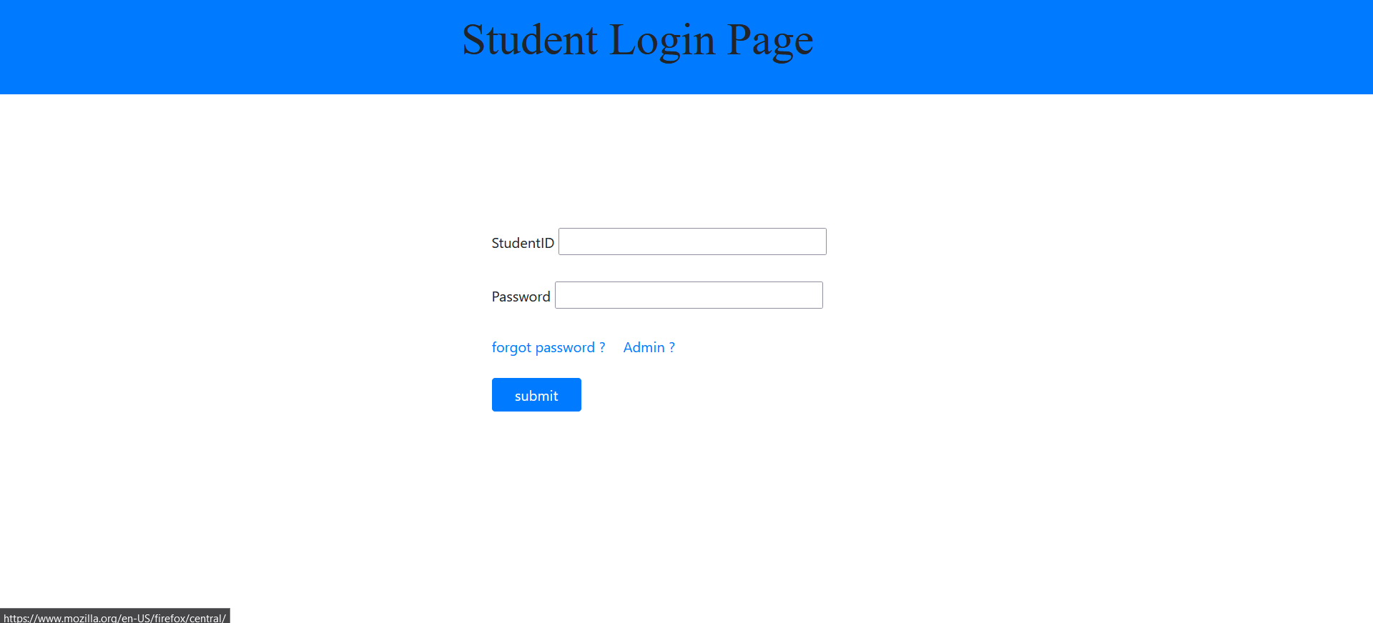

Slide 15
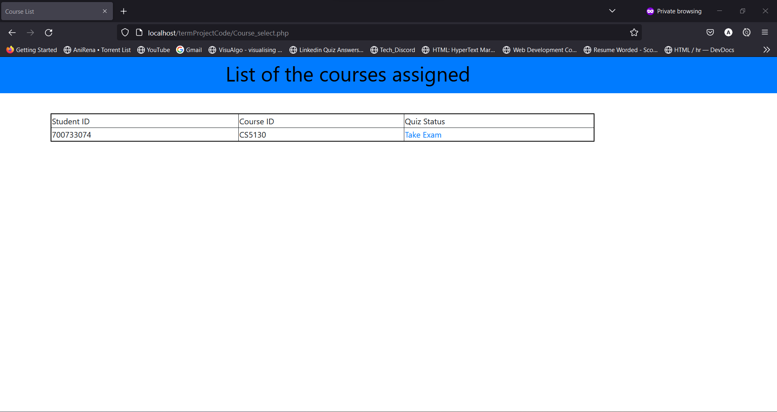

Slide 16
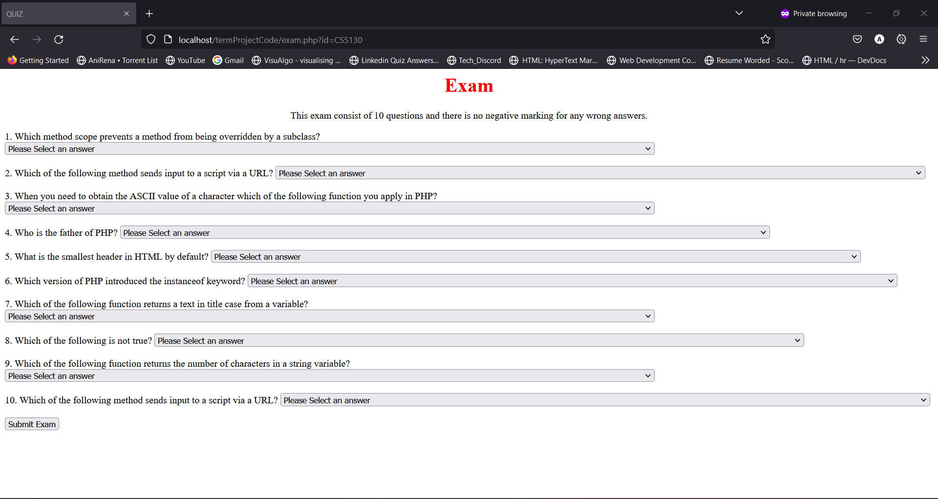

Slide 17
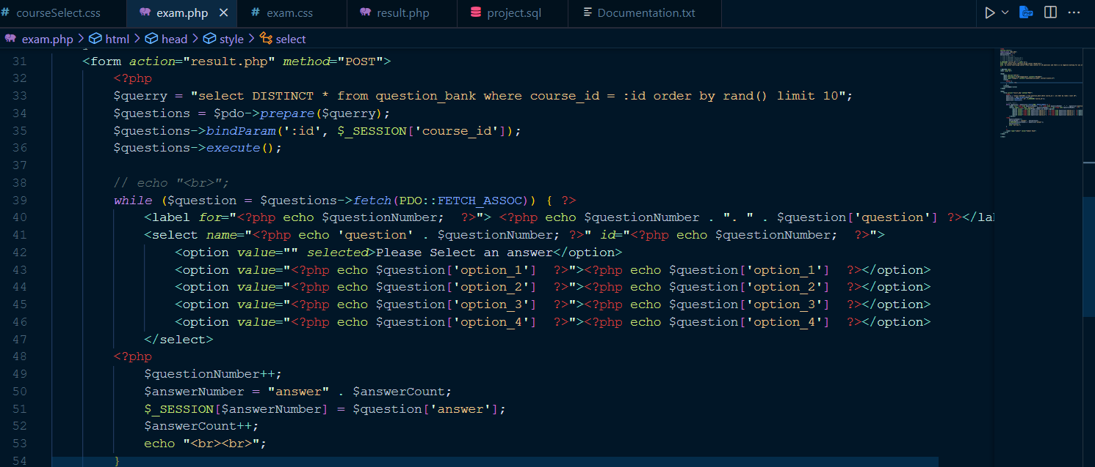

Slide 18
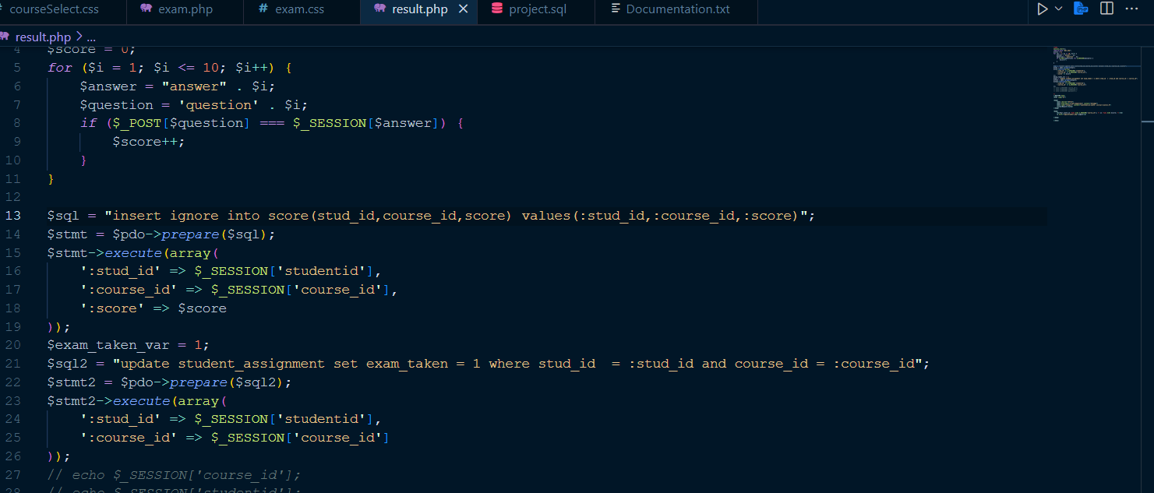

Slide 19
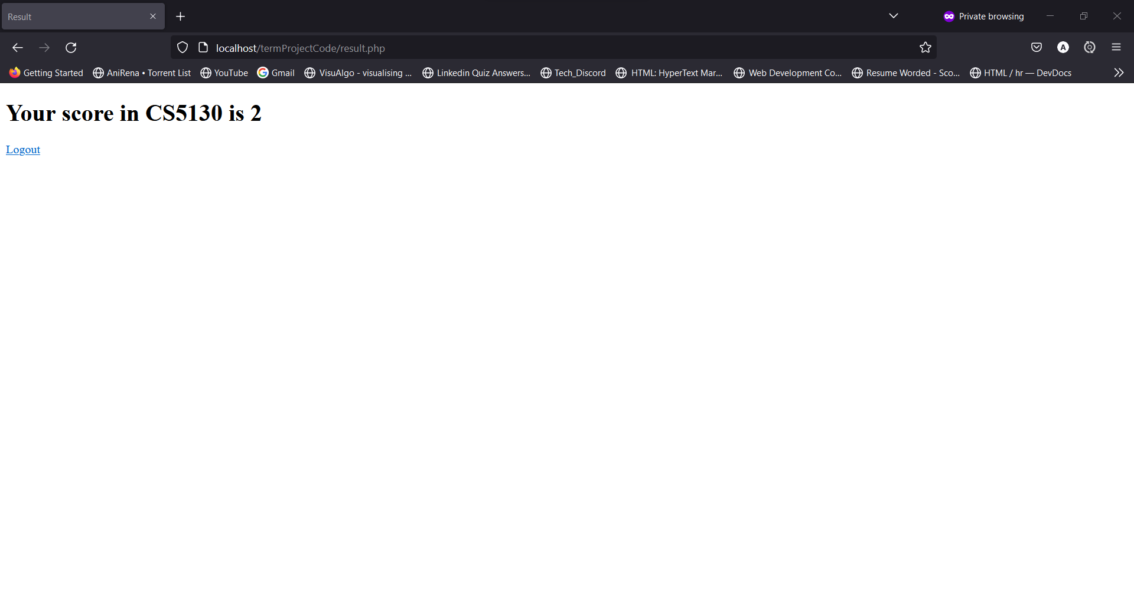

Slide 20
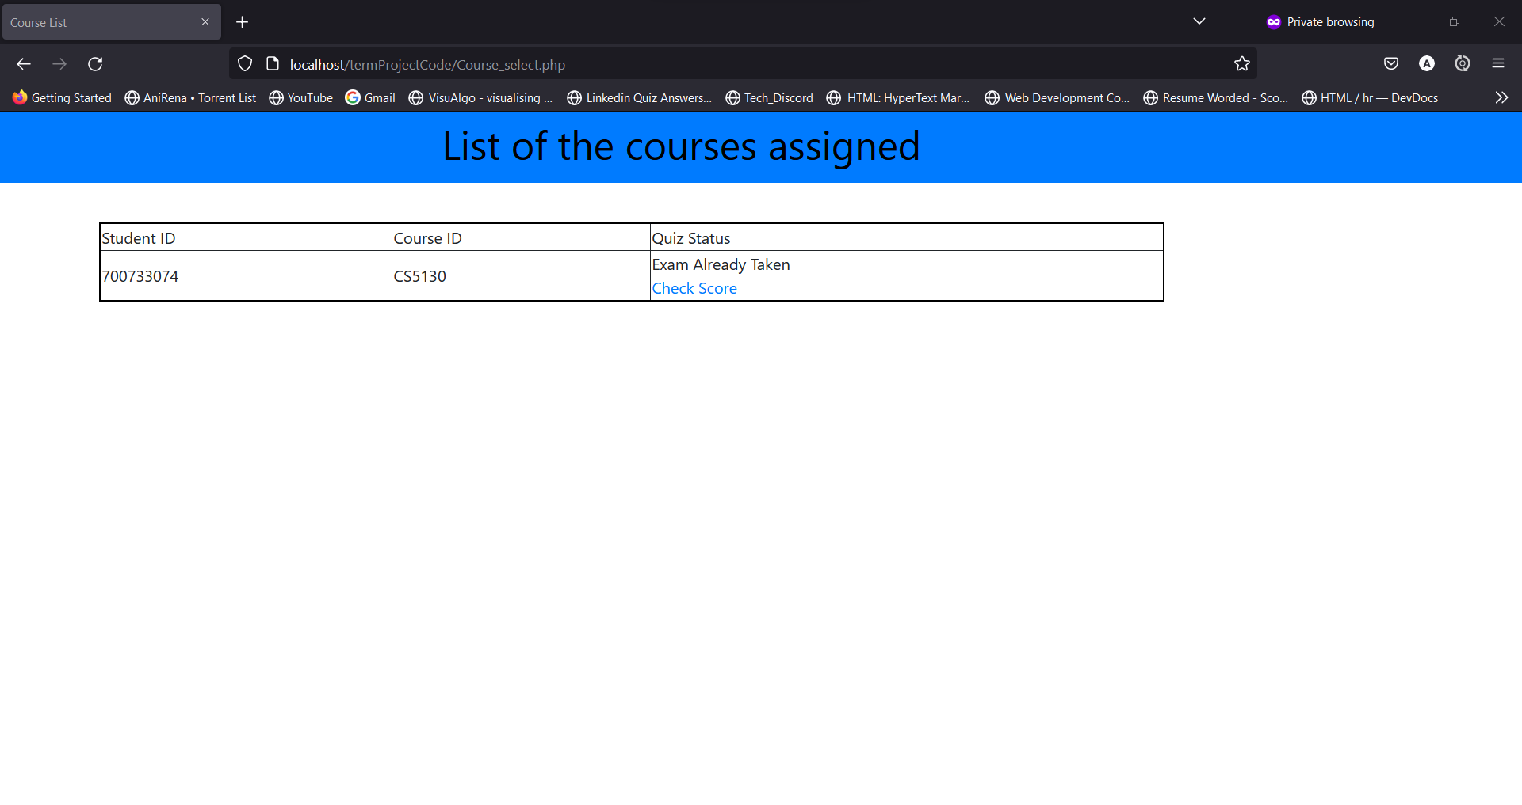

Slide 21
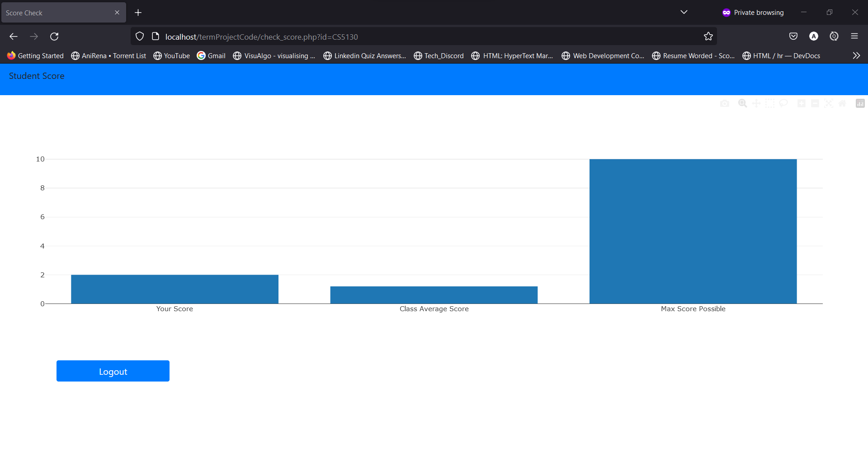

Slide 22


Slide 23
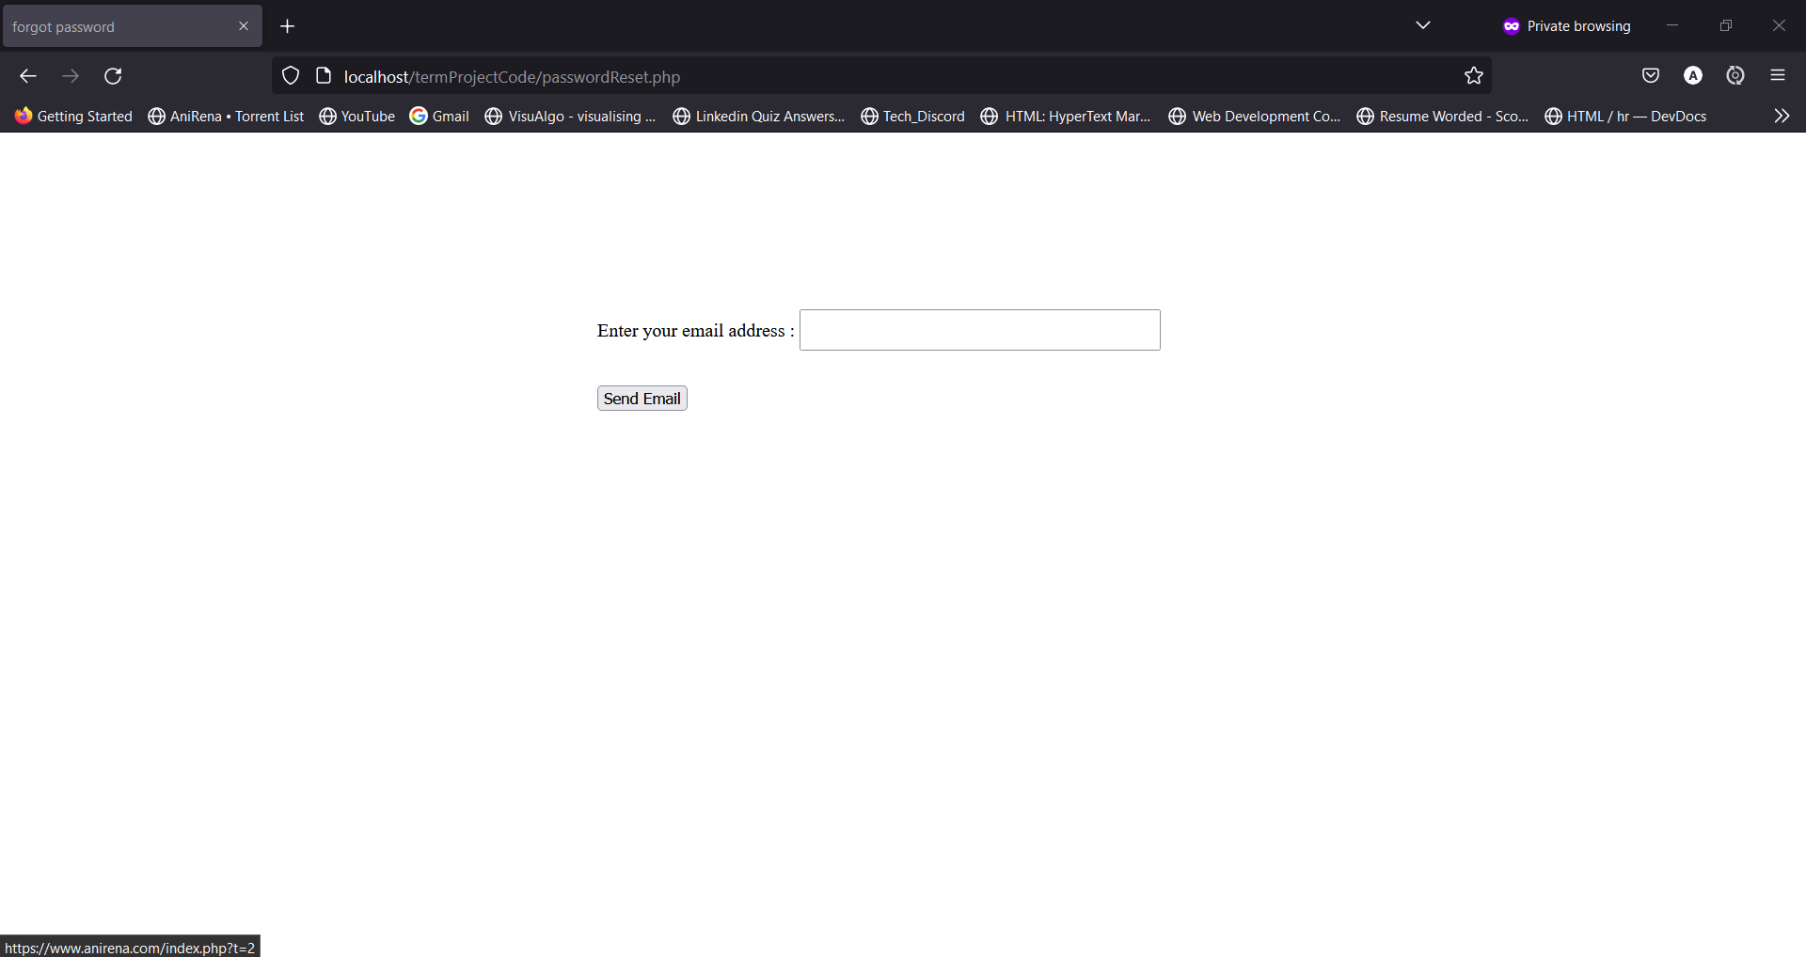

Slide 24
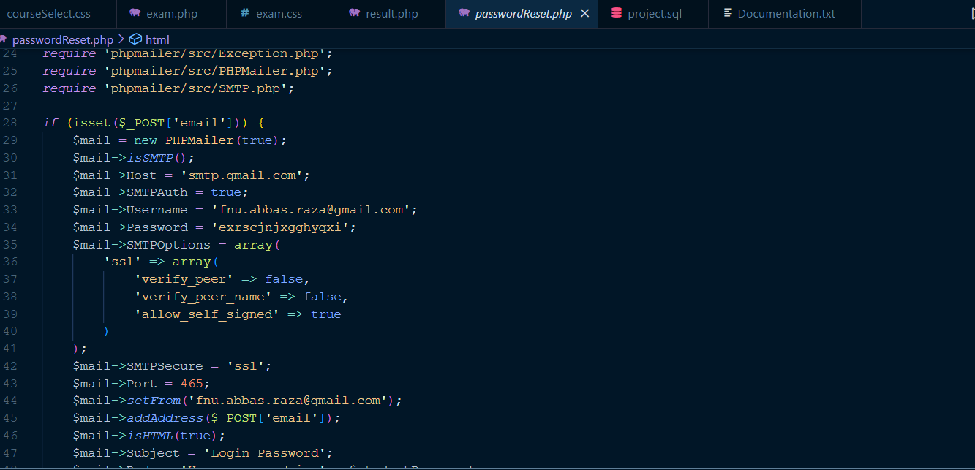

Slide 25
