Slide 1
PPTAgent: Beyond Text-to-Slides
Hao Zheng (CAS), Xinyan Guan (CAS)
2025-02-01

Slide 2
目录
介绍 PPTAgent
PPTAgent 工作流程
实验与评估
结论

Slide 3
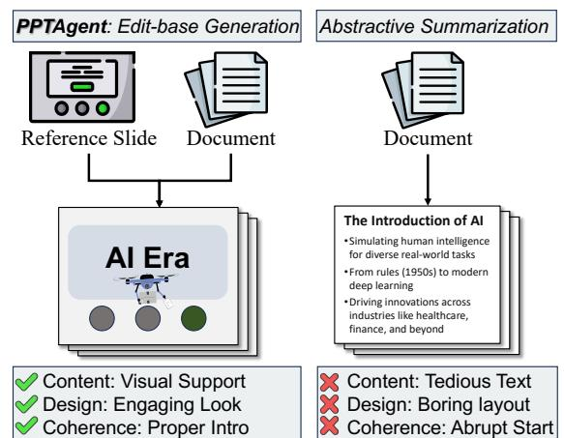
Presentation Importance
Why PPTAgent Matters
Advanced skills and effort required for high-quality presentations.
PPTAgent streamlines the process with automated generation.
Focuses on engaging and visually appealing designs.

Slide 4
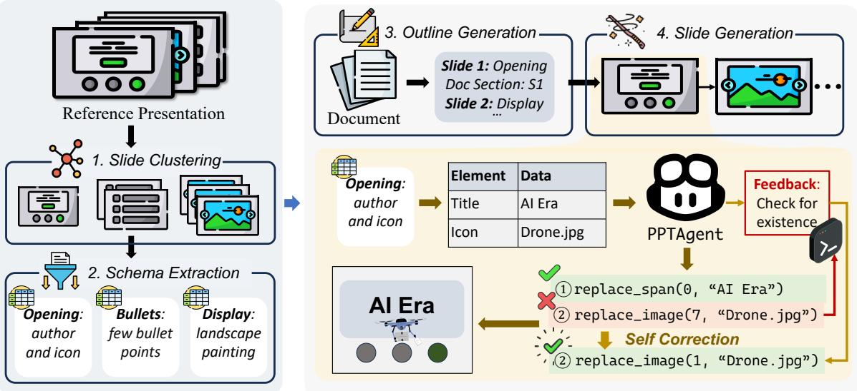
PPTAgent Workflow
Iterative, Edit-Based Process
Analyzes reference presentations for semantic info
Generates detailed presentation outline
Assigns document sections and reference slides

Slide 5
Presentation Analysis
Foundational Stage
Complex and fragmented real-world slides.
Requires sophisticated content extraction methods.
Content Extraction
Clustering algorithms for slide categorization.
LLMs and hierarchical clustering for schema extraction.

Slide 6
Presentation Generation
LLM-driven Slide Creation
LLMs create a structured outline for the new presentation.
Specify reference slides and relevant document sections.
Ensuring Engagement and Coherence
Use five specialized APIs for precise slide editing.
Convert slides to HTML for better interpretability and error correction.

Slide 7
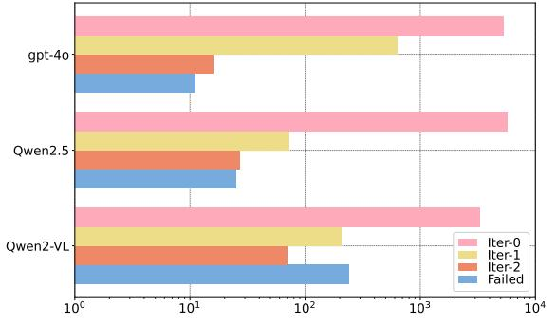
Success Rates
Comparison of Models
gpt-4o, Qwen2.5, and Qwen2-VL evaluated
Performance across iterations and failures
Results highlight model effectiveness

Slide 8
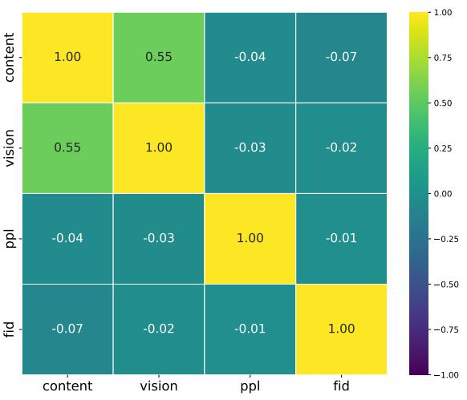
Correlation Analysis
Heatmap shows relationships between content, vision, ppl, and fid.
Strength and direction of correlations indicated by color.
Values range from -1.00 to 1.00.

Slide 9
Thank you

