Slide 1
Mining Association Rules
Kaivan Kamali
03/23/2021

Slide 2

What is it?
Mining Association Rules, or Affinity Analysis, or Market Basket Analysis (MBA): technique for finding correlations between different entities according to their co-occurrence in a dataset [1][2].
Can extract/uncover useful trends in a dataset

Slide 3
MBA algorithm
Two step procedure
First, find the “frequent” itemsets in a dataset
Second, generate association rules satisfying some criteria
E.g., Support, Confidence, Lift, Conviction

Slide 4
1. Find frequent itemsets
Apriori algorithm to find frequent item sets [3]
Works on a database containing transactions
E.g., items purchased by a customer
Algorithm parameters:
Support
Maximum length of itemset

Slide 5
Apriori algorithm
Itemset is considered frequent if meets a user specified “Support” threshold [4]
If Support is set to 0.5, frequent itemset is defined as set of items that co-occur in at least 50% of the transactions in the database
Support values between 0.00 and 1.00
Support is basically the probability of an itemset
Support(A) = P(A)
Support(A, B) = P(A, B)

Slide 6
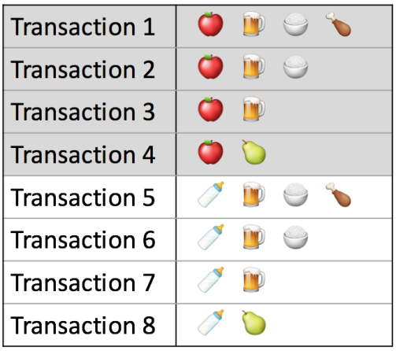
Transactions ^{[5]}

Slide 7
1 itemset Support calculation
Support(Apple) = 4/8 = 0.50
Support(Milk) = 4/8 = 0.50
Support(Beer) = 6/8 = 0.75
Support(Pear) = 2/8 = 0.25
Support(Rice) = 4/8 = 0.50
Support(Chicken) = 2/8 = 0.25

Slide 8
1 itemset Support threshold
If Support threshold is set to 0.30, then we drop Chicken and Pear
Their Support is less than 0.30
Use remaining Apple, Milk, Beer, and Rice to generate 2 itemsets

Slide 9
2 itemset Support calculation
Support(Apple, Milk) = 0 /8 = 0.00
Support(Apple, Beer) = 3/8 = 0.375
Support(Apple, Rice) = 2/8 = 0.250
Support(Milk, Beer) = 3/8 = 0.375
Support(Milk, Rice) = 2/8 = 0.25
Support(Beer, Rice) = 2/8 = 0.25

Slide 10
2 itemset Support threshold
If support threshold is 0.30, then we drop (Apple, Milk), (Apple, Rice), (Milk, Rice), and (Beer, Rice)
Their Support is less than 0.30
Use remaining (Apple, Beer) and (Milk, Beer) to generate 3 itemsets
Repeat this process until we reach Maximum length of itemset, Or we run out itemsets with minimum threshold

Slide 11
2. Generate association rules
After filtering itemsets via Support threshold, use remaining itemsets to create an implication expression [6] in the form of X -> Y
X and Y are disjoint itemsets

Slide 12
Criteria for filtering association rules
Confidence
Lift
Conviction

Slide 13
Confidence
Confidence(X -> Y)=Support (X,Y)/Support(x)
Support values come from the Apriori step
Confidence is basically the conditional probability
Confidence(X -> Y) = P(Y | X)
Confidence values between 0.00 and 1.00
Higher values are better

Slide 14
Confidence
Confidence(Apple -> Beer) = Support(Apple, Beer) / Support(Apple) = (3/8)/(4/8) = 0.75
Problems with Confidence [6]:
May misrepresent the importance of a rule
If Beer is frequent, Apple likely to co-occur with Beer
Need a measure that accounts for popularity of Beer
Lift

Slide 15
Lift
Lift(X -> Y)
Measures how many times more often X and Y occur together than expected if they were statistically independent [7]
Lift(Apple ->Beer)= Support(Apple, Beer)/Support(Apple) * Support(Beer) = (3/8) / (4/8)*(6/8) = 1/8

Slide 16
Lift
Lift is joint probability divided by product of probabilities marginal probabilities
Lift(X ->Y) = P(X,Y)/P(X) * P(Y)
Lift values between 0 and infinity [8]
Lift > 1: X and Y appear together more than expected
Lift < 1: X and Y appear together less than expected
Lift = 1: X and Y are independent

Slide 17
Lift
Problem with Lift:
Lift has no direction
Same value for X->Y and Y -> X
Need a measure with direction
Conviction

Slide 18
Conviction
Conviction(X->Y)=(1-Support(Y))/(1-Confidence(X->Y))
Conviction(Apple -> Beer) = (1-6/8)/(1-6/8)=1
Conviction values between 0 and infinity
The higher the conviction value, the higher Y is dependent on X
Conviction of 1: X and Y are independent

Slide 19
References
Affinity analysis. https://en.wikipedia.org/wiki/Affinity_analysis
Agrawal, R., Imielinski, T., Swami, A. Mining association rules between sets of items in large databases. Proceedings of the 1993 ACM SIGMOD.
Agrawal, R., Ramakrishnan, S. Fast algorithms for mining association rules. Proceedings of the 1994 VLDB.
Frequent Itemsets via Apriori Algorithm. http://rasbt.github.io/mlxtend/user_guide/frequent_patterns/apriori/
Association Rule Mining for Lastfm using Python. https://www.kaggle.com/ashishpatel26/association-rule-mining-for-lastfm-using-python

Slide 20
References
Association Rules Generation from Frequent itemsets. http://rasbt.github.io/mlxtend/user_guide/frequent_patterns/association_rules/
Commonly used interest measures for association rules. https://michael.hahsler.net/research/recommender/associationrules.html
Lift in an association rule. https://www.ibm.com/support/knowledgecenter/en/SSEPGG_11.1.0/com.ibm.im.model.doc/c_lift_in_an_association_rule.html

