Slide 1
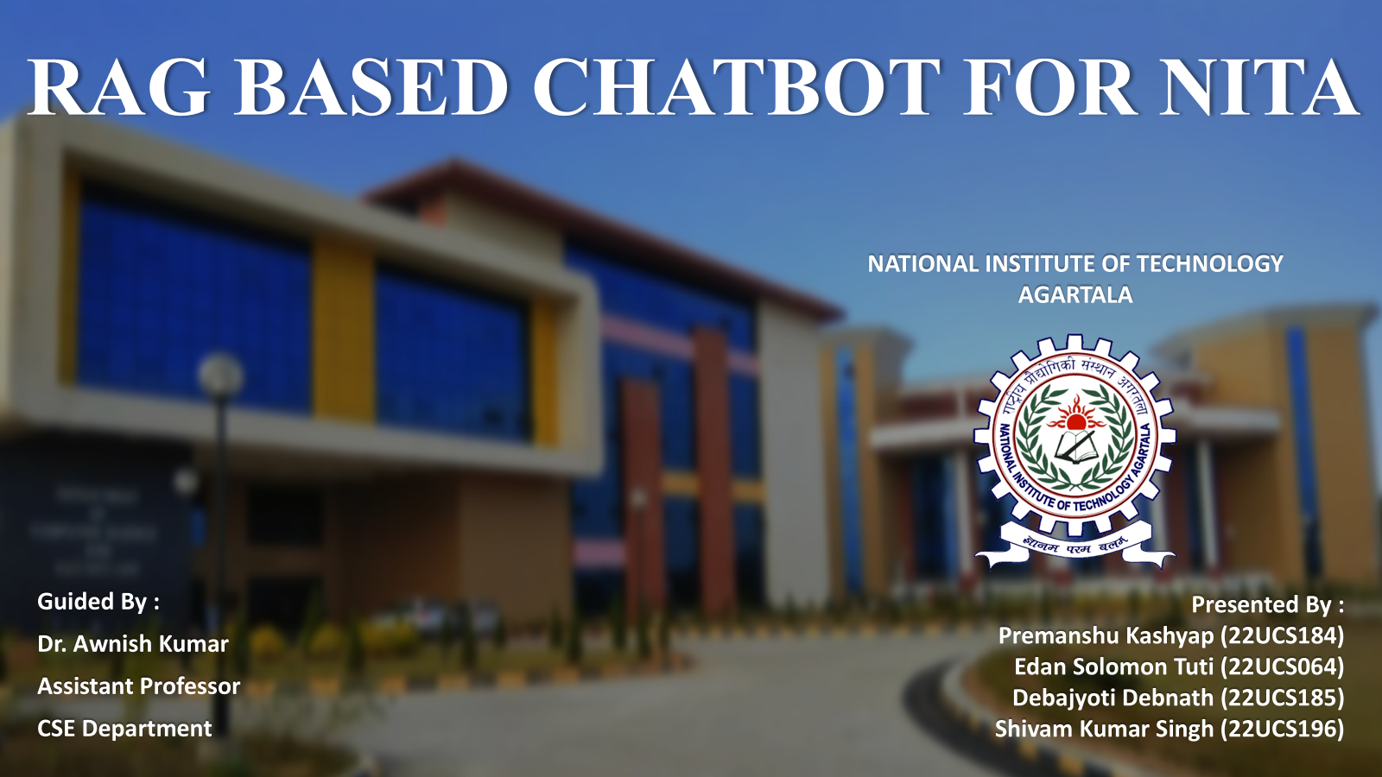

Slide 2
Introduction
The RAG-Based Chatbot is an AI-driven system designed specifically for NIT Agartala to simplify access to institutional information.
It retrieves verified data from the institute’s website and generates accurate and context-aware answers for the user queries.
Finding institutional information manually across multiple webpages and PDF notices is often time-consuming.
This chatbot overcomes these retrieval challenges by integrating vector database search with generative AI.

Slide 3
Problem Statement
NIT Agartala currently lacks a centralized, intelligent interface to access institutional information efficiently.
Critical data for students and faculty is scattered across several sections, PDFs, and links on the official website.
Users are forced to manually browse and search through multiple pages to find specific details, which is a time-consuming and inefficient process.
There is need for AI powered assistant that can understand natural queries, retrieve accurate information from official sources and provide reliable responses, not hallucinations.

Slide 4
Motivation
To solve the problem of scattered institutional information at NIT Agartala by creating a single intelligent platform that retrieves accurate data from official sources, reducing the need to manually browse multiple web pages and documents.
To develop a domain-specific RAG-based chatbot that delivers factual, context-aware, and verifiable responses, addressing the limitations and hallucination issues of general-purpose LLMs.
To encourage digital transformation inside the institute by introducing an AI-driven system that modernizes how students and faculty interact with institutional information.

Slide 5
Information Retrieval Methods: A Comparative View
Scenario:
Urgent need to retrieve Chief Information Security Officer (CISO) contact details.
We evaluate how three search methods perform:
Google Search
Institute Website Navigation
Chatbot Response

Slide 6
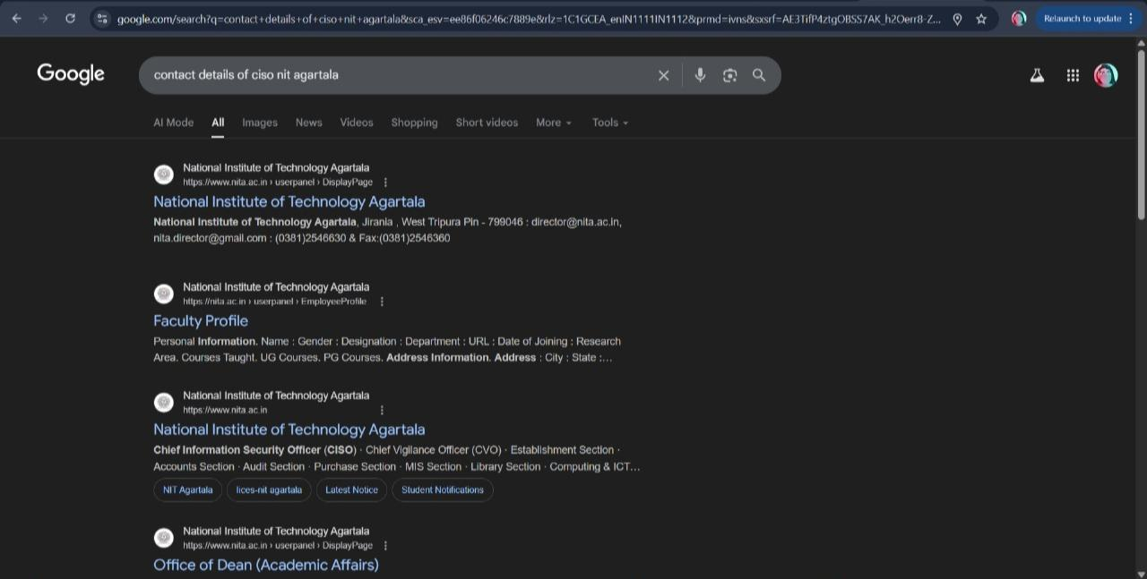
Information Retrieval Methods: A Comparative View
Method 1: Retrieving Information via Google Search

Slide 7
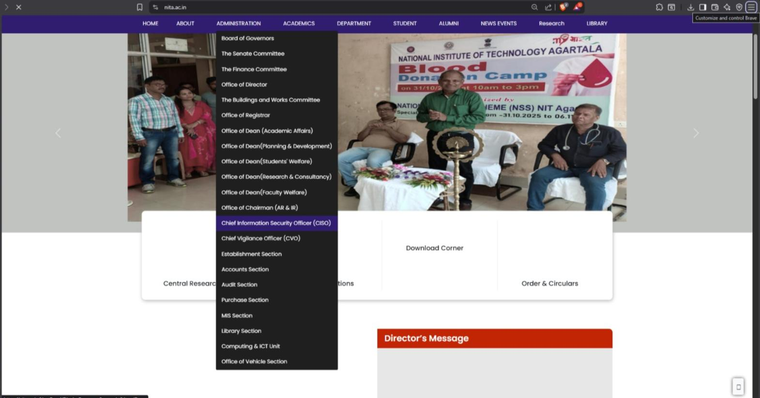
Information Retrieval Methods: A Comparative View
Method 2: Browsing the Institute Website to Access CISO Detail

Slide 8
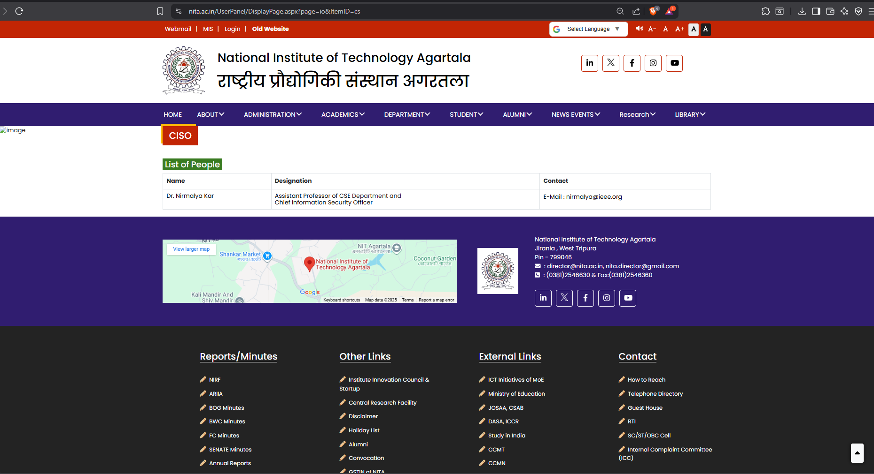
Information Retrieval Methods: A Comparative View
Method 2: Browsing the Institute Website to Access CISO Detail

Slide 9
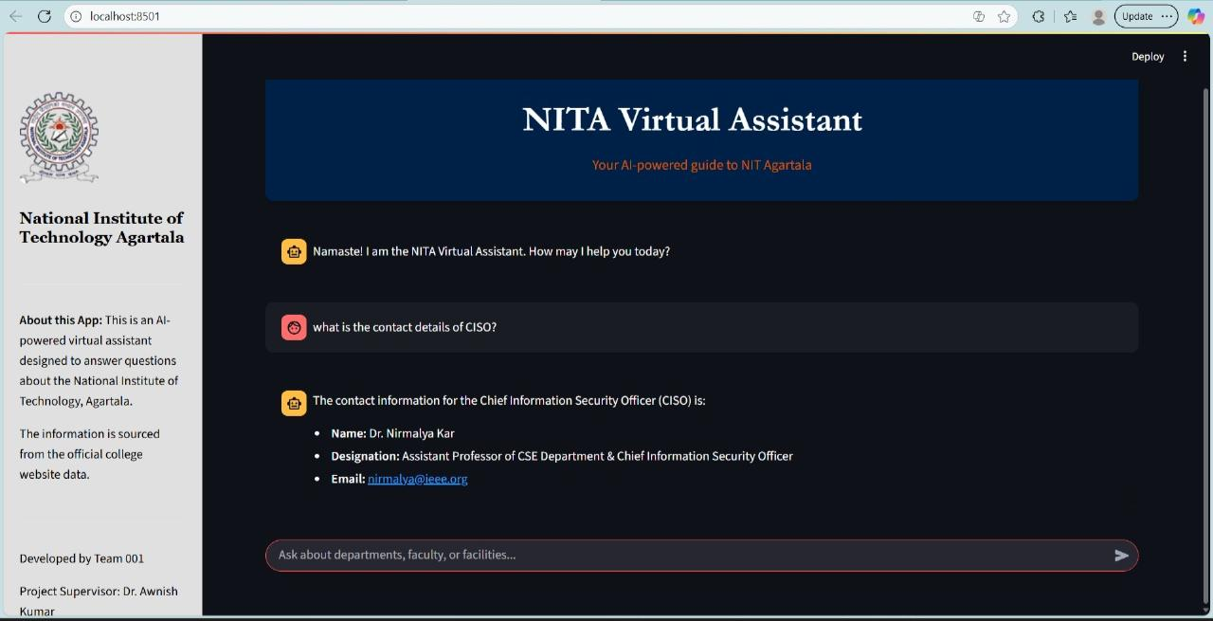
Information Retrieval Methods: A Comparative View
Method 3: Retrieving Information via Chatbot Response

Slide 10
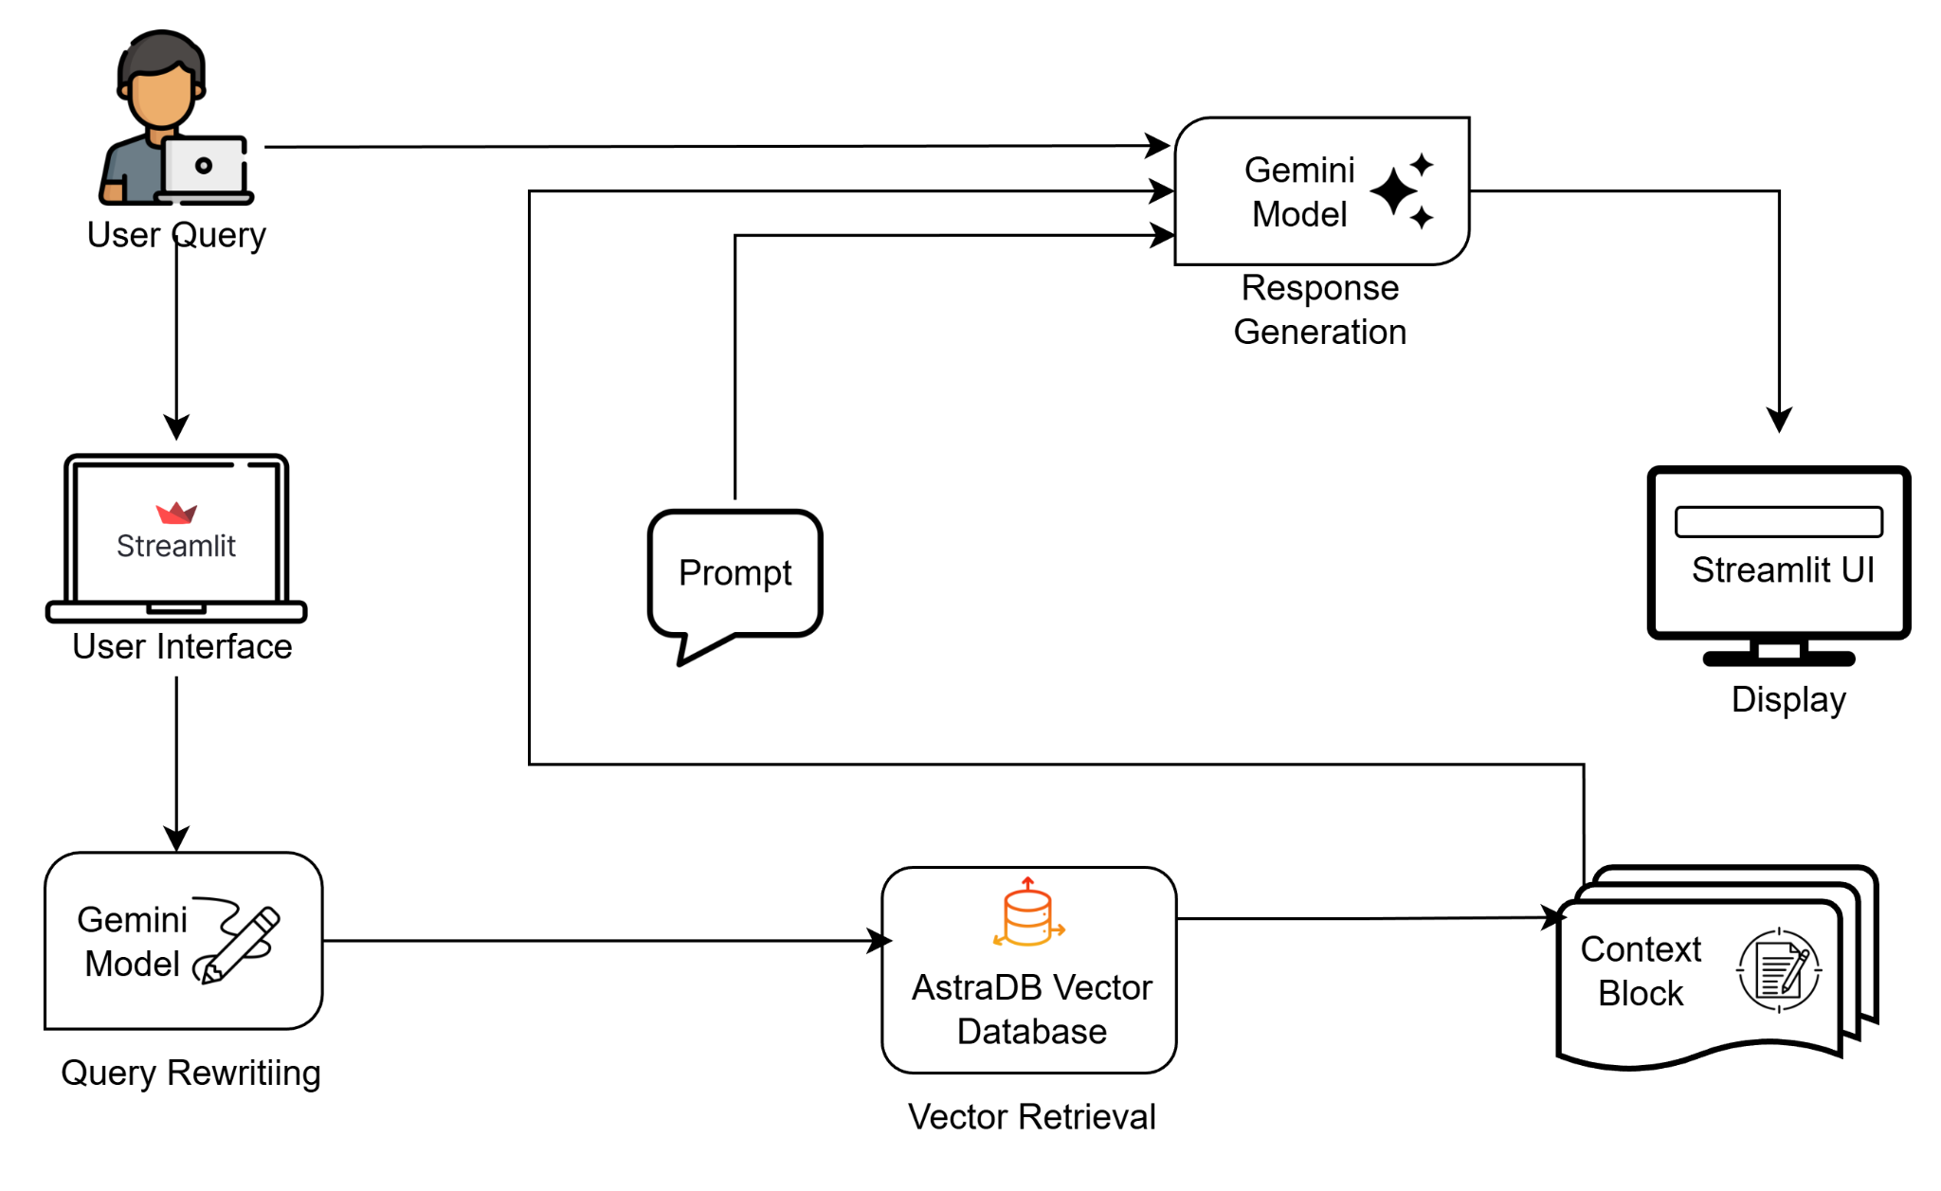
System Architecture
Figure 1: System Architecture Diagram

Slide 11
Query Processing Flow
User Query: User enters a natural-language query in the Streamlit interface.
Query Rewriting: Gemini rewrites the query to enhance clarity and retrieval accuracy.
Vector Retrieval: Rewritten query is embedded and used to retrieve top-k relevant chunks from AstraDB.
Context Assembly: Retrieved chunks are merged into a coherent context block.
Response Generation: Gemini generates an answer strictly using the retrieved context and original query.
Display: Final answer is shown in the Streamlit UI, completing the RAG cycle.

Slide 12
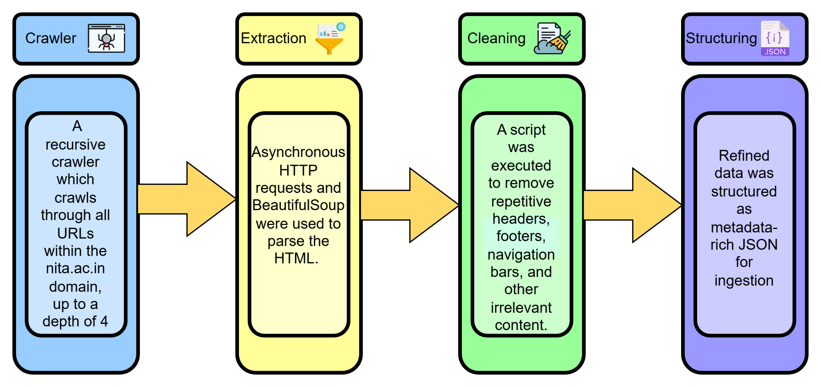
Data Pipeline
Figure 2: Data Extraction Pipeline

Slide 13
Embedding and Vector Storage
We use the HuggingFace all-MiniLM-L6-v2 embedding model to convert text into meaningful numerical vectors.
All generated vectors are stored in AstraDB vector database, which is designed for fast and efficient similarity search.
The cleaned institutional documents are first split into smaller chunks for better processing.
The embedding model transforms each chunk into a semantic vector that captures the actual meaning of the text.
AstraDB quickly finds the most similar vectors whenever a user asks a question, helping the system fetch the most relevant information.

Slide 14
Results
Accuracy Improvement: The implementation of Query Rewriting increased the system's accuracy from 82.75% to 94.25% across 200 test queries.
Hallucination Prevention: The system successfully eliminates fabrication by strictly refusing to answer questions that fall outside the provided institutional context.
System Performance: The chatbot achieves an average response latency of 2-6 seconds, supported by sub-second vector retrieval speeds from AstraDB.
Qualitative Reliability: Testing across administrative and academic queries confirmed that responses are consistently accurate and grounded solely in official NITA data.

Slide 15
Conclusion
The project delivers a reliable RAG-based chatbot for NIT Agartala using HuggingFace’s all-MiniLM-L6-v2 embedding model, AstraDB vector storage and Google Gemini to generate accurate and verified responses.
Query rewriting and semantic retrieval improve answer accuracy and relevance, proving the effectiveness of RAG systems for institutional information access.
The system creates a solid base for future enhancements like multilingual support, voice interaction and automated updates to make information more accessible.

Slide 16
Future Scope
Multi-Lingual Support: Adding support for Indian regional languages to enhance accessibility for non-English users. Utilizing translation APIs or fine-tuned multilingual LLMs to ensure accurate query processing.
Voice Interface Integration: Integrating Automatic Speech Recognition systems to convert spoken queries into text for processing and implementing TTS feature to provide verbal response.
Automated Data Updates: Developing an automated web crawler to periodically scan the NIT Agartala website for new or updated content. Ensuring content modifications are immediately reflected in responses.

Slide 17
Thank you

