Slide 1
ENT 609 AUT customer Discovery journal
© Devdip Purkayastha,

Slide 2
© Devdip Purkayastha
Team "____________________" / Member "M Danish M Jafar Sheikh (Roll No. 25M1704)" Customer Discovery Journal Startup: City wide EV battery swapping network for gig workers and commercial drivers ENT609 - 2025AUT
Potential Market? | Unmet Need? | Customer Profile? | Customer Name, Contact | Current Option / Cost? | What can be Better / Faster / Cheaper? | Price Willing to Pay?
Bike taxi riders (Rapido) using their own petrol two wheeler | Rental EV cost was too high and the nearest swapping station was up to 10 km away, which meant long detours and lost trips. | Rapido bike taxi rider. Owns a petrol bike. Has already used a rented electric bike earlier. Daily running: 100 to 150 km | 1) Name: Santosh Paswan Mobile: 9920969921 | Personal petrol bike today. Earlier: rented Stellar E-Bike at Rs 2,000 per week, about Rs 8,000 per month. Present petrol spend: Rs 265 – 395 per day | Lower monthly cost, and swapping points close to his riding area instead of 10 km away. Wants to run his own vehicle rather than pay rent for someone else's bike. | Ready to move back to EV if the monthly cost is clearly below Rs 8,000.
CNG auto rickshaw drivers considering a move to electric | Swapping and charging points are not available at convenient locations. He will not switch to electric until the network is as easy to reach as a petrol pump. | CNG auto rickshaw driver, runs a full daily shift in the city. Daily running: 100 to 120 km | 2) Name : Raju Patkar Mobile: 9321878231 | CNG auto rickshaw. CNG spend: Rs 325 – 400 per day | Swapping points every few kilometres across the city, on the pattern of petrol pumps, so that he never has to go home or waste shift time to refuel. | Found Rs 6,000 to 8,000 per month manageable and did not treat price as his main problem.
E-commerce and quick commerce delivery riders (Instamart) | Needs swapping stations inside his own delivery zone. Daily petrol cost cuts directly into his earning and he has no fixed monthly figure to plan around. | Instamart delivery partner riding a personal petrol bike. Daily running: 80 to 120 km | 3) Name: Siddharth Mobile: 8104615760 | Personal petrol bike. Petrol spend: Rs 210 – 300 per day | Swapping stations located inside his delivery area so that no detour is needed, and one fixed monthly payment in place of a daily petrol bill. | Rs 6,000 per month for unlimited swapping. Said he will shift from his petrol bike to an EV at this price because it works out cheaper for him.
Delivery riders who tried a rental EV and returned to petrol | The rental EV with unlimited swapping cost Rs 7,000 per month, which he found too costly, so he left EV altogether. He wants ownership of the vehicle, not a rental. | Delivery rider. Former EV user, now back on his own petrol bike. Daily running: 120 to 140 km | 4) Name: Sunil Kumar Mobile: 8291933165 | Own petrol bike today. Earlier: rental EV with unlimited swapping at Rs 7,000 per month. Petrol spend: Rs 210 – 320 per | The same unlimited swapping, but on his own bike and at a lower price. A saving of about Rs 1,000 per month is enough to make electric cheaper than petrol for him. | Rs 6,000 per month with his own bike. Called this affordable and said he would switch back to electric at that price.
ADDED INFORMATION

Slide 3
© Devdip Purkayastha
Team "____________________" / Member "M Danish M Jafar Sheikh (Roll No. 25M1704)" Customer Discovery Journal (continued) Startup: City wide EV battery swapping network for gig workers and commercial drivers ENT609 - 2025AUT
Potential Market? | Unmet Need? | Customer Profile? | Customer Name, Contact | Current Option / Cost? | What can be Better / Faster / Cheaper? | Price Willing to Pay?
Young gig workers with no vehicle of their own (parcel delivery) | Rental cost of Rs 8,000 to 9,000 per month is not sustainable on his earning. He wants to own a vehicle but cannot carry a high running cost while doing so. | Young parcel delivery gig worker. No vehicle of his own, so he rents an EV. Plans to buy his first bike soon and wants it to be electric. Daily running: 60 to 100 km | 5) Name: Mukesh Mobile: 9279611673 | Rental EV at about Rs 8,000 to 9,000 per month, which includes the vehicle and its charging. | Own an EV as his first vehicle and pay only for swapping, so the monthly outgo falls well below the present rental and he builds an asset at the same time. | Rs 4,000 to 5,000 per month quoted during the interview.
Delivery riders on rental EVs who want to own their vehicle | He is locked into renting. The monthly outgo is high, he builds no asset, and he stays dependent on the rental operator for the vehicle and its charging. | Young delivery worker currently running a rental EV. Daily running: 60 to 100 km | 6) Name: Mahesh war Mobile:7715854456 | Rental EV. Present rental cost: Rs 270 – 345 per day | Buy his own EV and use unlimited swapping on it. He expects a saving of Rs 1,000 to 2,000 per month against what he pays now for rental and fuel. | Rs 6,000 per month. Agreed to the plan when it was explained and said he will buy his own EV in order to join it.
CNG auto rickshaw drivers open to converting to electric | Wants a running cost lower than CNG without the long refuel wait that costs him earning hours every day. | CNG auto rickshaw driver running a daily commercial shift. Daily running: 100 to 120 km | 7) Name: Dilip Kumar Yadav Mobile: 9974601594 | CNG auto rickshaw. CNG spend: Rs 325 – 380 per day | One fixed monthly cost in place of a daily CNG bill, and a few minute swap in place of standing in the refuel queue. | Rs 6,000 per month for unlimited swapping. Agreed at this price and said he is ready to move his auto to electric.
Audio, Video, Picture Submitted on Moodle: ____6 images below given ______________ |  |  | Customer Interviews Done by: M Danish M Jafar Sheikh / Dates: _1 to 5 sept 2026 _________________
ADDED INFORMATION

Slide 4
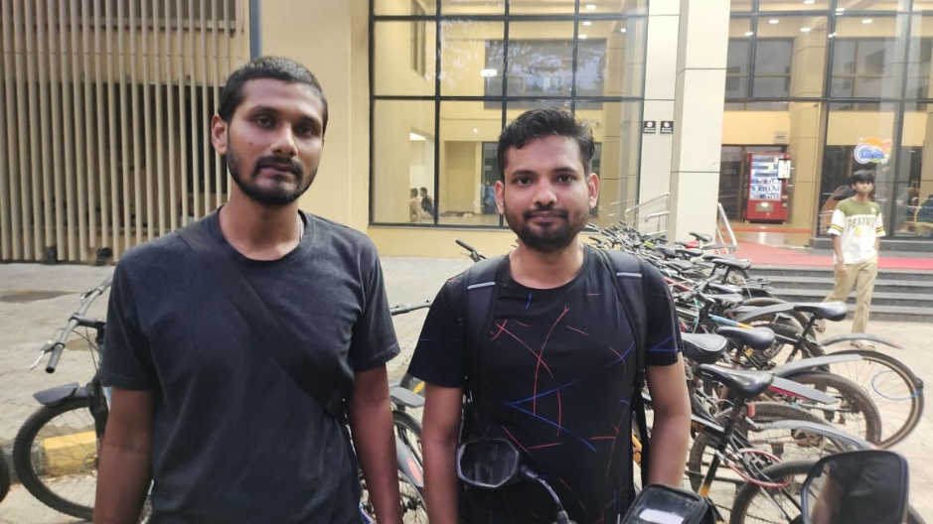
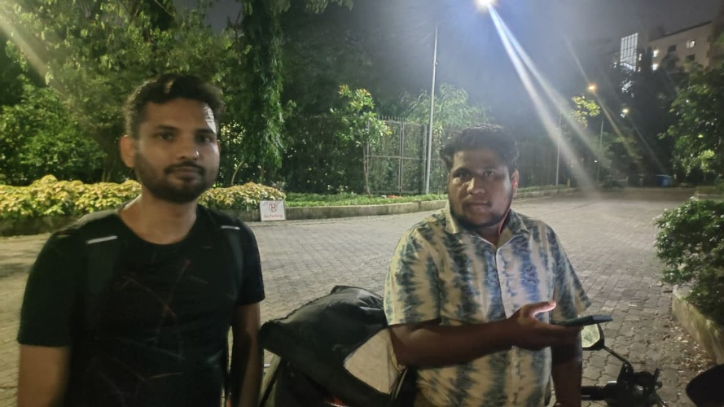
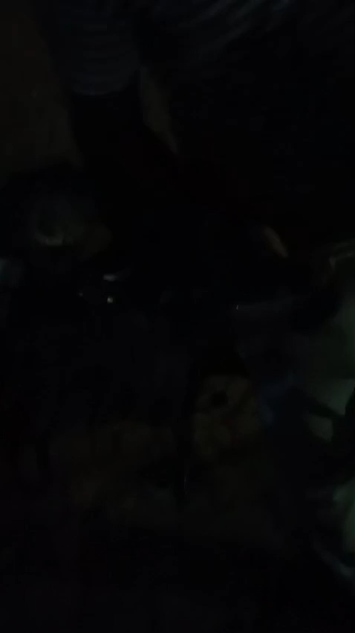
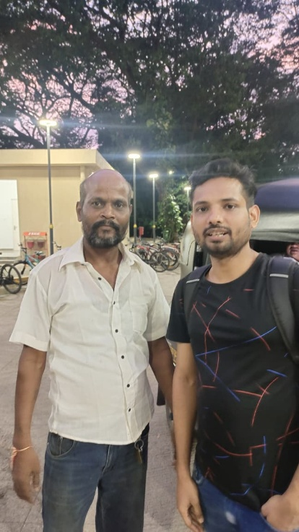
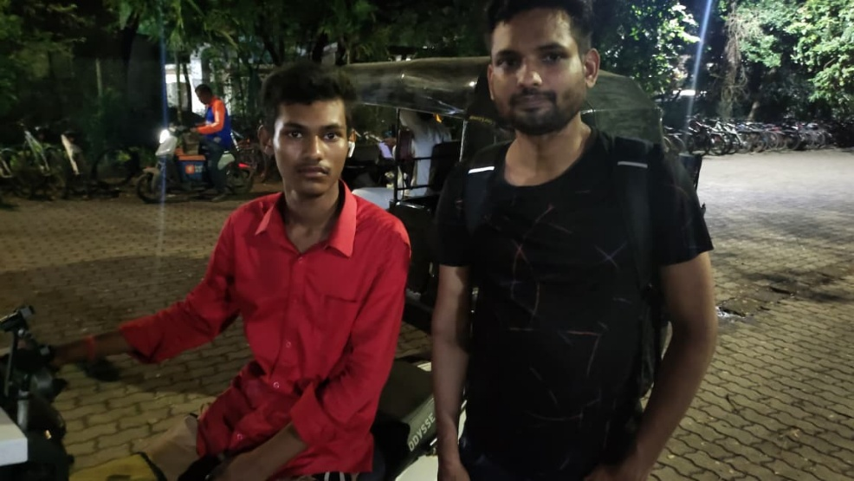
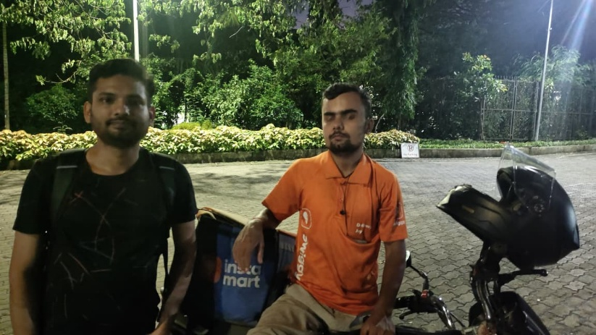
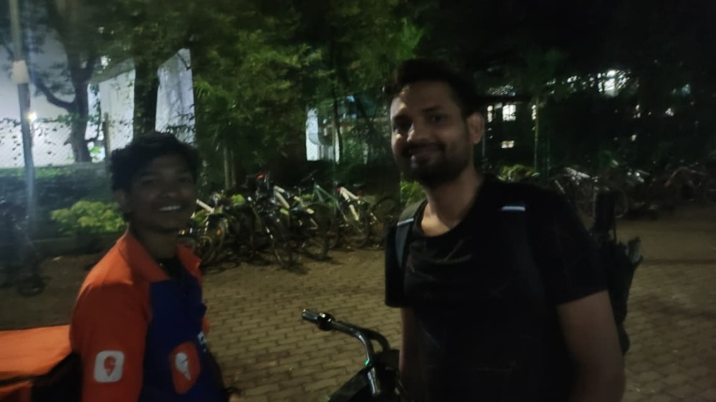
Team / Member “___________________________” Customer Discovery Journal ENT609 – 2025AUT
Audio, Video, Picture Submitted on Moodle Name : santosh paswan |  | Customer Interviews Done by M Danish (25m1704) / date – (1 to 5 sept 2026 )
Name : raju petkar
© Devdip Purkayastha
Name : sunil kumar
Name : Mukesh
Name : Siddharth
Name :Mahesh war

