Slide 1
Team 9 / Member “ 25M1708” Customer Discovery Journal
Potential Market? 1. Rapido & commercial riders 2. CNG Auto & commercial riders 3. Zomato food delivery riders | Unmet Need? 1. Affordable EV, nearby swapping, less downtime 2. Lower cost per km and more nearby battery stations 3. Affordable EV with better uphill performance | Customer Profile? 1. Rapido rider; personal petrol bike 2.Currently uses CNG vehicle 3. Zomato delivery boy; petrol bike | Customer Name, Contact 1.Nizzamuddin 9115346945 2. Amit Sindhe 9769856576 3. Raj 8303842812 | Current Option / Cost? 1. Petrol bike; previous rented EV ₹10,000/month; swapping up to 10 km away 2. CNG ~₹2.5/km; EV system ~₹1.5/km 3. Previous EV ~₹8,000/month; switched to petrol due to high cost and slow uphill performance | What can be Better / Faster / Cheaper? 1. Nearby swapping; less downtime; affordable EV plans 2. Save ~₹1/km; more stations nearby 3. Faster uphill performance; lower monthly price | Price Willing to Pay? 1. Ready to switch if cost is lower and swapping is nearby 2. Ready to purchase if more battery stations are nearby 3. Ready to purchase around ₹5,000/month
Audio, Video, Picture Submitted on Moodle |  |  |  | Customer Interviews Done by / date
© Devdip Purkayastha
ADDED INFORMATION

Slide 2
Team 9 / Member “25M1708” Customer Discovery Journal
Potential Market? 4. Ola & commercial auto drivers 5. Swiggy delivery riders 6. Zomato food delivery riders | Unmet Need? 4. Nearby station and affordable EV plan 5. Lower monthly EV cost 6. More affordable EV plan | Customer Profile? 4. Ola driver; currently uses CNG auto 5. Swiggy delivery boy; currently uses EV 6. Zomato delivery boy; currently uses EV | Customer Name, Contact 4. Sanjay 5.Kaushlendra Singh 6. Ritesh Yadav | Current Option / Cost? 4. Currently uses CNG auto 5. Current EV cost: ₹7,200/month 6. Current EV cost: ₹7,200/month | What can be Better / Faster / Cheaper? 4. Station near him; affordable monthly plan 5. Reduce monthly cost to ₹4,000 6. Monthly cost below ₹4,000 | Price Willing to Pay? 4. Ready to shift if station is nearby and price is ₹4,000–₹5,000/month 5. Ready to join our company at ₹4,000/month 6. Ready to join if price is below ₹4,000/month
Audio, Video, Picture Submitted on Moodle |  |  |  | Customer Interviews Done by / date
© Devdip Purkayastha
ADDED INFORMATION

Slide 3
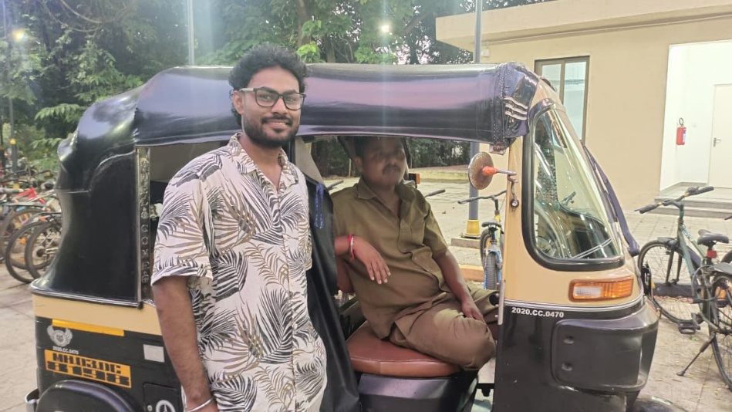
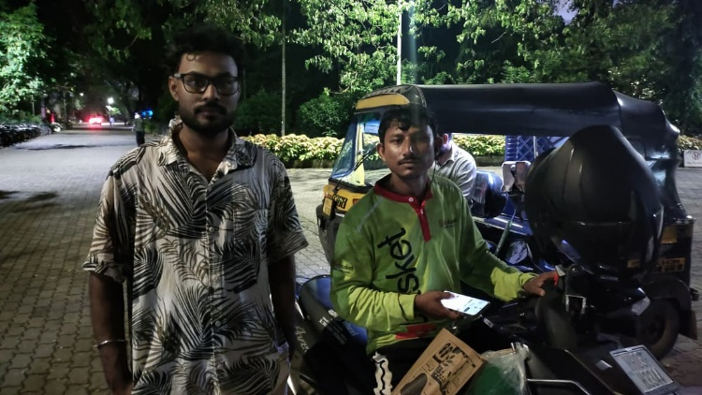
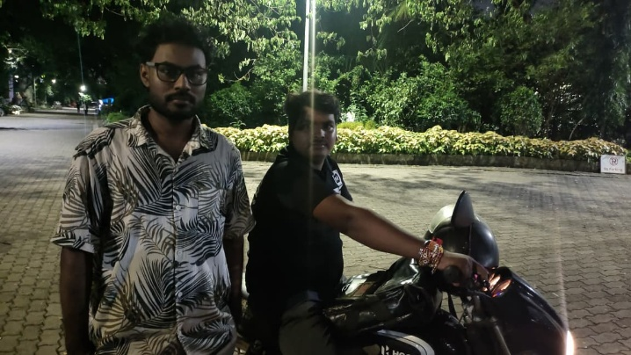
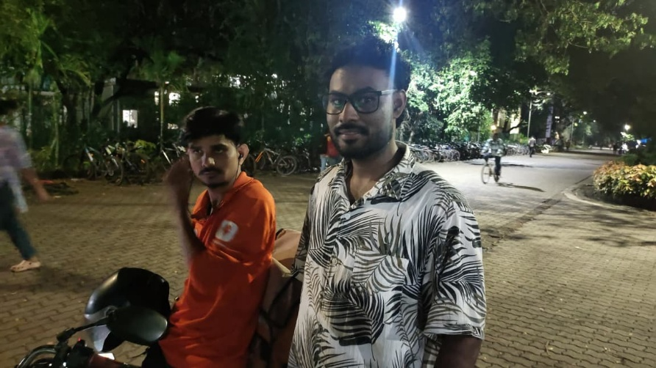
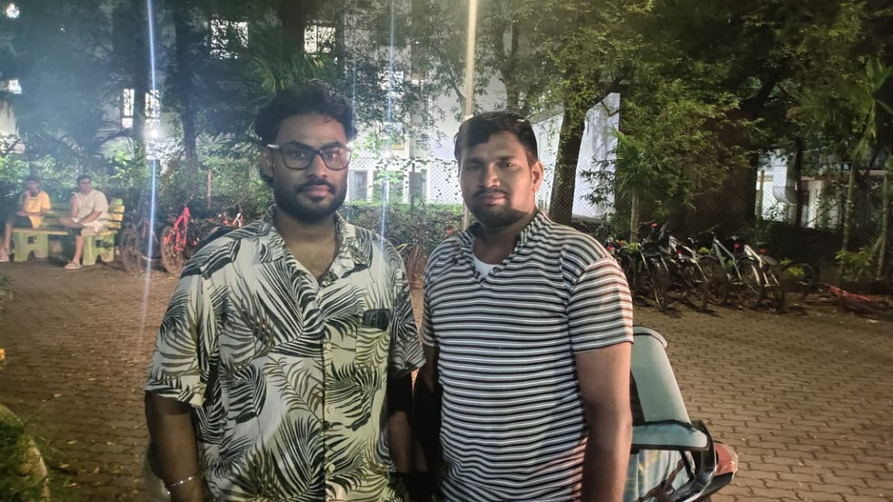
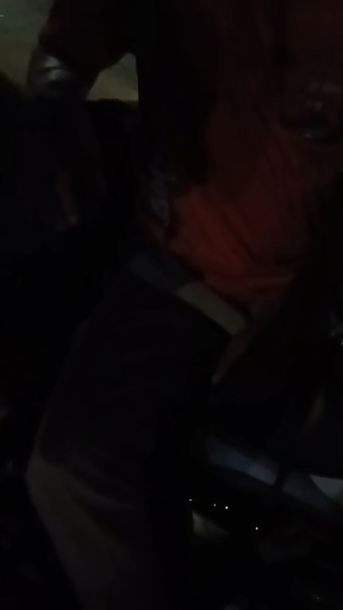
Team / Member “___________________________” Customer Discovery Journal ENT609 – 2025AUT
Audio, Video, Picture Submitted on Moodle 1. | Customer Interviews Done by / date 1. 27 Aug 2026 and 5 sep 2026

Slide 4
Thank You

