Slide 1

Self-Introduction
My name is Alex Snyder
I am a United States Navy veteran
I am twenty-eight years old
My wife and I are expecting our first child this November
I completed my undergraduate at the University of Tennessee Chattanooga in May of 2020, and I will be finishing my Master's degree in December of 2021.
Notes:
Originally from Northwest Ohio, Toledo Area… but probably better off described as corn country.
Lived in Yokosuka, Japan for 3 and a half years.
Graduated with a Bachelor degree in Mechanical engineering taking senior level electives in Kinematics and Dynamics 1 and 2 and Vibrations.
Masters Degree with focus in Mechanical and aerospace studies strictly computationally.

Slide 2

BAM6QT a Hypersonic Wind Tunnel
By:
Alexander J Snyder

Slide 3
Introduction
Purpose
Introduction to Problem
Problem Setup
Boundary Conditions
Meshing
Simulation Tools
Simulation Setup
High Performance Computational Setup
Results
Cartesian Solver
Steady State
Unsteady
Conclusion
Other Work
References
Questions

Slide 4
Purpose
Demonstrates what geometry will “start” in the BAM6QT wind tunnel.
Will save money in experimental costs.
Allows for multiple geometries to be tested computationally without the need for fabrication.
Observation on how primitive variables such as pressure, temperature, and density are being affected by changing boundary conditions, initial conditions or test geometries.
Understanding of how boundary layer forms in a hypersonic wind tunnel and how FUN3D and Cart3D flow parameters were determined, and how setup can be applied to future BAM6QT and other hypersonic wind tunnel simulations.
Notes:
start - referring to what geometry will reach desired Mach number

Slide 5
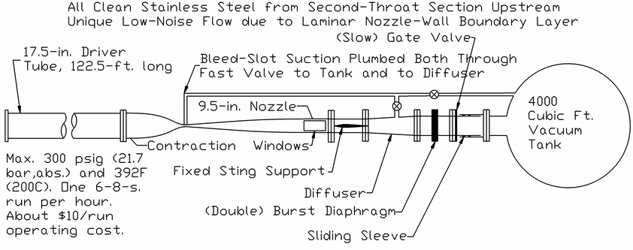
Introduction to Problem
The BAM6QT is a hypersonic wind tunnel that can reach Mach 6 in the test section under quiet flow conditions
It is located at Purdue University
It consists of a Driver section, a Test section, and a Vacuum tank section
Notes:
High pressure end and low-pressure end
Suction Tubes on Throat
Can work with diagram system or quick acting ball valve .
Sucks Boundary layer out of test section to provide more area for fully developed flow meaning a higher velocity leading to a higher Mach Number.
Stagnation pressure and temperature was set too 130 PSIA and 160 C to reach optimum performance – values chosen from experimental data.
Definition of the word started- the desired Mach number has been reached and is occurring at object in the test section.
There are two Set ups Noisy and Quiet, where the noisy refers to suction off and quiet refers to suction on

Slide 6
Problem Setup
Only a quarter of the wind tunnel needed to be simulated due to the geometry of the wind tunnel being centered along the x-axis and the model being symmetric both in the y and z directions.
Spacing of mesh wall (y+ = 1) | 1.0E-5 meters
Stagnation Pressure Inlet | 130 PSIA
Stagnation Temperature Inlet | 160 Celsius
Back Pressure Outlet | 10 Torr
Reynolds Number initialized flow conditions | 8223917.433 /meter
Turbulence Model | Spalart-Allmaras
Notes:
Y plus calculations were needed for anisotropic cells that were made to propagate of the surface of wall boundary layer, this was made to model the viscous forces at the boundary layer.
Fun3d and Cart3d require nondimensionalized pressure and temperature ratios. Where t infinity was based off of 288.15 k and was used with the Reynolds number to determine p infinity.
Boundary conditions for mesh consisted of wall , subsonic inlet, outlet, y and z symmetry planes. * talk about how the inlet condition was changed to wall for running shock problem
Also tried other Turbulence models such as SST

Slide 7
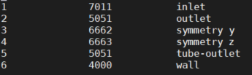
Boundary Conditions (FUN3D)
Inlet
Subsonic inlet set by stagnation/freestream pressure and temperature ratio.
Wall
Outlet
Subsonic outlet-set by back pressure ratio
Back Pressure Supersonic outlet-set by back pressure ratio
Wall
Viscous wall – adiabatic walls (zero heat flux)
Tangency wall (inviscid) – GPU did not support Z symmetry plan this was used instead.
Symmetry
Used to show center Symmetric plans in the wind tunnel
Notes:
Wall Inlet condition was used in the case of shock tube problem initially to determine mass conservation.

Slide 8
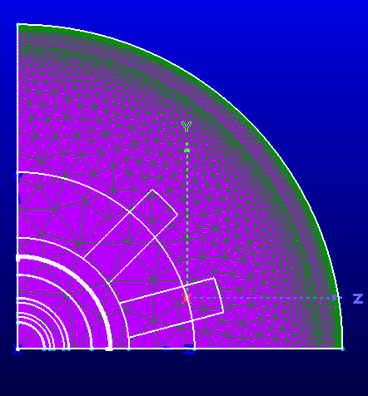
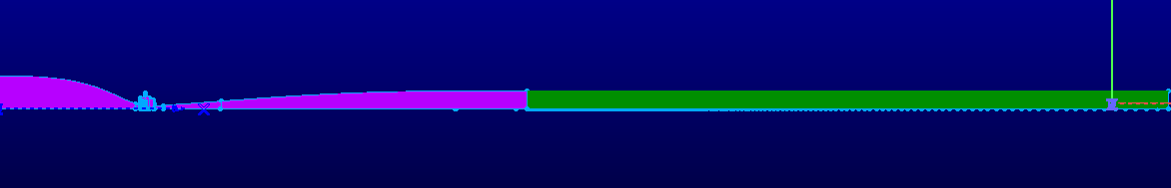
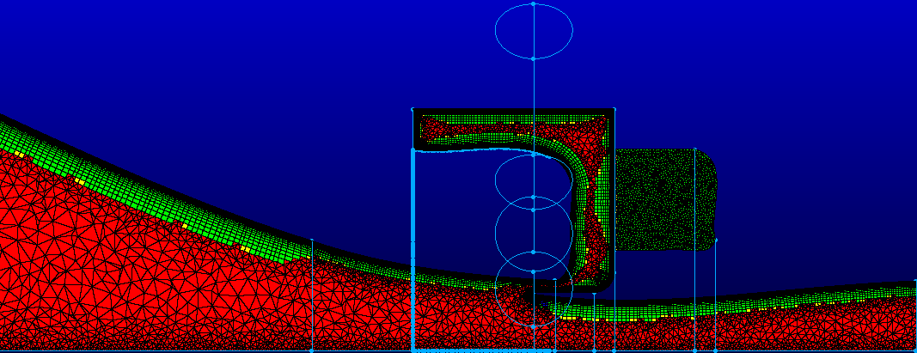
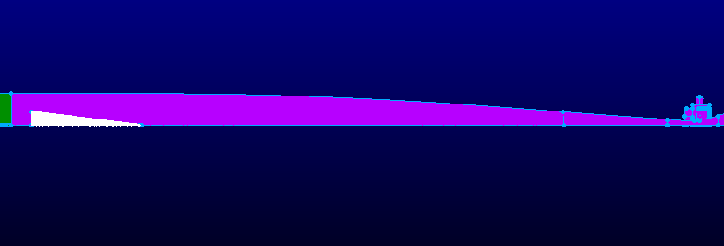
Meshing
Number of Points | Number of Cells | Number of Tetrahedrons | Number of Pyramids | Number of Prisms | Number of Hexes
12,792,320 | 28,013,856 | 4,643,578 | 282,415 | 23,056,539 | 31,324
Notes:
Top right
What was the size of the throat 1.5-inch throat
Area Change of 11.66
Inlet 17.5 inches
Outlet 9.5 inches
Bottom left
Anisotropic cells are formed along the boundary layer until isotropy is reached.
Isotropy is defined when elements high is equal too its length
Bottom right
Showing location of cone inside BAM6QT

Slide 9
Simulation Tools
Cart3d
Cartesian solver
Inviscid
Solution Adaptation
Fun3d
Inviscid and viscous
Time dependent simulations (shock tube)
Steady state simulations
Notes:
Fun3d- Developed by Nasa Langley
Cart3d-Developed by Nasa Ames
Adaptative Mesh allows for area such as shock wave or cones in nonempty wind tunnels to have more points to be bunched and generated in the volume to get better resolution
Cart 3D- creates its own volume mesh from a surface mesh of only triangles
Allows for simulations at different boundary conditions
Different flux solvers such as Roe or Aldfss or Vanleer
Flow initialization

Slide 10
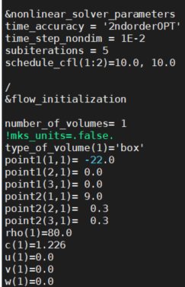
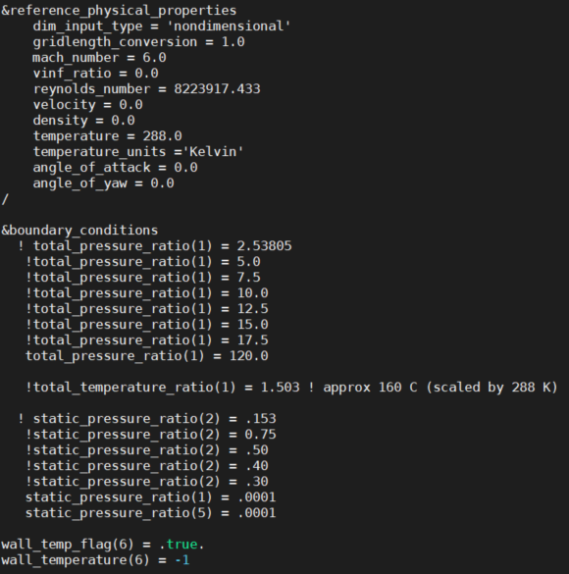
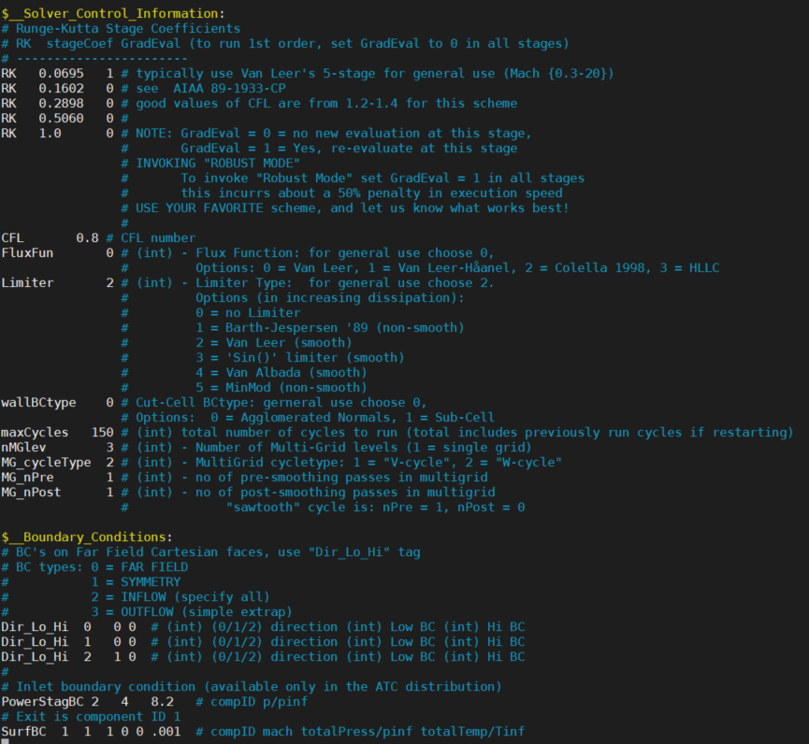
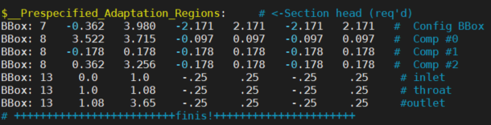
Simulation Setup
Fun3d
Cart3D
Notes:
2nd order OPT 2nd order optimization
Sub iterations are new iterations

Slide 11
High Performance Computational Setup
High Performance Cluster | Number of Computational Nodes | Numbers of Cores per Node | Computation Time Per Simulation (CPU)
Epyc | 16 | 128 | 20,000 Steps in 24 hours
High Performance Cluster | Number of GPUs | Type of GPUs | Number of Computational Nodes | Number of Cores per Node | Computation Time Per Simulation (GPU)
Firefly | 4 | 32 GB Nvidia V100 | 4 | 80 | 40,000 steps in 24 hours
Notes:
Total for Epyc = 2048 cores
Total for Firefly= 320 cores
Python Pressure Script
Bash Pressure Script
Current Research- determining if GPU can be used to BAM6QT correctly (test different flux schemes, first order iterations, and mesh set up)

Slide 12
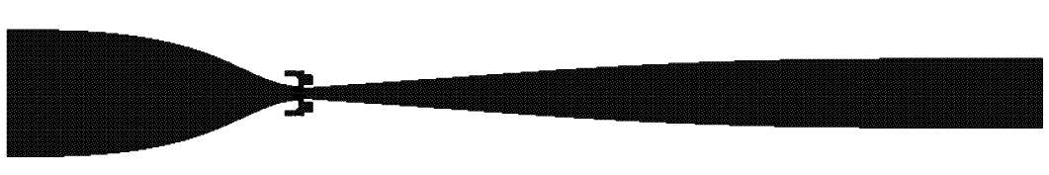
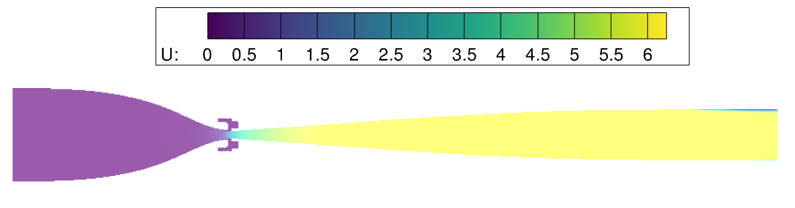
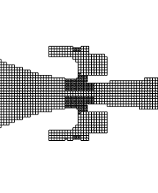
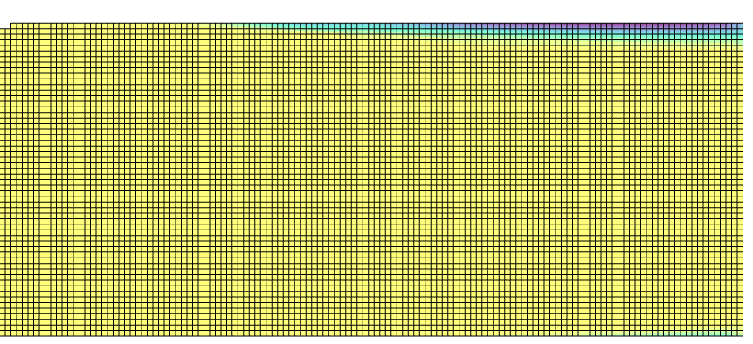
Results- Cartesian Solver (Cart3D) Empty Tunnel
Notes:
Cube volume mesh shown in top picture allows for refinement along angles, max refinment, and number of refinments to be specified
Middle picture shows
Non-dimensionalized velocity and Recirculation area
Bottom left
Refinement occurring in throat

Slide 13
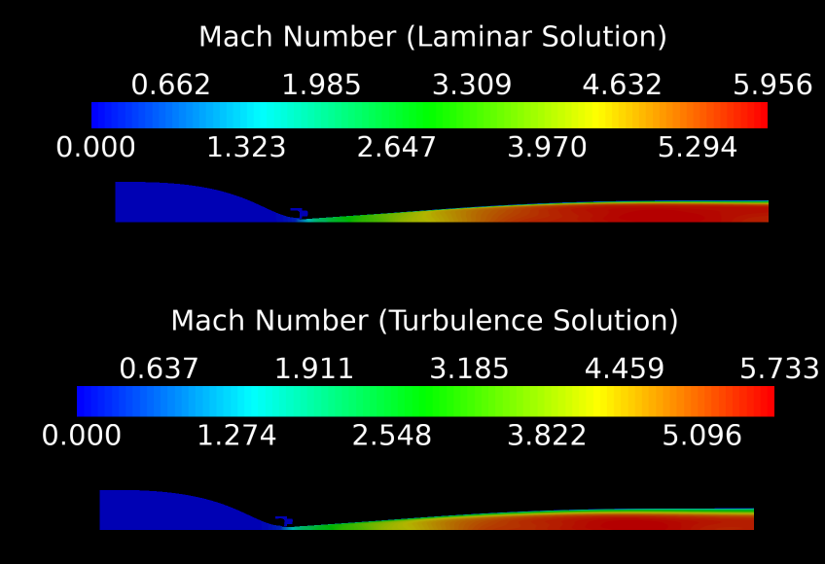
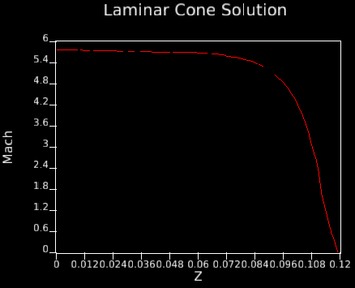
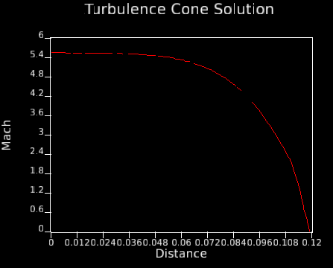
Results-Steady State (FUN3D) Empty Tunnel
Notes:
Empty Wind Tunnel laminar vs. Turbulent
Experimental 6
Experimental 5.8

Slide 14
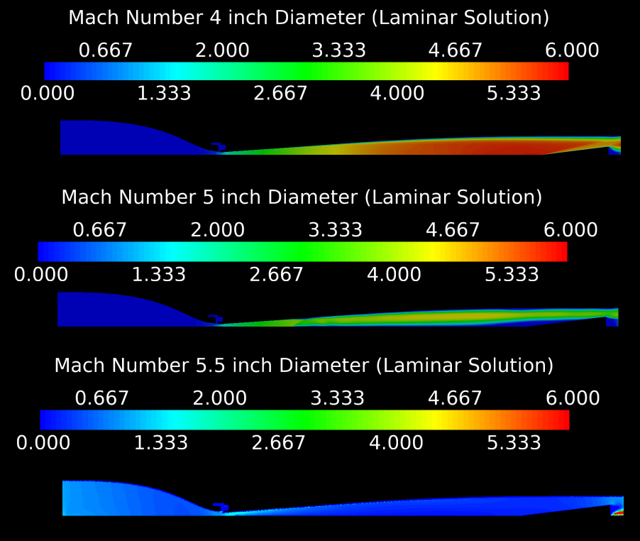
Results- Steady State (FUN3D) Cone in Tunnel
Notes:
Steady State cone comparison
Verified experimentally that 5.5D and 5D will not start by Purdue

Slide 15
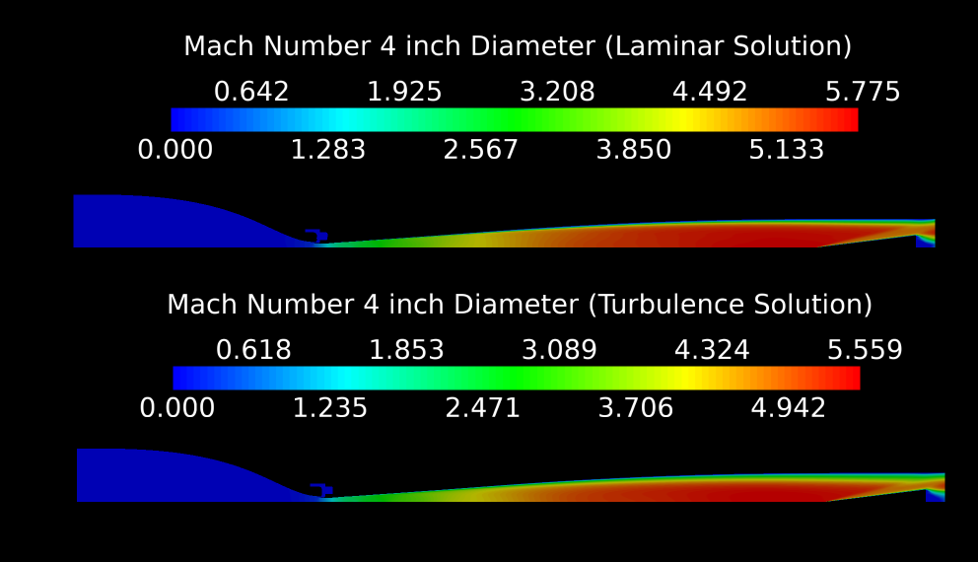
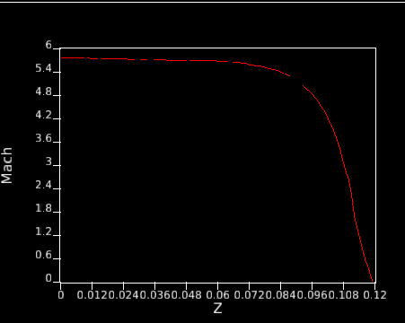
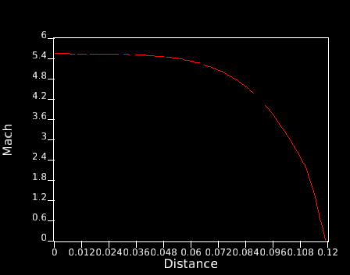
Results-Steady State (FUN3D) Cone in Tunnel
Notes:
Laminar vs Turbulent comparison between 4-inch Diameter cone

Slide 16
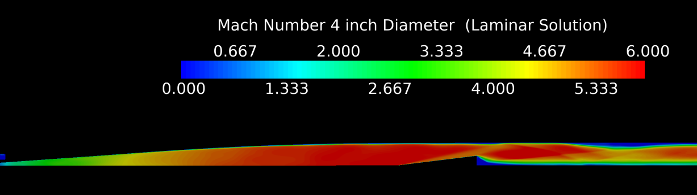
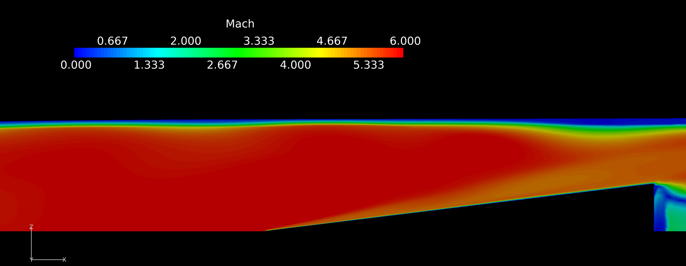
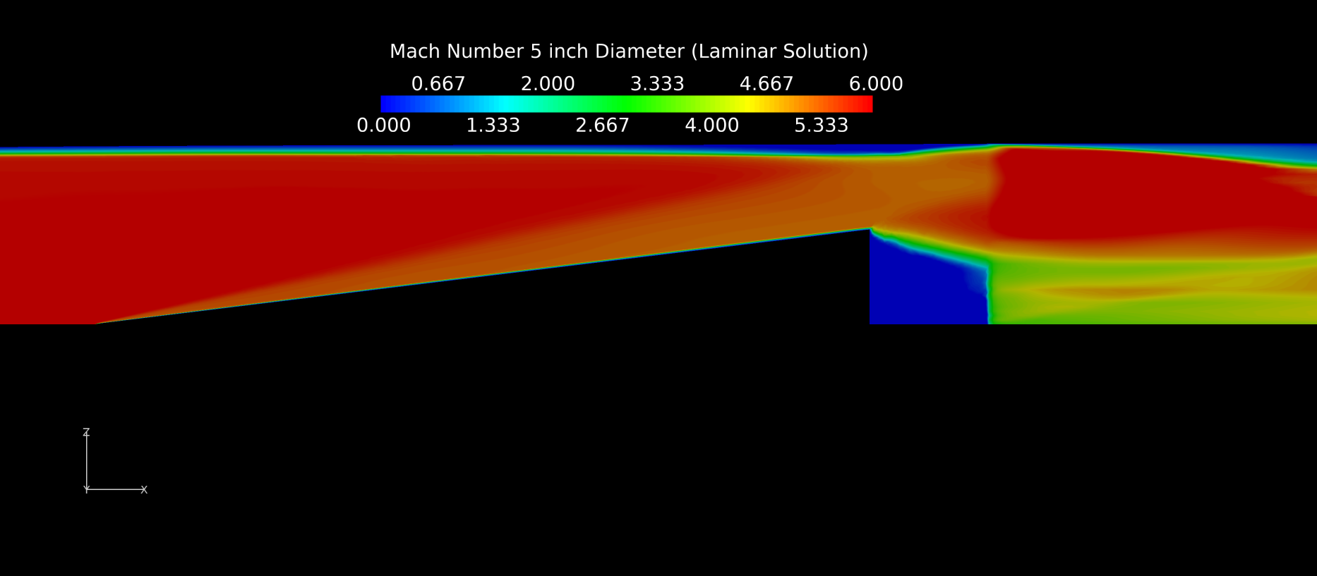
Results-Unsteady (FUN3D) Cone in Tunnel
Notes:
Unlike Steady State Solutions both the 4D and 5D cones started in Unsteady Case
Most research is occurring here right now because it appears that GPU effect solution, I have verified that its not due to the Flux Scheme, and wall boundary contions don’t effect sol

Slide 17
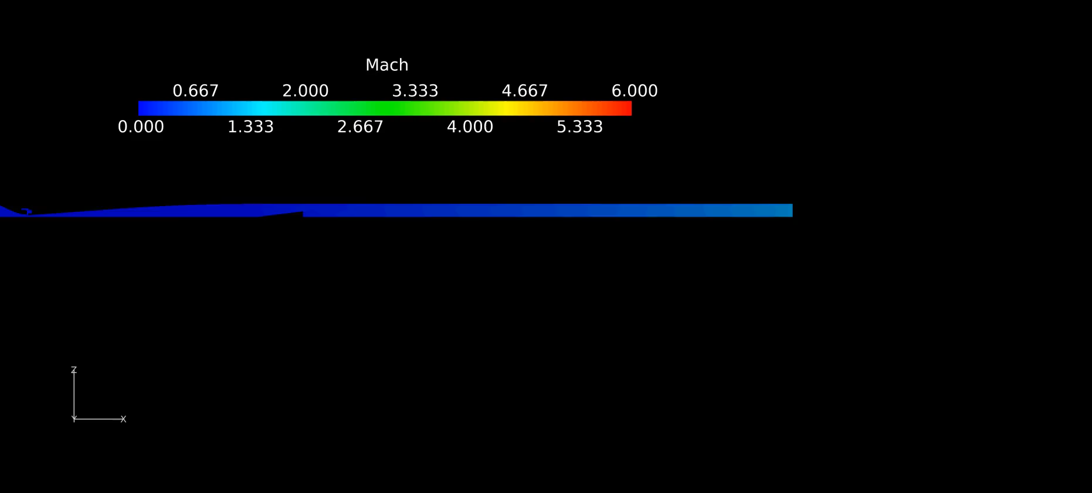
Results-Unsteady (FUN3D) Cone in Tunnel
Notes:
Further Testing is still required to determine is extensions in tube are required.

Slide 18
Conclusion
Cart3D had recirculation occurring at the end of the wind tunnel, one thought for why this was occurring was due to the step cubed mesh set up. Further testing needs to occur to determine proper simulation setup. Circulation seemed to decrease as number of steps increased but never completely disappeared.
It was observed that during steady state runs that laminar simulations recorded a higher Mach number which can also be understood due to the Turbulent simulations producing a thicker boundary layer.
No large change to the boundary layer was observed when boundary layer suction in test section occurred
The transient (shock tube) and steady-state solutions agreed that a 4-inch diameter cone with a 7-degree half angle would start, but cones with a larger diameter than 4 inches would not start in in steady state solution but up to 5.5-inch Diameter would start in unsteady solution.

Slide 19
Other Work
Dual T-38 Talon fighter jet Shock interaction -Ansys simulated
Aerodynamic Database GHV
Developing explicit unstructured 3D Computational Fluid Dynamics Solver using Roe scheme- C++
Shock wave properties calculator- MATLAB
Work in MATLAB, Python, C++ and Maple

Slide 20
References
“Cart3d->Main Page.” NASA, NASA, www.nas.nasa.gov/publications/software/docs/cart3d/pages/cart3Dhome.html.
“FUN3D Manual :: Chapter 1: Overview and Getting Started.” NASA, NASA, fun3d.larc.nasa.gov/chapter-1.html#user_manual.
Jewell, Joseph S., et al. “Transient Startup Simulations for a Large Mach 6 Quiet Ludwieg Tube.” 55th AIAA Aerospace Sciences Meeting, 2017, doi:10.2514/6.2017-0743.
Juliano, Thomas J., et al. “Quiet-Flow Ludwieg Tube for Hypersonic Transition Research.” AIAA Journal, vol. 46, no. 7, 2008, pp. 1757–1763., doi:10.2514/1.34640.
Kimmel, Roger L., et al. “AFRL Ludwieg Tube Initial Performance.” 55th AIAA Aerospace Sciences Meeting, 2017, doi:10.2514/6.2017-0102.
Schneider, Steven, et al. “Hypersonic Stability and Transition Experiments on BLUNT Cones and a Generic Scramjet Forebody.” 41st Aerospace Sciences Meeting and Exhibit, 2003, doi:10.2514/6.2003-1130.

Slide 21
Questions?
Contact Information
kxw148@mocs.utc.edu
Continued Work
https://github.com/kxw148

Slide 22
Thank you

