Slide 1
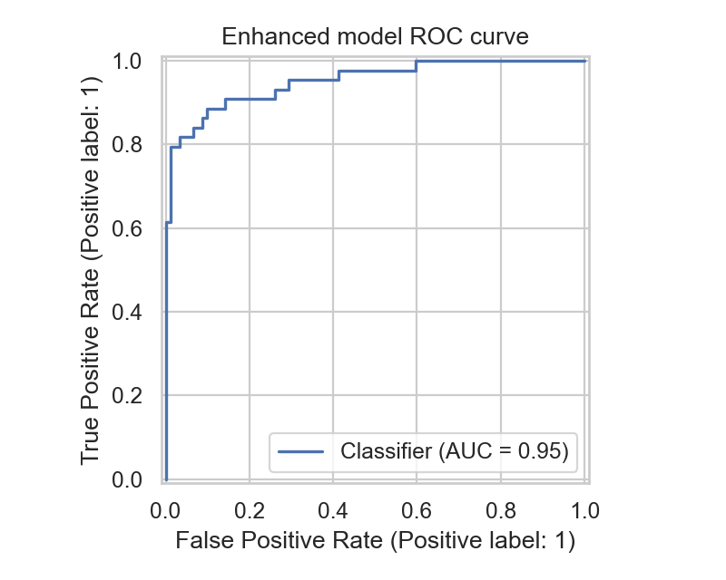
CLINICAL DECISION SUPPORT · BIOHACKATHON 2026 WOMEN'S HEALTH
PCOS Pathfinder
A tiered, explainable clinical decision-support prototype for earlier PCOS detection and safer differential workup.
0.953
Enhanced AUC
0.886
Sensitivity
13
Reproducible notebooks
Held-out test split, n=136. Thresholds selected from training out-of-fold probabilities.
1 / 23
Notes:
Good morning. We built PCOS Pathfinder: a practical, explainable decision-support workflow for earlier PCOS detection. Our thesis is simple — clinical AI should not just predict a label. It should help clinicians decide who needs assessment, explain why, and avoid missing overlapping conditions. On the held-out split, the enhanced model reaches 0.953 ROC-AUC with 0.886 sensitivity, and everything is reproducible from thirteen notebooks.

Slide 2
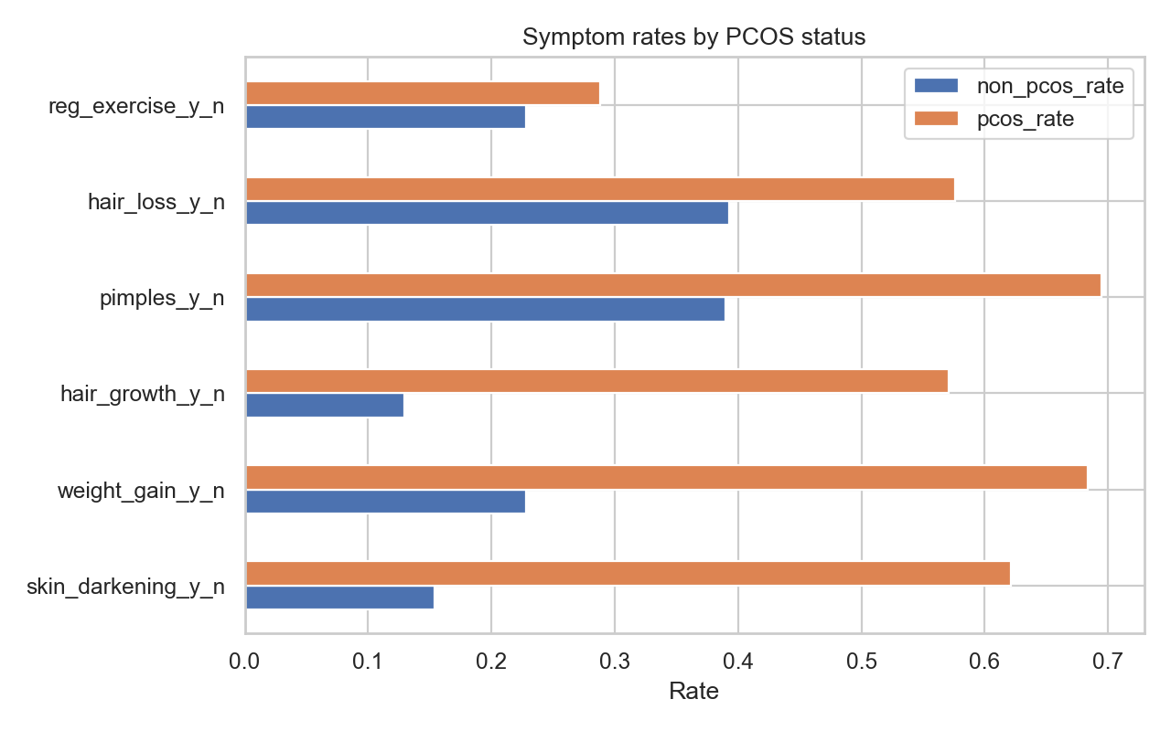
THE DIAGNOSTIC GAP
PCOS is common, heterogeneous, and routinely missed.
8–13%
of reproductive-age women affected (Teede et al., Fertil Steril 2023)
4+ yrs
average diagnostic delay across studies
~70%
estimated undiagnosed globally (Teede 2023; March 2010)
Complex presentation
Acne, weight change, irregular bleeding, infertility, metabolic risk, and ultrasound findings can each be the first signal.
Delayed pathway
Primary care sees the earliest signals; labs and ultrasound often arrive only after specialist referral.
Overlap risk
Pelvic pain and infertility can point toward adjacent gynecologic conditions — the system must reduce tunnel vision.
Source cohort symptom differences ground the clinical story.
2 / 23
Notes:
The challenge asks us to improve diagnostic accuracy in women's health. PCOS is a perfect core case because it is common, heterogeneous, and often delayed. A patient may first present with acne, hair growth, irregular bleeding, weight changes, or fertility concerns. Those signals are clinically meaningful, but they are often spread across visits and specialists. Our design goal is not just a high AUC — it is a workflow that fits the diagnostic pathway.

Slide 3
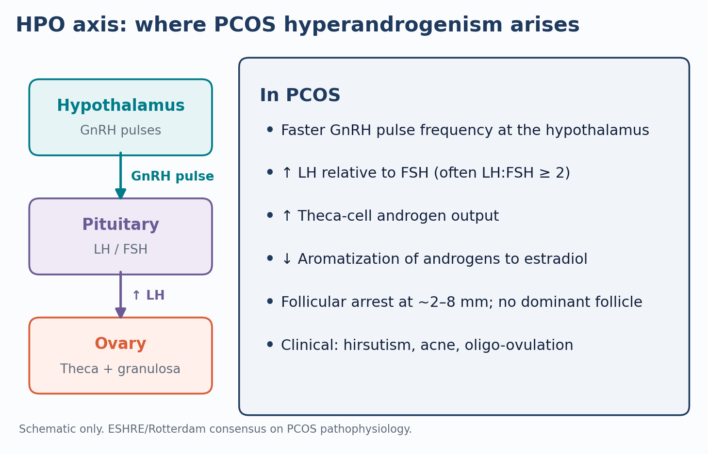
PATHOPHYSIOLOGY · HPO AXIS
The hyperandrogenism in PCOS is upstream of the ovary.
Why this matters for the model
• PCOS disrupts GnRH pulse frequency, raising LH relative to FSH.
• Elevated LH drives theca-cell androgen production; relative FSH deficit reduces aromatization to estradiol.
• Clinically: hirsutism, acne, oligo-ovulation — features the screening tier uses as low-friction inputs.
• Why an enhanced tier matters: testosterone is the missing direct biomarker; AMH + LH:FSH context partially substitutes.
3 / 23
Notes:
PCOS hyperandrogenism is not a primary ovarian problem alone — the GnRH pulse generator runs fast, LH dominates relative to FSH, and theca cells overproduce androgens. The screening model picks up the downstream skin and cycle features without needing the lab; the enhanced tier adds AMH and follicle counts that reflect the follicular-arrest endpoint.

Slide 4
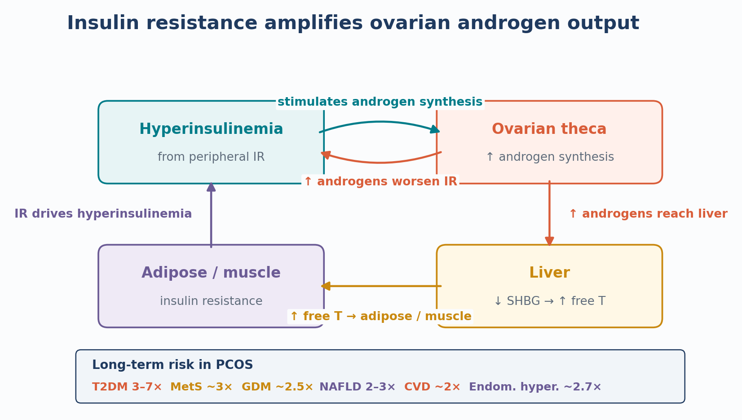
PATHOPHYSIOLOGY · METABOLIC AXIS
Insulin resistance amplifies the androgen loop and drives long-term risk.
Why this matters for the model
• Peripheral insulin resistance raises insulin, which directly stimulates ovarian theca androgen output.
• Hyperinsulinemia also lowers hepatic SHBG, raising free testosterone.
• PCOS confers 3–7× relative risk of T2DM; CVD, GDM, NAFLD, and endometrial hyperplasia all elevated.
• Why our app warns on lean PCOS: metabolic risk is not purely BMI-driven; lean patients can still be insulin-resistant.
4 / 23
Notes:
The insulin–androgen loop is the metabolic engine of PCOS. The long-term risk multipliers — type-2 diabetes, cardiovascular events, NAFLD — justify treating PCOS as a metabolic-cardiovascular condition, not only a reproductive one. The app's lean-PCOS warning is grounded in this biology: low BMI does not rule out insulin resistance.

Slide 5
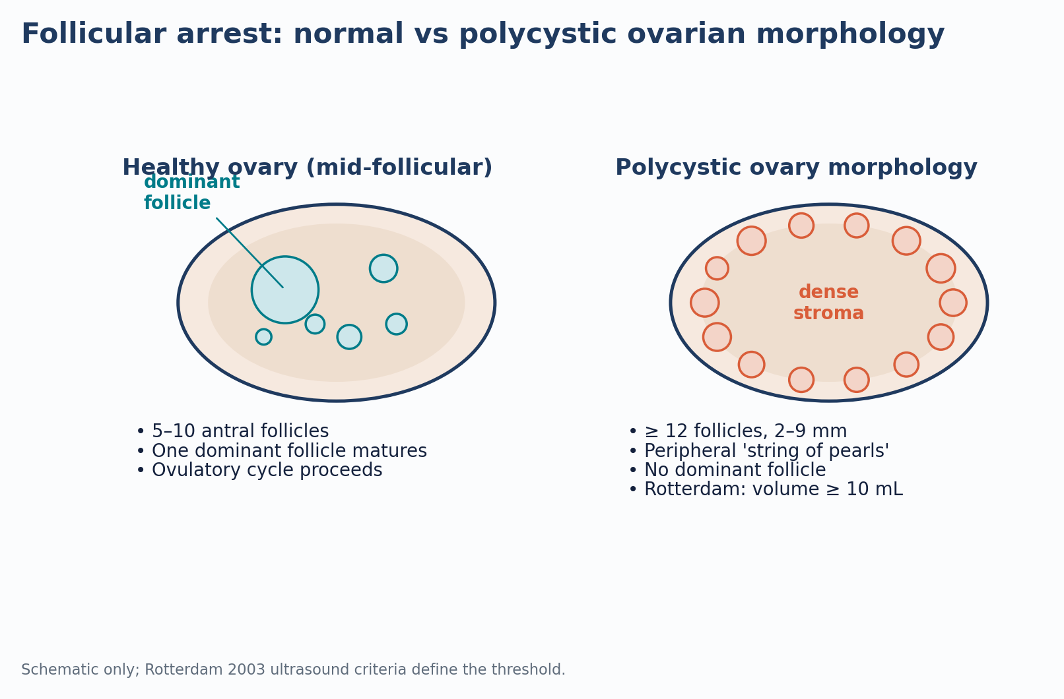
MORPHOLOGY · FOLLICULAR ARREST
Polycystic morphology is follicular arrest, not multiple cysts.
Why this matters for the model
• Healthy ovary: 5–10 antral follicles, one dominant follicle matures and ovulates.
• PCOM: ≥ 12 follicles 2–9 mm arranged peripherally; dense stroma; no dominant follicle.
• Rotterdam 2003 ultrasound criterion: ≥12 follicles or volume ≥10 mL.
• Why follicle counts dominate enhanced-model SHAP: they are the most specific morphologic feature available in this dataset.
5 / 23
Notes:
Polycystic morphology is not multiple cysts — it is follicular arrest. Small antral follicles accumulate at the periphery because none receive sufficient FSH to become dominant. This is why follicle_no_l and follicle_no_r dominate enhanced-model SHAP for positive cases: they are the most specific morphologic signal in the dataset.

Slide 6
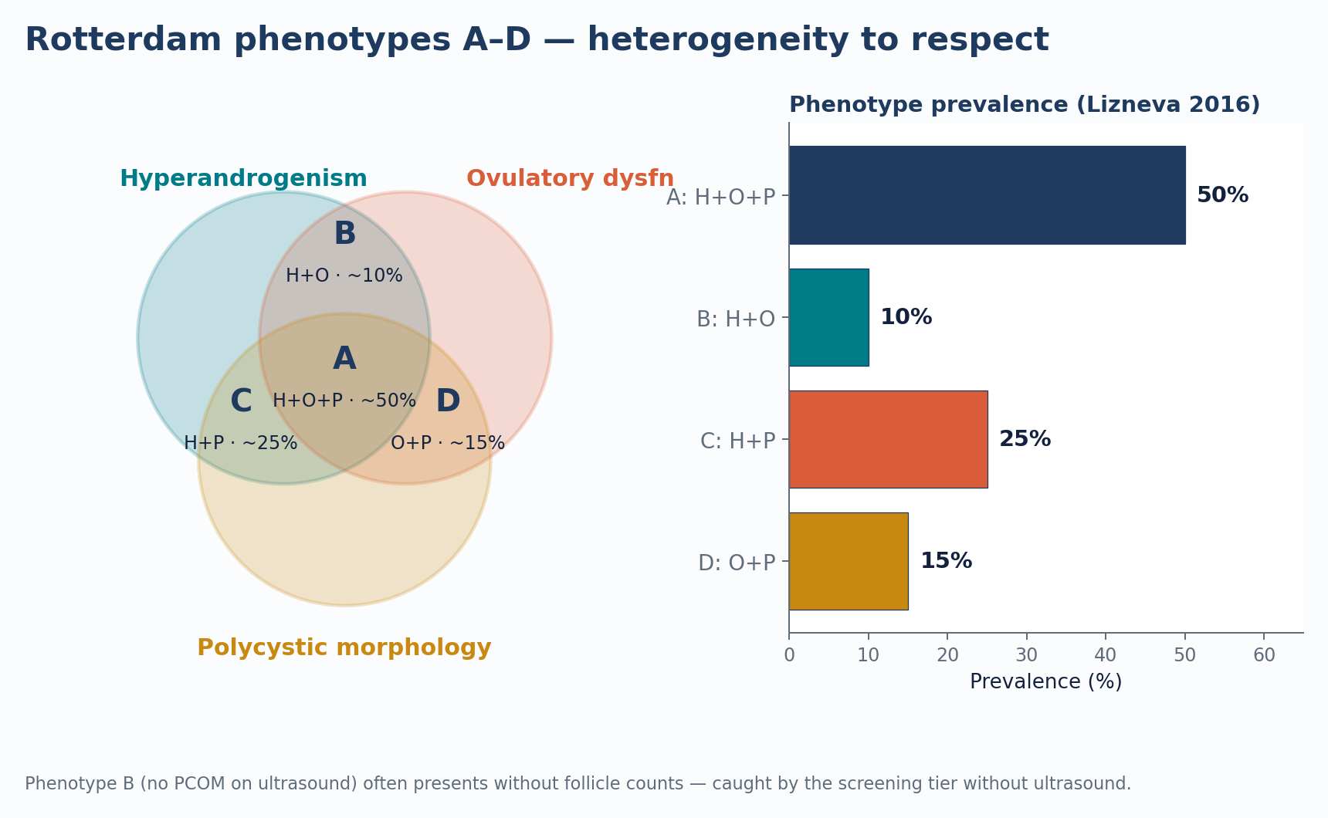
HETEROGENEITY · ROTTERDAM PHENOTYPES
PCOS is heterogeneous: 4 Rotterdam phenotypes with different presentations.
Why this matters for the model
• Rotterdam criteria: any 2 of hyperandrogenism, ovulatory dysfunction, polycystic morphology.
• Phenotype A (all three) ≈50%; B (H+O) ≈10%; C (H+P) ≈25%; D (O+P) ≈15% (Lizneva 2016).
• Phenotype B can lack ultrasound findings — screening tier catches it without follicle counts.
• Lean PCOS overlaps multiple phenotypes; the app's lean-PCOS warning addresses the screening recall gap we measured.
6 / 23
Notes:
PCOS is not one disease. Four phenotypes presenting through different combinations of hyperandrogenism, ovulatory dysfunction, and polycystic morphology — with different metabolic profiles. The screening tier exists in part to catch phenotypes B (H+O, no PCOM) without requiring ultrasound.

Slide 7
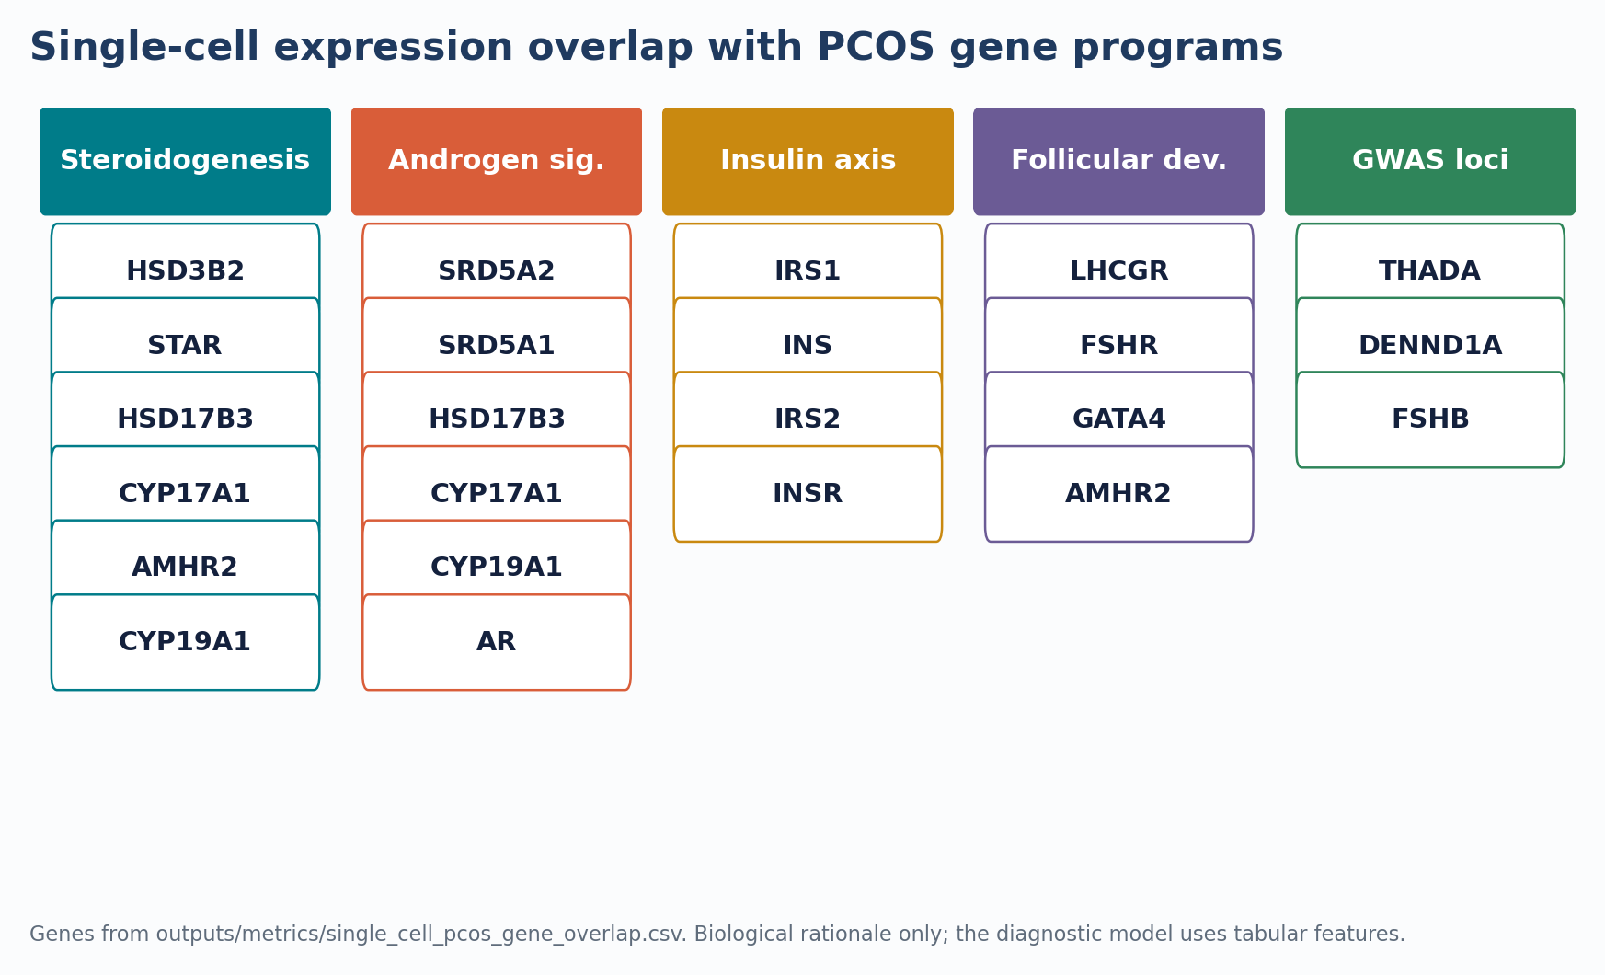
MOLECULAR RATIONALE · SINGLE-CELL OVERLAP
Single-cell gene programs ground the diagnostic feature set in biology.
Why this matters for the model
• Curated PCOS gene programs span steroidogenesis, androgen signalling, insulin axis, follicular development, and GWAS loci.
• 20 genes recovered from a sampled single-cell ovary feature list — biological rationale, not an expression analysis.
• Same axes (androgens, insulin, follicular development) that the tabular features capture downstream.
• Limitation: the diagnostic model uses tabular clinical features only — this slide grounds those features in the underlying biology.
7 / 23
Notes:
The single-cell layer is used for biological rationale only, not as expression evidence. The point is that the same biological axes that drive PCOS at the molecular level — steroidogenesis, androgen signalling, insulin, follicular development, GWAS loci — are the axes our clinical features capture downstream.

Slide 8
TIERED WORKFLOW
A tiered pathway that matches real clinical escalation.
1
2
3
4
Frontline screening
Symptoms and basic vitals for primary care, telehealth, or outreach.
Enhanced support
Add labs and ultrasound when the clinician has more evidence.
Checklist
Rotterdam-style completeness, missing-testosterone caveat, metabolic prompt, lean-PCOS warning.
Differential prompt
Endometriosis-overlap nudge using synthetic data, framed only as workflow support.
Core idea Give clinicians a sequence of next-best actions, not an opaque yes/no diagnosis.
8 / 23
Notes:
The product is tiered. First, a frontline model uses low-friction data. Second, an enhanced model uses labs and ultrasound. Third, the app shows a diagnostic-completeness checklist so the clinician sees what evidence is present and what is missing. Fourth, the overlap prompt warns when the symptom pattern deserves broader gynecologic workup. That is why this is decision support, not automated diagnosis.

Slide 9
DATA FOUNDATION
Data choices were conservative by design.
Dataset | Use | Claim boundary
PCOS clinical, n=541 | Main modelling foundation | 10 hospitals, Kerala, India · external validation required
Endometriosis, n=10,000 | Symptom-overlap prompt | Synthetic; not diagnostic validation
Single-cell archives | Gene-list rationale | Feature-list peek only; no expression analysis
Cycle-length data-quality fix
Source column labelled "cycle length" actually ranges 0–12 days — this is bleeding duration, not cycle interval. App relabels it to avoid out-of-distribution inputs.
Blood-group caveat
Yang et al. 2025 supports phenotype/severity context, not ordinal model input or standalone diagnosis.
Excluded from screening
Fast food and exercise proxies, to avoid stigma and weak generalization.
Coercions logged
Every non-numeric conversion is exported to the audit files.
9 / 23
Notes:
The data boundaries are as important as the model. We use the PCOS clinical data as the foundation. The endometriosis dataset is synthetic, so we only use it as a workflow prompt. The single-cell data supports biological rationale only. We also fixed a critical data-quality issue: the source says cycle length, but the range is 0 to 12 days, so it is actually bleeding duration. That prevents out-of-distribution inputs like 28 days. Blood group is handled as a categorical caveat per Yang et al. 2025.

Slide 10
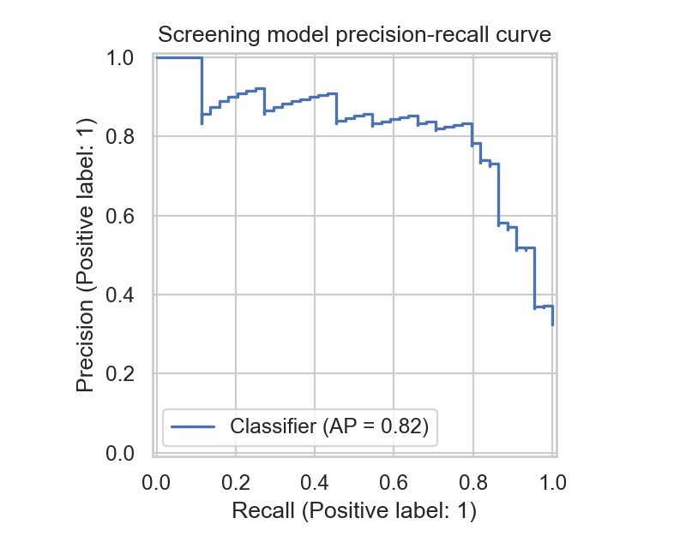
MODEL DESIGN
Validation avoids the common traps.
Model | Feature set | Clinical role
Screening RF | 13 basic features | Rule-out triage
Enhanced RF | 27 clinical features | Diagnostic support
Endometriosis LR | 6 overlap features | Differential prompt only
No test leakage
Model selection uses 5-fold CV on training data. Action thresholds come from out-of-fold training probabilities.
One final holdout
The held-out test split is touched once for final reporting.
Recall-first thresholding
Threshold sweep targets training-CV recall ≥ 0.90, then maximizes specificity, precision, and F1.
10 / 23
Notes:
The threshold is not chosen on the test set. We select models using cross-validation on training data, then choose thresholds using out-of-fold probabilities from that training split. Only after that do we evaluate on the held-out test set. We optimize for recall — missing a PCOS case is more costly than sending someone for follow-up.

Slide 11
HELD-OUT PERFORMANCE
Enhanced support preserves sensitivity and greatly improves precision.
Model | Threshold | AUC | Recall | Specificity | PPV | NPV | F2
Screening | 0.285 | 0.896 | 0.886 | 0.685 | 0.574 | 0.926 | 0.799
Enhanced | 0.380 | 0.953 | 0.886 | 0.902 | 0.812 | 0.943 | 0.871
Endometriosis prompt | 0.510 | 0.660 | 0.628 | 0.618 | 0.532 | — | 0.609
39/44
PCOS positives caught
+21.7
Specificity points vs screening
0.943
Enhanced NPV
+0.057
ΔAUC vs screening, 95% CI [+0.013, +0.105], p≈0.015
11 / 23
Notes:
The screening model catches 39 of 44 PCOS-positive patients in the holdout cohort. The enhanced model keeps the same sensitivity, but raises specificity from 0.685 to 0.902 and precision from 0.574 to 0.812. That is the point of the tiered workflow: screen broadly first, then use labs and ultrasound to reduce false positives.

Slide 12
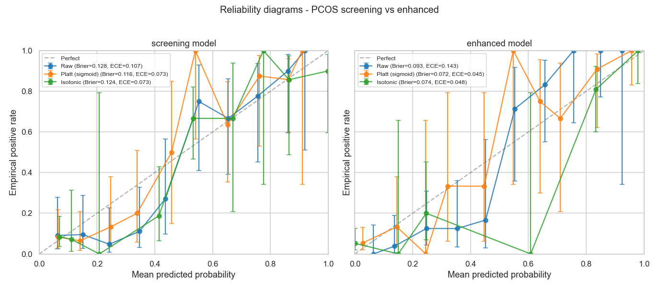
UNCERTAINTY, CALIBRATION & CONFORMAL · TRIPOD+AI ALIGNED
The rigor layer makes the model harder to dismiss.
Uncertainty
2000-resample bootstrap CIs; enhanced AUC advantage: +0.057, 95% CI [+0.013, +0.105].
Calibration
Enhanced Platt scaling improves Brier 0.093 → 0.072 and ECE 0.143 → 0.045.
Conformal coverage
Target 0.90; empirical holdout coverage 0.912. Empty sets are abstentions.
Reporting standard Collins et al., BMJ 2024 (TRIPOD+AI); Van Calster et al., BMC Med 2019; Angelopoulos & Bates 2023.
Notebook 08: probability quality before and after recalibration.
12 / 23
Notes:
Point estimates alone are not enough for a clinical prediction pitch. We added bootstrap confidence intervals, calibration, decision curve analysis, conformal prediction, subgroup audits, TabPFN benchmarking, and a Rotterdam comparison. The combined layer is what makes the model harder to dismiss in peer review.

Slide 13
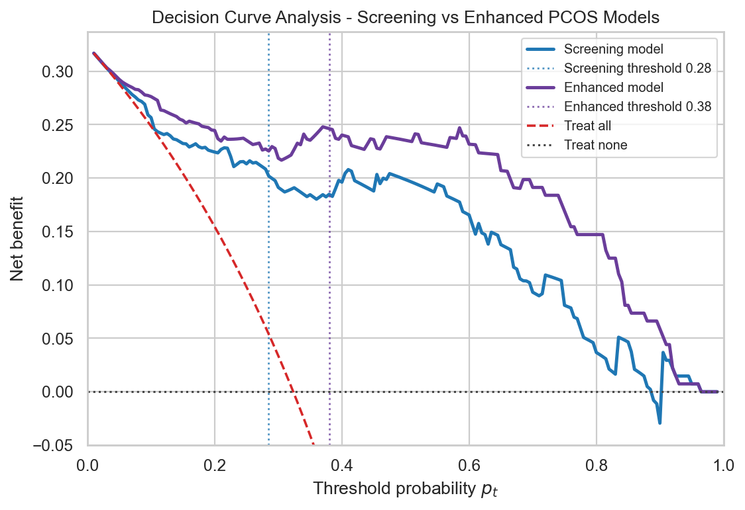
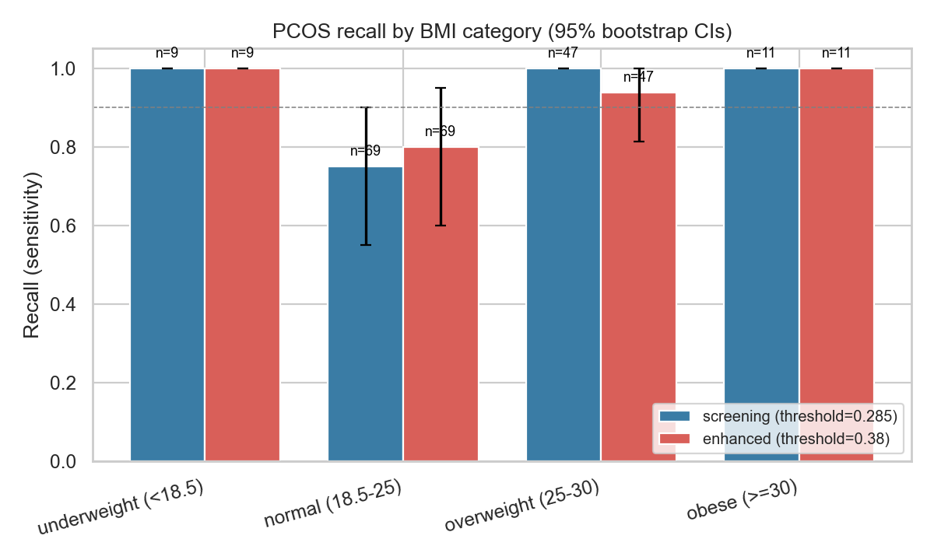
CLINICAL UTILITY AND SAFETY
Actionability matters more than a prettier metric.
Decision curve analysis
Both selected thresholds sit inside useful net-benefit ranges against treat-all and treat-none baselines.
Subgroup honesty
Screening has a 25-point BMI recall gap, lowest in normal-BMI patients. The app warns not to rule out lean PCOS solely from low probability.
Decision-curve analysis: both selected thresholds sit inside useful net-benefit ranges.
13 / 23
Notes:
Decision curve analysis asks whether a model helps at clinically plausible thresholds — ours do. We also found an honest fairness risk: recall is lower in the normal-BMI group for screening. Rather than hide that, we added a warning to the prototype.

Slide 14
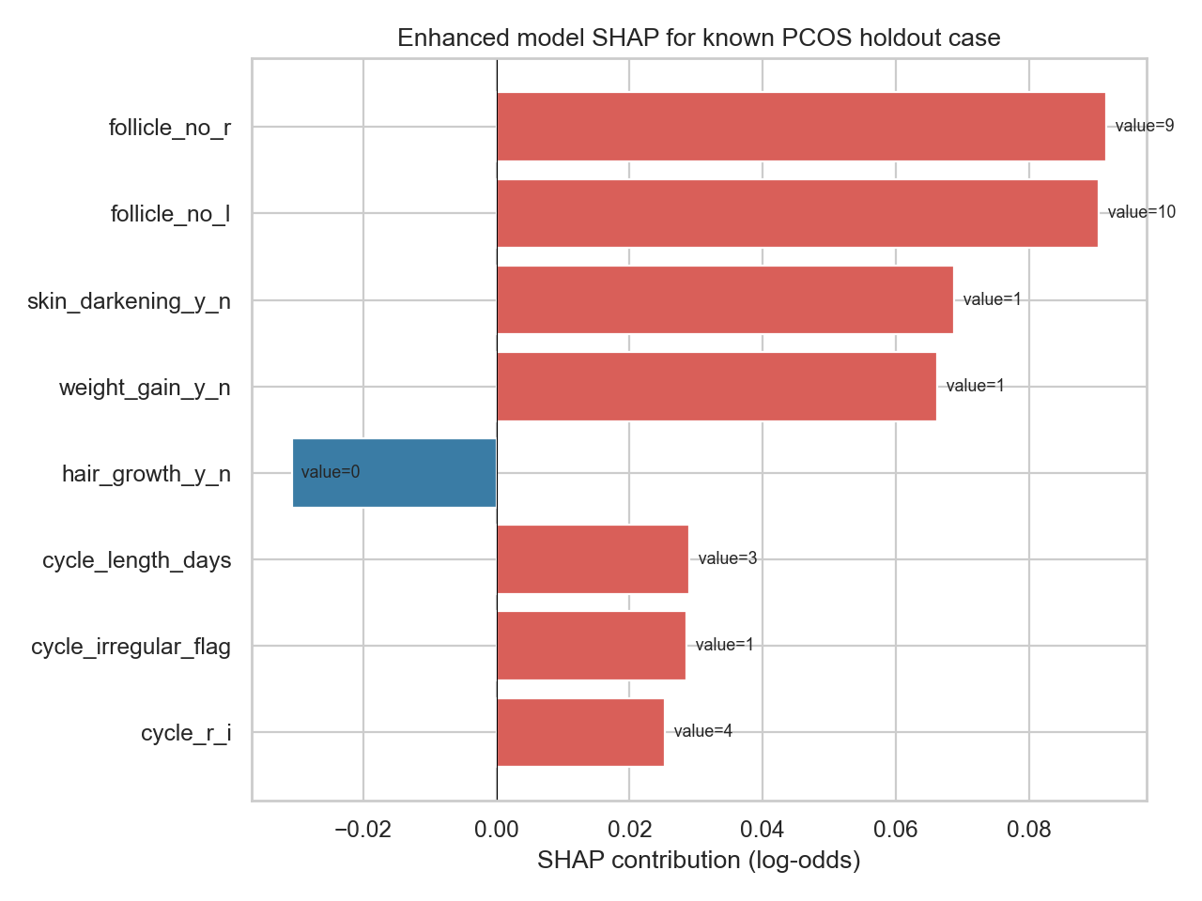
EXPLAINABILITY AT THE PATIENT LEVEL
Every prediction needs a reason clinicians can inspect.
Patient-level SHAP
The demo surfaces top log-odds contributors for the individual patient, not just global feature rankings.
Checklist safety net
The app shows which clinical evidence is present, which tests are missing, and when metabolic or lean-PCOS follow-up is needed.
Held-out positive case: follicle counts dominate the enhanced-model explanation.
14 / 23
Notes:
Explainability is not an afterthought. The clinician sees the probability, the action threshold, the risk tier, and the top SHAP contributors. In the enhanced model, follicle counts rise to the top, which is clinically sensible. The checklist translates that into next-step reasoning.

Slide 15
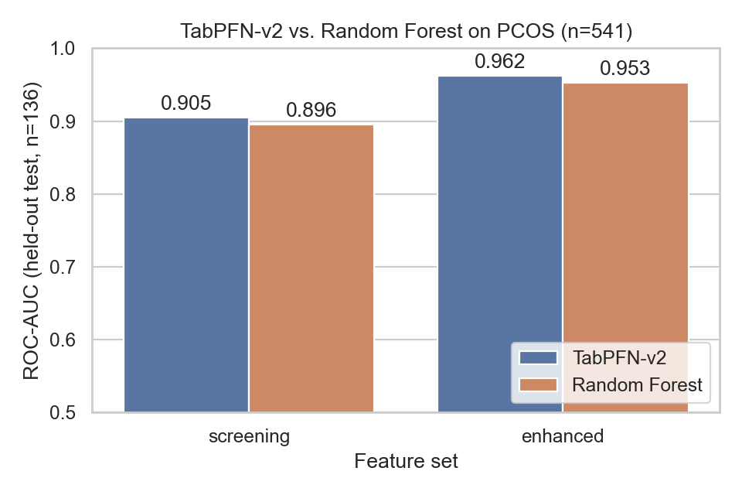
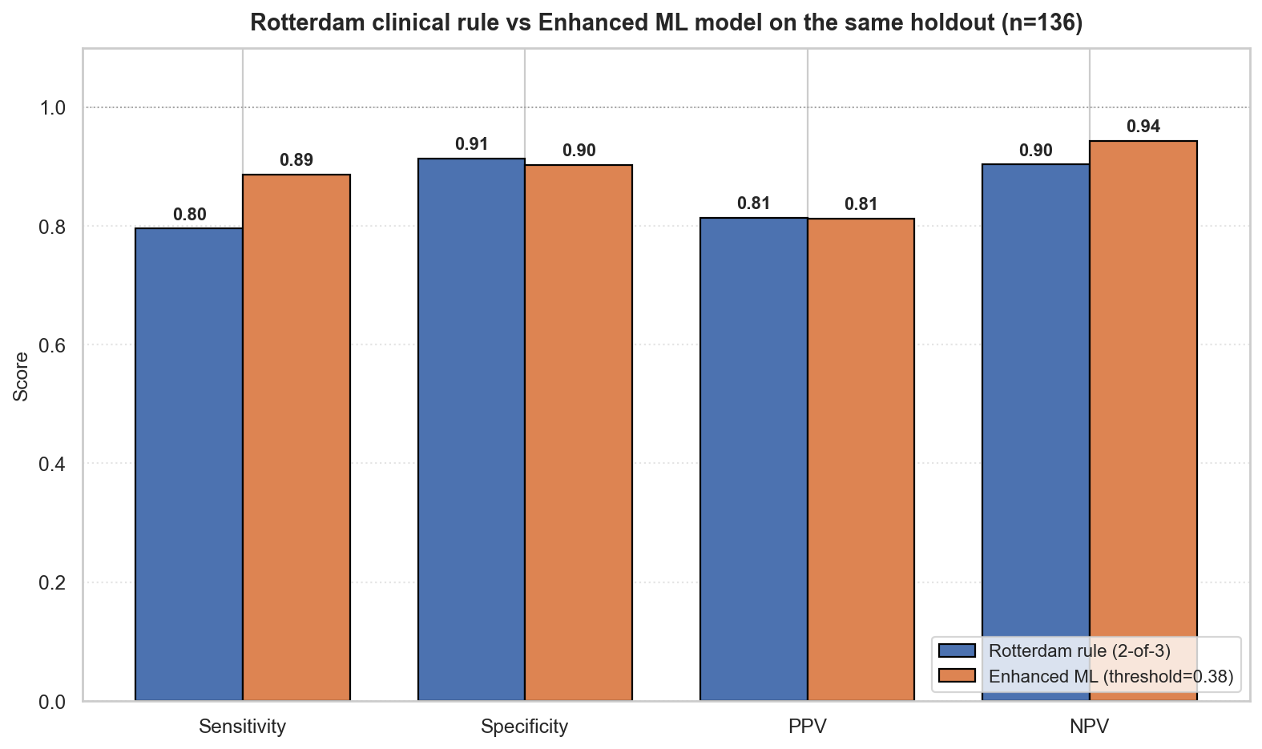
EXTERNAL BENCHMARKS
We benchmarked against both modern ML and clinical rules.
TabPFN-v2 benchmark
AUC 0.905 screening / 0.962 enhanced; trades away recall at our clinical threshold and is slower on CPU.
Rotterdam comparison
Enhanced ML adds 9.1 sensitivity points with a 1.1 specificity-point cost versus a hand-coded 2-of-3 rule.
TabPFN-v2 (foundation model) vs the random-forest pipelines.
15 / 23
Notes:
We did not stop at comparing random forest to logistic regression. TabPFN slightly improves AUC, but the random forest keeps better recall and F2 at the selected action threshold and is easier to deploy. Against Rotterdam, enhanced ML catches more positives with only a small specificity cost.

Slide 16
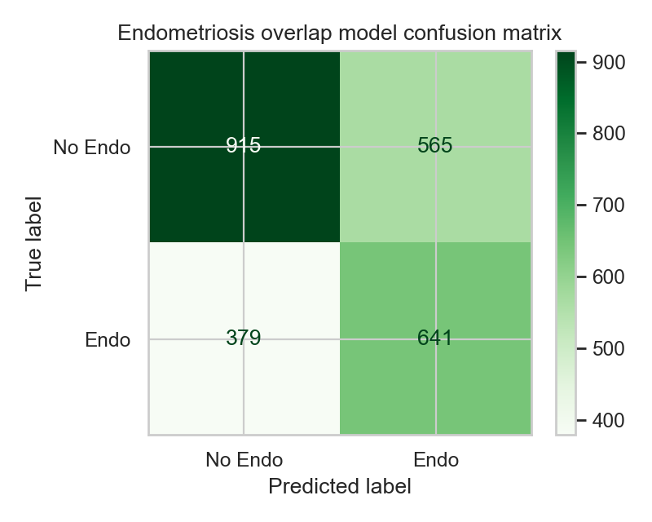
DIFFERENTIAL DIAGNOSIS PROMPT
PCOS Pathfinder avoids tunnel vision.
The endometriosis module is intentionally modest: a synthetic-data prompt that says "consider broader workup," not "diagnose endometriosis."
0.660
Overlap AUC
6
Prompt features
0
Diagnostic overclaim
16 / 23
Notes:
The differential module is framed as a prompt. Because the endometriosis dataset is synthetic, we make no clinical diagnostic claim. But when chronic pain, infertility, hormonal abnormality and menstrual irregularity cluster together, the system reminds the clinician not to stop thinking after the PCOS risk score.

Slide 17
APP WALKTHROUGH · TWO HELD-OUT CASES
What the clinician sees — high-risk vs. low-risk patient.
High-risk · test-set row 395 · PCOS-positive (true)
Low-risk · test-set row 383 · non-PCOS (true)
Patient intake (key features)
BMI 29.3
Cycle Irregular
Skin darkening Yes
AMH 6.0 ng/mL
Follicles L/R 10 / 9
Patient intake (key features)
BMI 24.2
Cycle Regular
Skin darkening No
AMH 11.4 ng/mL
Follicles L/R 2 / 3
Tiered assessment
Tiered assessment
Frontline screening p=88.6% thr 0.29 HIGH
Frontline screening p=20.8% thr 0.29 LOW
Enhanced (labs + ultrasound) p=90.7% thr 0.38 HIGH
Enhanced (labs + ultrasound) p=21.4% thr 0.38 LOW
Top SHAP drivers (enhanced)
follicle_no_r 9 +0.092 ↑
follicle_no_l 10 +0.090 ↑
skin_darkening 1 +0.069 ↑
Top SHAP drivers (enhanced)
follicle_no_r 3 −0.157 ↓
follicle_no_l 2 −0.117 ↓
amh_ng_ml 11.4 +0.062 ↑
All four Rotterdam-style checklist boxes tick. SHAP led by ovarian morphology.
Elevated AMH pushes up, but low follicle counts dominate — correctly Low Risk.
17 / 23
Notes:
Two held-out app walkthroughs side by side. The high-risk patient: follicle counts ten and nine, irregular cycle, skin darkening — both tiers say High Risk, all four checklist boxes tick. The low-risk patient: elevated AMH at 11.4 might worry a clinician, but low follicle counts and regular cycle correctly drive a Low Risk score on both tiers. Pre-rendered from outputs/metrics/demo_*.csv.

Slide 18
IMPLEMENTATION PATH · PATIENT & SYSTEM IMPACT
From submission-ready to deployable — honestly.
Earlier triage
Identify patients who need PCOS assessment before years of delay.
Low-resource fit
Frontline tier uses symptoms and basic vitals — no labs needed.
Patient safety
SHAP, calibration, conformal abstention, and explicit caveats.
Equity honesty
Subgroup gaps are measured, surfaced in the app, and flagged in the model card.
Deployment step | What changes before real use | Acceptance gate
Internal validation | Repeat notebook pipeline on partner data | Recall and calibration remain stable
Clinical pilot | Run as silent decision support beside usual care | Measures earlier referral without excess harm
Prospective study | Collect outcomes and subgroup performance | External validation before deployment
18 / 23
Notes:
The deployment path is honest: internal validation, silent pilot, prospective study — external validation before any clinical claim. The impact is earlier triage for delayed patients, a screening model that needs no labs for low-resource settings, transparent SHAP and conformal abstention for safety, and subgroup gaps that we measured and surfaced rather than hid. Thank you.

Slide 19
DEMO 1 · NOTEBOOK 01 · APPENDIX
Every silently coerced cell is logged. Every dropped column is justified.
scripts/create_training_notebooks.mjs — clean_pcos_dataframe
Output — outputs/metrics/pcos_coercion_report.csv
# Drop identifiers / sensitive fields; withhold
# blood_group until categorical encoding is validated.
def clean_pcos_dataframe(df):
df = df.copy()
coercion_report = {}
for col in df.columns:
coerced = pd.to_numeric(df[col], errors="coerce")
new_nan = coerced.isna().sum() - df[col].isna().sum()
if new_nan > 0:
offenders = df.loc[df[col].notna() & coerced.isna(), col]
coercion_report[col] = {
"coerced_to_nan": int(new_nan),
"examples": offenders.astype(str).unique().tolist()[:5],
}
df[col] = coerced
df = df.drop(columns=[c for c in DROP_COLUMNS if c in df.columns])
df.attrs["coercion_report"] = coercion_report
return df
DROP_COLUMNS = ["sl_no", "patient_file_no",
"blood_group", "marriage_status_yrs"]
PCOS shape: (541, 41)
Dropped columns: ['sl_no', 'patient_file_no',
'blood_group', 'marriage_status_yrs']
Non-numeric values coerced to NaN:
ii_beta_hcg_miu_ml: 1 cell(s); examples=['1.99.']
amh_ng_ml: 1 cell(s); examples=['a']
pcos_y_n
0 364
1 177
Name: count, dtype: int64
Takeaway Two stray data-quality issues caught and logged before they can bias a model. ABO/Rh withheld from screening; Yang et al. 2025 supports retaining it later as categorical phenotype metadata, not as a numeric 11–18 input.
19 / 23
Notes:
This is the cleaning step. Every column gets numeric-coerced and every non-numeric cell that drops to NaN is recorded with an example. That is how we caught the literal string '1.99.' in the second beta-HCG column and the literal letter 'a' in the AMH column. We drop identifiers and the marriage-status column. Blood group is withheld because codes 11–18 are categorical ABO/Rh labels, not an ordered diagnostic scale.

Slide 20
DEMO 2 · NOTEBOOK 02 · APPENDIX
Action thresholds come from training cross-validation. The test set is touched once.
notebook 02 — cv_oof_probabilities + threshold sweep
Output — chosen threshold + held-out test
# 1. Out-of-fold probabilities on the TRAINING set only.
cv = StratifiedKFold(n_splits=5, shuffle=True,
random_state=RANDOM_STATE)
oof_proba = cross_val_predict(
best_model, X_train, y_train,
cv=cv, method="predict_proba", n_jobs=-1,
)[:, 1]
# 2. Sweep thresholds; pick the one with recall >= 0.90
# that also maximises specificity, precision, F1.
chosen, table = choose_high_recall_threshold(
y_train, oof_proba, min_recall=0.90,
)
threshold = float(chosen["threshold"])
# 3. Refit on FULL training data, evaluate ONCE on test.
best_model.fit(X_train, y_train)
metrics = evaluate_holdout(best_model, X_test, y_test,
threshold=threshold)
Best screening model: random_forest
Chosen threshold (from training CV):
threshold 0.285
recall 0.901
specificity 0.683
precision 0.535
f1 0.669
balanced_accuracy 0.792
Holdout evaluation (touched ONCE):
roc_auc 0.896
recall 0.886
specificity 0.685
precision 0.574
npv 0.926
f1 0.696
f2 0.799
Takeaway The test set is evaluated exactly once after the model is refit on the full training data — that is why the recall and specificity numbers on the next slide are honest.
20 / 23
Notes:
A common failure mode in clinical ML pitches is choosing the threshold on the same test set you then report metrics from. We avoid it. The threshold is picked from out-of-fold training probabilities. The held-out test set is evaluated exactly once, after the model is refit on the full training data.

Slide 21
DEMO 3 · NOTEBOOK 07 · APPENDIX
Paired bootstrap (2000 resamples) gives an AUC delta with a real interval.
notebook 07 — paired bootstrap loop
Output — outputs/metrics/holdout_bootstrap_cis.json
rng = np.default_rng(seed=42)
n = len(y_test)
deltas = []
for _ in range(2000):
idx = rng.choice(n, n, replace=True)
yb = y_test.values[idx]
if yb.sum() == 0 or yb.sum() == len(yb):
continue # AUC undefined on single-class draw
auc_s = roc_auc_score(yb, screening_proba[idx])
auc_e = roc_auc_score(yb, enhanced_proba[idx])
deltas.append(auc_e - auc_s)
deltas = np.asarray(deltas)
point = deltas.mean()
ci = np.percentile(deltas, [2.5, 97.5])
p_val = 2 * min((deltas <= 0).mean(),
(deltas >= 0).mean())
{
"screening": {"roc_auc": {
"point": 0.8955,
"ci_lo": 0.8300, "ci_hi": 0.9515
}},
"enhanced": {"roc_auc": {
"point": 0.9528,
"ci_lo": 0.9114, "ci_hi": 0.9852
}},
"auc_difference": {
"point": +0.0573
"ci_lo": +0.0130
"ci_hi": +0.1051
"p_value_two_sided": ~0.015
}
}
Takeaway The enhanced model's AUC advantage is +0.057 with a 95% CI that excludes zero — the kind of statement that survives peer review.
21 / 23
Notes:
We ran a paired bootstrap: the same 2000 resampled index vectors for both models, computed delta-AUC on each, and reported the 2.5 and 97.5 percentile of the differences plus the empirical two-sided p value. The enhanced model is above the screening model on AUC with 95% confidence on this holdout.

Slide 22
DEMO 4 · NOTEBOOK 05 · APPENDIX
SHAP attributes every prediction to the patient's actual feature values.
notebook 05 — shap_for_artifact (enhanced model, holdout positive)
Output — outputs/metrics/demo_positive_enhanced_shap.csv
def transform_through_preprocessing(model, X_row):
X = X_row.copy()
for _, transformer in model.steps[:-1]:
X = transformer.transform(X)
return X
# Reproduce the train/test split, pull positive holdout case.
_, X_te, _, y_te = train_test_split(
pcos[feats], pcos["pcos_y_n"],
test_size=0.25, stratify=pcos["pcos_y_n"],
random_state=42,
)
positive = pcos.loc[X_te[y_te == 1].index[0]].to_dict()
# TreeExplainer is fast and exact for the RF.
estimator = artifact["model"].named_steps["model"]
X_t = transform_through_preprocessing(artifact["model"],
pd.DataFrame([positive])[feats])
explainer = shap.TreeExplainer(estimator)
shap_values = explainer.shap_values(X_t)[0, :, 1]
Top SHAP drivers, known PCOS holdout case
feature value log-odds Δ
follicle_no_r 15.0 +0.213 ↑ PCOS
follicle_no_l 13.0 +0.166 ↑ PCOS
skin_darkening_y_n 0.0 −0.040 ↓ PCOS
weight_gain_y_n 0.0 −0.036 ↓ PCOS
amh_ng_ml 16.4 +0.034 ↑ PCOS
cycle_irregular_flag 1.0 +0.028 ↑ PCOS
bmi 27.3 +0.022 ↑ PCOS
fsh_lh 0.39 +0.018 ↑ PCOS
Takeaway A clinician opens the patient record and sees exactly which findings pushed the prediction up or down. Demo cases come from held-out rows the model never saw in training.
22 / 23
Notes:
For one held-out positive case, SHAP tells us why the model said PCOS: high follicle counts on both ovaries do most of the work, with AMH and cycle irregularity contributing, and the absence of skin darkening and weight gain pulling slightly the other way.

Slide 23
DEMO 5 · NOTEBOOK 12 · APPENDIX
Split-conformal gives every patient a distribution-free coverage guarantee.
notebook 12 — split-conformal recipe
Output — outputs/metrics/conformal_coverage.json
# 1. Split training into proper-train + calibration slice.
X_pt, X_cal, y_pt, y_cal = train_test_split(
X_train, y_train, test_size=0.30,
stratify=y_train, random_state=42,
)
# 2. Refit a clone on PROPER-TRAIN only.
model = clone(enhanced_artifact["model"])
model.fit(X_pt, y_pt)
# 3. Nonconformity scores: s = 1 − p_model(y_true | x).
p_cal = model.predict_proba(X_cal)
scores = 1 - p_cal[np.arange(len(y_cal)), y_cal.values]
# 4. q-hat at ceil((n_cal+1)(1-alpha)) / n_cal.
alpha = 0.10
n_cal = len(scores)
q_hat = np.quantile(scores,
np.ceil((n_cal + 1) * (1 - alpha)) / n_cal)
# 5. Prediction set: { y : 1 − p(y|x) <= q_hat }.
p_te = model.predict_proba(X_test)
sets = (1 - p_te) <= q_hat
{
"target_coverage": 0.900,
"q_hat": 0.486,
"empirical_coverage": 0.912,
"mean_set_size": 0.993,
"singleton_fraction": 0.993,
"doubleton_fraction": 0.000,
"empty_fraction": 0.007,
"worked_examples": [
{"true": 1, "p_pcos": 0.903,
"set": [1], "covers": true},
{"true": 0, "p_pcos": 0.271,
"set": [0], "covers": true}
]
}
Takeaway Target coverage 0.90, empirical 0.912 on the held-out set. The 0.7% empty sets are honest abstentions — patients the model refuses to call confidently.
23 / 23
Notes:
Split-conformal gives each patient a prediction set with a distribution-free coverage guarantee. We hold out 30% of the training set as a calibration slice, compute one minus the model probability of the true label on it, and pick q-hat at the appropriate quantile. Targeted 90% coverage; observed 91.2% on the holdout. Empty sets count as abstentions.

