Slide 1

Internship / Professional Practice Presentation on “A Responsive Music Website”
Guide:
Dr. G T Raju
Vice Principal,
Prof. and Head, Dept. of CSE,
RNSIT
Student : Batch 22 Karthik C (1RN17CS042)
Department of Computer Science and Engineering
RNS Institute of Technology
2020-21

Slide 2
CONTENTS
INTRODUCTION
Online Platform (Coursera)
Domain (Applied Machine Learning)
Problem Statement
Existing System/Solution and their Limitations
Proposed Solution
REQUIREMENTS
Functional Requirements (FR)
Non-functional Requirements (NFR)
Specific Hardware & Software Requirements
SYSTEM ARCHITECTURE/BLOCK DIAGRAM
ARCHITECTURE/Block Diagram/DFD/Sequence diagram/Class diagrams /Flowchart
IMPLEMENTATIONS
Algorithm/Methods/ Pseudo code
Libraries used / API’S
Configuration
RESULT ANALYSIS
CONCLUSION AND FUTURE WORK
Conclusion
Limitations and Future work
REFERENCES

Slide 3
INTRODUCTION
Online Platform:
Coursera (FSW01)
Technology:
Front-End Web UI Frameworks and Tools: Bootstrap 4.
Problem Statement:
This project aims to build a responsive music website which is the best solution for creating a centralized location where music fans can listen to their favorite artist songs, check the latest albums, popular artists and find out about their upcoming concerts and new releases.

Slide 4
INTRODUCTION
Existing problem and proposed solution:
The responsive music website can be an open upload platform where Artists can sign up and upload or showcase their own with the audience. The design/style of the website can be modified depending upon the creator interests.

Slide 5
REQUIREMENTS
Minimum Hardware & Software Requirements
Latest Bootstrap, jQuery-2.2.4 js, Plugins js, Active js.
Atom – A hackable text editor.
Bootstrap 4 framework.
Operating​ ​System​ ​used: Windows/ubuntu
Processor: Pentium4​ ​processor.
RAM: 2GB.
Storage​ ​Space: 40​ ​GB.

Slide 6
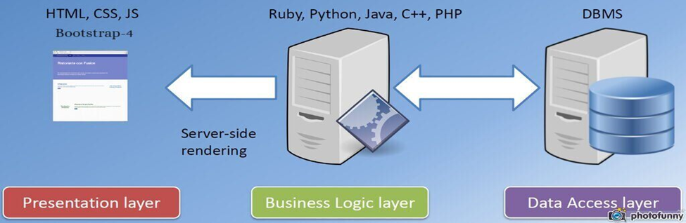
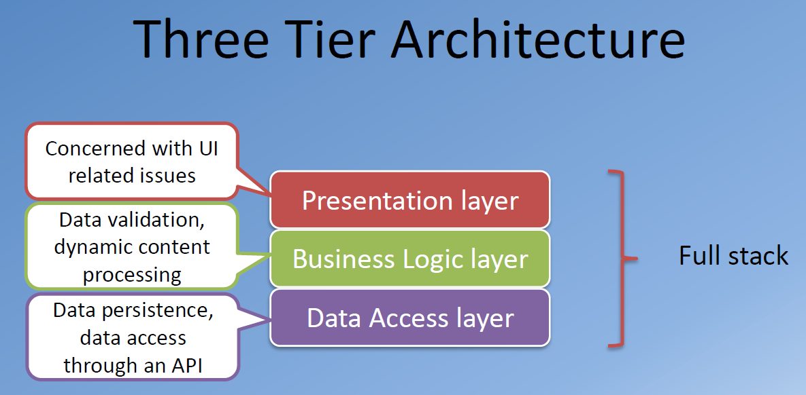
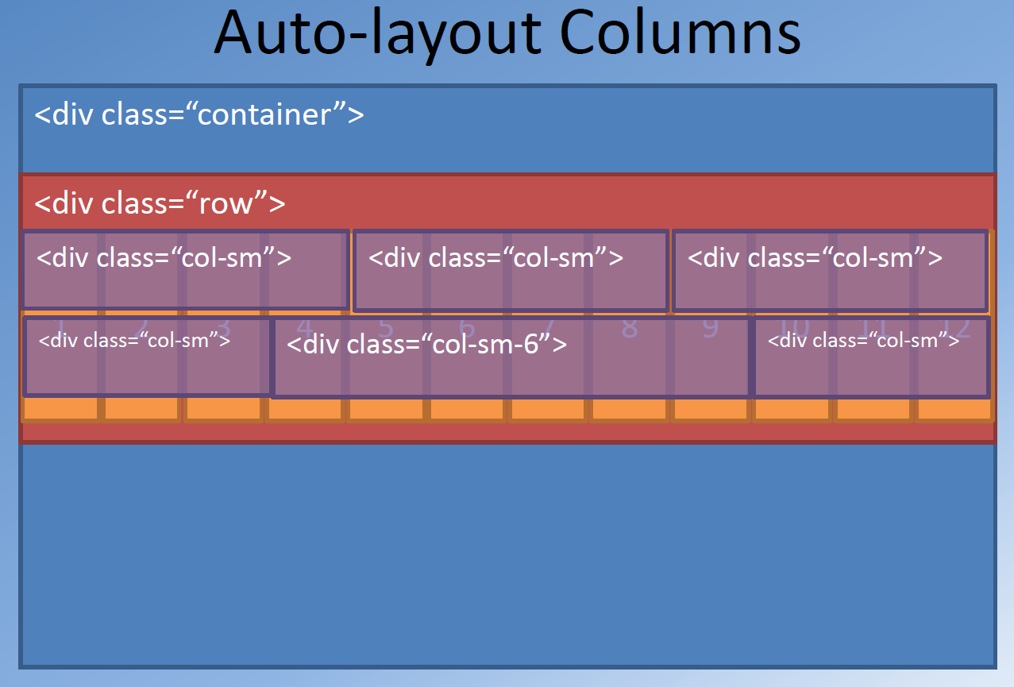
SYSTEM ARCHITECTURE/BLOCK DIAGRAM

Slide 7
IMPLEMENTATION
Algorithm/Methods/ Pseudo code
/* :: 1.0 Import Fonts */
@import url("https://fonts.googleapis.com/css?family=Archivo+Narrow:400,400i,500,500i,600,600i,700,700i");
/* :: 2.0 Import All CSS */
@import url(css/bootstrap.min.css);
@import url(css/classy-nav.css);@import url(css/owl.carousel.min.css);
@import url(css/animate.css);
@import url(css/magnific-popup.css);
@import url(css/font-awesome.min.css);
@import url(css/audioplayer.css);

Slide 8
IMPLEMENTATION
All Javascript Script
<!-- jQuery-2.2.4 js -->
<script src="js/jquery/jquery-2.2.4.min.js"></script>
<!-- Popper js -->
<script src="js/bootstrap/popper.min.js"></script>
<!-- Bootstrap js -->
<script src="js/bootstrap/bootstrap.min.js"></script>
<!-- All Plugins js -->
<script src="js/plugins/plugins.js"></script>
<!-- Active js -->
<script src="js/active.js"></script>

Slide 9
IMPLEMENTATION
Libraries used / API’S / Frameworks :
Bootstrap4
Jquery
Configuration
High Speed RAM
High Storage Capacity

Slide 10
RESULT ANALYSIS
The users/music fans can listen to their favorite artist songs, check the latest songs, latest albums, popular artists and find out about their upcoming concerts and new releases.
The website is completely responsive which enables the users to browse the website on devices of various screen sizes and is also cross browser compatible.
The user/music-fan can also get in touch with the creator/artist/admin to leave a message or a feedback regarding suggestions, errors and also the updates/information of artists upcoming songs or album.

Slide 11
CONCLUSION AND FUTURE WORK
Conclusion
This responsive music website is an HTML website, fully responsive, flexible, optimized and cross-browser compatible. It has a modern web design with a zoom-in slideshow, loads content on the scroll and includes an audio player. The users can explore a large community of artists, bands, podcasters and creators of music and audio. Bootstrap is the most popular, HTML, CSS, and JS framework for developing responsive, mobile first projects on the web.
Limitations and Future work
The responsive music website can be an open upload platform where Artists can sign up and upload or showcase their own with the audience. Future work is to further improve the design and to add the backend database for the website.

Slide 12
REFERENCES
https://getbootstrap.com/docs/4.0/getting-started/introduction/
https://www.w3schools.com/bootstrap4
https://www.w3schools.com/jquery/default.asp
https://www.w3schools.com/css/css_website_layout.asp

Slide 13
Suggestions….!

Slide 14
Thank You!!!

