Slide 1


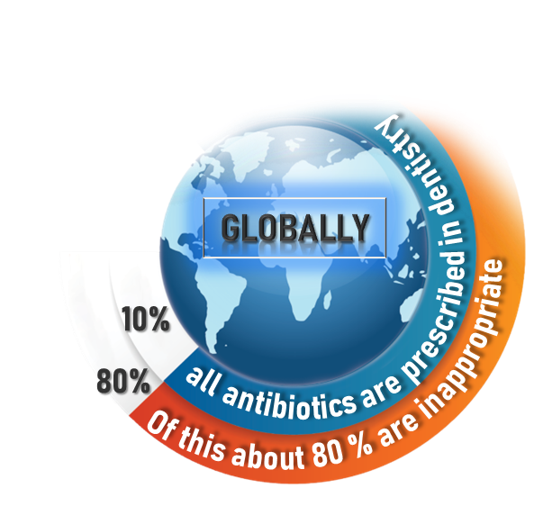
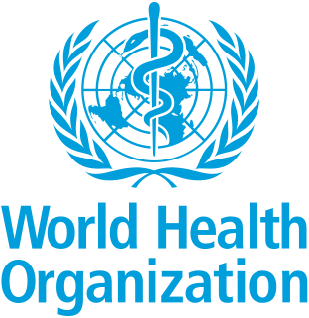
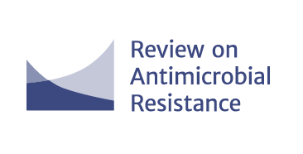
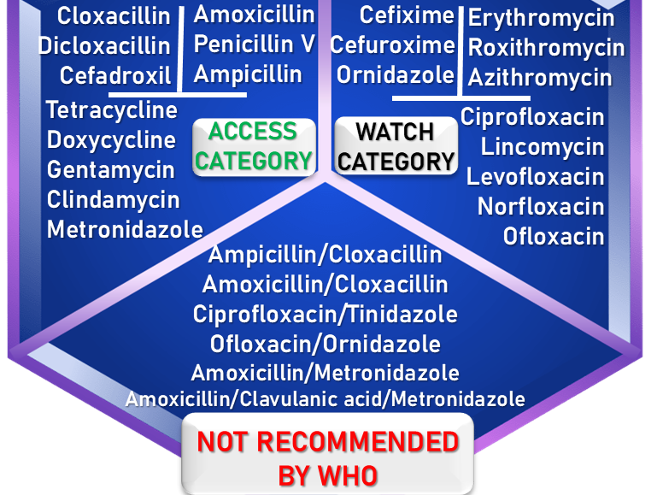
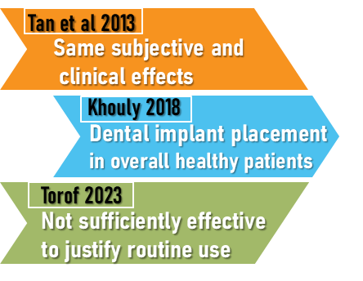
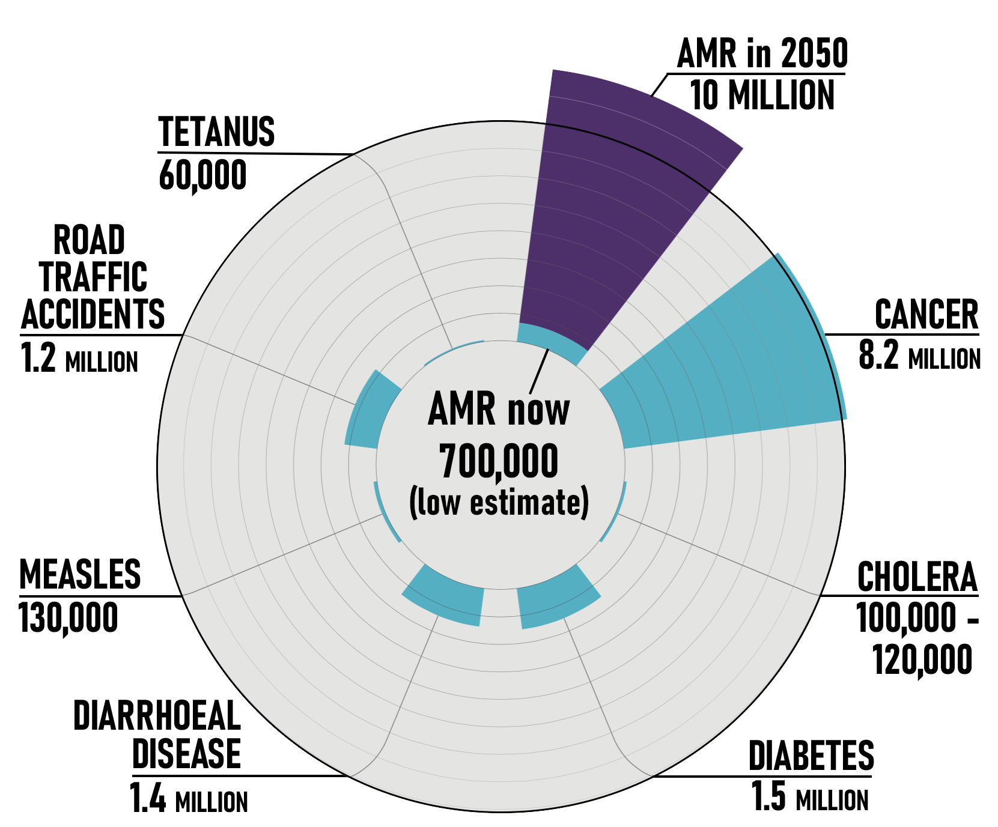
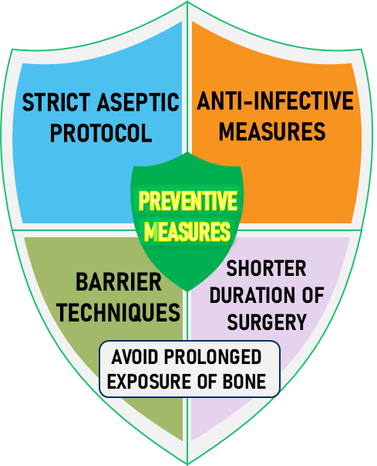
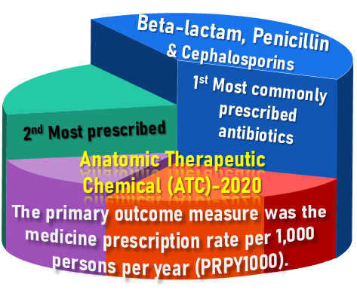
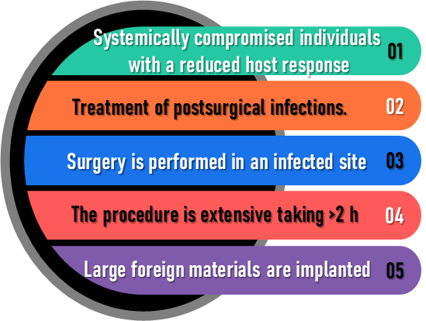
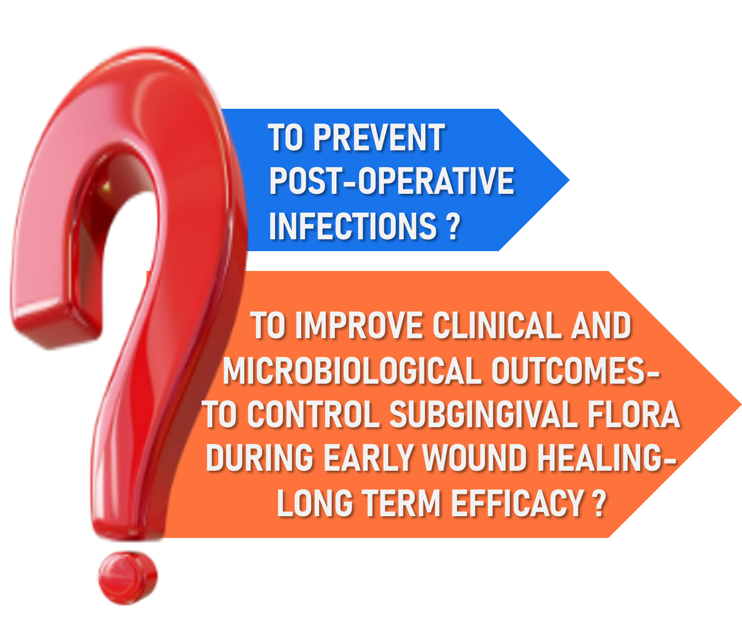
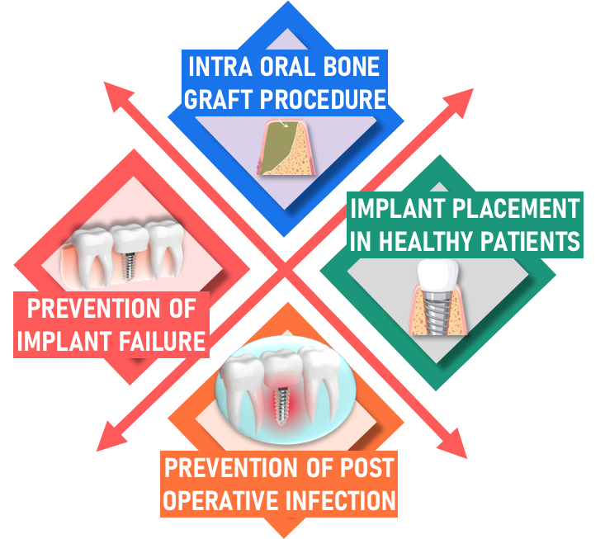
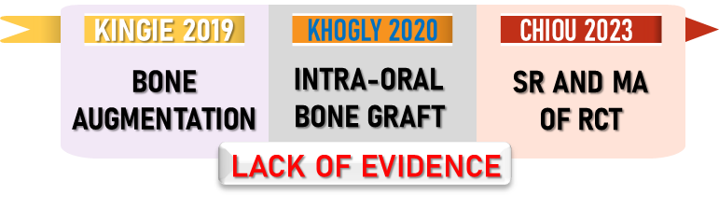
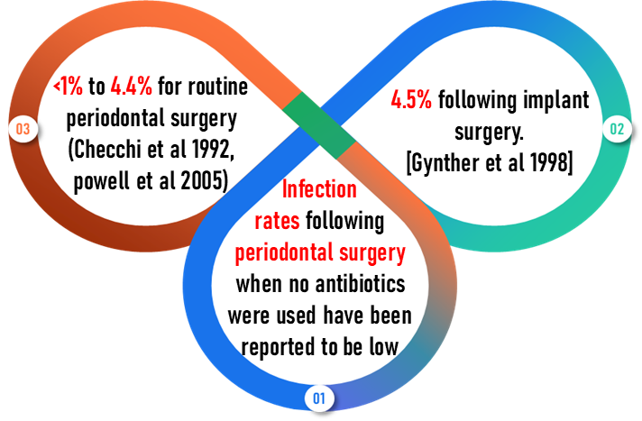
ANTIBIOTICS AFTER PERIODONTAL SURGERY : VALID OR VOID ?
INTRODUCTION
Surgical therapy in its various forms is considered a mainstay in the modern practice of periodontics
Infections that are identified post-surgically are readily treated with local measures and often with the adjunctive use of systemic antibiotics.
TYPE OF ANTIBIOTICS BASED ON THE WHO AWaRe CLASSIFICATION
PREVENTION OF INFECTION IN
DEATHS ATTRIBUTABLE TO ANTI-MICROBIAL RESISTANCE EVERY YEAR (JIM O’NEILL 2016)
IMPLANT PLACEMENT
Systematic Review & Meta-analysis
SHOULD BE HELD IN RESERVE FOR TREATMENT
NOT RECOMMENDED
REGENERATIVE PERIODONTAL SURGERY
Systematic Review & Meta-analysis
PROBLEMS ASSOCIATED WITH THE USE OF
SYSTEMIC ANTIBIOTICS
Periodontal diseases are heterogeneous
Antibiotic resistance bacteria
Risk of super infection
Drug interaction
Systems for culture and sensitivity testing of bacterial plaque are not readily available.
CONCLUSION
Research demonstrating a low rate of postoperative
infection following periodontal surgical procedures (ca powell et al , 2005).
No benefit in using antibiotics for the sole purpose of preventing post-surgical infections.

