Slide 1
2024 S&C Preseason Update
**In collaboration with Dr. Michelle Van Dyke (Head Pitt Women’s Basketball Strength and Conditioning Coach)

Slide 2
Power Complex
Strength Block
Hypertrophy Block
Primers (Jumps, Decels, etc.)
Warm – Up

Slide 3
4-Week Preseason Recap – Cycle 1 (08/26-09/21)
Timeline:
4 Weeks
16 Training Sessions
Athlete Health Considerations:
1 Achilles Rupture
2 Shoulder rehab/prehab
Focus Lifts:
Barbell Back Squat
Barbell Bench Press
Barbell RDL
Trap Bar Deadlift
Week 1:
Squat 3 x 8 @ 65, 75, 75%
Bench 3 x 6 @ 65%
Barbell RDL 3 X 5 @ 65, 75, 75%
Week 3 :
Squat 3 x 5 @ 70, 80, 90%
Bench 3 x 3 @ 70, 80, 90%
Trap Bar Deadlift 3 X 5 @ No set %
Week 2 :
Squat 3 x 6 @ 65, 75, 75%
Bench 3 x 5 @ 65%
Barbell RDL 3 X 5 @ 65, 75, 75%
Week 4 :
Squat 3 x 3 @ 65, 75, 75%
Bench 3 x 3 @ 70, 80, 90%
Trap Bar Deadlift 3 X 5 @ 75%

Slide 4
4-Week Preseason Recap – Cycle 2 (09/23-Present)
Timeline:
2 Weeks
8Training Sessions
Athlete Health Considerations:
1 Achilles Rupture
2 Shoulder rehab/prehab
Focus Lifts:
Hatfield Hands-Free Squat
Barbell Bench Press
B Stance Trap Bar Deadlift
Incline Bench Press**
Week 1: 4 X 4 @ 0.6 m/s Velocity
Week 2: 4 X 4 @ 0.6 m/s Velocity

Slide 5
PlayerLoad Breakdown (Game AVG = 680 PlayerLoad)
Average Game PlayerLoad
680 + (Over 100%) | Very High
544 - 680 (80 - 100%) | High
408 – 544 (60 - 80%) | Medium
0 - 408 (0 - 60%) | Low
Very High (>100%)
High (80 – 100%)
Medium (60 – 80%)
Low (< 60%)

Slide 6
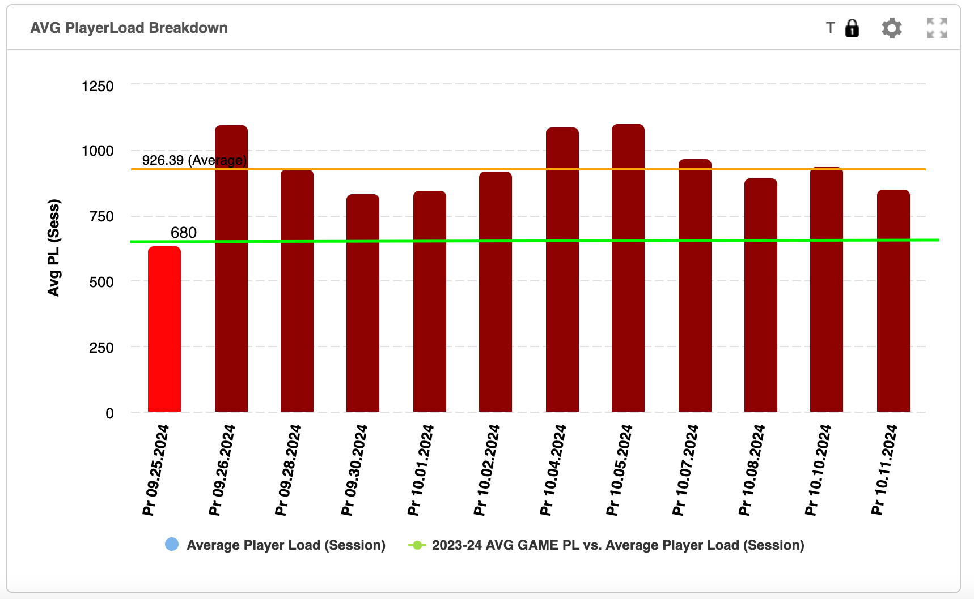
PlayerLoad Breakdown (Practice 9/25-10/11)
Very High (>100%)
High (80 – 100%)
Medium (60 – 80%)
Low (< 60%)
Notes:
10.2.24- Only has Data for Battle, Rust, and Washenitz

