Slide 1



Mendler-style
Recursion Schemes for
Mixed-Variant Datatypes
Ki Yung Ahn Tim Sheard Marcelo P. Fiore
kya@cs.pdx.edu sheard@cs.pdx.edu Marcelo.Fiore@cl.cam.ac.uk
TYPES 2013

Slide 2
Outline
Mendler-style Recursion Schemes
mit (iteration)
msfit (iteration with syntactic Inverse)
Untyped HOAS (Regular Mixed-Variant Datatype)
Formatting Untyped HOAS (using msfit at kind *)
Simply-Typed HOAS (Indexed Mixed-Variant Datatype)
Formatting Untyped HOAS (using msfit at kind * → *)
The Nax language
Need for yet another Mendler-style Recursion Scheme

Slide 3
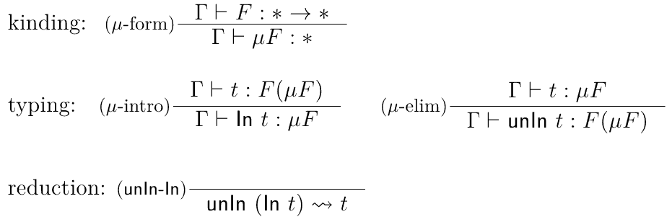
(iso-) Recursive Types
in Functional Languages
already inconsistent as a logic (via Curry--Howard correspondence)
without even having to introduce any term-level recursion
since we can already define general recursion using this

Slide 4
Having both unrestircted formation
and unrestricted elimination
of μ leads to inconsistency
data T a r = C (r → a)
w : μ (T a) → a -- encoding of (λx. x x) in the untyped λ-calc
w = λv. case (unIn v) of (C x) → f (C x)
-- w (C w) amounts to a well-known diverging term in λ-calculus
fix : (a → a) → a -- the Y combinator (λf.(λx.f(xx))(λx.f(xx))))
fix = λf. (λx. f (w x)) (In (C (λx. f (w x))))
To recover consistency, one could
either restrict formation (conventional approach)
or restrict elimination (Mendler-style approach)

Slide 5
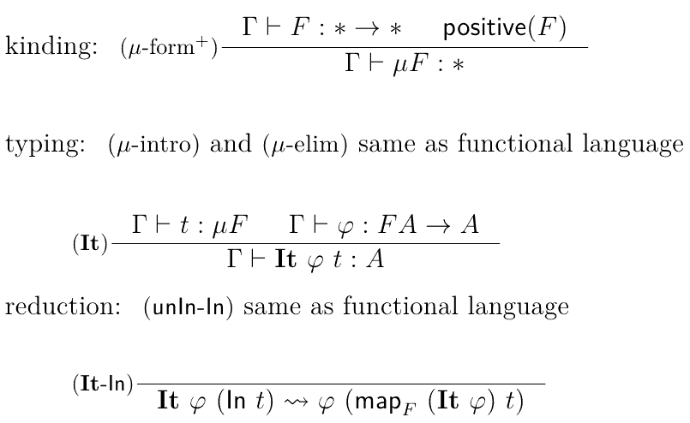
Conventional Iteration over Recursive Types
allow formation of only positive recursive types
(i.e., when F has a map)
freely eliminate (i.e. use unIn) recursive values

Slide 6
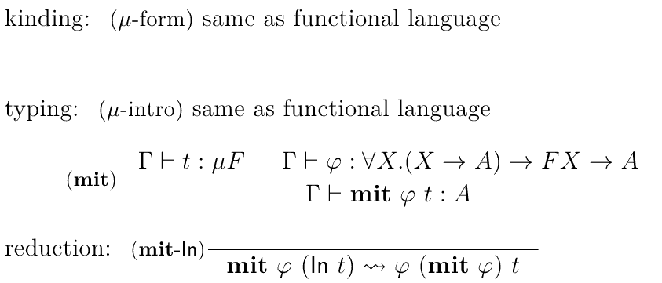
Mendler-style Iteration over Recursive Types
freely form ANY recursive type!!
note, no (μ-elim) rule
elimination is possible only through mit

Slide 7
Mendler-style Iteration
-- Mu at different kinds (there are many more, one at each kind)
data Mu0 (f :: * → *) = In0 (f (Mu0 f ))
data Mu1 (f :: (*→*)→(*→*)) i = In1 (f (Mu1 f ) i)
-- Mendler-style iterators at different kinds
mit0 :: Phi0 f a → Mu f → a
mit0 phi (In0 x) = phi (mit0 phi) x
mit1 :: Phi1 f a i → Mu f i → a i
mit1 phi (In1 x) = phi (mit1 phi) x
type Phi0 = ∀r. (r → a ) → (f r → a )
type Phi1 = ∀r. (∀i. r i → a i) → (∀i. f r i → a i)
Uniformly defined at different kinds (can handle non-regular datatypes quite the same way as handling regular datatypes)
Terminates for ANY datatype
(can embed Mu and mit into Fw.
see Abel, Matthes and Uustallu TCS'04)
However, not very useful for mixed-variant datatypes
recursive call
eliminating In0 or In1 by pattern matching is only allowed in Mendler-style iterators

Slide 8
Mendler-style Iteration
with a syntactic inverse
-- Mu' at different kinds (we only use two of them in this talk)
data Mu'0 (f :: * → *) a = In'0 (f (Mu'0 f a)) | Inverse0 a
data Mu'1 (f :: (*→*)→(*→*)) a i = In'1 (f (Mu'1 f a) i) | Inverse1 (a i)
-- msfit at different kinds
msfit0 :: Phi'0 f a → Mu'0 f → a
msfit0 phi (In'0 x) = phi Inverse0 (msfit0 phi) x
msfit1 :: Phi'1 f a i → Mu'1 f i → a i
msfit1 phi (In'1 x) = phi Inverse1 (msfit1 phi) x
type Phi'0 f a = ∀r. (a → r a ) → (r a → a ) → (f r a → a )
type Phi'1 f a = ∀r. (∀i. a i → r a i) → (∀i. r a i → a i) → (∀i. f (r a) i → a i)
Terminates for ANY datatype
(can embed Mu and msfit into
Fw. see Ahn and Sheard ICFP'11)
msfit is quite useful for mixed-variant datatypes,
due to "inverse" operatation in addition to "recursive call"
inverse
recursive call
eliminating In'0 or In'1 by pattern matching is only allowed in Mendler-style iterators

Slide 9
Untyped HOAS
(a regular mixed-variant datatype)
-- using general recursion at type level
data Exp = Lam (Exp → Exp) | App Exp Exp
-- using fixpoint (Mu'0) over non-recursive base structure (ExpF)
data ExpF r = Lam (r → r) | App r r
type Exp' a = Mu'0 ExpF a -- (Exp' a) may contain Inverse
type Exp = ∀a . Exp' a -- Exp does not contain Inverse
lam :: (∀a. Exp' a → Exp' a) -> Exp -- it's not (Exp → Exp) → Exp
lam f = In'0 (Lam f ) -- f can handle Inverse containg values
-- but can never examine its content
app :: Exp → Exp → Exp
app e1 e2 = In'0 (App e1 e2)

Slide 10
Formatting Untyped HOAS
using msfit0 at kind *
showExp :: Exp → String
showExp e = msfit0 phi e vars where
phi :: Phi'0 ExpF ([String] → String)
phi inv showE (Lam z) =
λ(v:vs) → "(λ"++v++"→"++ showE (z (inv (const v))) vs ++")"
phi inv showE (App x y) =
λvs → "("++ showE x vs ++" "++ showE y vs ++")"
type Phi0 f a = ∀ r. (a → r a) -> (r a -> a) → (f r a → a)
vars = [ "x"++show n | n<-[0..] ] :: [String]
inverse
recursive call

Slide 11
Simply-Typed HOAS
(a non-regular mixed-variant datatype)
-- using general recursion at type level
data Exp t where -- Exp :: * → *
Lam :: (Exp t1 → Exp t2) → Exp (t1 → t2)
App :: Exp (t1 → t2) → Exp t1 → Exp t2
-- using fixpoint (Mu'1) over non-recursive base structure (ExpF)
data ExpF r t where -- ExpF :: (* → *) → (* → *)
Lam :: (r t1 → r t2) → ExpF r (t1 → t2)
App :: r (t1 → t2) → r t1 → ExpF r t2
type Exp' a t = Mu'1 ExpF a t -- (Exp' a t) might contain Inverse
type Exp t = ∀a . Exp' a t -- (Exp t) does not contain Inverse
lam :: (forall a . Exp' a t1 -> Exp' a t2) -> Exp (t1 → t2)
lam f = In'1 (Lam f ) -- f can handle Inverse containg values
-- but can never examine its content
app :: Exp (t1 → t2) → Exp t1 → Exp t2
app e1 e2 = In'1 (App e1 e2)

Slide 12
Evaluating Simply-Typed HOAS
using msfit1 at kind *→*
newtype Id a = MkId { unId :: a }
evalHOAS :: Exp t → Id t
evalHOAS e = msfit1 phi e where
phi :: Phi'1 ExpF Id {- v :: t1 -} {- f :: r Id t1 -> r Id t2 -}
phi inv ev (Lam f ) = MkId(λv → unId(ev (f (inv (MkId v)))))
phi inv ev (App e1 e2) = MkId(unId(ev e1) (unId(ev e2)))
type Phi'1 f a = ∀r. (∀i. a i → r a i) → (∀i. r a i → a i) → (∀i. f (r a) i → a i)
This is example is a super awesome cooooool discovery that System Fw can express Simply-Typed HOAS evaluation!!!
inverse
recursive call

Slide 13
The Nax language
Built upon the idea of Mendler-style recursion schemes
Supports an extention of Hindley--Milner type inference to make it easier to use Mendler-style recursion schemes and indexed datatypes
Handling differnt notions of recursive type operators (Mu, Mu') still needs more rigorous clarification in the theory, but intuitively,
Mu0 f = ∀a. Mu'0 f a
Mu1 f = ∀a. Mu'1 f a i
...
So, we hide Mu' from users as if there is one kind of Mu
and Mu' is only used during the computation of msfit
Supports term-indexed types as well as type-indxed types.
Our term indexed calculus, System Fi (to appear in TLCA 2013), extends System Fw with erasable term indices.

Slide 14
Need for yet another
Mendler-style recursion scheme
There are more recursion schemes other than mit and msfit
E.g., Mendler-style primitive recursion (mpr) can cast from abstract recursive type (r) to concrete recursive type (Mu f ).
Phi0 f a = ∀r. (r → Mu f ) → (r → a ) → (f r → a )
Phi1 f a = ∀r. (∀i. r i → Mu f i) → (∀i. r i → a i) → (∀i. f r i → a i)
With mpr, one can write constant time predecessor for natrual numbers and tail function for lists by using the cast operation.
Next example motivates an extension to mpr that can uncast from concrete recursive type (Mu f i) to abstract recursive type (r i)
Phi1 f a = ∀r. (∀i. Mu f i -> r i) →
(∀i. r i → Mu f i) → (∀i. r i → a i) → (∀i. f r i → a i)
Recursion scheme with above Phi1 type does not terminate for mixed-varaint datatypes -- needs some additional restriction on uncast.

Slide 15
Evaluating Simply-Typed HOAS
into a user defined value domain
data V r t where V :: (r t1 → r t2) → V r (t1 → t2)
type Val t = Mu V t
val f = In1 (V f )
evalHOAS :: Exp t → Val t
evalHOAS e = msfit1 phi e where
phi :: Phi'1 ExpF (Mu1 V) -- f :: r Val t1 -> r Val t2 , v :: Val t1
phi inv ev (Lam f ) = val(λv → ev (f (inv v)))
phi inv ev (App e1 e2) = unVal (ev e1) (ev e2)
Only if we had unVal :: Val (t1 → t2) → (Val t1 → Val t2) it would be possible to write this, but unVal does not seem to be definable using any known Mendler-style recursion scheme.

Slide 16
New recursion scheme to write unVal
data V r t where V :: (r t1 → r t2) → V r (t1 → t2)
type Val t = Mu V t
val f = In1 (V f )
unVal v = unId(mprsi phi v) where
phi :: Phi1 V Id
phi uncast cast (V f) = Id(λv. cast (f (uncast v)))
mprsi :: Phi1 f a → Mu f i → a i
mprsi phi (In1 x) = phi id id (mrpsi phi) x
-- size restriction over indices over indices in both uncast and cast
type Phi1 f a = ∀ r j. (∀i. (i < j) ⇒ Mu f i → r i) → -- uncast
(∀i. (i < j) ⇒ r i → Mu f i) → -- cast
(∀i. r i → a i) → (r j → a j)
-- or, maybe without the size restriction over indices in cast
type Phi1 f a = ∀ r j. (∀i. (i < j) ⇒ Mu f i → r i) → -- uncast
(∀i. r i → Mu f i) → -- cast
(∀i. r i → a i) → (f r j → a j)
Preliminary idea that still need further studies for the termination proof

Slide 17
Questions or Suggestions?
Thanks for listening.
===============< Advertisement >=============
Ki Yung Ahn <kya@cs.pdx.edu> is graduating soon this summer and openly looking for research positions worldwide.

