Slide 1
CUHK Statistics Department Workshop on Python 101
Object-Oriented Programming 101
By KY Alan Lo

Slide 2
Important elements in OOP
Object-oriented programming (OOP) is a programming paradigm based on the concept of "objects",
Classes – the definitions for the data format and available procedures for a given type or class of object
Objects, instances of classes, may contain
data, in the form of fields, often known as attributes
code, in the form of procedures, often known as methods
Objects are created by calling a special type of method in the class known as a constructor.

Slide 3
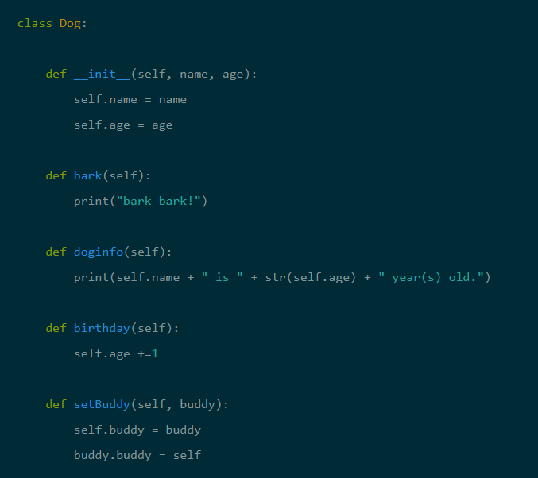
Class: Dog
Private function
Constructor
Attribute: Name, Age
Methods: bark, doginfo, birthday, setBuddy

Slide 4
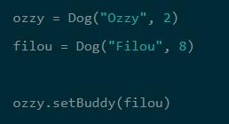


Objects Created
Objects’ Method called, with parameter
Objects’ attribute outputted
Objects’ Method called
How about Class’ Method ?
Class dog { …
def population():
return (100000000)
…
}
Print( dog.population() )
Classes’ Method
Classes’ Method called

Slide 5
Reference
https://www.datacamp.com/community/tutorials/python-oop-tutorial
https://ithelp.ithome.com.tw/articles/10161285
http://teddy-chen-tw.blogspot.com/2012/01/2object-class-instance.html

Slide 6
Thank you

Slide 7
Appendix

