Slide 1
CUHK Statistics Department Workshop on Python 101
Week 2, 19 July 2018
By KY Alan Lo

Slide 2








Team Data Science Process lifecycle
Start
Analyst (Domain SME)
Data Scientist
Business Understanding ⬄ Project Objective
Data Engineer
Data
Source
Feature Engineering
Pipeline
Model Fitting
Modeling
Data Acquisition and Understanding
Data
Wrangling
Model Evaluation
Performant Model
Production Pipeline
Analytics Environment
Deployment
End
User Acceptance

Slide 3
Keymans in the cycle
Data Science Manager / Project Manager
Data Architect
Data Engineer
Data Scientist
Data Visualizer / Business Analyst
Data Governor
…

Slide 4





Keymans in the cycle
Data Governor
Data Source
Database
Data Analysis / Modelling
Data Visualization
Business Values
Data Architect
Data Visualizer / Business Analyst
Data Engineer
Data Scientist
Data Science Manager / Project Manager
Notes:
Data Science Manager / Project Manager
Data Architect
Data Engineer
Data Scientist
Data Visualizer / Business Analyst
Data Governor
…

Slide 5
80% times on Data Processing
From NY Times in 2014
Data scientists spend from 50 percent to 80 percent of their time mired in this more mundane labor of collecting and preparing unruly digital data, before it can be explored for useful nuggets.
https://www.nytimes.com/2014/08/18/technology/for-big-data-scientists-hurdle-to-insights-is-janitor-work.html?_r=0

Slide 6
Start Python Coding !

Slide 7
DataFrame Unit - Series
Create a series: pd.Series([List])
Create a dataframe: pd.DataFrame([List of Series])
Select columns: df[ [List of column names] ]
Select rows: df.loc[ [List of index names] ] df.iloc[ no. of rows ]
Select elements: df.loc[ index names , column names ] df.iloc[ no. of rows , no. of columns ]
%in% s.isin( List )

Slide 8
DataFrame operations
Filter / Subset df[ Boolean expressions ], e.g. df[ df[columns]>0 ] df.where( Boolean expressions ) df.query( Boolean expressions → string )
Mutate / Transform df[ new_colname ] = … df.assign( new_name = f(df[‘col’], …) )
Arrange / Sort df.sort_values( columns )
Rename df.rename(columns = { column_bf : column_after } )
Quick overview df.info() , df.describe() , df.head() , df.tail()

Slide 9
DataFrame Index
Pd.DataFrame( [List of Series] , index = [Series] )
df.set_index( column )
df.reset_index()
Call index : df.index.names, df.index.values
Select rows : df.loc[ index.names ]
Sort index : df.sort_index()

Slide 10
Missing Values Handling
df[columns].isna()
df[columns].fillna()

Slide 11
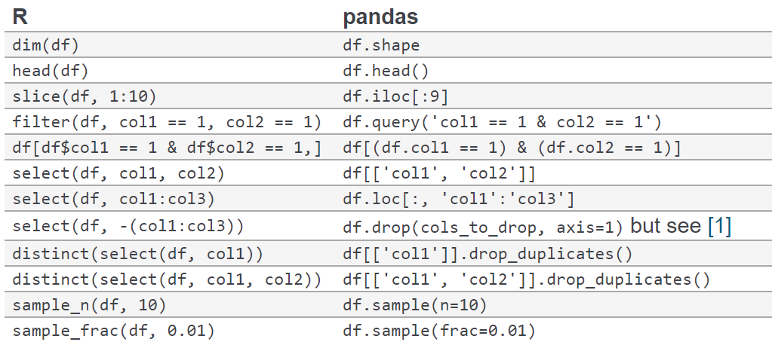
Pandas / R comparison

Slide 12
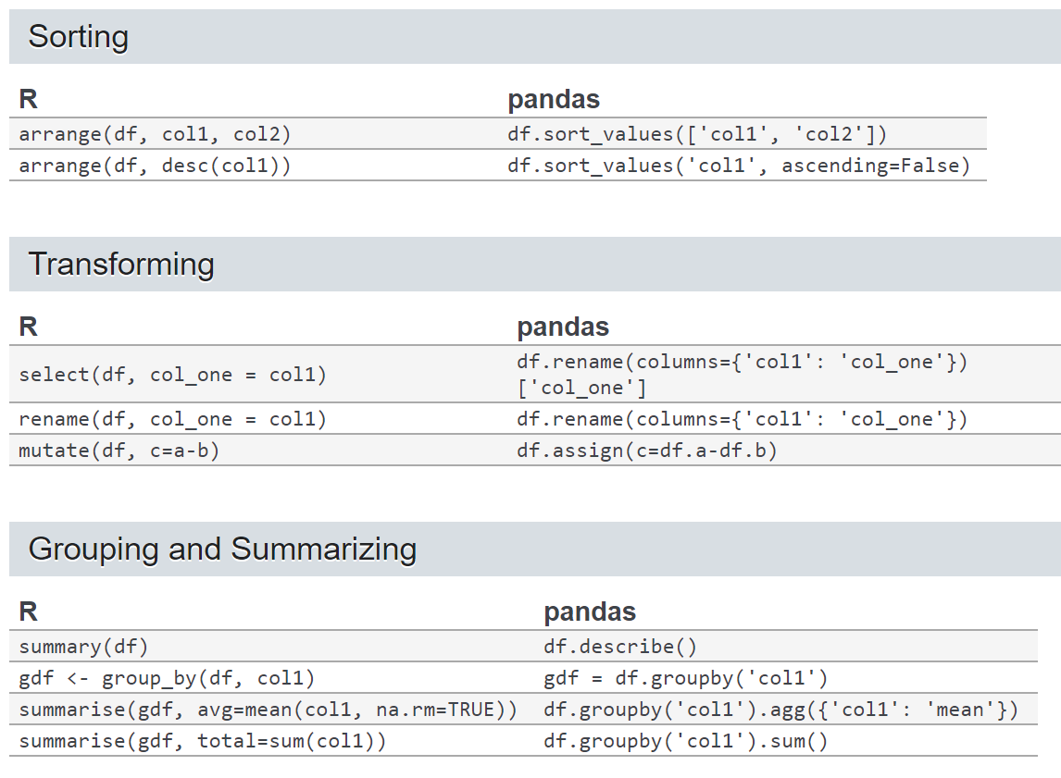
Pandas / R comparison

Slide 13
Thank you

Slide 14
Appendix

