Slide 1
CUHK Statistics Department Workshop on Python 101
Week 5, 9 August 2018
By KY Alan Lo

Slide 2
Content
Free Source of Infographics
Power BI, Tableau Public
Data Theme: Finance
Matplotlib.pyplot
Different kinds of plots
Scatter, Line, Bar, Histogram, Boxplot, Heatmap
Subplots, Pandas plot , Seaborn

Slide 3
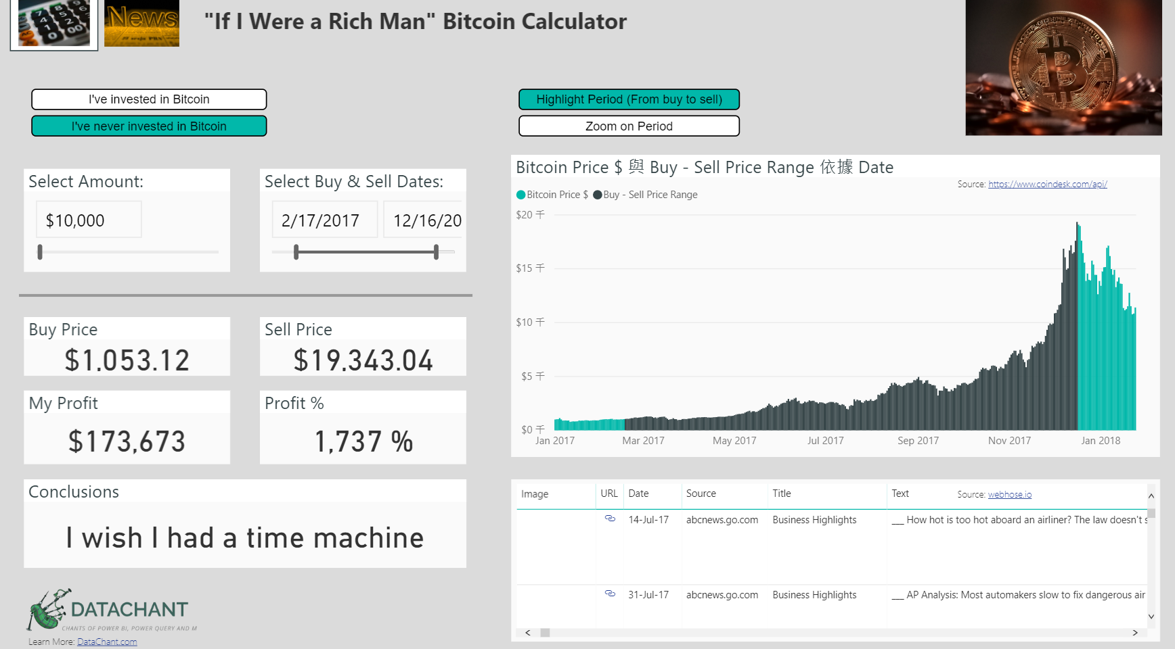
Power BI
https://community.powerbi.com/t5/Data-Stories-Gallery/bd-p/DataStoriesGallery

Slide 4
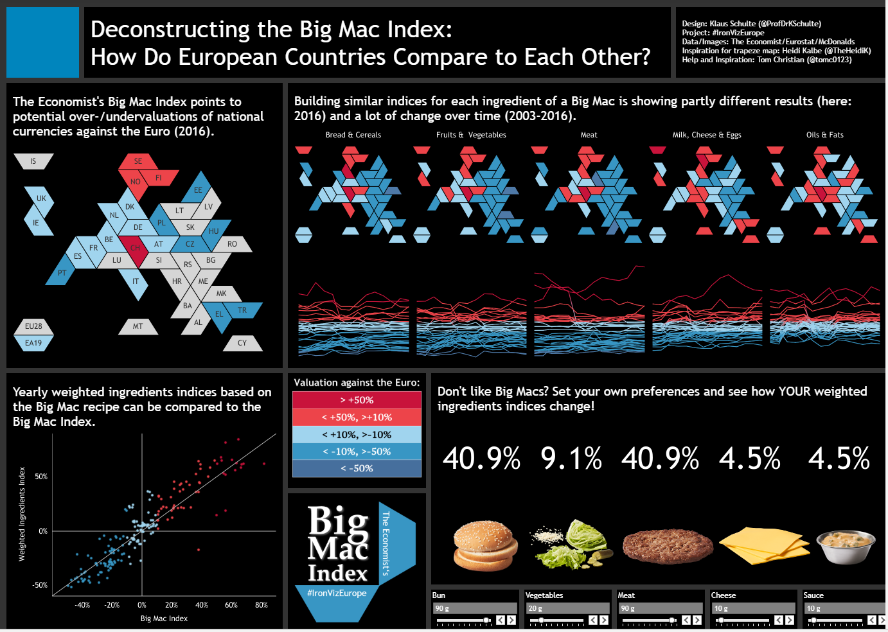
Tableau Public
https://public.tableau.com/en-us/s/gallery

Slide 5
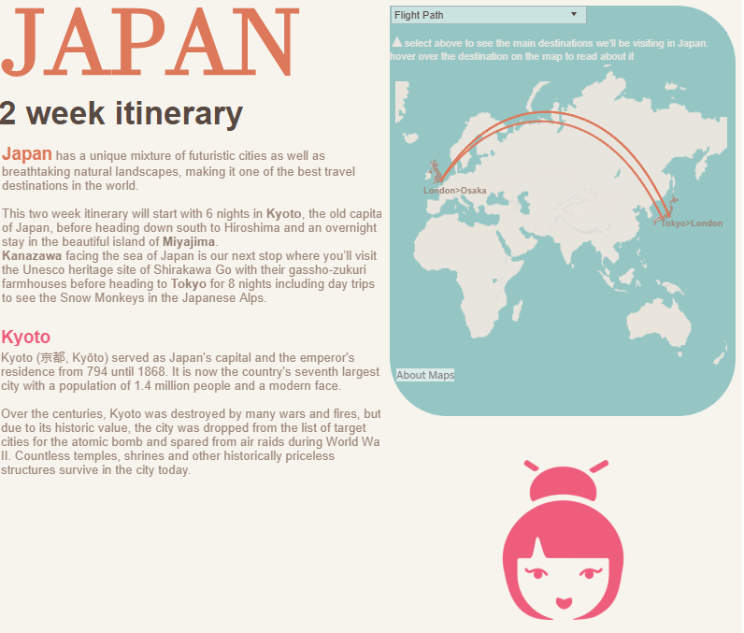
Tableau Public
https://public.tableau.com/profile/david.pires#!/vizhome/JapanIten/Japan2WeekItinerary

Slide 6
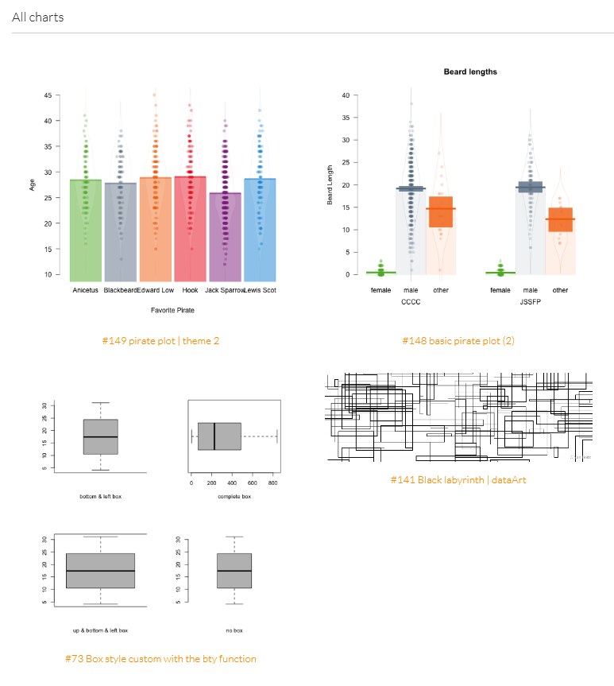
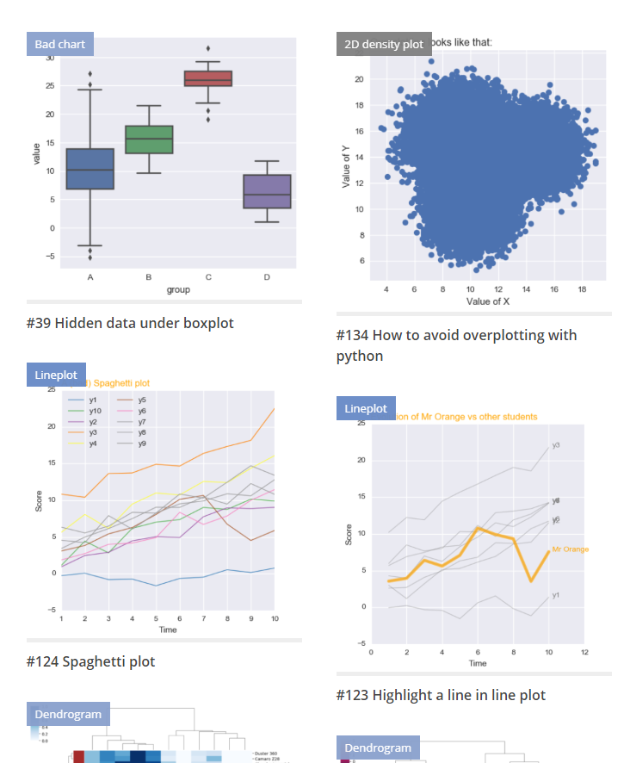
R / Python gallery
https://www.r-graph-gallery.com/
https://python-graph-gallery.com

Slide 7
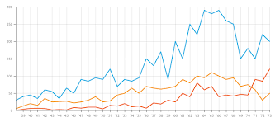
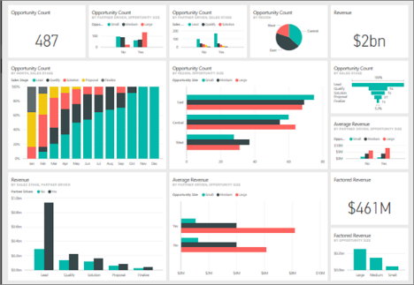
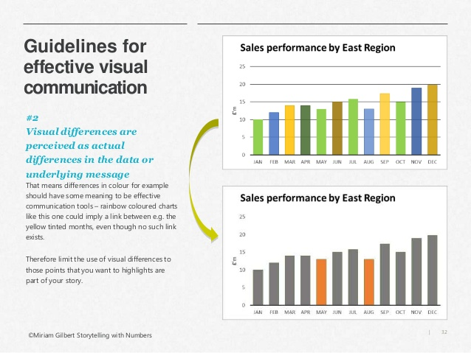
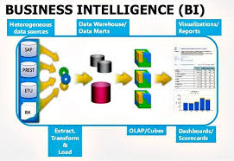
Data Visualization Hierarchy
Graphs
Dashboards
Data Stories
Business Intelligence

Slide 8
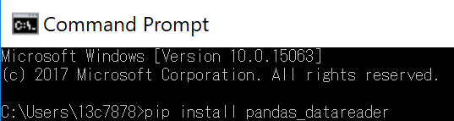
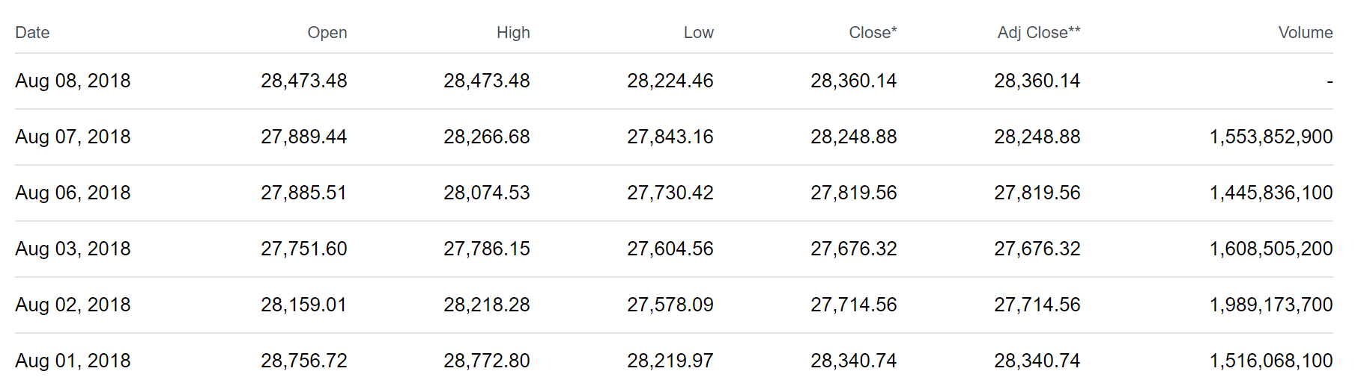
Financial Data
Installing Library
pandas_datareader , fix_yahoo_finance

Slide 9
Start Python Coding !

Slide 10
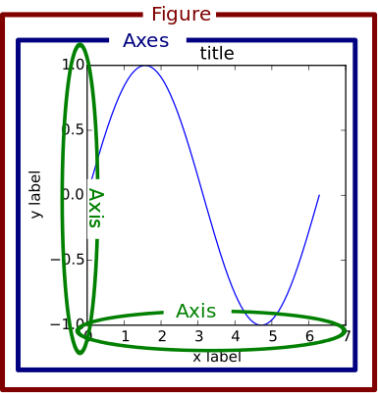
Fig, ax = plt.subplots()

Slide 11
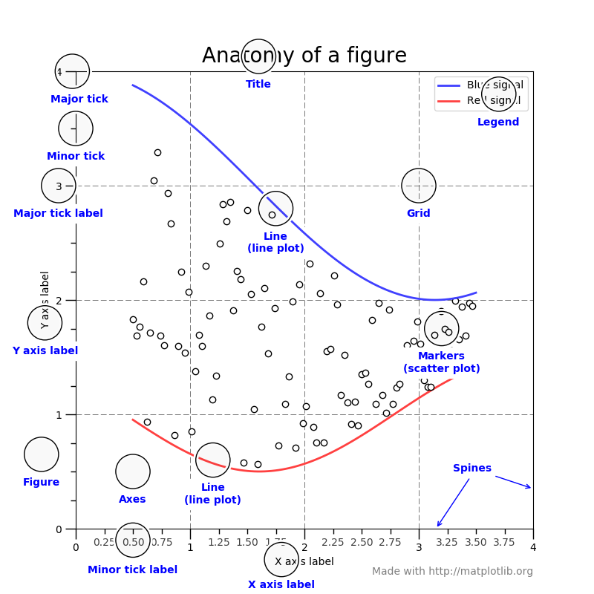
Anything can be set in pyplots…

Slide 12
To create plots…
https://matplotlib.org/tutorials/introductory/sample_plots.html
Fig, ax = plt.subplots()
ax.scatter(x,y,color='blue',s=5)
ax.plot(x1, y1, 'o-’)
ax.bar(index, values, bar_width, color='b')
ax.hist(x,numBins,color='green',alpha=0.8)
ax.boxplot(data)
ax.hist2d(X, Y, bins=25)

Slide 13
To create plots with dataframe…
df.plot.scatter(x='a', y='b')
df.plot()
df.plot(kind='bar’) / df.plot.bar()
df.plot.hist(alpha=0.5)
df.plot.box()

Slide 14
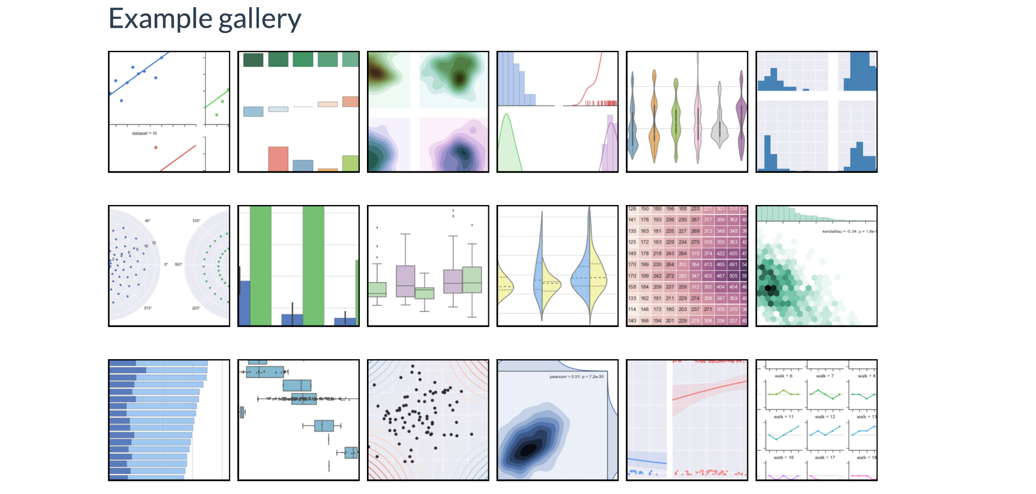
Seaborn library
sns.heatmap(…)
sns.kdeplot(…)
sns.jointplot(…)

Slide 15
Thank you

Slide 16
Appendix

