Slide 1
CUHK Statistics Department Workshop on Python 101
Week 3, 23 July 2018
By KY Alan Lo

Slide 2
Workshop / Summit for Data Scientists
Leader Summit
Director / CXO Class Speakers
Mainly for Networking
$$$
E.g. https://www.theinnovationenterprise.com/summits/big-data-analytics-hong-kong-2018/speakers
E.g. https://forwardleading.co.uk/summits/big-data-and-ai-leaders-hongkong-2018
Technical Workshop
Technicians as Speakers
Mainly use case / technical sharing
Free
E.g. https://hkoscon.org/2018/
E.g. http://pycon.hk/2017/

Slide 3

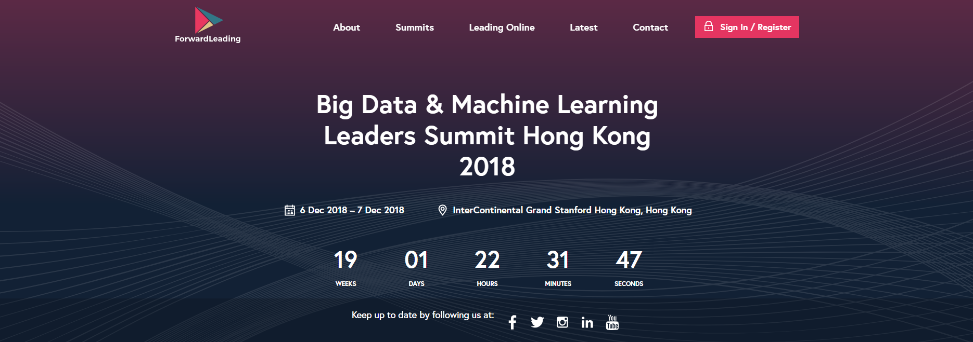
Leader Summit
https://www.theinnovationenterprise.com/summits/big-data-analytics-hong-kong-2018/speakers
https://forwardleading.co.uk/summits/big-data-and-ai-leaders-hongkong-2018

Slide 4
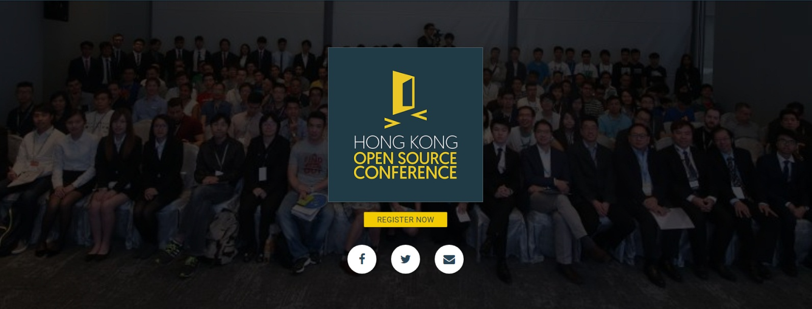
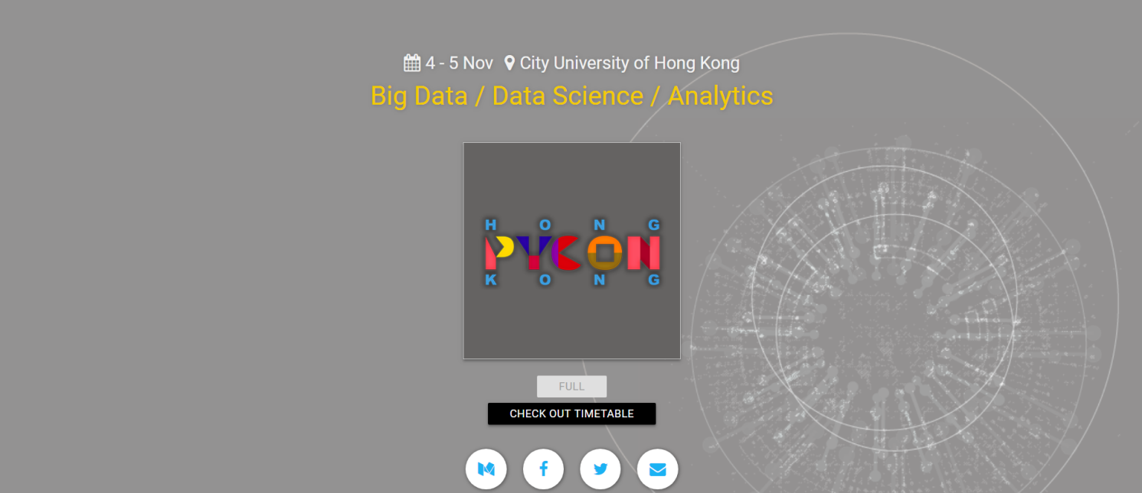
Technical Workshop
https://hkoscon.org/2018/
http://pycon.hk/2017/

Slide 5
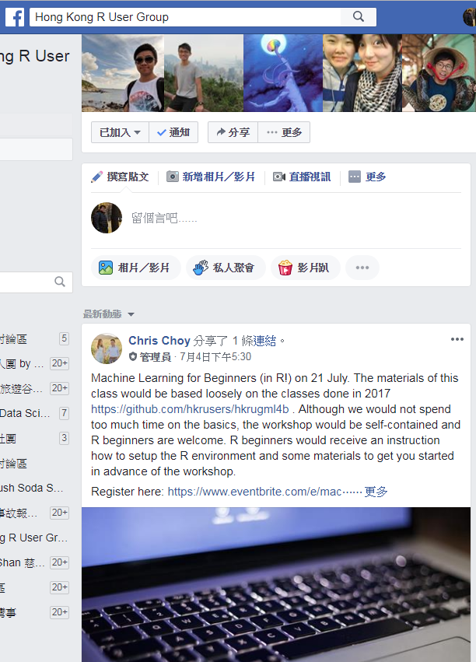
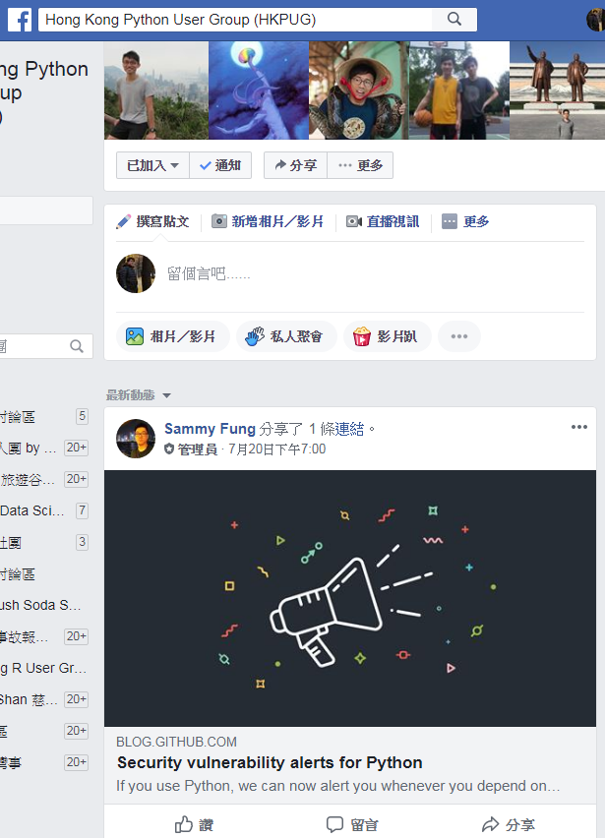
Facebook Groups
https://www.facebook.com/groups/hkrusers/
https://www.facebook.com/groups/hkpug/

Slide 6
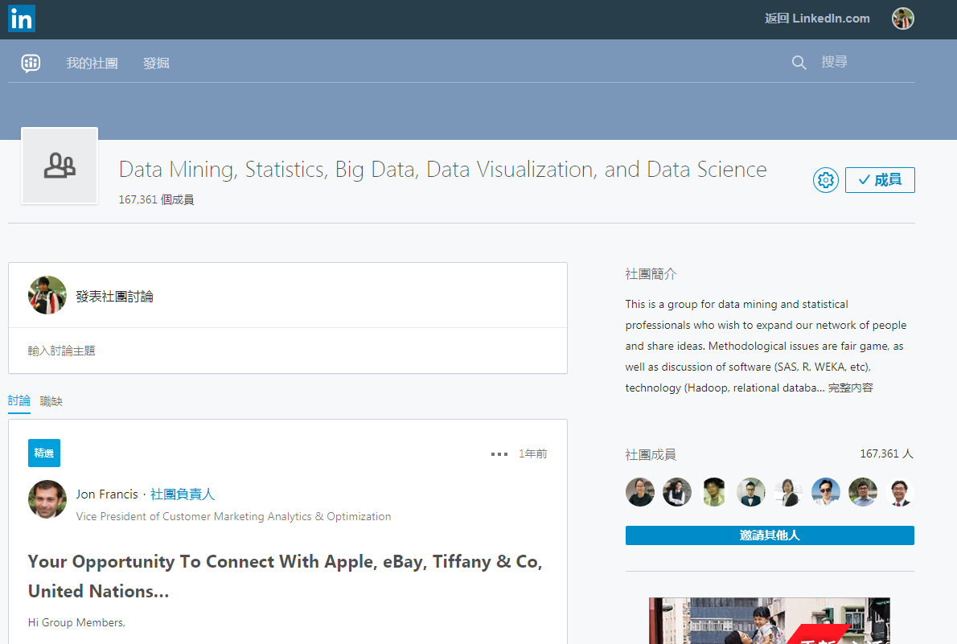
Linkedin Groups
Machine Learning and Data Science
Data Mining, Statistics, Big Data, Data Visualization, and Data Science

Slide 7
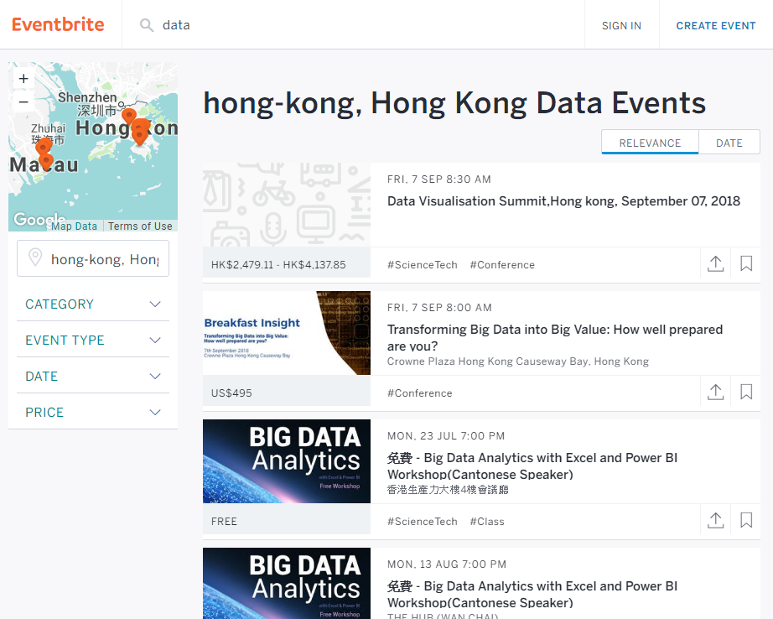
Eventbrite
https://www.eventbrite.com/

Slide 8


Hackathon
https://www.bochkhackathon.com/eng.html
http://hack.ust.hk-cic.com/

Slide 9
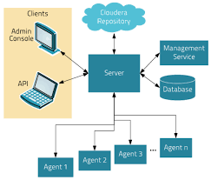
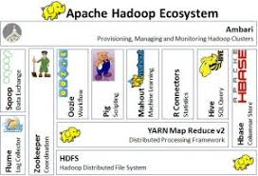

Hadoop Environment / Spark

Slide 10
Continue on lesson 2
DataFrame Index Manipulation
Missing Data Handling

Slide 11
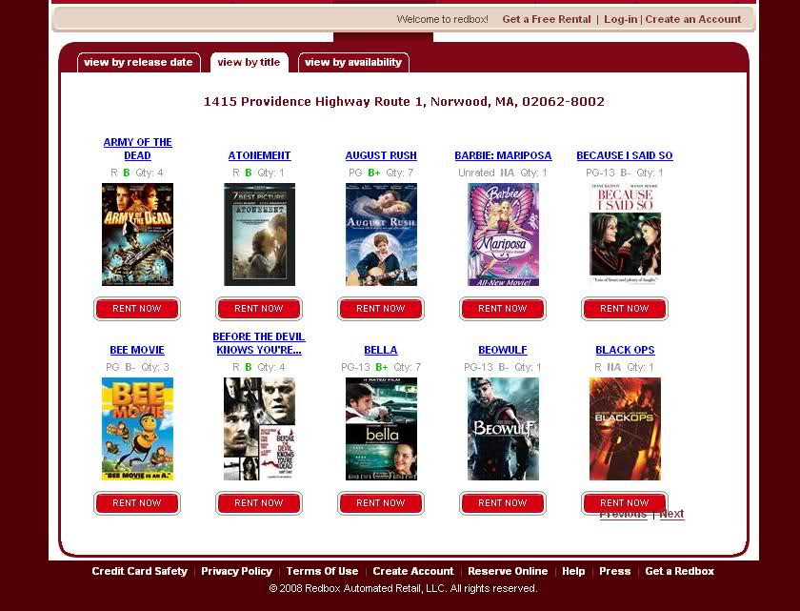
Today Theme
https://www.datacamp.com/community/tutorials/recommender-systems-python
https://grouplens.org/datasets/movielens/

Slide 12
Start Python Coding !

Slide 13
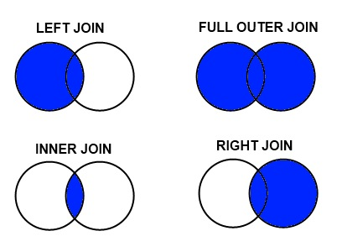
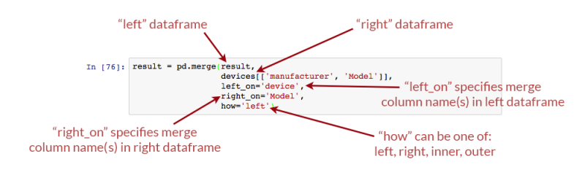
Merge

Slide 14
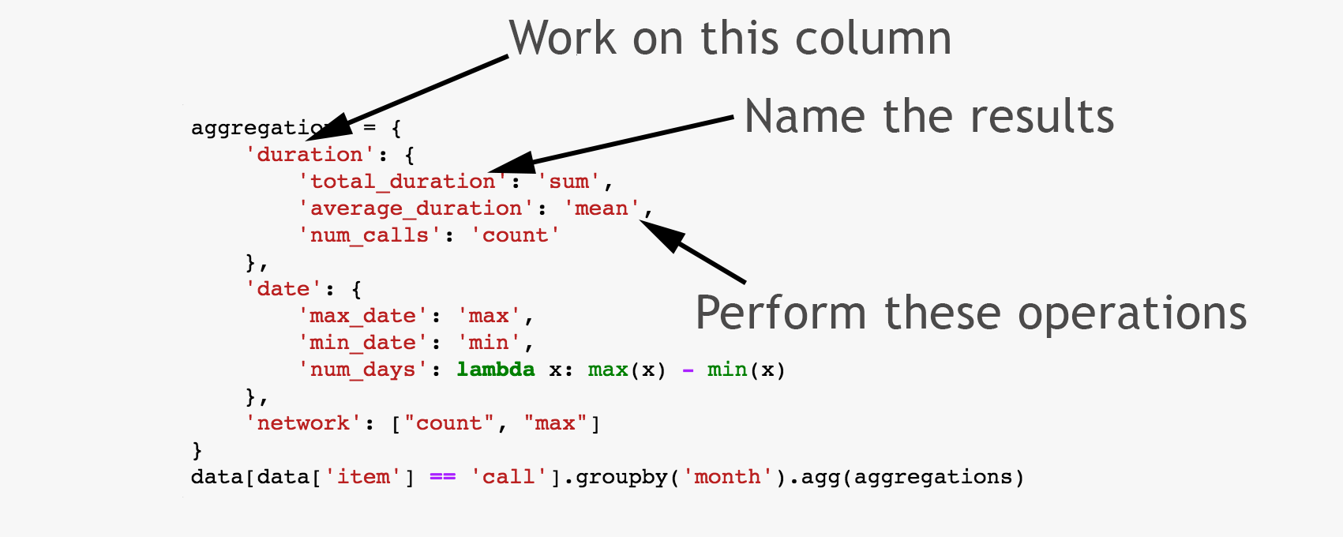
Aggregation (Group by)

Slide 15
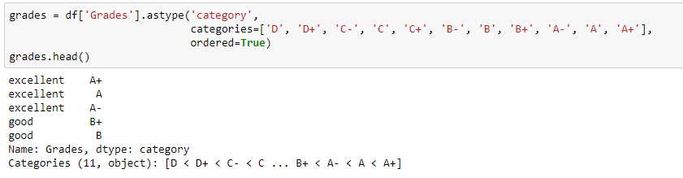
Categorical / Ordered Variable

Slide 16
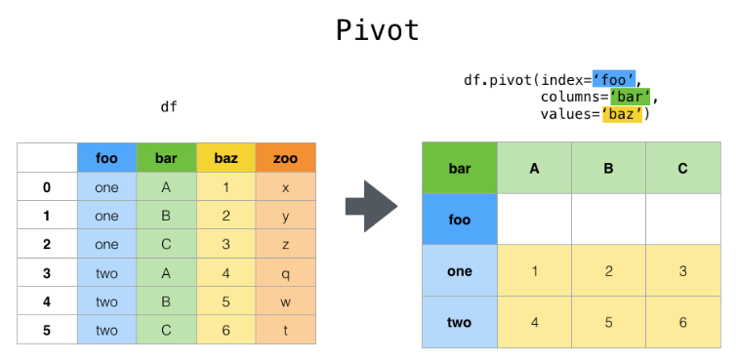
Pivot Tables

Slide 17
Thank you

Slide 18
Thank you

Slide 19
Appendix

