Slide 1
CUHK Statistics Department Workshop on Python 101
Week 4, 2 August 2018
By KY Alan Lo

Slide 2
Content
Data Source
CSV, XLSX, HTML, API
5-number summary, Moments
Mean, Variance, Skewness, Kurtosis
Probability and Distributions
Density, Quantile, Distribution, Random Numbers

Slide 3
Start Python Coding !

Slide 4
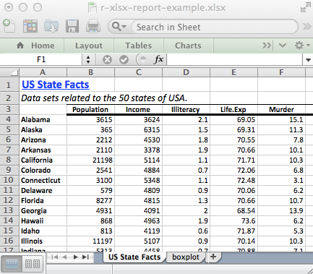
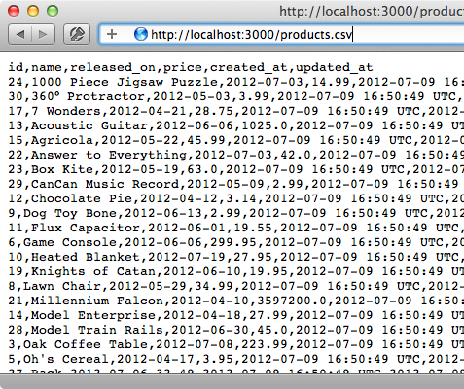


Import Data Source
Importing… | R | Python
temp.csv | d <- read.csv(“temp.csv”) | df = pd.read_csv(“temp.csv”)
temp.xlsx | library(xlsx) d <- read.xlsx(“temp.xlsx") | df = pd.ExcelFile(“temp.xlsx”)
Notes:
https://msropendata.com/

Slide 5
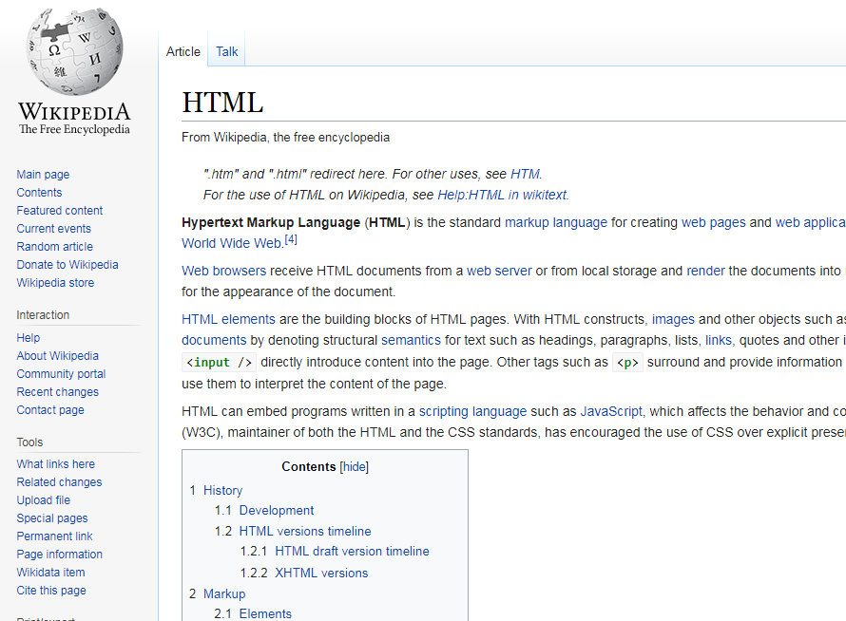
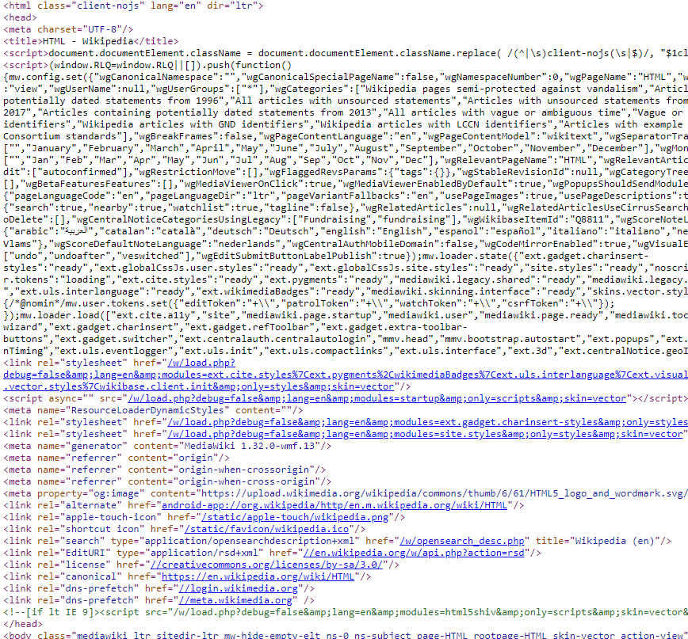


HTML
HyperText Markup Language
DataFrame
BeautifulSoup
Notes:
Use skyscanner

Slide 6



API
Application programming interface https://youtu.be/zvKadd9Cflc
DataFrame
urllib
Notes:
https://www.dataquest.io/blog/python-api-tutorial/
https://data.gov.hk/tc/

Slide 7
5-number summary, Moments
Statistics | R | Python
5-no. Summary | Summary(x) Summary(d) | (code for each functions…) df.describe()
mean | mean(x, [na.rm=T]) | np.mean(x) / np.nanmean(x)
Variance | var(x, [na.rm=T]) | np.var(x) / np.nanvar(x)
Skewness | skewness(x) | Scipy.stats.skew(x)
Kurtosis | kurtosis(x) | scipy.stats.kurtosis(x)

Slide 8
Probability & Distributions
Probability Functions | R | Python
Density / Distribution | dnorm(x, 0, 1) dbinom(x, n, p) | scipy.stats.norm.pdf(x, 0, 1) scipy.stats.binom.pmf(x, n, p)
Quantile | qnorm(p, 0, 1) | scipy.stats.norm.ppf(p, 0, 1)
CDF | pnorm(x, 0, 1) | scipy.stats.norm.cdf(x, 0, 1)
Random Numbers | rnorm(N, 0, 1) | np.random.normal(0,1,N)
More on Random nos. | R | Python
Set seed | seed(n) | np.random.seed(n)
Sample | sample(x, n, replace=T) | Np.random.choice(x, n, replace=True) (Note: sample(n) ~ U(0,1))

Slide 9
MSc Courses and the Python Libraries
Course Code | Topic | Python Library involved
STAT5102 | Linear Regression | sklearn.linear_model statsmodels.regression.linear_model
STAT5103 | Principle Component Analysis | sklearn.decomposition.PCA
STAT5105 | Cox Proportional Hazard Regression | statsmodels.duration.hazard_regression.PHReg
STAT6103 | Any kind of Simulation | scipy.stat numpy.random
STAT6104 | ARIMA | statsmodels.tsa.arima_model
STAT6106 | Naïve Bayes Model Any Bayesian Models | sklearn.naive_bayes pymc3
STAT6108 | Structural Equation Models | (R is better)
Run R in Python Kernel : rpy2

Slide 10
Thank you

Slide 11
Appendix

