Slide 1
CUHK Statistics Department Workshop on Python 101
Week 1, 12 July 2018
By KY Alan Lo

Slide 2



Self-Introduction
www.linkedin.com/in/kyalanlo/
kyalan.2013@gmail.com
2008 July BSc in Statistics CUHK (1st Hons) in Data Science and Bus. Stat. Stream
2010 July MPhil in Statistics CUHK under Supervised by Prof. Ben Chan
2010 Oct – 2013 Sept Research Analyst – Algo Trading CASH Dynamic Opportunities Investment
2013 Sept – 2014 Sept Quantitative Analyst – IT Consulting Long Term Intelligence
2014 Sept – 2015 Sept Project Officer - Environmental Predictive Modelling Environmental Protection Dept, HK Gov’t
2016 March – NOW Data Scientist – Group IT, CoE Analytics CLP Power Limited

Slide 3



















Ability
T/U-SQL Azure Data Factory
Data Source
Data Analysis / Modelling
Data Visualization
Data Warehousing
R / SAS / SPSS
10-yr experience
Database
Python
3-yr experience
Notes:
Data Source: APIs (Facebook / Google Analytics / …)
Data Warehousing: T/U-SQL, Azure Data Factory
Data Analysis & Modeling - High Level Experience: 10 years experience in R / SAS / SPSS 3 years experience in Python
Data Visualizer: Tableau, Power BI (Add data flow chart, and indicate the importance: 10 year R but 3 year python)

Slide 4
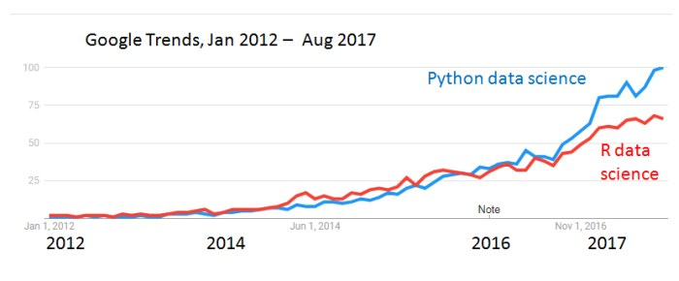
R vs Python
R for Data Analytics ; Python is OO-interpreted
R is a programming language and free software environment for statistical computing and graphics that is supported by the R Foundation for Statistical Computing. The R language is widely used among statisticians and data miners for developing statistical software and data analysis.
ggplots, tidyr, dplyr, lubridate, … = tidyverse
Python is an interpreted high-level programming language for general-purpose programming. It supports multiple programming paradigms, including object-oriented, imperative, functional and procedural, and has a large and comprehensive standard library.
Pandas , numPy, matplotlib, Scipy: Scikit-learn, statsmodels, Tensorflow, PyTorch, …
Google Trends

Slide 5
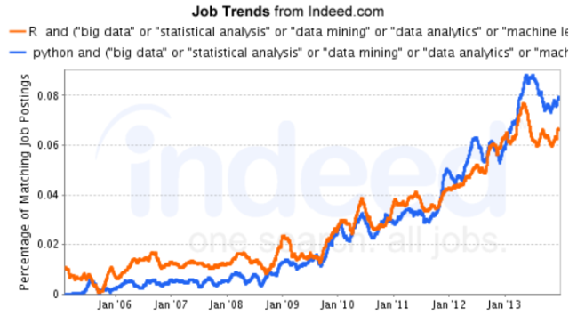
R vs Python
Library no. and supports
R – 12000+ packages, various importance on them
Python – 142000+ projects , most of them are not useful
In Job market

Slide 6
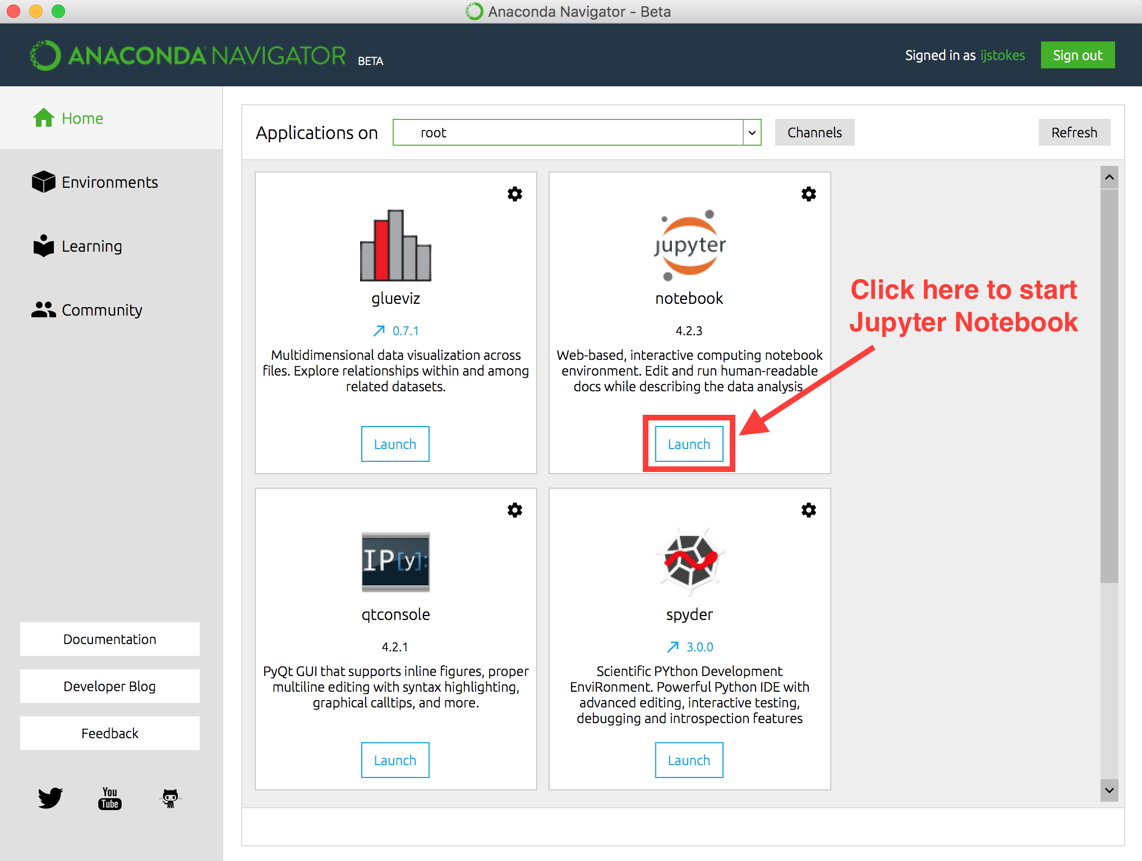
Python Program Editor – Jupyter & Spyder
Open Anaconda
Click here to start Spyder

Slide 7
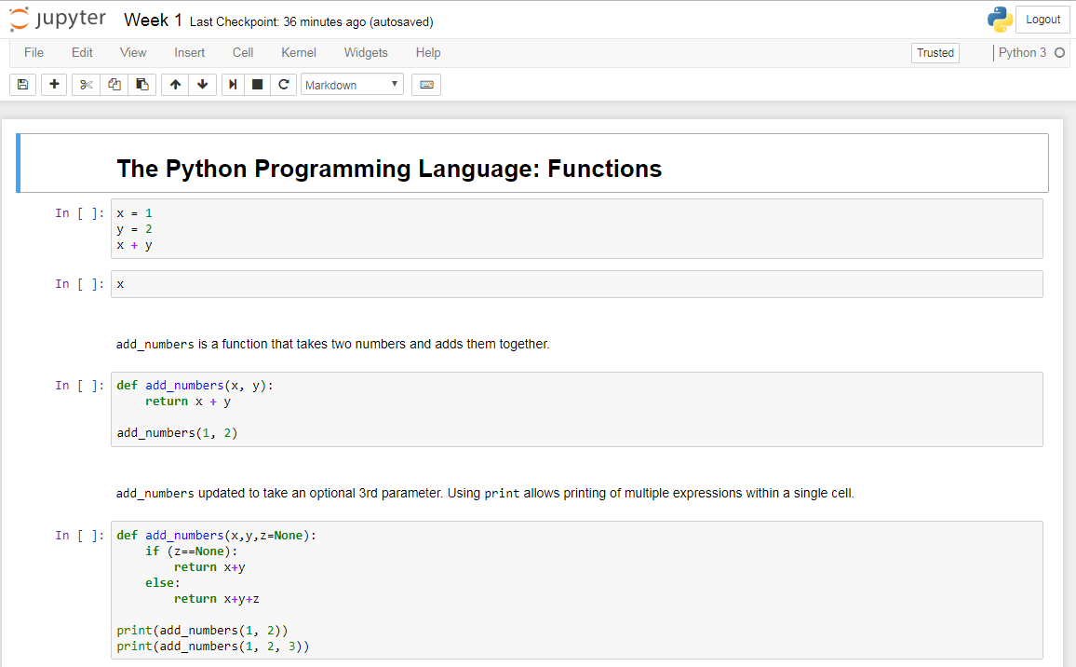
Python Program Editor – Jupyter & Spyder
Jupyter = Presentation mode for Python / R / SAS
Some Hints:
Command Mode vs Edit Mode
See Shortcuts, Press H
Run cell, Press Ctrl + Enter
Run cell and move to the next, Press Shift + Enter
Notes:
Jupyter R kernel: https://github.com/IRkernel/Irkernel
Jupyter SAS kernel: https://github.com/sassoftware/sas_kernel

Slide 8
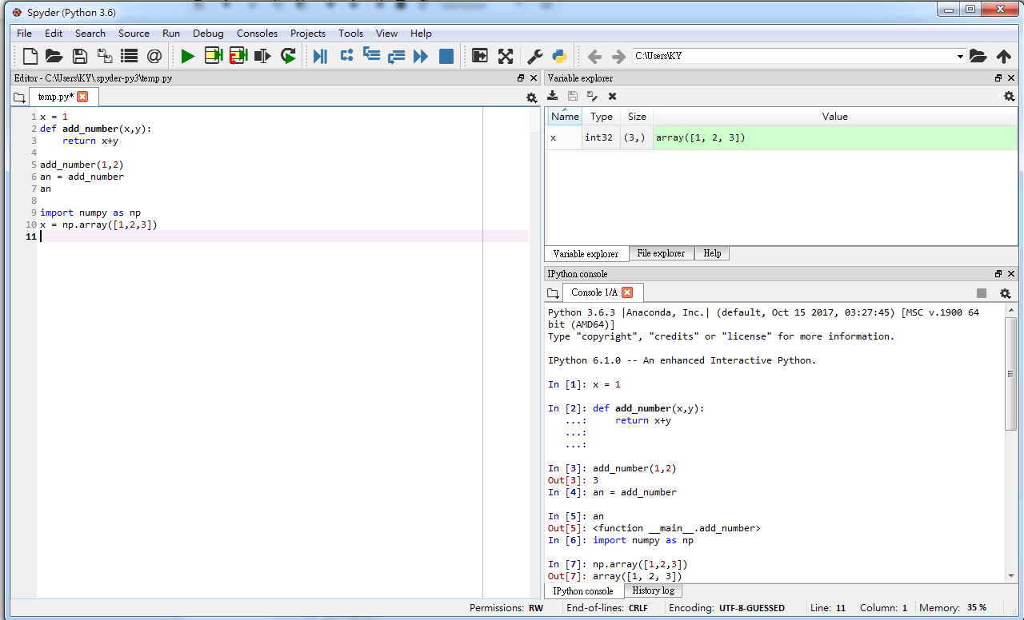
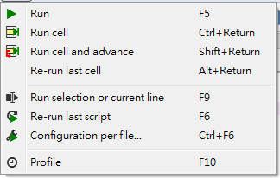
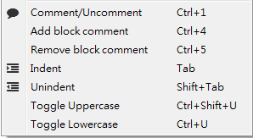
Python Program Editor – Jupyter & Spyder
Spyder = IDE for Python (RStudio = IDE for R)
Some Hints:

Slide 9
Who can help you editing program?
Google !!!
Most of cases, please input “pandas XXX” instead of “python XXX”
e.g. search “numeric to string”
?help (In Spyder, locate the function and press Ctrl-I)
Library document
Python, Pandas, Numpy, Matplotlib
Statmodels, Scikit.learn, Scikit.Image, PyTorch
Tensorflow

Slide 10
Start Python Coding !

Slide 11
Arithmetics
Variable Type: Number, Character
Arithmetics Operators
Operator | Description | Example | R program
+ Addition | Adds values on either side of the operator. | a + b = 30 | a + b
- Subtraction | Subtracts right hand operand from left hand operand. | a – b = -10 | a – b
* Multiplication | Multiplies values on either side of the operator | a * b = 200 | a * b
/ Division | Divides left hand operand by right hand operand | b / a = 2 | b / a
% Modulus | Divides left hand operand by right hand operand and returns remainder | b % a = 0 | b %% a
** Exponent | Performs exponential (power) calculation on operators | a**b =10 to the power 20 | a ^ b
// Floor Division | The division of operands where the result is the quotient in which the digits after the decimal point are removed. But if one of the operands is negative, the result is floored, i.e., rounded away from zero (towards negative infinity) − | 9//2 = 4 and 9.0//2.0 = 4.0, -11//3 = -4, -11.0//3 = -4.0 | a %/% b

Slide 12
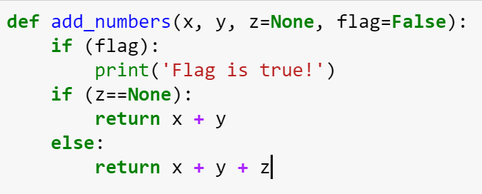
Functions
None: NULL value
Default Value
If- condition

Slide 13
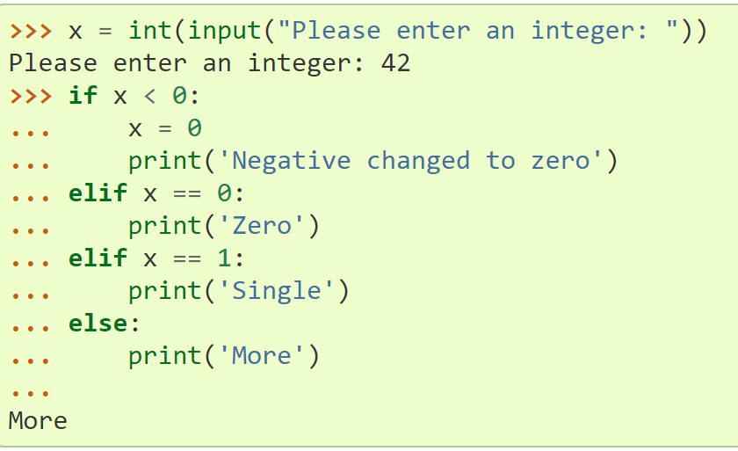
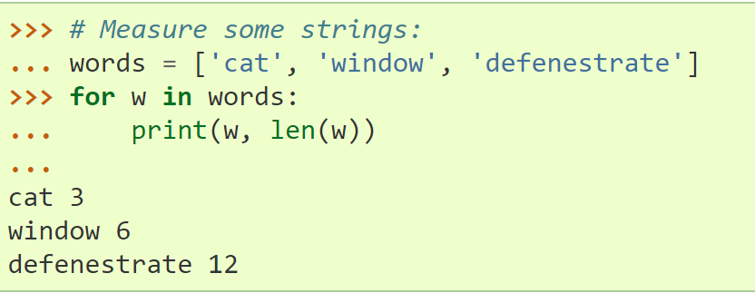
If Conditions & For loops
Control Flow

Slide 14
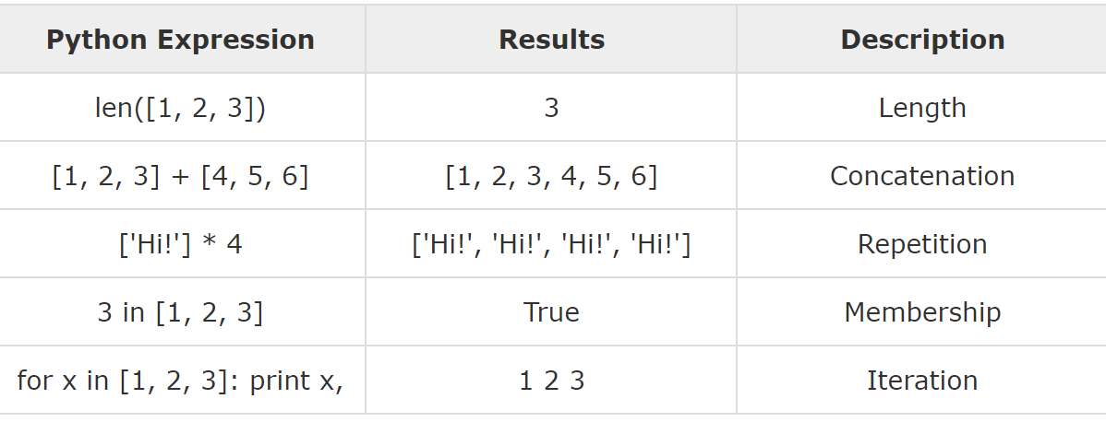
Tuple, List, Dictionary
Tuple
x = (1, 'a', 2, 'b’)
cannot be altered
List
x = [1, 'a', 2, ‘b’]
can be altered
Dictionary
Collection of key-value pairs
x = {‘a’: 1; ‘b’: 2}
x.keys() = [‘a’, ‘b’] ; x.values() = [1, 2]

Slide 15
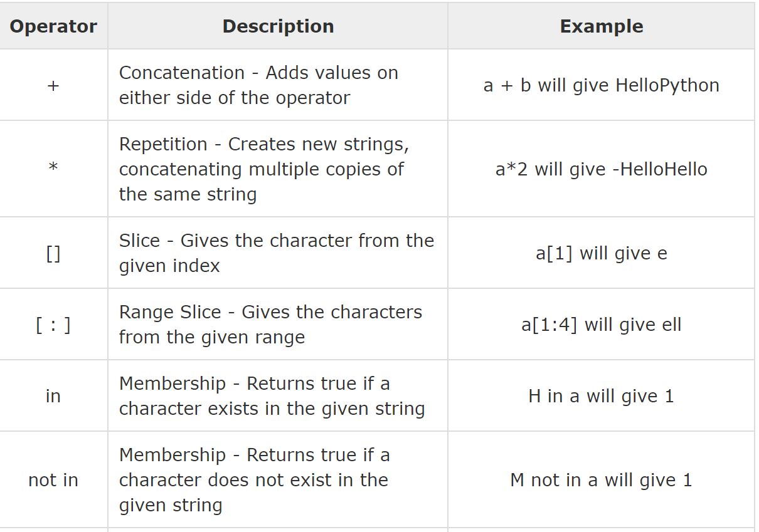
Strings Operations, Slicing
Strings = List of characters
Slicing:
string[1:4] = 2nd to 5th characters
string[-4:-1] = last 4 characters
Strings.split(‘ ‘)
Strings.format(…)

Slide 16
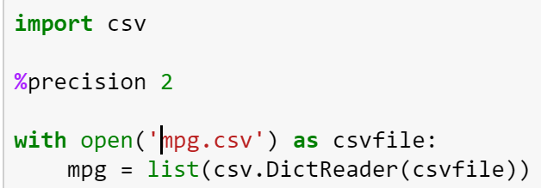
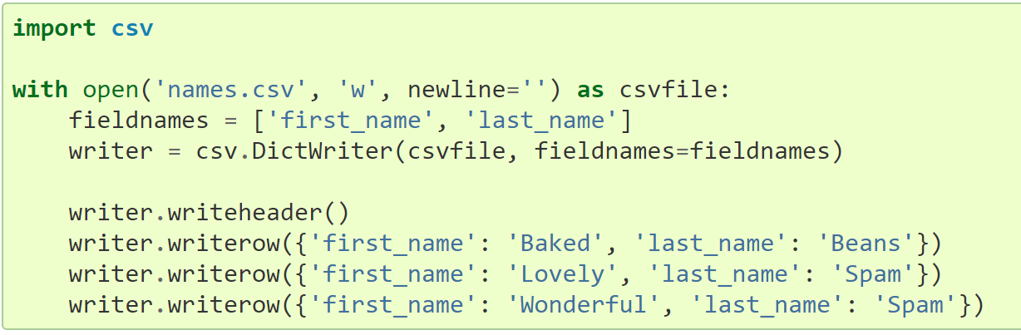
Read & Write CSV
csv library
csv.writer / csv.reader
csv.DictReader / csv.DictWriter

Slide 17
DateTime
Datetime library
Object datetime
Elements: year, month, day, hour, minute, second, microsecond
Object timedelta
Use for +- date and times
Object date
Object time

Slide 18
Shorten For loops
Map / pandas.series.Apply
Map(function f, list) = output each f(x) in list
Lambda = one line function
my_function = lambda a, b, c : a + b
List Comprehensions / pandas.series.filter
my_list = [number for number in range(0,1000) if number % 2 == 0]

Slide 19
Library numpy
Matrix computation
a powerful N-dimensional array object
useful linear algebra, Fourier transform, and random number capabilities

Slide 20
Thank you

Slide 21
Appendix

