Slide 1
CUHK Statistics Department Workshop on Python 101
Week 3, 13 July 2019
By KY Alan Lo

Slide 2
Last Lesson – all are scalar computation…
Thanks to pandas → Column-wise Computation starts…
P.S.: Thanks to numpy later → n-dim matrix-wise computation…

Slide 3
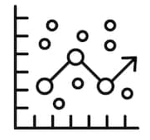


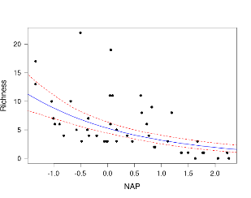











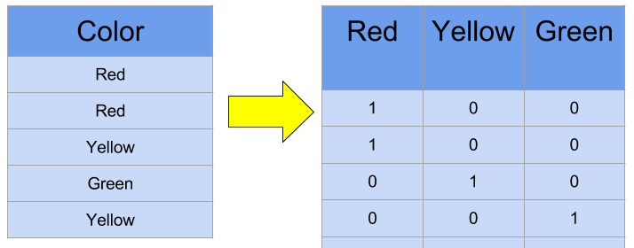
From data to model
Type = data.frame
Stat. Models
lm / glm /
ts / CART / …
R data.frame
data.table
Database
Data Table (numeric + category)
ML Models
get_dummies /
One hot encoding
Type = np.array
One hot encoding
Array / Matrix
(numeric only!!!)

Slide 4
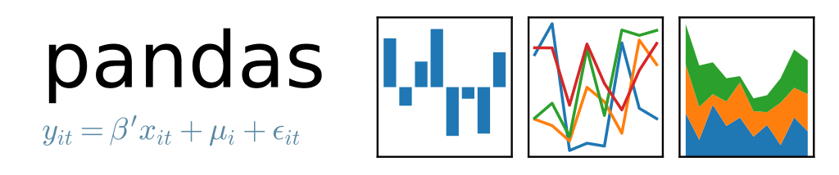
Pandas introduction
Initial release: 11 January 2008
Author: Wes McKinney – Developer
Need for Quantitative Analysis on financial data
Pandas = The short from PANel DAta

Slide 5
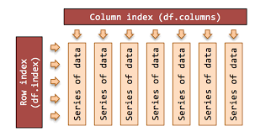
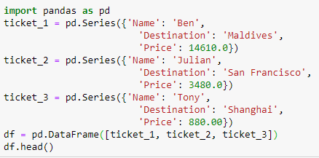
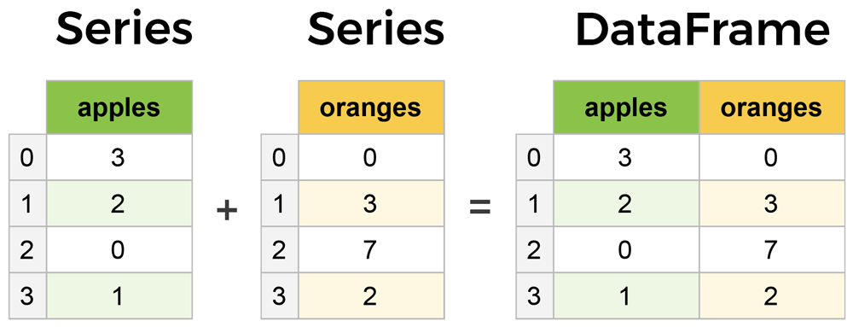
Series / DataFrame

Slide 6
DataFrame row, column selection
Select columns: df[ [List of column names] ]
Select rows: df.loc[ [List of index names] ] df.iloc[ no. of rows ]
Select elements: df.loc[ index names , column names ] df.iloc[ no. of rows , no. of columns ]
Quick overview df.info() , df.describe() , df.head() , df.tail()

Slide 7
Workshop / Summit for Data Scientists
Leader Summit
Director / CXO Class Speakers
Mainly for Networking
$$$
E.g. https://www.theinnovationenterprise.com/summits/big-data-analytics-hong-kong-2018/speakers
E.g. https://forwardleading.co.uk/summits/big-data-and-ai-leaders-hongkong-2018
Technical Workshop
Technicians as Speakers
Mainly use case / technical sharing
Free
E.g. https://hkoscon.org/2018/
E.g. http://pycon.hk/2017/

Slide 8


Leader Summit
https://www.theinnovationenterprise.com/summits/big-data-analytics-hong-kong-2018/speakers
https://forwardleading.co.uk/summits/big-data-and-ai-leaders-hongkong-2018

Slide 9
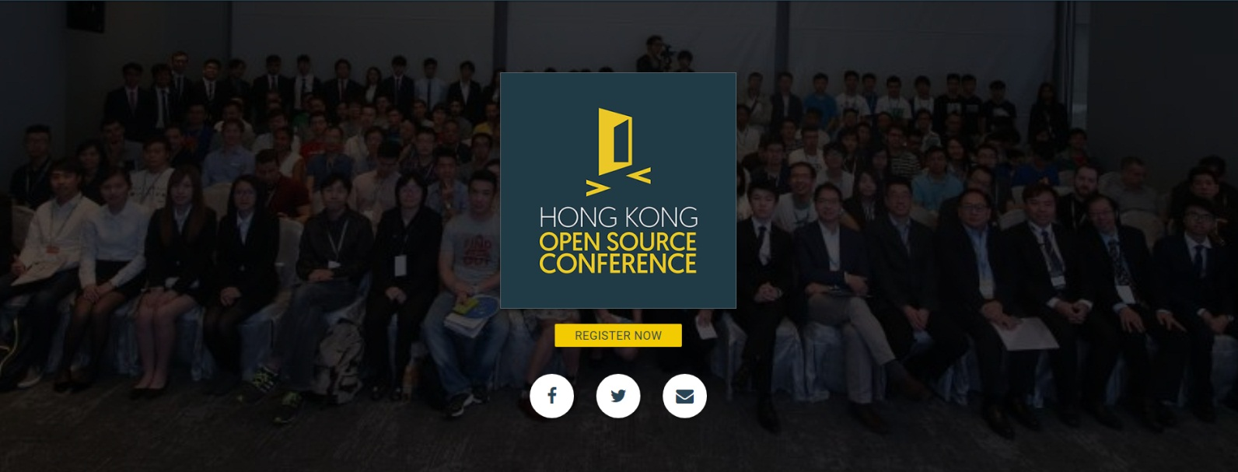

Technical Workshop
https://hkoscon.org/2018/
http://pycon.hk/2017/

Slide 10


Facebook Groups
https://www.facebook.com/groups/hkrusers/
https://www.facebook.com/groups/hkpug/

Slide 11
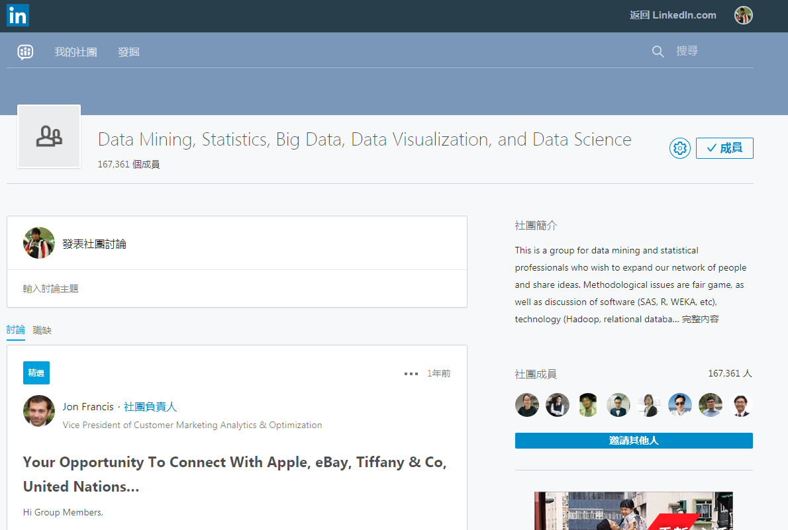
Linkedin Groups
Machine Learning and Data Science
Data Mining, Statistics, Big Data, Data Visualization, and Data Science

Slide 12
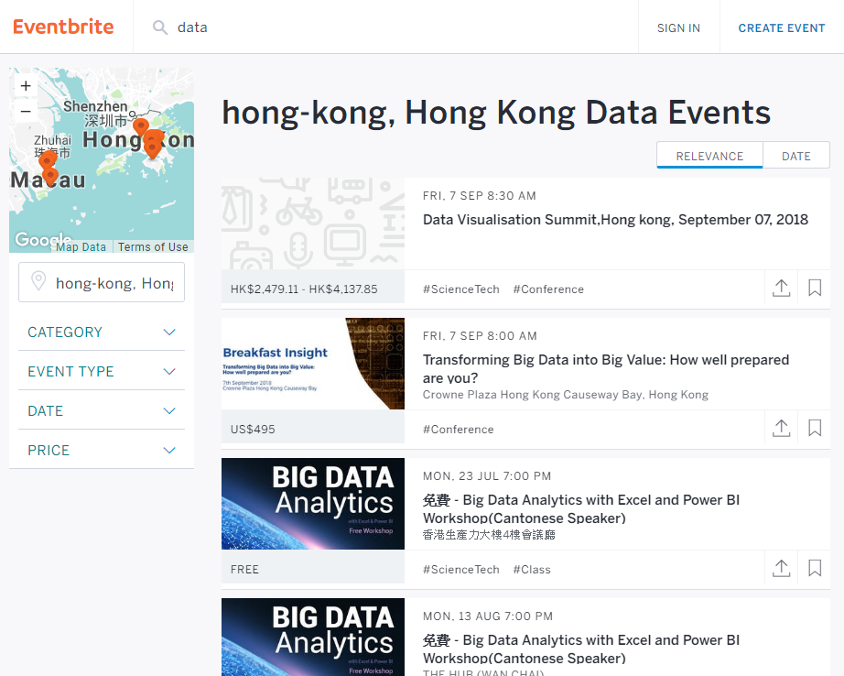
Eventbrite
https://www.eventbrite.com/

Slide 13


Hackathon
https://www.bochkhackathon.com/eng.html
http://hack.ust.hk-cic.com/

Slide 14
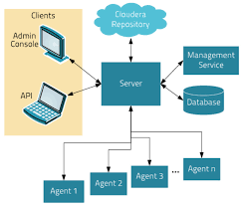
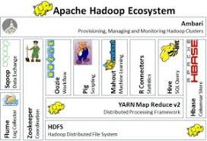

Hadoop Environment / Spark

Slide 15
Start Python Coding !

Slide 16
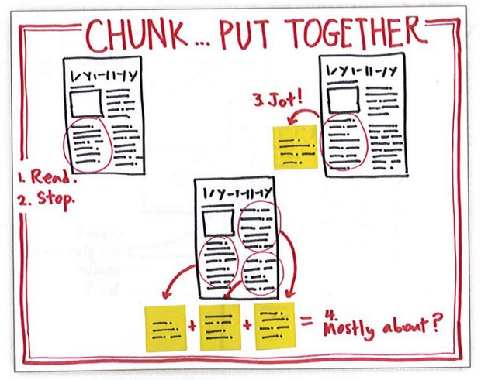
Read_csv with chunksize
df_chunk = read_csv(filename, chunksize = 1024)
Chunksize best choice = 2^N (1024, 2048, …) depends to you PC RAM

Slide 17
DataFrame operations
Filter / Subset df[ Boolean expressions ], e.g. df[ df[columns]>0 ] df.where( Boolean expressions ) df.query( Boolean expressions → string )
Mutate / Transform df[ new_colname ] = … df.assign( new_name = f(df[‘col’], …) )
Arrange / Sort df.sort_values( columns )
Rename df.rename(columns = { column_bf : column_after } )

Slide 18
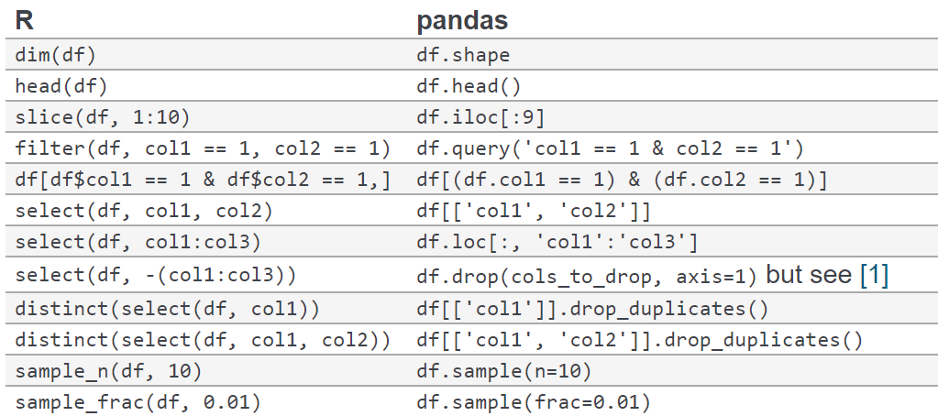
Pandas / R comparison

Slide 19
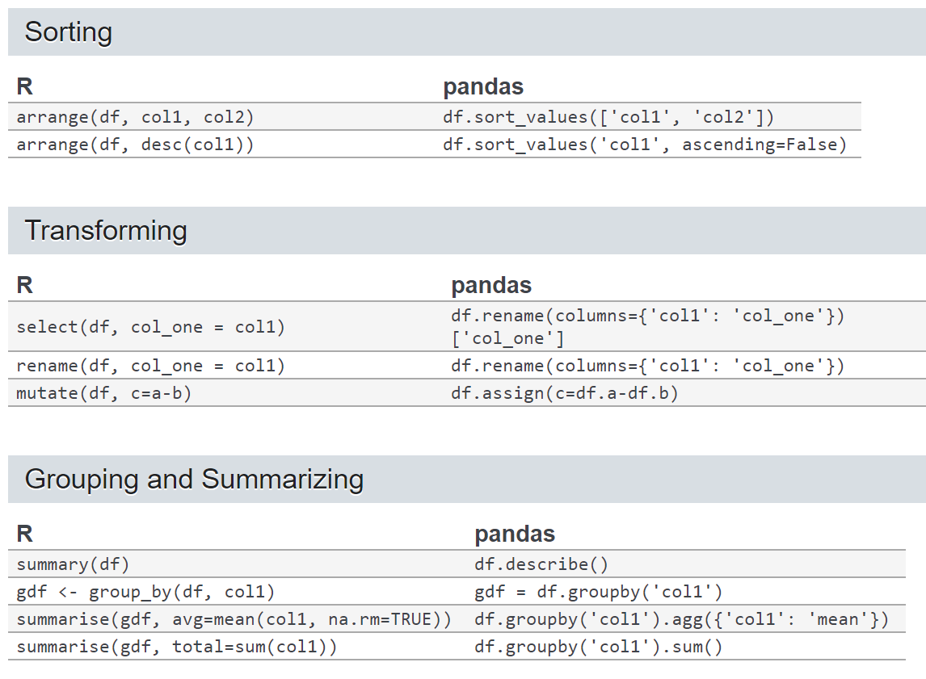
Pandas / R comparison

Slide 20
Missing Values Handling
df[columns].isna()
df[columns].fillna()
df[columns].dropna()

Slide 21
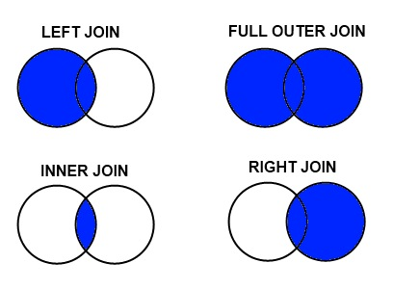
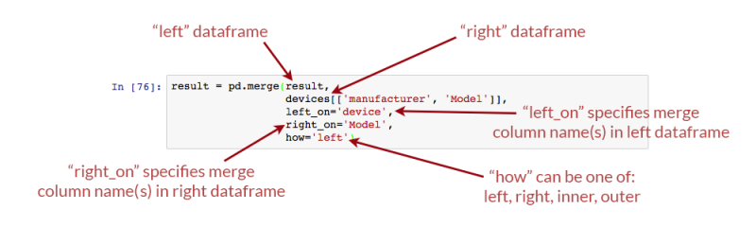
Merge

Slide 22
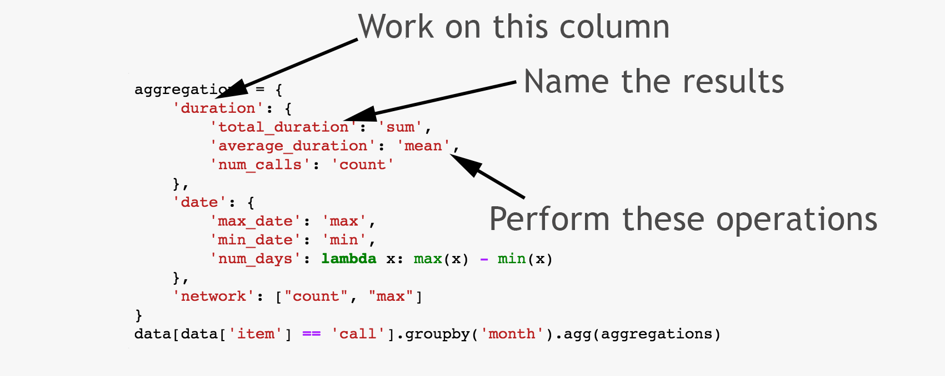
Aggregation (Group by)

Slide 23
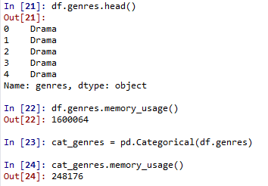
Categorical Variable
String Columns
Categorical Columns
= integer column + code mapping
[0, 0, 0, 0, 0, …] : levels = [‘Drama’, …]

Slide 24
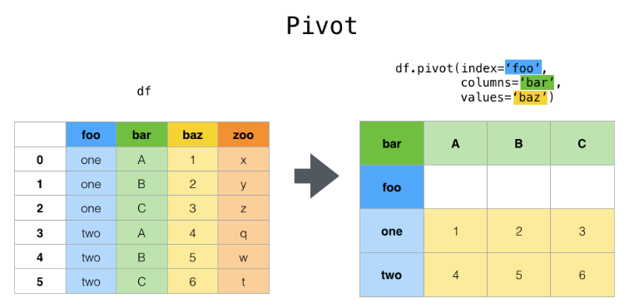
Pivot Tables

Slide 25

NumPy introduction
support for large, multi-dimensional arrays and matrices, along with mathematical functions to operate on them
Older Array Packages
In 1995, package called “Numeric” released.
Somewhile, another package called “numarray” released.
In 2006, “Numeric” and “numarray” are integrated to the new package “NumPy”, by Travis Oliphant (After that he founded Anaconda)

Slide 26
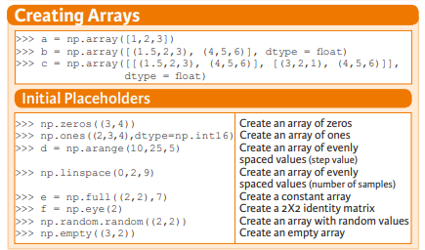
Creating Arrays

Slide 27
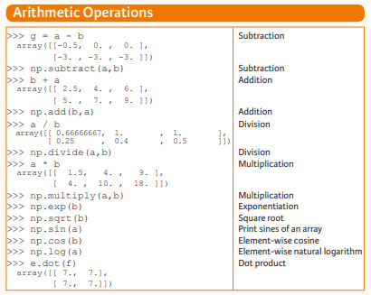
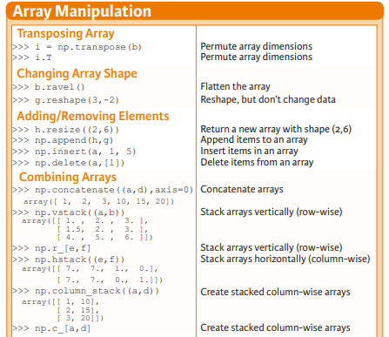
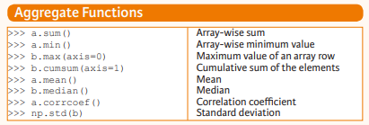
Array Computation / Manipulation

Slide 28
Cheat Sheets
https://sinxloud.com/python-cheat-sheet-beginner-advanced/

Slide 29
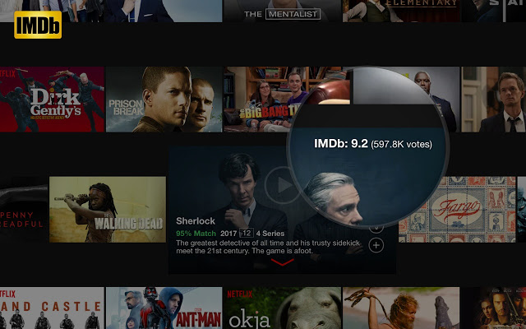
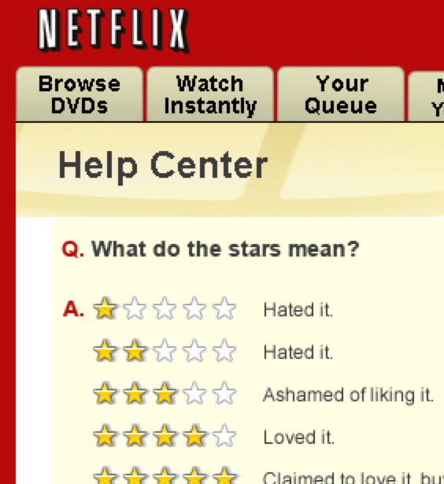

Assignment 3 – Netflix Movies

Slide 30
Assignment 3 – Netflix Movies
Data Source Link
The small dataset version is involved – ml-latest-small.zip, with 100K ratings (Of course you can play the larger version if you are interested in)
4 files are consisted (details)
Ratings.csv | Ratings for movies from users
Tags.csv | Tags to movies from users
Movies.csv | Movie titles, with genres (categories)
Links.csv | The link id, can connect to the website movies

Slide 31
Assignment 3 – Netflix Movies
To do:
Indicate the unique keys of each dataset.
Join the datasets with appropriate keys, depends on what you need in the following tasks.
Find the titles of 3 movies, with the most nos. of ratings
Find the no. of movies, with the highest ratings
Find the peak month users rate movies
Find the peak hour users rate movies (Note: Q5, 6 you need to convert from the UNIX timestamp – seconds from 1970-01-01 00:00)
Find the movie having the most tags
Find the most active userID on tagging movies.
Find the most common tags on those movies.

Slide 32
Assignment 3 – Netflix Movies
To do:
Indicate the unique keys of each dataset.
Join the datasets with appropriate keys, depends on what you need in the following tasks.
Find the titles of 3 movies, with the most nos. of ratings
Find the no. of movies, with the highest ratings
Find the peak month users rate movies
Find the peak hour users rate movies (Note: Q5, 6 you need to convert from the UNIX timestamp – seconds from 1970-01-01 00:00)
Find the movie having the most tags
Find the most active userID on tagging movies.
Find the most common tags on those movies.

Slide 33
Assignment 3 – Netflix Movies
Marking Scheme:
40% - the program should be RUN-able.
10% - for task 1 – identify unique keys
35% - success and accurate for task 3-9 (each 5%)
10% - The program should be READ-able
5% - The assignment should be handed ON-TIME
Super NOTE:
Suggest to use pandas as your analysis
Welcome to get reference to your classmates if you cannot solve this

Slide 34
Thank you

