Slide 1
CUHK Statistics Department Workshop on Python 101
Week 2, 6 July 2019
By KY Alan Lo

Slide 2
Continue from the previous lesson…

Slide 3
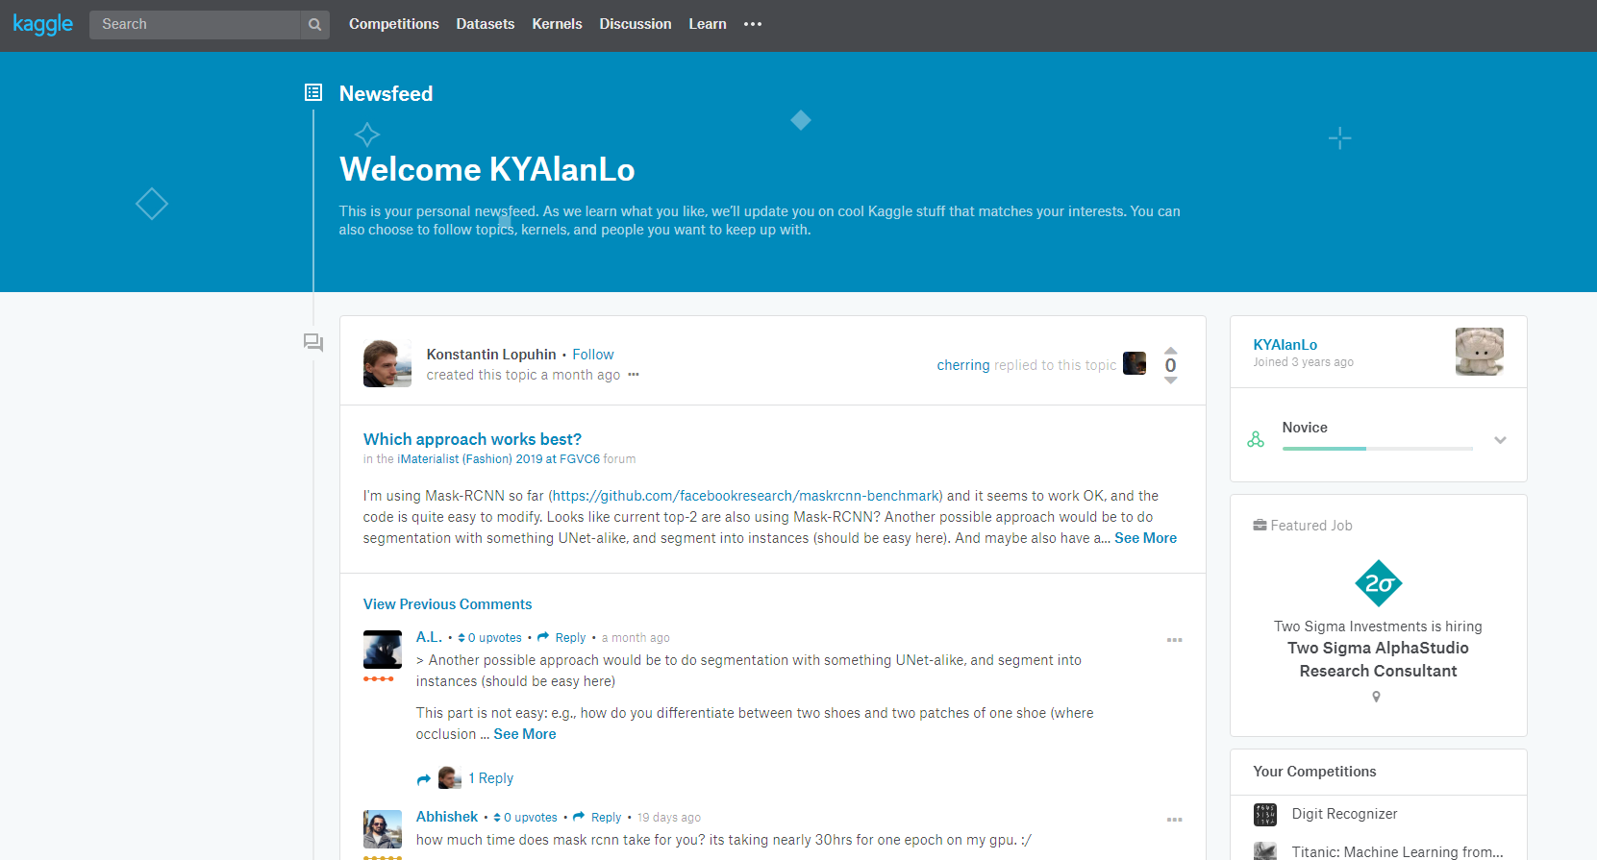
(FYI) Kaggle
allows users to find and publish data sets, explore and build models in a web-based data-science environment, work with other data scientists and machine learning engineers, and enter competitions to solve data science challenges.
owned by Google LLC

Slide 4
DateTime
Datetime library
Object datetime
Elements: year, month, day, hour, minute, second, microsecond
Object timedelta
Use for +- date and times
Build-in Functions
Recent time - Datetime.datetime.now()
String to datetime: strptime(“2019-06-22’’)
Datetime to String: strftime(dt.now())

Slide 5
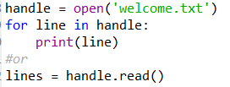
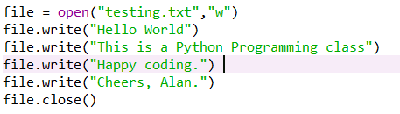
Read & Write Files
Reading File
Writing File

Slide 6
Start Python Coding !

Slide 7
Programming
Algorithm: (coding in previous lesson) A set of rules or steps used to solve a problem
Data Structure: (variables) A particular way of organizing data in a computer
NOW more Data Structure… Tuple / List / Dictionary Series / DataFrame in Pandas Array in Numpy

Slide 8
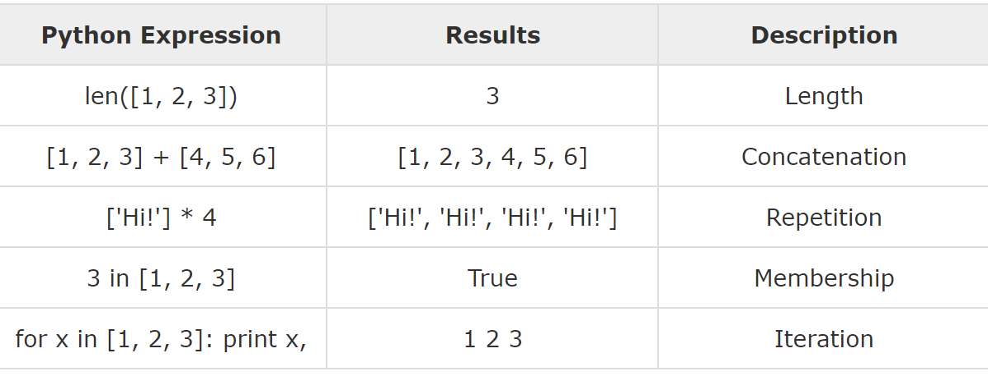
Tuple / List / Dictionary
Tuple - x = (1, 'a', 2, 'b’)
cannot be altered
List - x = [1, 'a', 2, ‘b’]
can be altered
Dictionary - x = {‘a’: 1; ‘b’: 2}
Collection of key-value pairs
x.keys() = [‘a’, ‘b’] ; x.values() = [1, 2]

Slide 9

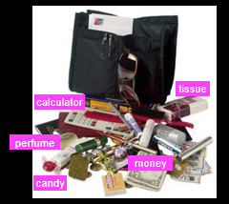
Tuple / List / Dictionary
Note
string = list tuple of characters
Tuple & List can use slicing properties (x[0:5])
List vs Dictionary
List: A linear collection of values that stay in order
Dictionary: A “bag” of values, each with its own label
Dictionary input = JSON

Slide 10








Team Data Science Process lifecycle
Start
Analyst (Domain SME)
Data Scientist
Business Understanding ⬄ Project Objective
Data Engineer
Data
Source
Feature Engineering
Pipeline
Model Fitting
Modeling
Data Acquisition and Understanding
Data
Wrangling
Model Evaluation
Performant Model
Production Pipeline
Analytics Environment
Deployment
End
User Acceptance

Slide 11
Keymans in the cycle
Data Science Manager / Project Manager
Data Architect
Data Engineer
Data Scientist
Data Visualizer / Business Analyst
Data Governor
…

Slide 12





Keymans in the cycle
Data Governor
Data Source
Database
Data Analysis / Modelling
Data Visualization
Business Values
Data Architect
Data Visualizer / Business Analyst
Data/ML Engineer
Data Scientist / ML Researcher
Data Science Manager / Project Manager
Notes:
Data Science Manager / Project Manager
Data Architect
Data Engineer
Data Scientist
Data Visualizer / Business Analyst
Data Governor
…

Slide 13
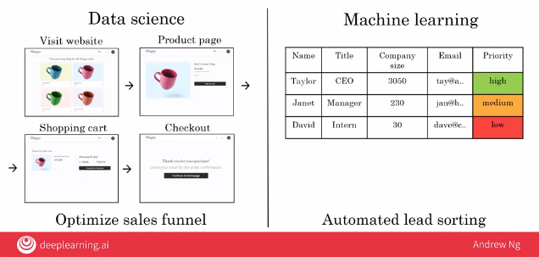
Keymans in the cycle
Data Governor
Data Source
Database
Data Analysis / Modelling
Business Values
Data Analysis / Modelling
Data Visualization
Data Engineer / Scientist
Aim on insight / silde-deck
Visualization / Analytics
ML Engineer / Scientist
Aim on prediction / automation
Model / Applications
Data Architect
Data Visualizer / Business Analyst
Data/ML Engineer
Data Scientist / ML Researcher
Data Science Manager / Project Manager
Notes:
Data Science Manager / Project Manager
Data Architect
Data Engineer
Data Scientist
Data Visualizer / Business Analyst
Data Governor
…

Slide 14
80% times on Data Processing
From NY Times in 2014
Data scientists spend from 50 percent to 80 percent of their time mired in this more mundane labor of collecting and preparing unruly digital data, before it can be explored for useful nuggets.
https://www.nytimes.com/2014/08/18/technology/for-big-data-scientists-hurdle-to-insights-is-janitor-work.html?_r=0

Slide 15
Shorten For loops
Map
Map(function f, list) = output each f(x) in list
Lambda = one line function
my_function = lambda a, b, c : a + b
List Comprehensions
my_list = [number for number in range(0,1000) if number % 2 == 0]

Slide 16
Up to here – all are scalar computation…
Thanks to pandas → Column-wise Computation starts…
P.S.: Thanks to numpy later → n-dim matrix-wise computation…

Slide 17
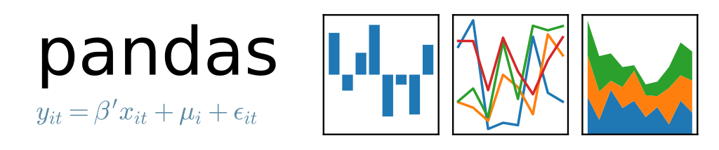
Pandas introduction
Initial release: 11 January 2008
Author: Wes McKinney – Developer
Need for Quantitative Analysis on financial data
Pandas = The short from PANel DAta

Slide 18
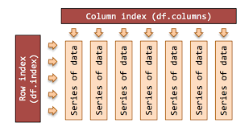
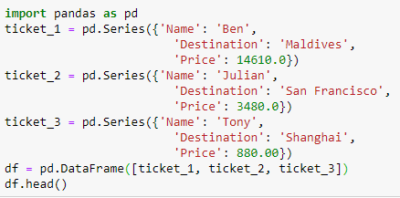
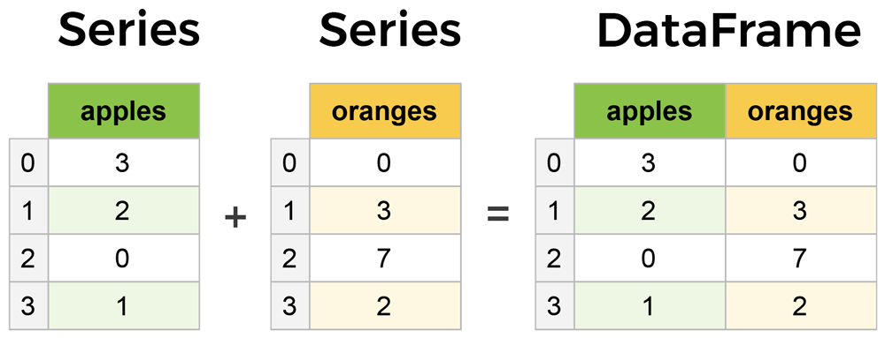
Series / DataFrame

Slide 19
DataFrame row, column selection
Select columns: df[ [List of column names] ]
Select rows: df.loc[ [List of index names] ] df.iloc[ no. of rows ]
Select elements: df.loc[ index names , column names ] df.iloc[ no. of rows , no. of columns ]
Quick overview df.info() , df.describe() , df.head() , df.tail()

Slide 20


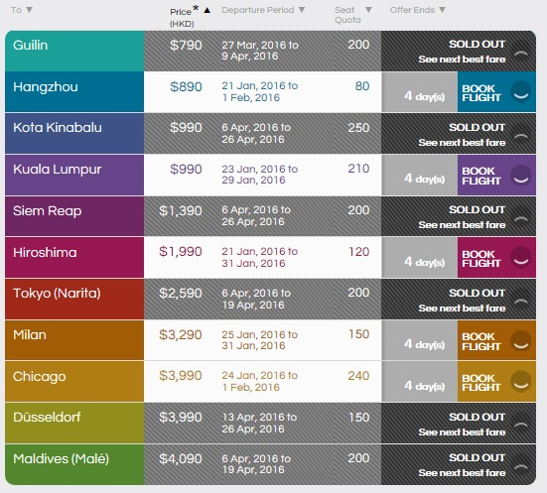
Assignment 2 – CX Fanfares

Slide 21
Assignment 2 – CX Fanfares
Reference: https://www.cathaypacific.com/cx/zh_HK/latest-offers/flights/fanfares/index.html
Data source: http://roasterpig.blogspot.com/2012/10/cathay-fanfares.html
Proceeded data: fanfares.csv
Task:
Reading the csv (Reference: fanfares_import.py) Note: the first row is the header.
Find the no. of offers (row) for each destination country
Find the top 5 cities having largest no. of quotas
Find the average price (quota weighted) for each city
For each offer, compute its offering period
Find the no. of offers for each offering period

Slide 22
Assignment 2 – CX Fanfares
Marking Scheme:
50% - the program should be RUN-able.
30% - success and accurate for task 1-6 (each 5%)
10% - The program should be READ-able
10% - The assignment should be handed ON-TIME
Super NOTE:
30% DISCOUNT to your mark if “import pandas” is in your program
Since the objective is for familiar the usage of Tuple / List / Dictionary, and also the map / lambda / and comprehension functions
Welcome to get reference to your classmates if you cannot solve this

Slide 23
Thank you

