Slide 1

Welcome Survey
https://wall2.sli.do/event/zet7cz6o

Slide 2
CUHK Statistics Department Tutorial in Python 101 for Data Science
Week 1, 22 June 2019
By KY Alan Lo

Slide 3



Self-Introduction
www.linkedin.com/in/kyalanlo/
kyalan.2013@gmail.com
2008 July BSc in Statistics CUHK (1st Hons) in Data Science and Bus. Stat. Stream
2010 July MPhil in Statistics CUHK under Supervised by Prof. Ben Chan
2010 Oct – 2013 Sept Research Analyst – Algo Trading CASH Dynamic Opportunities Investment
2013 Sept – 2014 Sept Quantitative Analyst – IT Consulting Long Term Intelligence
2014 Sept – 2015 Sept Project Officer - Environmental Predictive Modelling Environmental Protection Dept, HK Gov’t
2016 March – 2018 Dec Data Scientist – Group IT, CoE Analytics CLP Power Limited
2019 February – NOW Data Scientist, Data Analytics Manager – Chief Data Office Hang Seng Bank Limited

Slide 4





















Ability
T/U-SQL Azure Data Factory
Data Source
Data Analysis / Modelling
Data Visualization
Data Warehousing
R / SAS / SPSS
11-yr experience
Database
Python
4-yr experience
Notes:
Data Source: APIs (Facebook / Google Analytics / …)
Data Warehousing: T/U-SQL, Azure Data Factory
Data Analysis & Modeling - High Level Experience: 10 years experience in R / SAS / SPSS 3 years experience in Python
Data Visualizer: Tableau, Power BI (Add data flow chart, and indicate the importance: 10 year R but 3 year python)

Slide 5
Agenda in this 5 weeks
22 June - Python Basics, IO, strings, datetime
6 July - Data Structures - List, Dictionary, Tuple, DataFrame in Pandas
13 July - Pandas for Data Processing - Query, Sort, Merge, Missing Value Handling
20 July - APIs, web scraping
27 July - Numpy, univariate statistics, random generators, Plots, and the other topics

Slide 6
Agenda in this 5 weeks
Lecture
Classwork
Break
Blow Water
What’s happened about Data Science ?
Career in recent market
Assignment / Mock Exam
Feel Free to do
As a PoC of STAT5106 in the coming Sem 1

Slide 7

What is Data Science ?

Slide 8
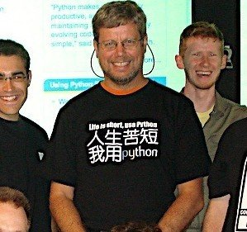
What is Python ?
implementation was started in December 1989
by Guido van Rossum, a Dutch programmer
Python was named for the BBC TV show Monty Python's Flying Circus.
Reference is here
Version
Python 0.9.0 - February 20, 1991
Python 1.0 - January 1994
Python 2.0 - October 16, 2000
Python 3.0 - December 3, 2008
Recent - Python 3.7 - June 27, 2018

Slide 9
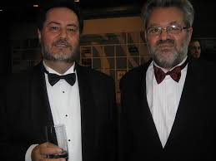
(FYI) What is R ?
initial version released in 1995
by Ross Ihaka and Robert Gentleman, Statisticians at the Auckland U
named partly after the first names of the first two R authors
Reference is here
Version
R 1.0 - 2000-02-29
R 2.0 - 2004-10-04
R 3.0 - 2013-04-03
Recent – R 3.6 - 2019-04-26

Slide 10
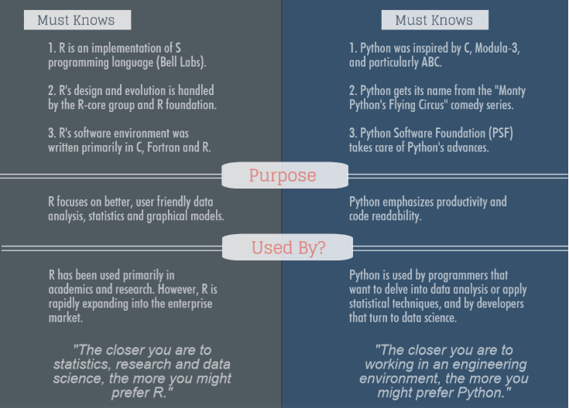
R vs Python
R from Statistics; Python from Computer Science

Slide 11
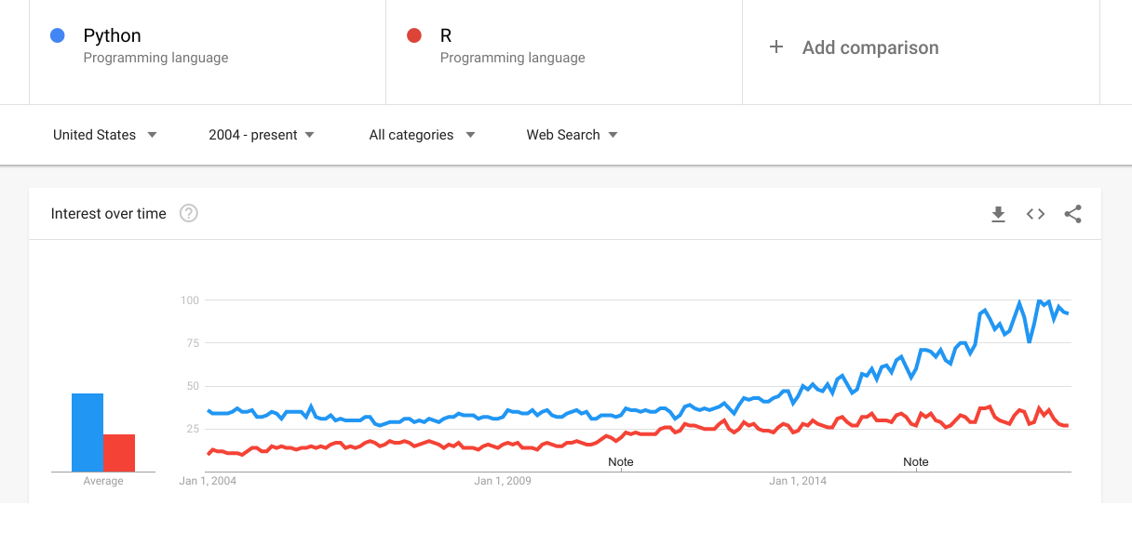
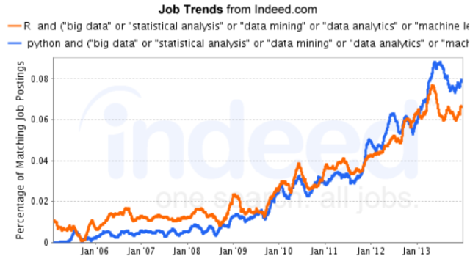
R vs Python
Google Trends
In Job market

Slide 12
R vs Python – My Practice
R
For data analysis / mining / visualization
For data analytics perspective
For STATISTICAL Modelling use
Python
For large scale data flow / engineering
For web scraping / getting web data
For Machine Learning / Deep Learning Modelling use
For productionalizing DS projects
Tell you more in the final lesson.

Slide 13
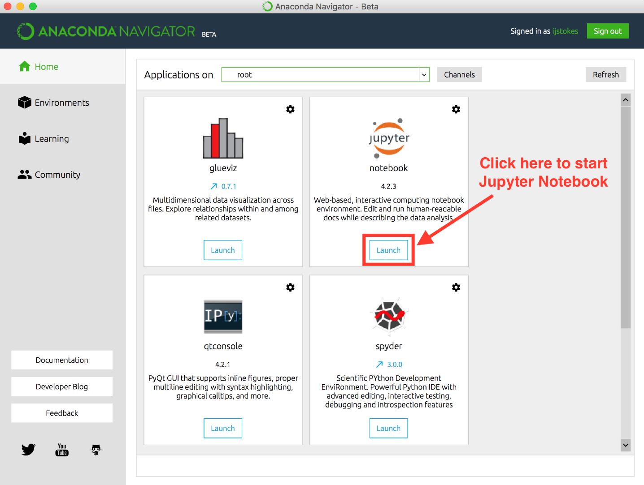
Python Program Editor – Jupyter & Spyder
Open Anaconda
Click here to start Spyder

Slide 14
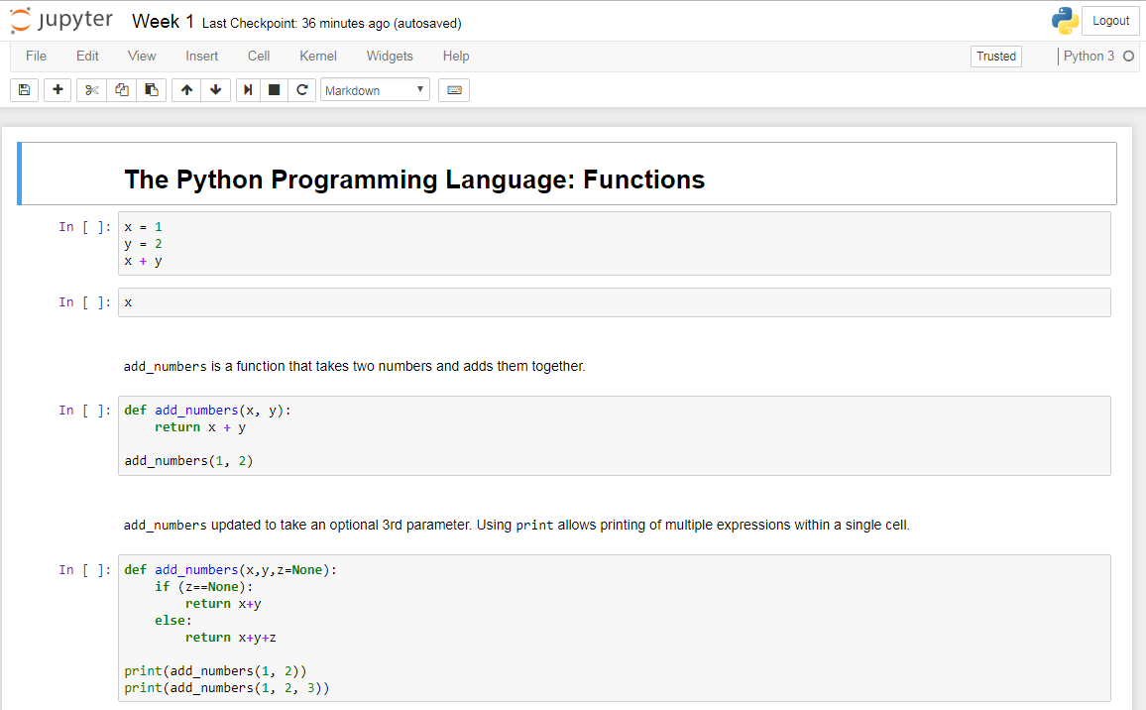
Python Program Editor – Jupyter & Spyder
Jupyter = Presentation mode for Python / R / SAS
Some Hints:
Command Mode vs Edit Mode
See Shortcuts, Press H
Run cell, Press Ctrl + Enter
Run cell and move to the next, Press Shift + Enter
Notes:
Jupyter R kernel: https://github.com/IRkernel/Irkernel
Jupyter SAS kernel: https://github.com/sassoftware/sas_kernel

Slide 15
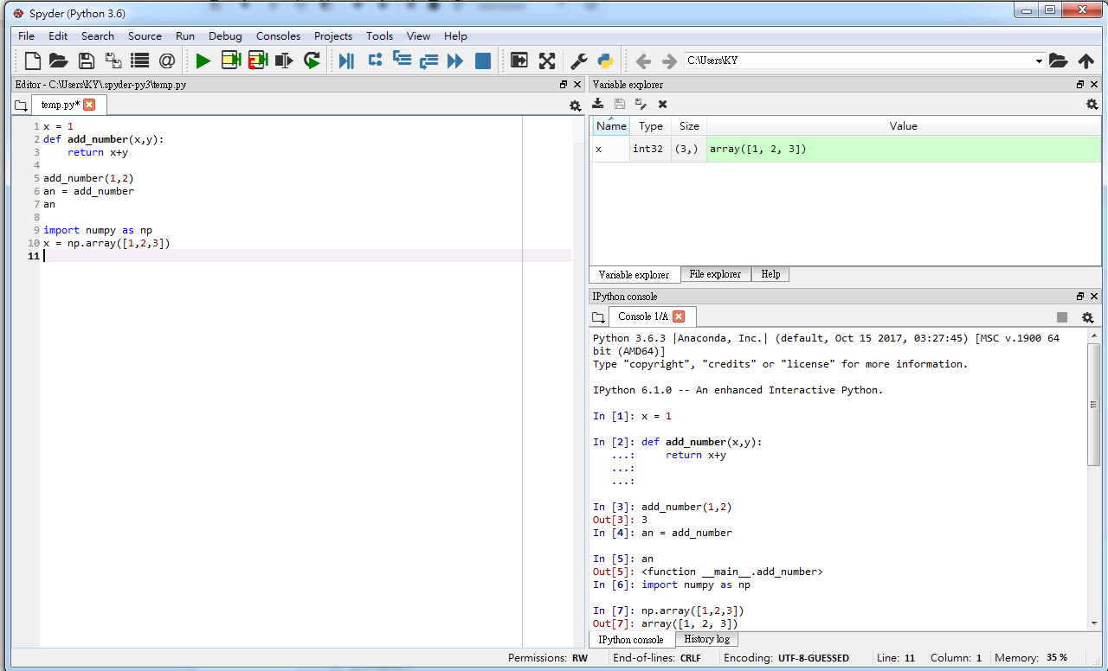
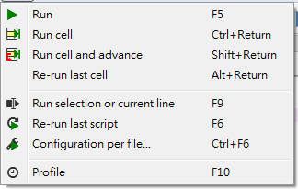
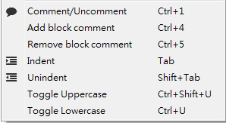
Python Program Editor – Jupyter & Spyder
Spyder = IDE for Python (RStudio = IDE for R)
Some Hints:

Slide 16
Resources for Python coding
Py4e
Coursera / edX
Datacamp

Slide 17
Start Python Coding !

Slide 18
Constant & Variables
Constant = Fixed values , their value does not change
Numeric / String
String constants use single quotes (') or double quotes (")
Reserved Words – colour changed
Don’t use as variable names
Variables = named place in the memory where a programmer can store data and later retrieve the data using the variable “name”
Variable Name Rules
Must start with a letter or underscore _
Must consist of letters, numbers, and underscores
Case Sensitive

Slide 19
Sentences or Lines
x = 2
x = x + 2
print(x)
Assignment statement
Assignment with expression
Print statement
Variable
Operator
Constant
Function

Slide 20
Expressions
Operator | Operation
+ | Addition
- | Subtraction
* | Multiplication
/ | Division
** | Power
% | Remainder
Operator Precedence Rules
Parentheses are always respected
Exponentiation (raise to a power)
Multiplication, Division, and Remainder
Addition and Subtraction
Left to right

Slide 21
Variable Types
Numeric
int , float
Characters
String = List of Characters
Type(.) – Type function
int(.) / float(.) / str(.) – Type Conversion functions
int / int → float

Slide 22
Conditional Statements
x = 5
print('Before 5')
if x == 5 :
print('Is 5')
print('Is Still 5')
print('Third 5')
print('Afterwards 5')
print('Before 6')
if x == 6 :
print('Is 6')
print('Is Still 6')
print('Third 6')
print('Afterwards 6')
x == 5 ?
Yes
No
print('Is 5’)
print('Still 5')
print('Third 5')
Indentation (Tab)
Increase indent indent after an if statement or for statement (after : )
Maintain indent to indicate the scope of the block (which lines are affected by the if/for)
Reduce indent back to the level of the if statement or for statement to indicate the end of the block

Slide 23
try / except
astr = 'Bob'
astr = 'Bob'
try:
print('Hello')
istr = int(astr)
print('There')
except:
istr = -1
print('Done', istr)
print('Hello')
istr = int(astr)
print('There')
istr = -1
print('Done', istr)
Safety net

Slide 24
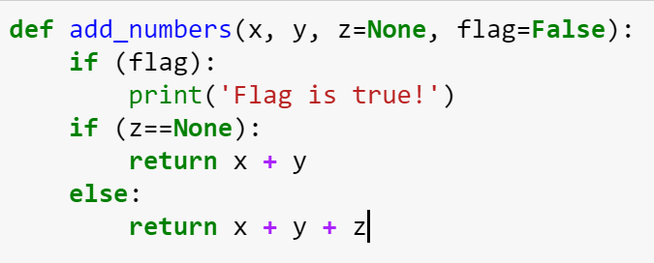
Functions
There are two kinds of functions in Python.
Built-in functions that are provided as part of Python – print(), input(), type(), float(), int() ...
Functions that we define ourselves and then use
None: NULL value
Default Value
If- condition

Slide 25
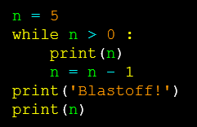

Iterations (Loops)
Two kinds of loops
Indefinite Loops (While Loops)
Definite Loops (For Loops)
continue – jump to next iteration
break – jump out the loop

Slide 26
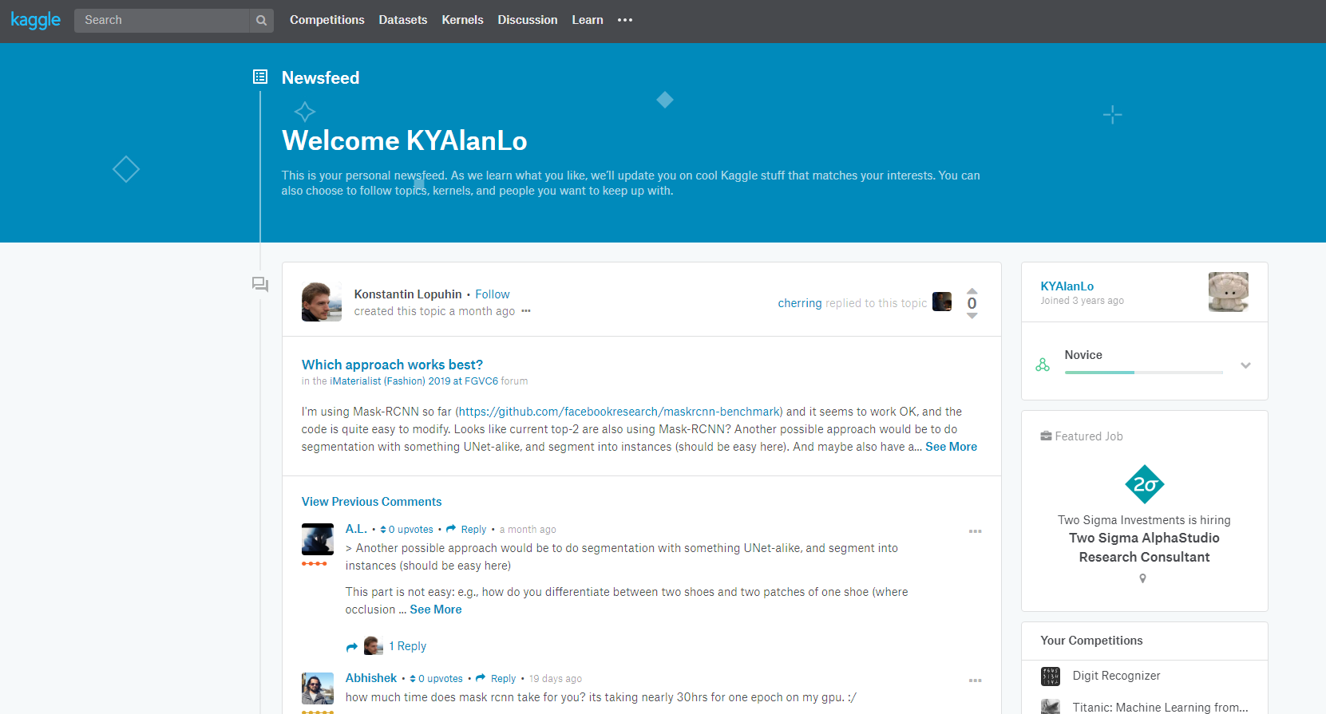
(FYI) Kaggle
allows users to find and publish data sets, explore and build models in a web-based data-science environment, work with other data scientists and machine learning engineers, and enter competitions to solve data science challenges.
owned by Google LLC

Slide 27
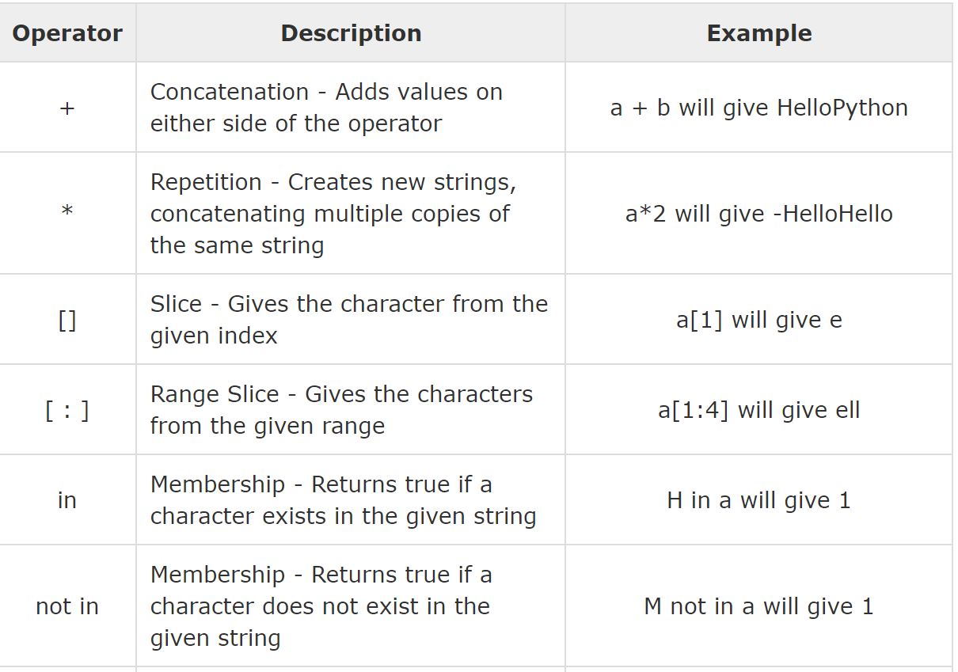
Strings Operations, Slicing
Strings = List of characters
Slicing:
string[1:4] = 2nd to 5th characters
string[-4:-1] = last 4 characters
Strings.split(‘ ‘)
Strings.format(…)

Slide 28
DateTime
Datetime library
Object datetime
Elements: year, month, day, hour, minute, second, microsecond
Object timedelta
Use for +- date and times
Build-in Functions
Recent time - Datetime.datetime.now()
String to datetime: strptime(“2019-06-22’’)
Datetime to String: strftime(dt.now())

Slide 29
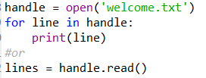
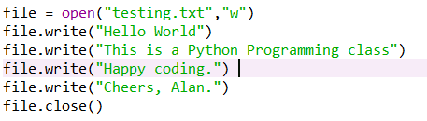
Read & Write Files
Reading File
Writing File

Slide 30
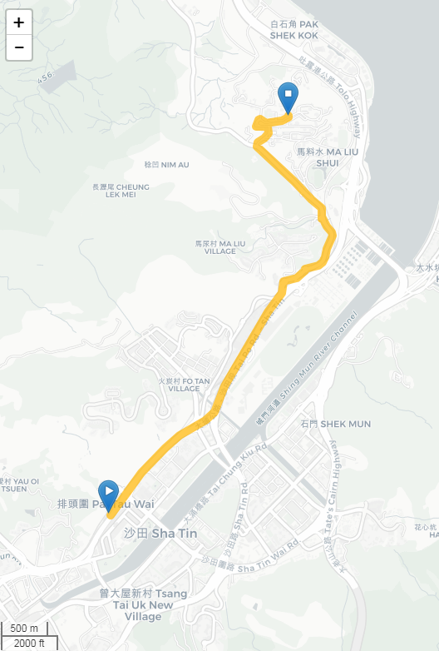
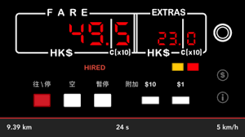
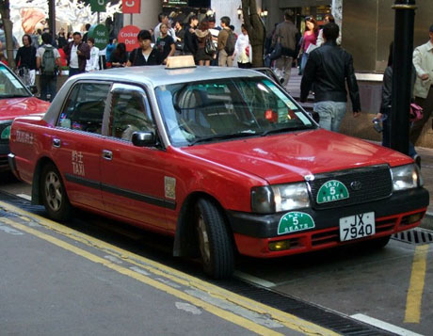
Assignment 1 – Taxi Calculator

Slide 31
Assignment 1 – Taxi Calculator
The recent rule – please refer to here – gov Transport Department
Splint 1: Construction a function: TaxiFare
Input parameter: the number of km
Return value: the price
Validation : from Shatin Station → LSB, CUHK (UAT#1) TaxiFare(5.7) # Return value = 54.6
Use try-except block to protect this: (UAT#2) TaxiFare(“Free”) / TaxiFare(None) # print: “Something goes wrong !” # return (None)
Note:
起錶 start meter: First 2 km, Fare = $24
跳錶 tick meter: For each 200m afterwards, Fare = $1.7 (you should truncate into integer if the remainder is not enough 200m)
Assume:
Urban Taxi Only
No waiting time

Slide 32
Assignment 1 – Taxi Calculator
Splint 2: Modify the function: TaxiFare
短加長減 – if the fare exceeds $83.5, Fare for each 200m = $1.2
Or use the logic: if distance > 9 km, Fare for each 200m = $1.2
Validation: from Sheung Shui Station → LSB, CUHK (UAT#3) TaxiFare(17.6) # Return value = 135.1
Splint 3: Add the parameter into function: TaxiType
Taxi Type: “urban”, “NT”, “lantau”
You need to copy and rewrite with different values for each taxi type. Please refer to the here – gov Transport Department
Taxi Type can be lower / upper case
NT taxi threshold : 8km / $65.5
Lantau taxi threshold: 20km / $154
Set default parameter = “urban”
Validation: (UAT#4) TaxiFare(5.7, TaxiType=“nT”) # Return value 47.5 (UAT#5) TaxiFare(17.6, TaxiType=“nT”) # Return value 123.1 (UAT#6) TaxiFare(17.6, TaxiType=“laNtAu”) # Return value 136.0 (UAT#7) TaxiFare(36.4, TaxiType=“laNtAu”) # Return value 268.8 (Disneyland → Tai O)

Slide 33
Assignment 1 – Taxi Calculator
Marking Scheme
The program should be RUN-able – 50%
The program should be PASSed all UAT case – 7*5% = 35% (UAT = user acceptance test)
The program should be READ-able – 10%
The assignment should be handed ON-TIME – 5%

Slide 34
Next week 29 June – NO LESSON !!!
See you next next week – 6 July

Slide 35
Thank you

