Slide 1
CUHK Statistics Department Workshop on Python 101
Week 5, 3 August 2019
By KY Alan Lo

Slide 2




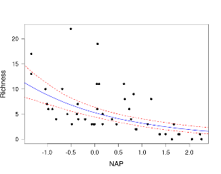
From Data to Model
Data
read_csv / read_xlsx
Pandas.DataFrame
Urllib + BeautifulSoup = API
Visuals
Matplotlib
Seaborn
plotly
Stat. Analysis / Model
numpy.random
Scipy.stat
Statmodels
ML Model
Scikit-learn / sklearn
Tensorflow
Keras
Xgboost

Slide 3
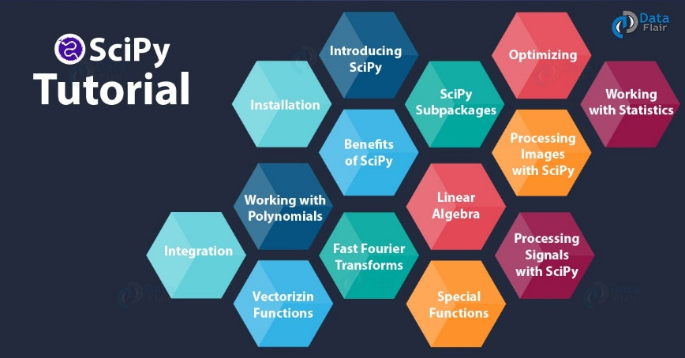
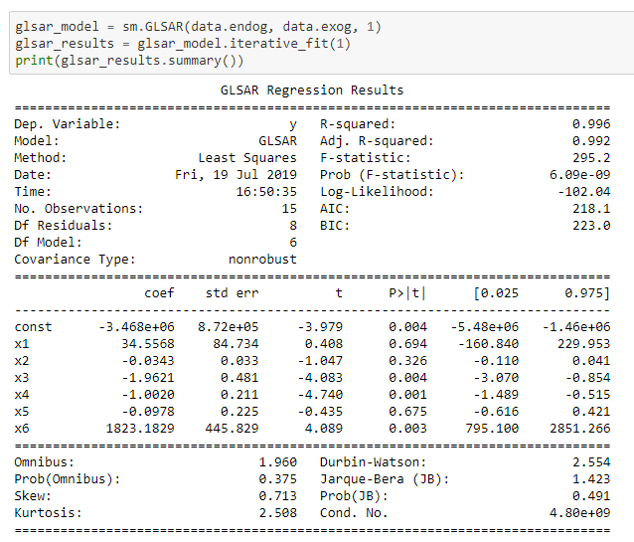
Statistical Analysis
Numpy
Scipy
Simulation - numpy.random
Statistics - Scipy.stat
Stat Models - Statmodels

Slide 4
Statistical Analysis - Simulations
Probability Functions | R | Python
Density / Distribution | dnorm(x, 0, 1) dbinom(x, n, p) | scipy.stats.norm.pdf(x, 0, 1) scipy.stats.binom.pmf(x, n, p)
Quantile | qnorm(p, 0, 1) | scipy.stats.norm.ppf(p, 0, 1)
CDF | pnorm(x, 0, 1) | scipy.stats.norm.cdf(x, 0, 1)
Random Numbers | rnorm(N, 0, 1) | np.random.normal(0,1,N)
More on Random nos. | R | Python
Set seed | seed(n) | np.random.seed(n)
Sample | sample(x, n, replace=T) | Np.random.choice(x, n, replace=True) (Note: sample(n) ~ U(0,1))

Slide 5
5-number summary, Moments
Statistics | R | Python
5-no. Summary | Summary(x) Summary(d) | (code for each functions…) df.describe()
mean | mean(x, [na.rm=T]) | np.mean(x) / np.nanmean(x)
Variance | var(x, [na.rm=T]) | np.var(x) / np.nanvar(x)
Skewness | skewness(x) | Scipy.stats.skew(x)
Kurtosis | kurtosis(x) | scipy.stats.kurtosis(x)

Slide 6
MSc Courses and the Python Libraries
Course Code | Topic | Python Library involved
STAT5102 | Linear Regression | sklearn.linear_model statsmodels.regression.linear_model
STAT5103 | Principle Component Analysis | sklearn.decomposition.PCA
STAT5105 | Cox Proportional Hazard Regression | statsmodels.duration.hazard_regression.PHReg
STAT6103 | Any kind of Simulation | scipy.stat numpy.random
STAT6104 | ARIMA | statsmodels.tsa.arima_model
STAT6106 | Naïve Bayes Model Any Bayesian Models | sklearn.naive_bayes pymc3
STAT6108 | Structural Equation Models | (R is better)
Run R in Python Kernel : rpy2

Slide 7
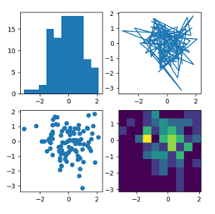
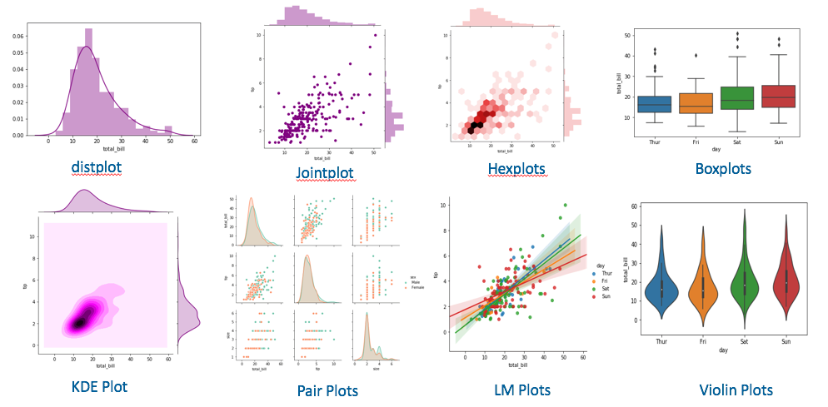
Data Visualization
Matplotlib
Seaborn
Plotly

Slide 8
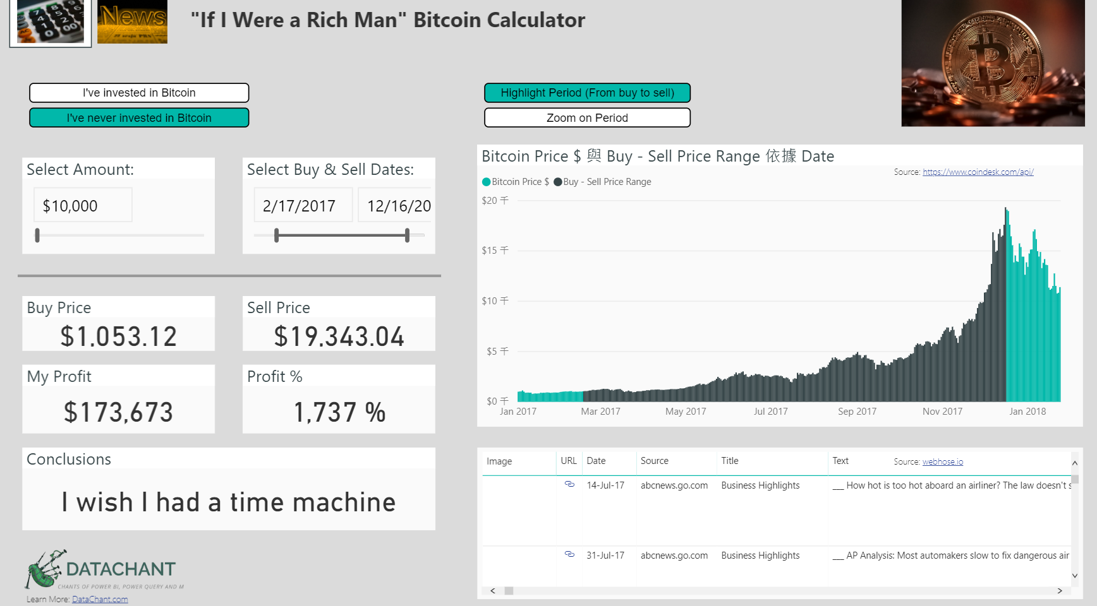
Power BI
https://community.powerbi.com/t5/Data-Stories-Gallery/bd-p/DataStoriesGallery

Slide 9
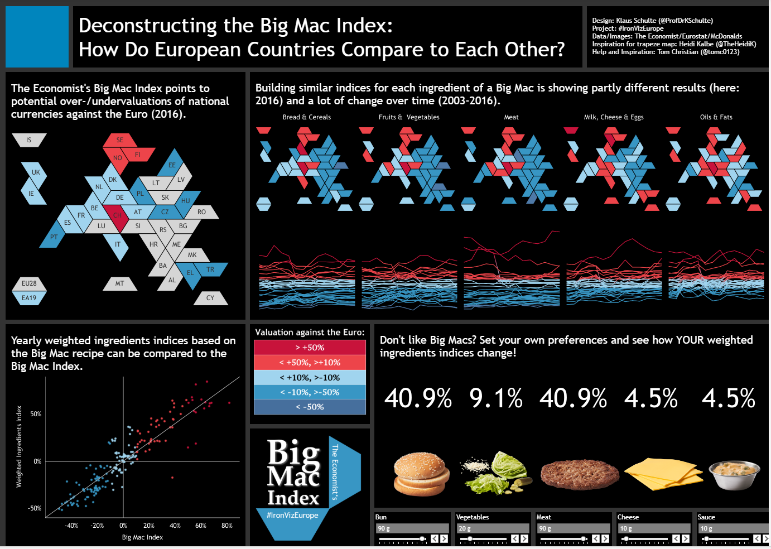
Tableau Public
https://public.tableau.com/en-us/s/gallery

Slide 10

Tableau Public
https://public.tableau.com/profile/david.pires#!/vizhome/JapanIten/Japan2WeekItinerary

Slide 11
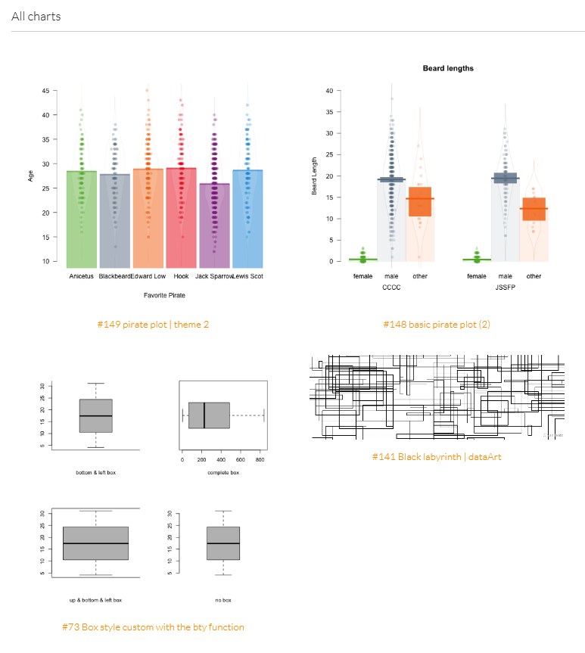
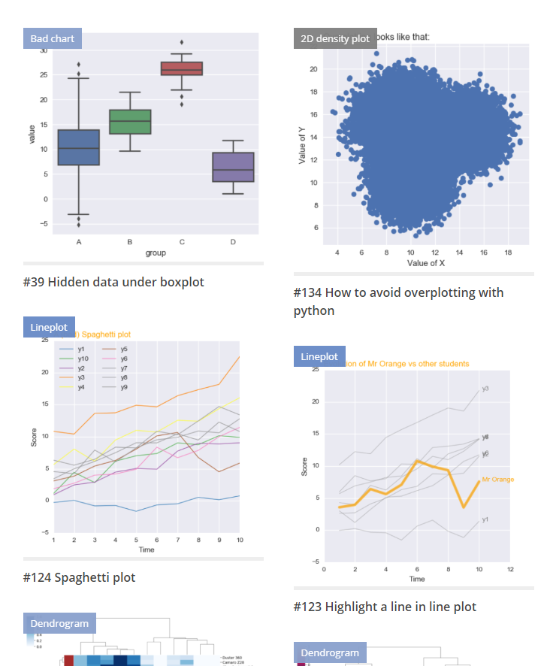
R / Python gallery
https://www.r-graph-gallery.com/
https://python-graph-gallery.com

Slide 12
Models
Sklearn
Keras, Tensorflow
Neural Network / Convolutional NN / Recurrent NN / LSTM
XGBoost
Bagging + Boosting

Slide 13
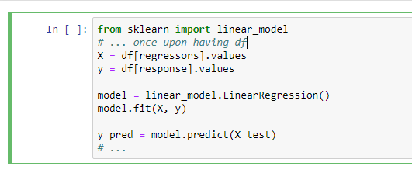
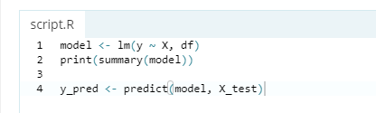
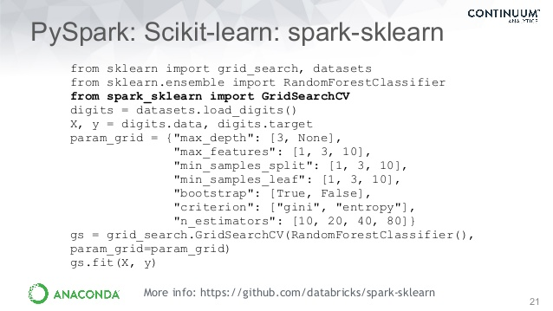
Scikit-learn / sklearn

Slide 14
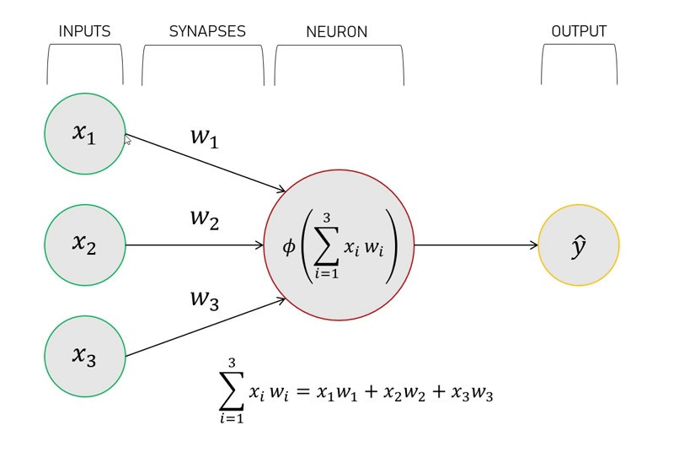
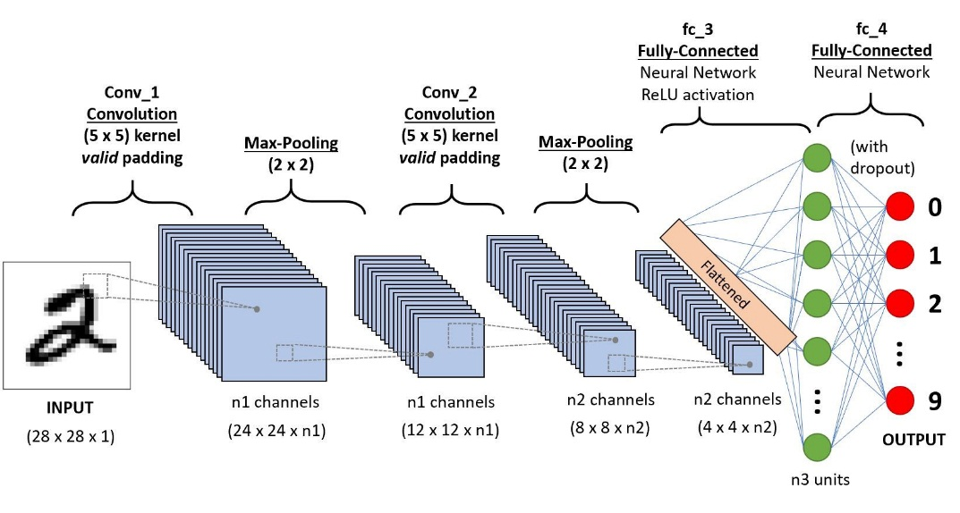
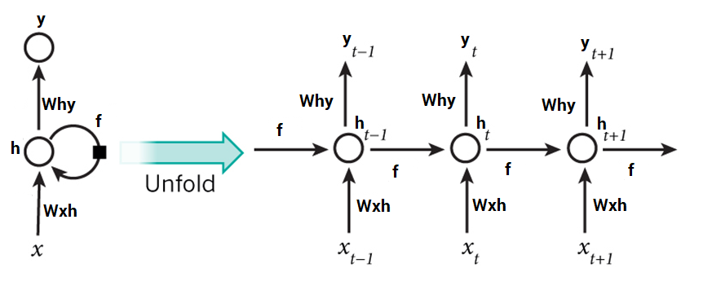
Keras + Tensorflow
Neural Network
Convolution NN
Recurrent NN, LSTM

Slide 15
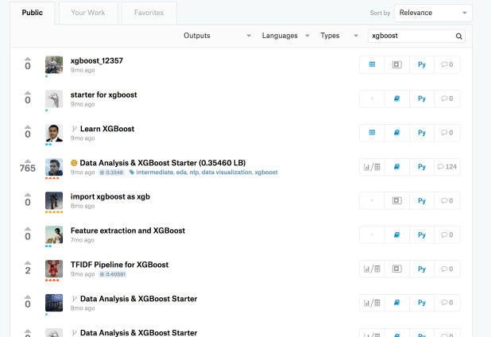
XGBoost

Slide 16
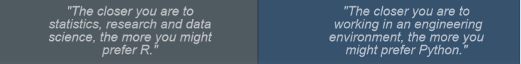


R vs Python – My Practice
R
For data analysis / mining / visualization
For data analytics perspective
For STATISTICAL Modelling use
Python
For large scale data flow / engineering
For web scraping / getting web data
For Machine Learning / Deep Learning Modelling use
For productionalizing DS projects
Data
Analysis
ML
Visuals

Slide 17
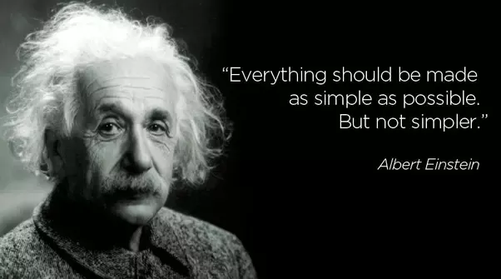
To Everyone wanna trap into Data Science…

Slide 18
Thank you

