Slide 1
CUHK Statistics Department Workshop on Python 101
Week 4, 20 July 2019
By KY Alan Lo

Slide 2
Content
Some Knowledge on Internet
Web Scraping
urllib , BeautifulSoup
API
Google API, data.gov.hk, Twitter API

Slide 3
Some knowledge on internet
TCP/IP
Protocol A set of rules that all parties follow so we can predict each other’s behavior
HTTP – HyperText Transfer Protocol
HTTPS – (+) Secure
Request – GET / PUT / DELETE …
Protocol + Host + Files
Port
https://www.sta.cuhk.edu.hk/default.aspx
protocol
host
file

Slide 4



www.sta.cuhk.edu.hk
Incoming
E-Mail
25
Login
23
blah blah blah blah
80
137.189.37.207
Web Server
443
Personal
Mail Box
109
110
Telnet (23) – Login | SSH (22) – Secure Login
HTTP (80) | HTTPS (443)
SMTP (25) (Mail) | FTP (21) – File Transfer
https://en.wikipedia.org/wiki/List_of_TCP_and_UDP_port_numbers

Slide 5
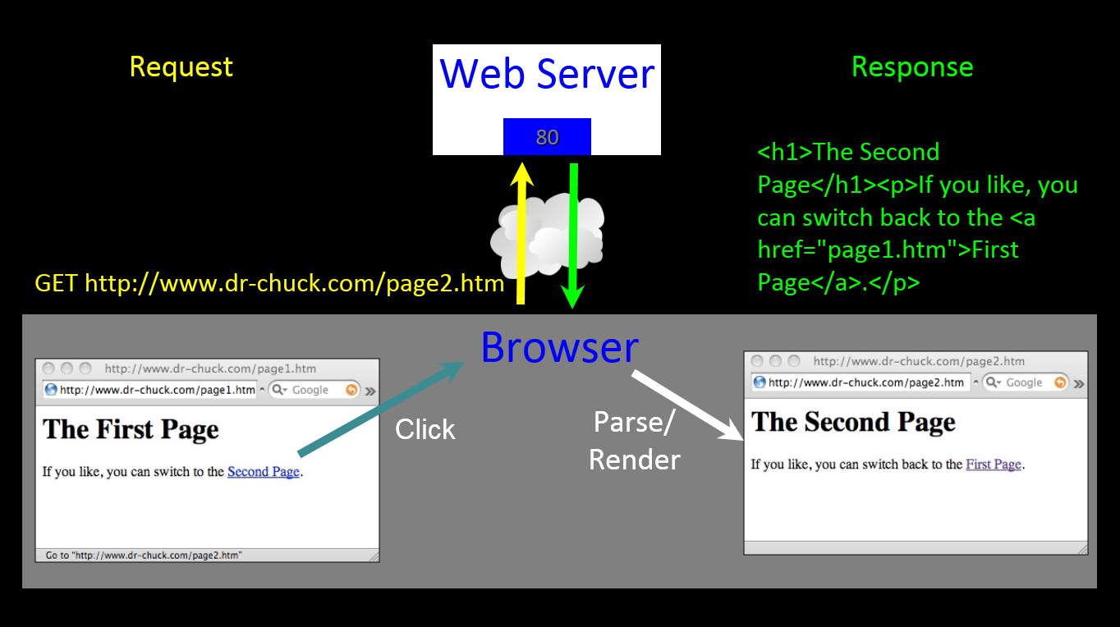

Slide 6
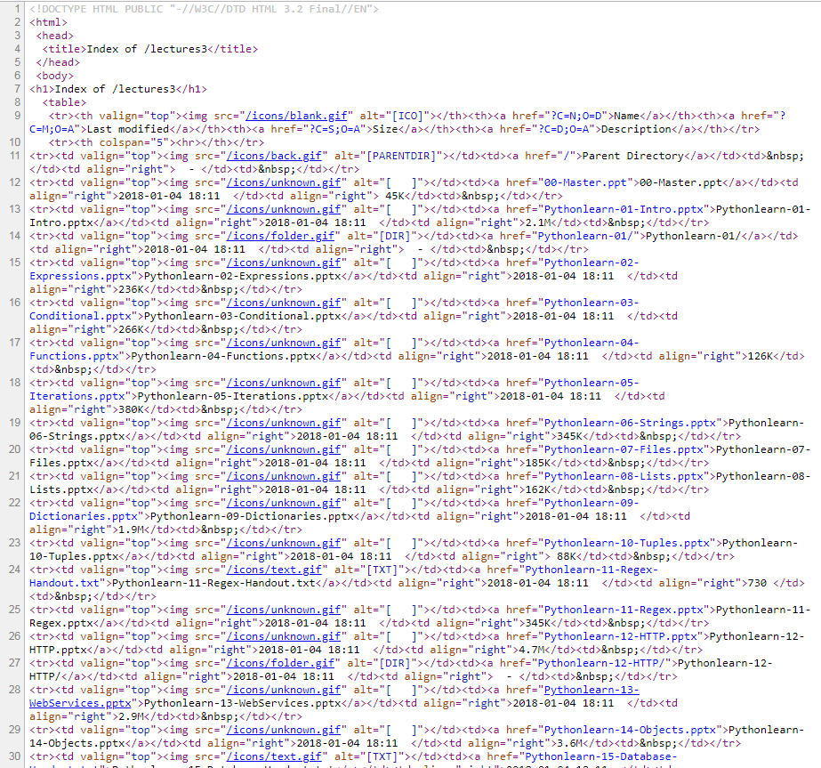
Ctrl+U: View Source Code

Slide 7
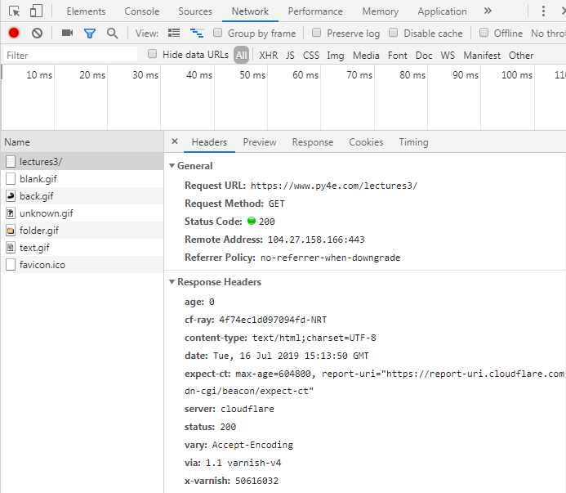
F12 – Network Information

Slide 8
HTTP response
100 Continue
101 Switching Protocols
103 Early Hints
200 OK
201 Created
202 Accepted
203 Non-Authoritative Information
204 No Content
205 Reset Content
206 Partial Content
300 Multiple Choices
301 Moved Permanently
302 Found
303 See Other
304 Not Modified
400 Bad Request
401 Unauthorized
402 Payment Required
403 Forbidden
404 Not Found
405 Method Not Allowed
406 Not Acceptable
407 Proxy Authentication Required
408 Request Timeout
500 Internal Server Error
501 Not Implemented
502 Bad Gateway
503 Service Unavailable
504 Gateway Timeout
505 HTTP Version Not Supported
511 Network Authentication Required
https://en.wikipedia.org/wiki/List_of_HTTP_status_codes

Slide 9
Start Python Coding !

Slide 10
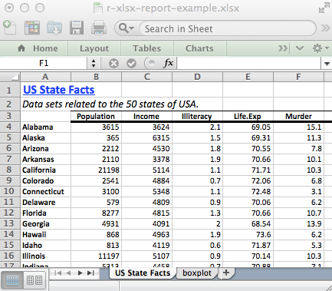
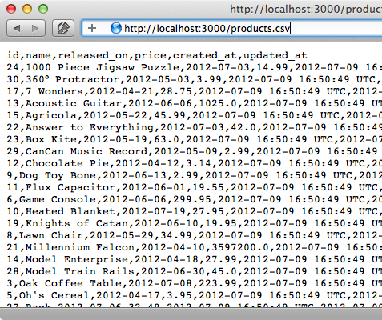


Import Data Source
Importing… | R | Python
temp.csv | d <- read.csv(“temp.csv”) | df = pd.read_csv(“temp.csv”)
temp.xlsx | library(xlsx) d <- read.xlsx(“temp.xlsx") | df = pd.ExcelFile(“temp.xlsx”)
Notes:
https://msropendata.com/

Slide 11
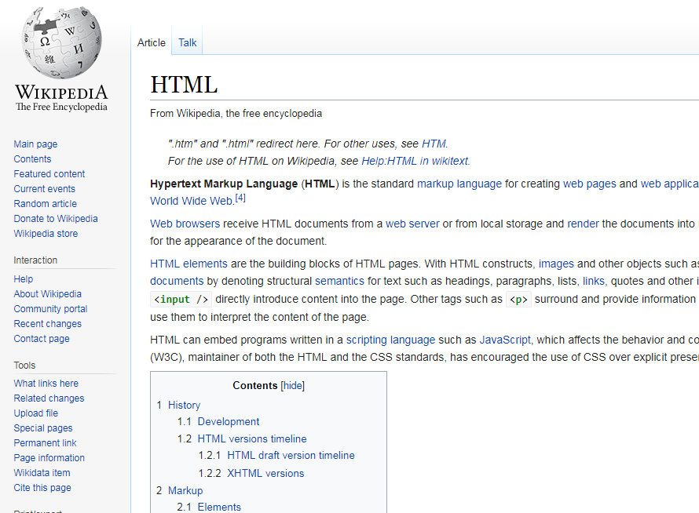
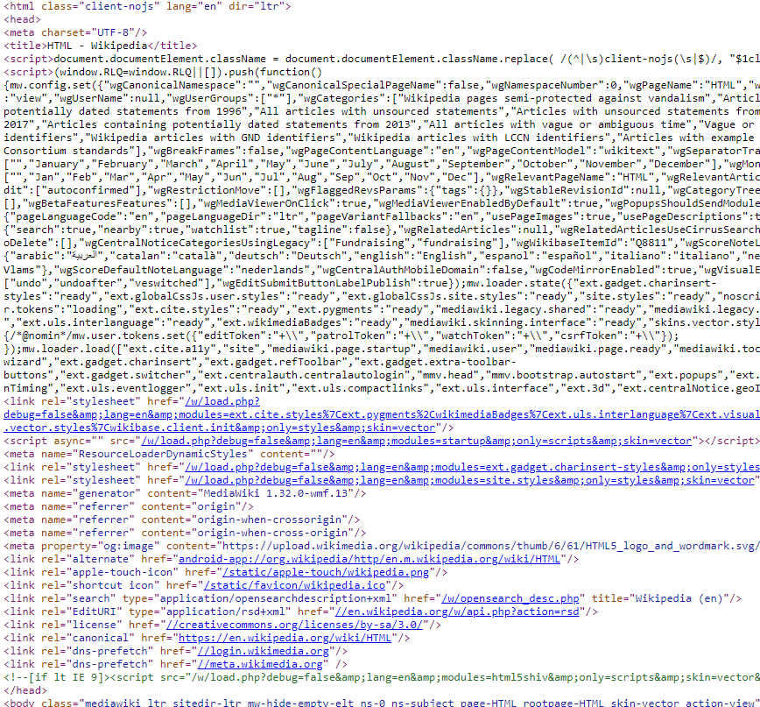


HTML
HyperText Markup Language
DataFrame
BeautifulSoup
Notes:
Use skyscanner

Slide 12
Urllib + BeautifulSoup
import urllib.request from bs4 import BeautifulSoup
html = urllib.request.urlopen(‘https://www.sta.cuhk.edu.hk’).read() # “ <html lang=“en-US”> # <head id=“Head”> # <title> # Statistics > Home # </title>… “ soup = BeautifulSoup(html, 'html.parser’)
# Retrieve all of the anchor tags tags = soup('a’) for tag in tags: print(tag.get('href', None))

Slide 13
Web scraping extreme example
https://boingboing.net/2017/08/25/person-tests-amazons-unlim.html
A fellow who goes by the handle beaston02 wanted to see how unlimited Amazon's "unlimited" cloud storage plan was, so he uploaded 293 years' worth (2 million gigabytes or 2 petabytes) of ☺☺☺ videos to his account.

Slide 14



API
Application programming interface https://youtu.be/zvKadd9Cflc
DataFrame
urllib
Notes:
https://www.dataquest.io/blog/python-api-tutorial/
https://data.gov.hk/tc/

Slide 15
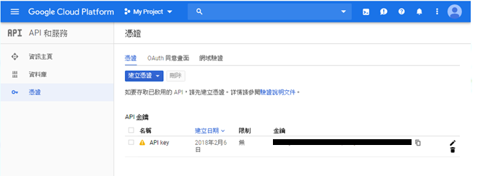
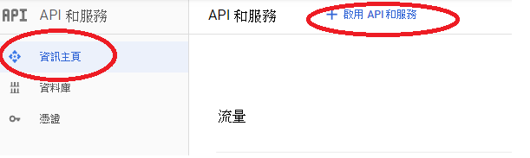
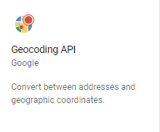
Google Map API
Get API key (Reference)
At here , Create the credential = your API Key (time limit = 24 hours)
At here , Choose your API you want
Then choose this
Try this in your browser: https://maps.googleapis.com/maps/api/geocode/json?address=Lady+Shaw+Building%2C+Hong+Kong&key=YOUR_API_KEY

Slide 16
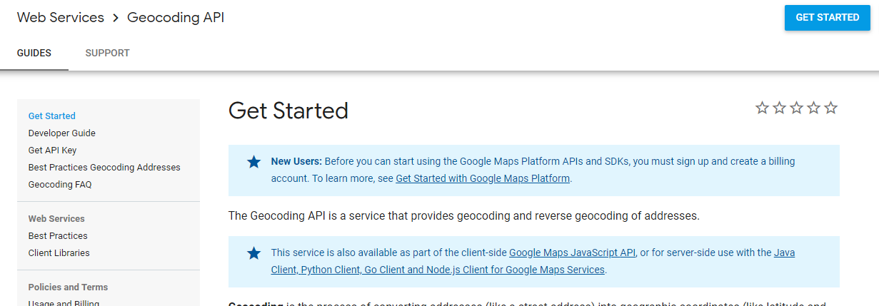
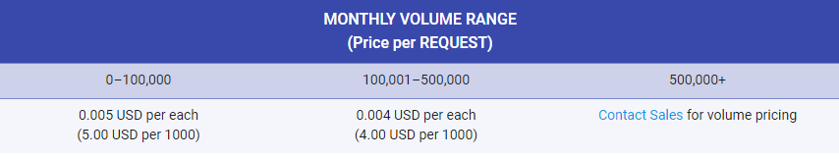
Google Map API
The API documentation
Usage and Billing $200 USD Google Maps Platform credit is available each month

Slide 17
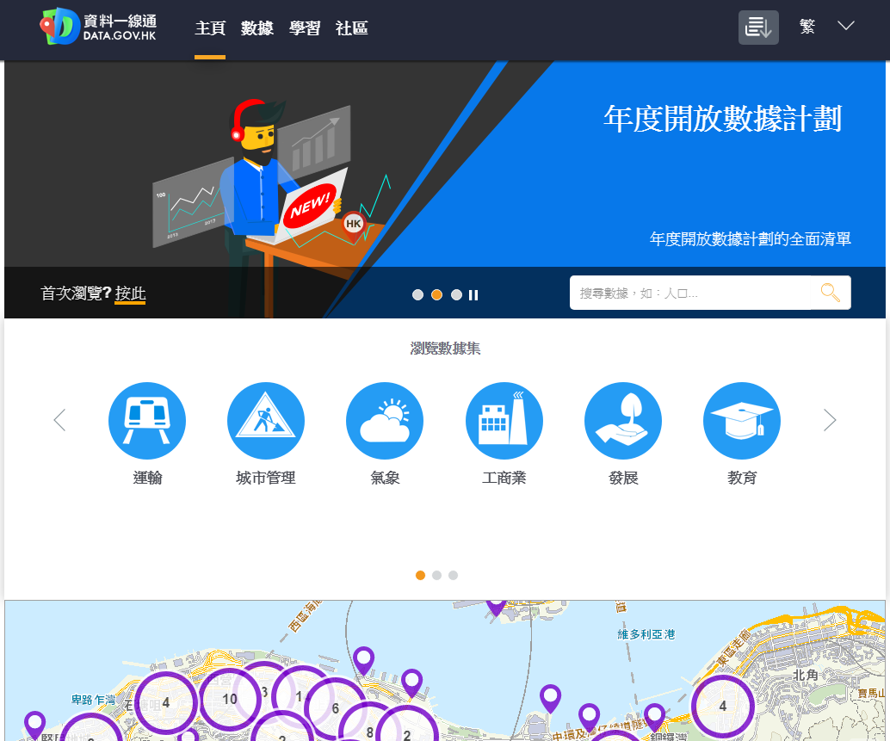
Data.gov.hk API

Slide 18
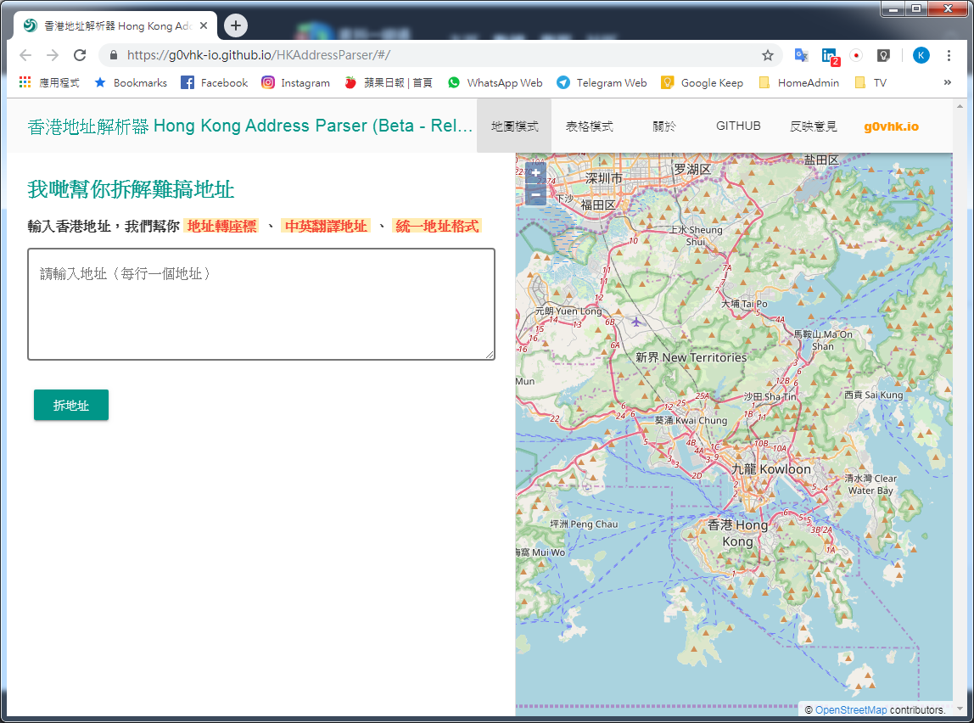
HKAddressParser

Slide 19
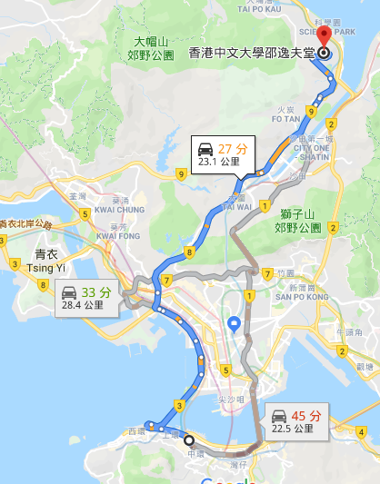
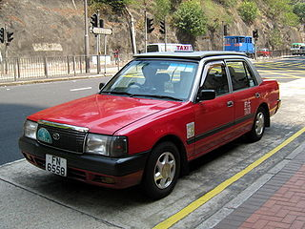
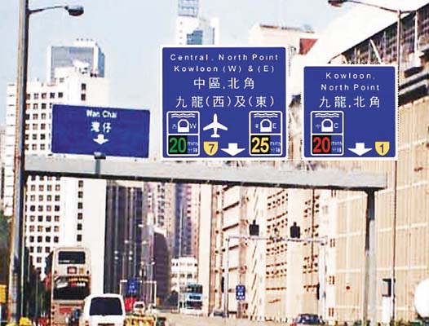
Assignment: Continue from taxi meter

Slide 20



Twitter API
If we have time, also go through this.

Slide 21
Assignment 4: Continue from taxi meter
Use Google Direction API to search the best route
The sample API url: https://maps.googleapis.com/maps/api/directions/json?origin=Hang+Seng+Bank+Headquarter&destination=The+Chinese+University+of+Hong+Kong&key=YOUR_API_KEY
The sample JSON output
Level 1 – Create a function: getRoute(origin, destination) with return ({‘Dist’, ‘Time’}) – The Route Distance and Time
UAT#1 – getRoute(‘Hang Seng Bank Headquarter’, ‘The Chinese University of Hong Kong’) → {‘Dist’: 23.193, ‘Time’: 25.2667}

Slide 22
Assignment 4: Continue from taxi meter
Level 2 – Modify the function: getRoute For detecting whether the route is using any harbour crossing tunnel important key: “html_instructions”
If html_instructions contains
“1號幹線” and “收費路段” → Harbour Tunnel Crossing
“2號幹線” and “收費路段” → Eastern Harbour Tunnel Crossing
“3號幹線” and “收費路段” → Western Harbour Tunnel Crossing
with return ({‘Dist’, ‘Time’, ‘HC’}) – The Route Distance, Time, Harbour Crossing
UAT#2 - getRoute(‘Hang Seng Bank Headquarter’, ‘The Chinese University of Hong Kong’) → {‘Dist’: 23.193, ‘Time’: 25.2667, ‘HC’: ‘West’}
UAT#3 – getRoute(‘Sogo Causeway Bay’, ‘The Chinese University of Hong Kong’) → {‘Dist’: 21.365, ‘Time’: 31.0833, ‘HC’: ‘Central’}
UAT#4 – getRoute(‘Tai Koo Place’, ‘The Chinese University of Hong Kong’) → {‘Dist’: 25.219, ‘Time’: 31.8333, ‘HC’: ‘East’}
UAT#5 - getRoute(‘Shatin Station’, ‘The Chinese University of Hong Kong’) → {‘Dist’: 6.426, ‘Time’: 8.8, ‘HC’: None}

Slide 23
Assignment 4: Continue from taxi meter
Marking Scheme:
50% - the program should be RUN-able.
10% - Succeed to get json from API
25% - success to pass UAT#1-5 (each 5%)
10% - The program should be READ-able
5% - The assignment should be handed ON-TIME
Super NOTE:
Good to train your techniques on urllib
Welcome to use the word searching library re – regular expression (Notes is here)

Slide 24
Thank you

