Slide 1
Predicting Winning Chances in Horse Racing
Statistics Projects
www.themegallery.com

Slide 2
Content
1
Introduction
2
Investigation of Kelly’s Criterion
3
Predictive model
4
Application
5
Conclusion and Reference
www.themegallery.com

Slide 3
1.Introduction
Aim of the project:
  Study the Kelly’s Criterion and investigate the capital change under this betting system
  Find the best model to fit the predictive model to make the estimated probability as accurate as possible
  Propose the best strategy to maximize the capital growth based on the estimation
www.themegallery.com

Slide 4
1.1 Dataset Description
  From 3/9/2000 – 2/7/2007
  67 variables
  60434 data
  726 races
  Containing all sort of information about the horse like odds, rank etc.
www.themegallery.com

Slide 5
1.1 Dataset Description
Variable | Explanation
Date | Date of the race
DateValue | Excel internal date count
Raceno | Race number of the day
HorseNo | Assigned horse number
NewH | Whether the horse is a first time to race in Hong Kong
Session | Yearly Session, from 2000 to 2007
Session2006 | Indicator for last session
NoRace | Race number within a Session
Going | Numerical value of the hardness of the surface
Ncourse | Numerical value for course “A” or “B” or “C”
HV | Indicator whether the race was held in Happy Valley
AWT | Indicator whether the race was held in all weather track
ST | Indicator whether the race was held in Shatin turf track
Dist | Distance of the race
DistT | log(Dist) – log(1000)
Drawing | Starting gate assignment of the horse
DaySinceNC | Days between last race and the current race
S14 | The number of swimming’s in last 14 days
HAgeNC | Age of horse, not centered
LHNR | The total number of races of the horse + 1
HWgtNC | Non centered horse body weight
HWgtChgNC | The change in body weight since last race
Brace2raceNC | Number of barrier trial since last race
ClaimNC | weight carried allowance for the apprentice jockey
RClass | Racing class offered by Jockey Club
NonGroupRace | Indicator of non group races
DrawC | Drawing centered within race
DaySince | Days between last race and the current race, centered
LastPubLogPP | Centered value of log Percentage of public betting in place Pool for the horse at its last race
Rating | Rating of the horse by Jockey Club
RatingChg | Rating change
WtCarried | Weight carried for the horse in this race, centered
LogHWgt12R | Log of horse body weight, truncated at 1200 pounds
LastLogOdds | The final Odds in the last race
HWinPer | Horse win percentage prior to the race
NHPP | Horse place percentage prior to the race
JWinPer | Jockey’s win percentage prior to the race
JPP | Jockey’s place percentage prior to the race
TwinPer | Trainer’s win percentage prior to the race
TPP | Trainer’s place percentage prior to the race
HAge | Age of the horse, centered
LifeHNoRace20 | LHNR truncated at 20
Brace2race | Number of barrier trial since last race, centered
NG14 | Number of gallops in last 14 days, centered
NT14 | Number of trotting in last 14 days, centered
NS14 | Number of awimmings in last 14 days, centered
AveStdRank60 | Recency weighted finishing ranks
AveSpeedRating | Average speed rating of the horse prior to the race
LastSpeedRating | Speed rating in its last outing, centered
WtCarriedChg | Weight carried change from its last race, centered
DistTChg | Change from last race in DistT
LWP60 | Recency weighted log of win percent in past battings
LogClaim jockey, centered | Log of the weight carried allowance for the apprentice
AveRating365ChgNC | Rating change in 365 days
AveRating365Chg | Rating change in 365 days, centered
NSTPer | ST race percentage
NAWTPer | All weather track race percentage
BR3012 | In indicator whether the horse won a recent barrier trial
FinalOdds | Final Win Odds for the horse
LogFinalOdds | Log of the final win odds
LogFOddsByNewH | LogFinalOdds times NewH, centered
Runners | Number of horsesin the race
Rank | finishing rank of the race
PubWinPer | Public win percent betting in this race
PubPP | Public Place percent betting
NFIN | Normalized finish position
Status3(4) | Indicator for the first 3 (4) horses in the race
www.themegallery.com

Slide 6
1.2 Data for validation
  Divide the dataset into:
    Training dataset (Session = 2000-2005)
      for building the predictive model
      to obtain winning probability for creating investment strategy
    Testing dataset (Session = 2006)
      to run the simulation for our strategy
      for model validation.
www.themegallery.com

Slide 7
2. Investigation of Kelly’s Criterion
2.1
Introduction of Kelly’s Criterion
2.2
Properties of Kelly’s Criterion
2.3
Comparison with Other Betting Systems
2.4
Comparison in Logistic Regression Model
www.themegallery.com

Slide 8
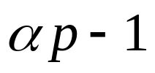


2.1 Investigation of Kelly’s Criterion
  Terms and notations introduced:
  Edge
    how much gambler expects to win
    assume: make this wager over and over with the same probability
    Edge =
    where = the money you receive if our betting horse wins for each $1 bet
    = P (The horse wins)
www.themegallery.com

Slide 9

2.1 Investigation of Kelly’s Criterion
  Odds
    measures the profits if the gambler wins
    set by market forces
    Odds =
    where = the money you receive if our betting horse wins for each $1 bet
www.themegallery.com

Slide 10
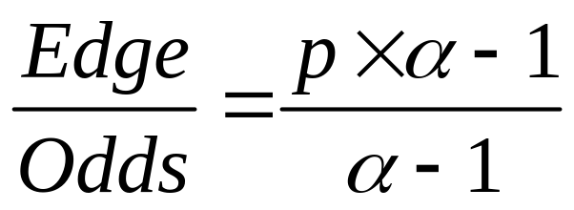

2.1 Investigation of Kelly’s Criterion
  Kelly’s Formula:
  where is the probability of winning
  and is the odds
  Wager this fraction of bankroll on a favorable bet
www.themegallery.com

Slide 11
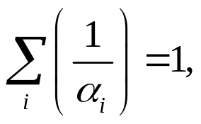


2.1 Investigation of Kelly’s Criterion
  If
  where = the money you receive if our betting horse wins for each $1 bet
  no arbitrage betting system
  In reality, will not follow this case
www.themegallery.com

Slide 12



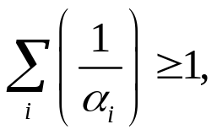

2.1 Investigation of Kelly’s Criterion
  1)
  ➔bet with its probability
  2) and
  ➔bet with Kelly’s formula
  3) otherwise
  ➔don’t bet
  keeps repeating this strategy over a long period of time➔ bankroll increases at its maximum rate.
www.themegallery.com

Slide 13
2.1.1 Limitation of Kelly’s Criterion
  Hard to find those rare situations where gambler has an advantage.
  Must stop when private information becomes public knowledge.
www.themegallery.com

Slide 14

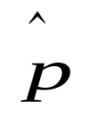

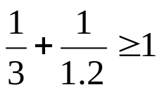
2.2 Properties of Kelly’s Criterion
To make a demonstration of Kelly’s Criterion
  Kelly’s system fails in short term, but maximize the capital growth in long term
  Demonstration of properties of Kelly’s criterion
  -wins if a coin comes up heads
  -loses it if the coin comes up tails
  p= 0.5
  =0.4
  for head = 3
  for tail= 1.2
  Sum(1/ )=
  for head x p= 3 x0.5=1.5
Apply Kelly’s formula!!!
www.themegallery.com

Slide 15
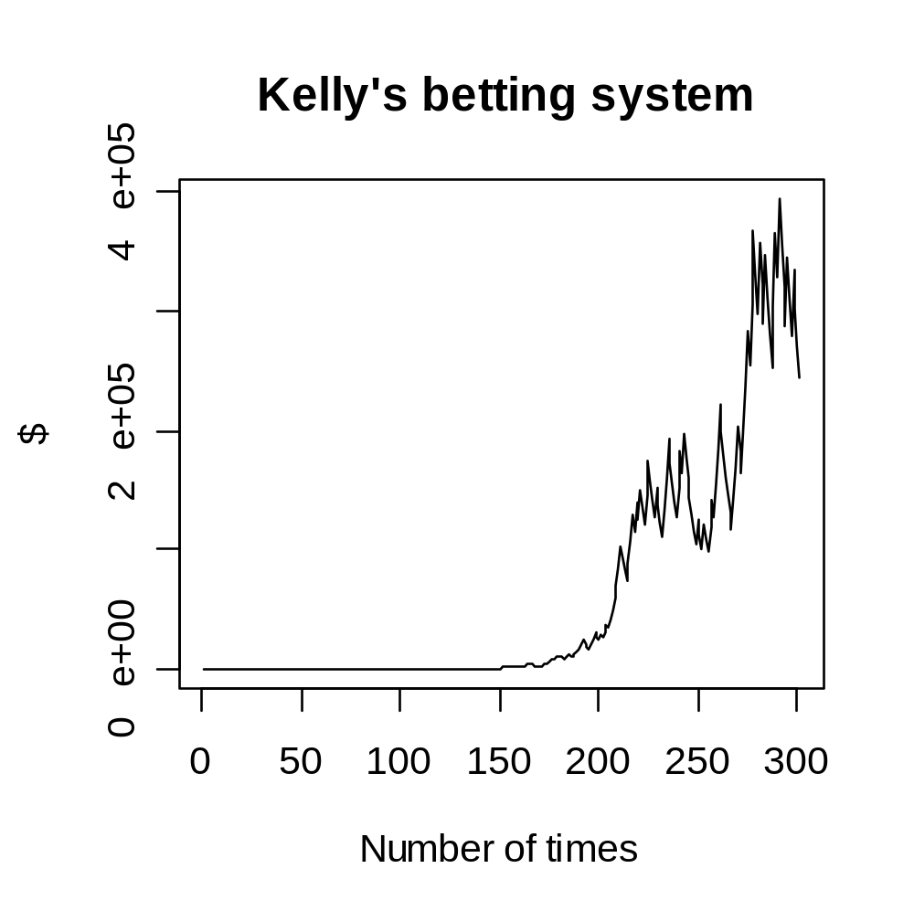
To make a demonstration of Kelly’s Criterion
  bettor’s wealth grows from 1 to a maximum of 394527.2
  get off the ground and swoops upwards
www.themegallery.com

Slide 16
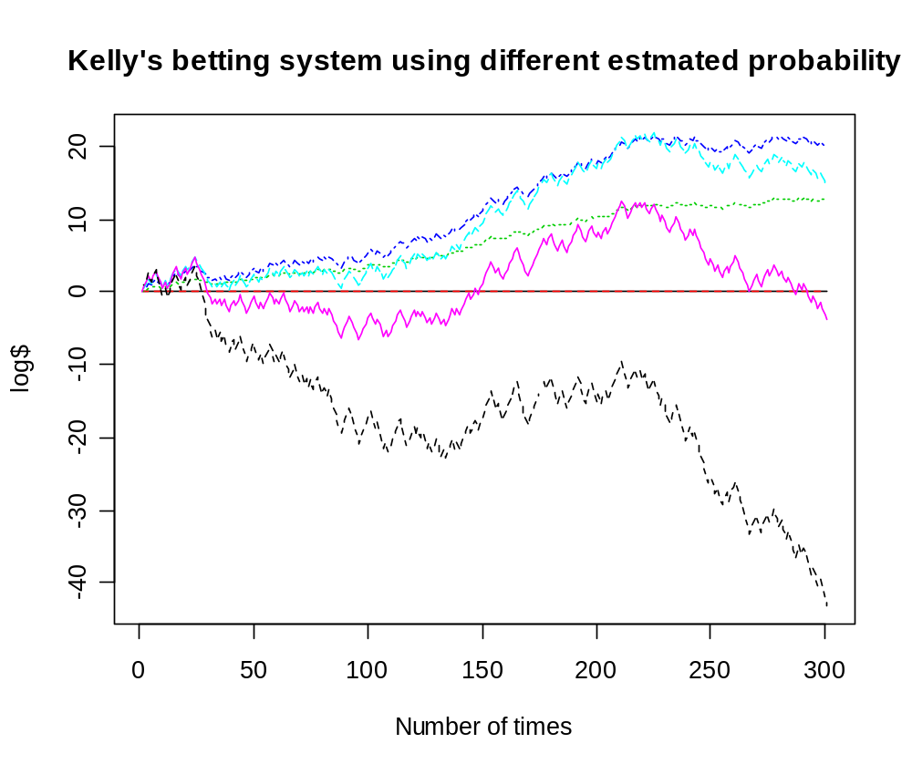

Further investigation on estimated probability
  deviates more from the true probability
  (p=0.5)
  bettor’s wealth grows more
  slowly, or even lead to ruin
0.5
0.6
0.4
0.7
0.2
0.3
0.8
www.themegallery.com

Slide 17
2.3 Comparison with Other Betting Systems
Investigation on other betting systems
Other
betting systems
Fixed- wager
Martingale
www.themegallery.com

Slide 18
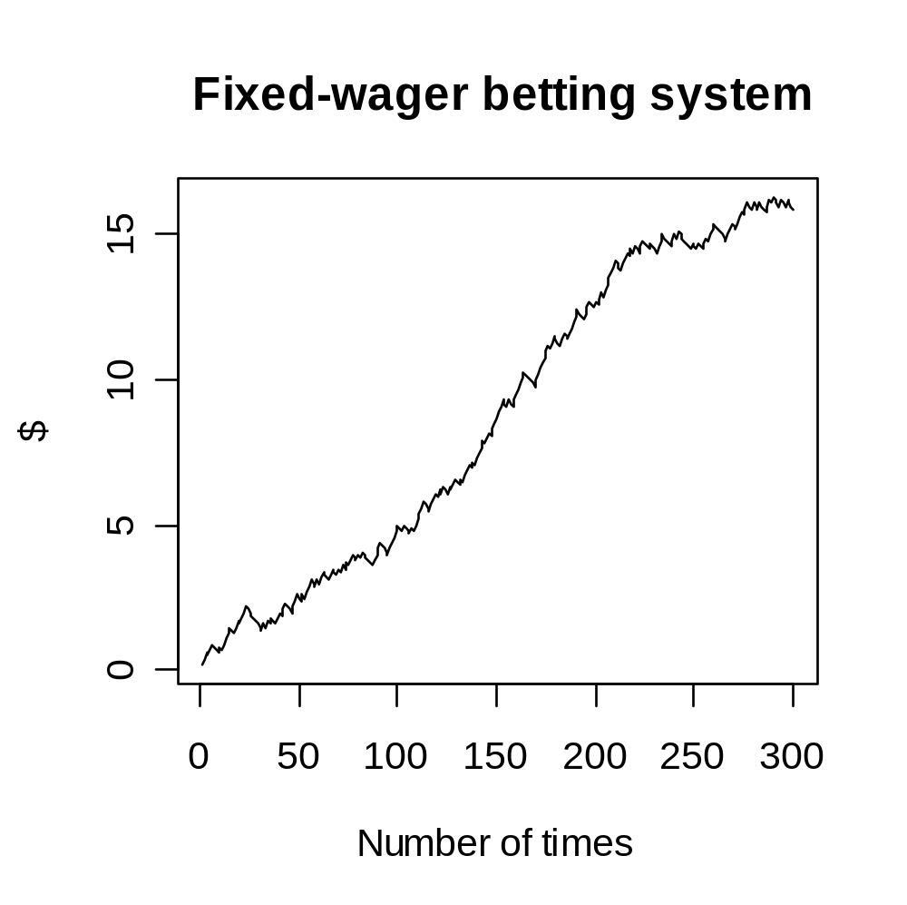
Investigation on fixed wager betting system
  Fixed wager - the bet amount starts at 0.1 and does not vary in the entire betting
  The gambler’s wealth climbs slowly upward from 0.1 to 16.3
www.themegallery.com

Slide 19
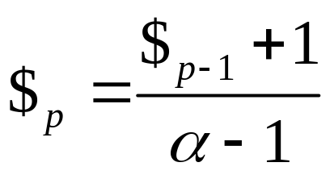
Martingale betting system
Investigation on martingale betting system
  The strategy had the gambler double his bet after every loss
  First win =previous losses + win a profit equal to the original stake.
  Suppose the bet amount starts at 1,
  If the bettor wins, the next time the bet amount restarts from 1, otherwise the bet amount is increased to double the wager as long as the bettor is losing.
  i.e
www.themegallery.com

Slide 20
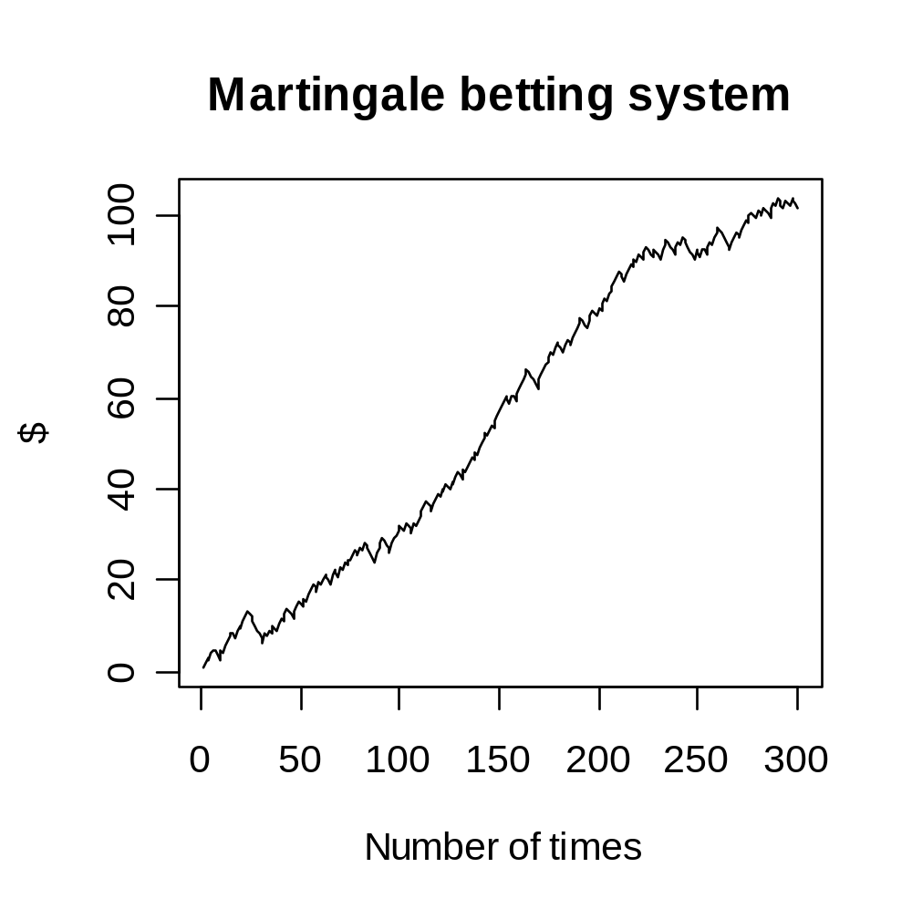
Investigation on martingale betting system
  gambler’s wealth climbs upward gradually from 1 to 103.5547
  The spikes in red circles are streaks of bad luck.
www.themegallery.com

Slide 21
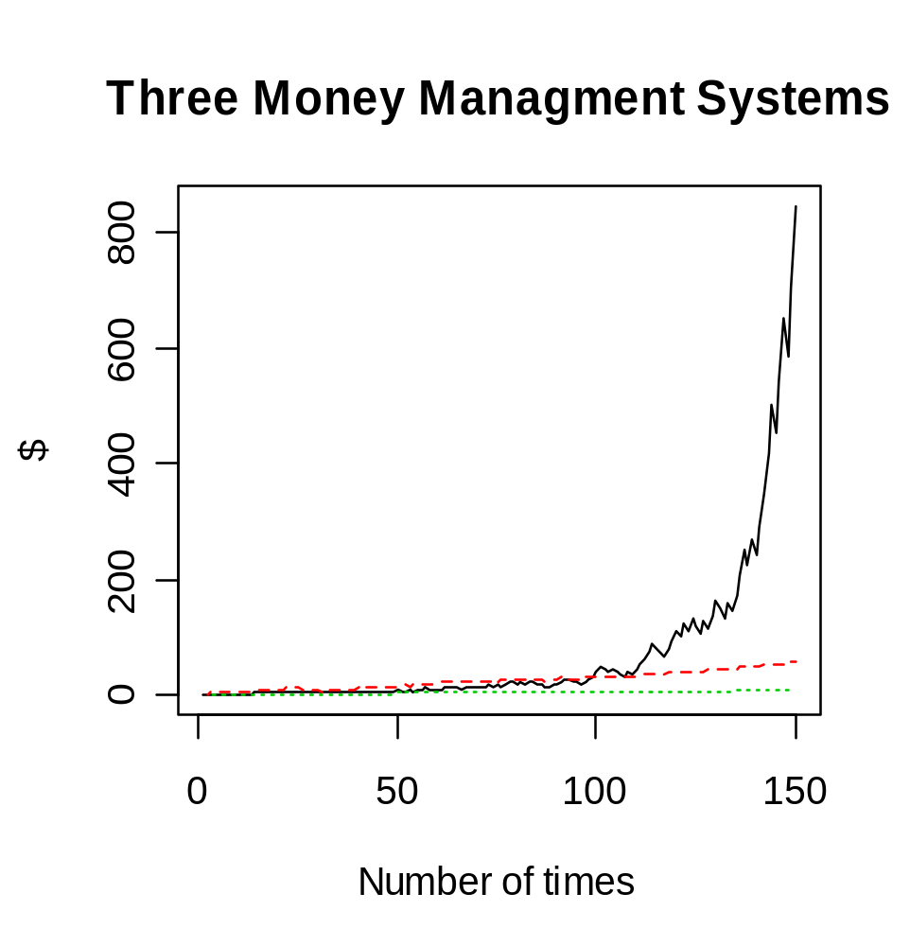
Comparison between three betting systems
  fixed-wager and martingale systems are straight lines vs
  Kelly systems are an upward curve.
  1. In the left half of the chart, the Kelly’s bettor’s line hugs that of the others.
Kelly
1
Martingale
Fixed Wager
www.themegallery.com

Slide 22
Comparison between three betting systems
  2. Much of time, martingale’s bettor is ahead.
  3.The Kelly strategy takes off
  Kelly’s system fails in short term, but maximize the capital growth in long term
Kelly
3
2
Martingale
Fixed Wager
www.themegallery.com

Slide 23
3. Predictive model
Outflow of the project
3.1
Introduction to Multinomial Logistic Regression Model
3.2
Model Building
3.3
Methodology of Variable Selection
3.4
Model Improvement
www.themegallery.com

Slide 24
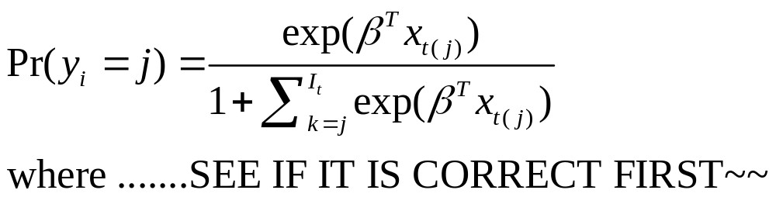
3.1 Introduction to Multinomial Logistic
Regression Model
Multinomial Logistic Regression Model :
  For dependent variables with more classes than two
  To predict the categorical outcomes
  To predict the winning probability of each horse in the race.
General Formula of the Model :
www.themegallery.com

Slide 25
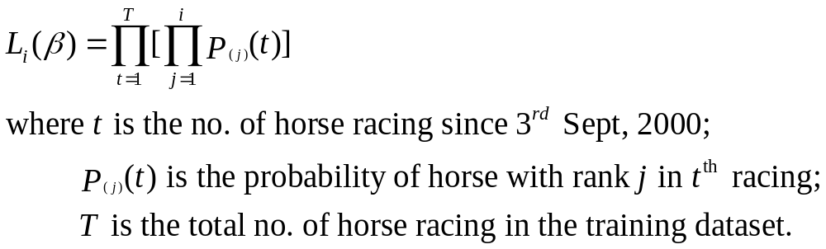
3.1 Introduction to Multinomial Logistic
Regression Model
General Formula of the likelihood:
www.themegallery.com

Slide 26


3.1 Introduction to Multinomial Logistic
Regression Model
1
2
3
for multinomial logistic regression model
best estimates - MLE of the beta.
winning probability of each horses that win the first place in each race
www.themegallery.com

Slide 27
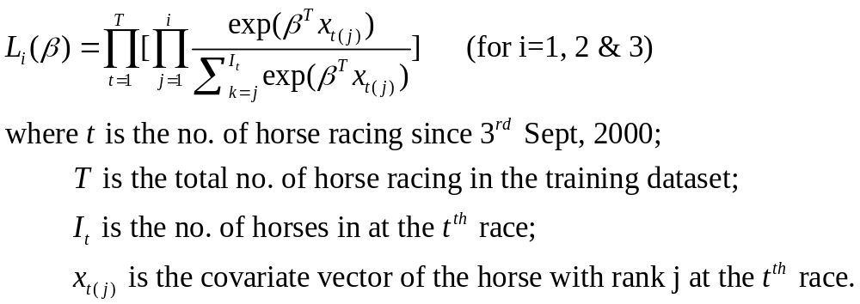
3.2 Model Building
3 models are built up to construct the likelihood
  for each i=1,2,3
General Formula of the likelihood:
www.themegallery.com

Slide 28
3.2 Model Building
Reasons for building up 3 models
  Different amount of data used in the likelihood will affect the result of
  To find the MLE of to see the difference among them.
www.themegallery.com

Slide 29
3.2 Model Building
Likelihood of betas in the
Cox proportional hazard model
  Sub-class of survival model in Statistics
  Strata confounding with respective to each race
  Same as the likelihood used in logistic model
Use of Cox proportional hazard model
  Load Cox regression model building
  To obtain the betas in multinomial logistic regression model
www.themegallery.com

Slide 30
3.2 Model Building
Likelihood of betas in the
Cox proportional hazard model
  Sub-class of survival model in Statistics
  Strata confounding with respective to each race
  Same as the likelihood used in logistic model
Use of Cox proportional hazard model
  Load Cox regression model building
  To obtain the betas in multinomial logistic regression model
www.themegallery.com

Slide 31
3.2 Model Building
Difficulties encountered in fitting full model
  60 variables is too many for computer to run program
  too complicated for the computer to analyze data
Selection Criteria of 28 variables
  Choose the variables which are subjectively important in our consideration
  Appendix
www.themegallery.com

Slide 32

3.2 Model Building
Rank as time variable
  is the time variable in Cox regression.
  Existence of negative data in the time variable.
  Note that for SAS software, it will delete all data with negative time automatically.
  Use a positive variable related to , the rank as the time variable as the solution.
www.themegallery.com

Slide 33
3.2 Model Building
Interaction terms inclusion
  Existence two or more important variables that are highly correlated
  SAS cannot build models with these variable
  Interaction terms will be included in the model
  Reload the SAS Program
www.themegallery.com

Slide 34
3.3 Methodology of Variable Selection
Why variable selection?
  To “kick” out nuisance variables → reduce the cost of building model
Forward-Backward stepwise regression
  Aim: determine which regressors in the list are the most important
www.themegallery.com

Slide 35
3.3 Methodology of Variable Selection
Forward-Backward stepwise regression
  PREDICTORS ← {}
  While (X_{i} not in PREDICTORS)
    Fit y ~ PREDICTORS & X_{i}
    If p-value of the model with X_{i} is maximum
      Then PREDICTORS ← PREDICTORS & X_{i}
    For (X_{i} in PREDICTORS)
      If p-value of X_{i} > α_{leave}
        Then PREDICTORS ← PREDICTORS \ X_{i}
    Until this p-value < α_{enter}
www.themegallery.com

Slide 36
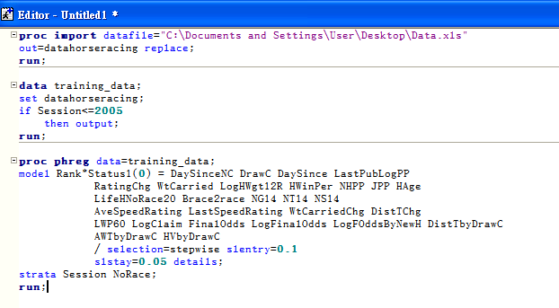
3.3 Methodology of Variable Selection
Now, set α_{enter} = 0.15, α_{leave} = 0.1
  → Run SAS Program
How to find p-value ?
www.themegallery.com

Slide 37
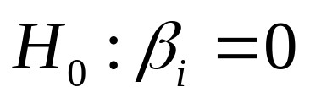
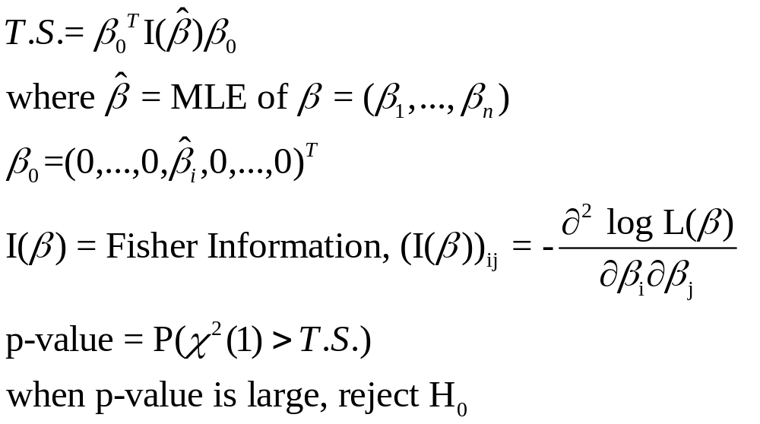
3.3 Methodology of Variable Selection
Rejection Criterion: Wald test
where β_{i} is going to be added or rejected
www.themegallery.com

Slide 38
3.3 Methodology of Variable Selection
Result:
Reduced model 1 | DrawC, DaySince, WtCarried, JPP, Brace2race, NS14, AveSpeedRating, LastSpeedRating, WtCarriedChg, DistTChg, LWP60, LogClaim, FinalOdds, LogFinalOdds. AWTbyDrawC, HVbyDrawC
Reduced model 2 | DrawC, DaySince, WtCarried, LogHWgt12R, JPP, Brace2race, NS14, AveSpeedRating, LastSpeedRating, WtCarriedChg, DistTChg, LWP60, LogClaim, FinalOdds, LogFinalOdds, AWTbyDrawC, HVbyDrawC
Reduced model 3 | DrawC, WtCarried, JPP, NS14, AveSpeedRating, WtCarriedChg, LWP60, FinalOdds, LogFinalOdds, AWTbyDrawC, HVbyDrawC
www.themegallery.com

Slide 39
3.3 Methodology of Variable Selection
Reduced model 1 | Reduced model 2 | Reduced model 3
DrawC | DrawC | DrawC
DaySince | DaySince | WtCarried
WtCarried | WtCarried | JPP
JPP | LogHWgt12R | NS14
Brace2race | JPP | AveSpeedRating
NS14 | Brace2race | WtCarriedChg
AveSpeedRating | NS14 | LWP60
LastSpeedRating | AveSpeedRating | FinalOdds
WtCarriedChg | LastSpeedRating | LogFinalOdds
DistTChg | WtCarriedChg | AWTbyDrawC
LWP60 | DistTChg | HVbyDrawC
LogClaim | LWP60
FinalOdds | LogClaim
LogFinalOdds | FinalOdds
AWTbyDrawC | LogFinalOdds
HVbyDrawC | AWTbyDrawC
 | HVbyDrawC
Result:
www.themegallery.com

Slide 40
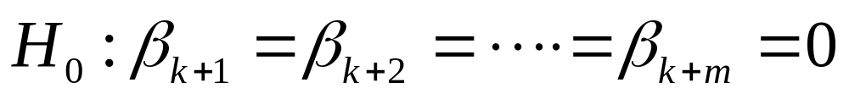
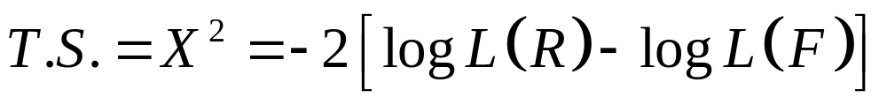
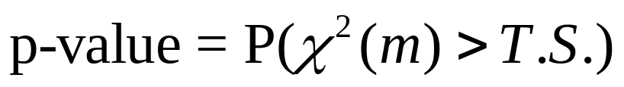
3.3 Methodology of Variable Selection
Likelihood Ratio Test
where k = # regressors in reduced model
m = # regressors rejected
  where
    L(R) is the likelihood of βs in the reduced model
    L(F) is the likelihood of βs in the full model
www.themegallery.com

Slide 41
3.3 Methodology of Variable Selection
 | Test Statistics | Degree of freedom | P-value
Reduced Model 1 | 15.9086 | 17 | 0.5303234 → quite large
Reduced Model 2 | 15.0868 | 11 | 0.1785576 → quite large
Reduced Model 3 | 17.3922 | 12 | 0.1354301 → quite large
Therefore, all the p-value is significant not to reject H₀
www.themegallery.com

Slide 42
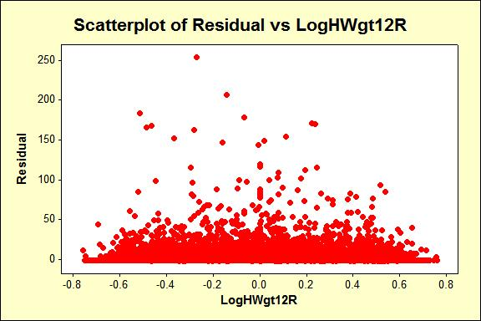
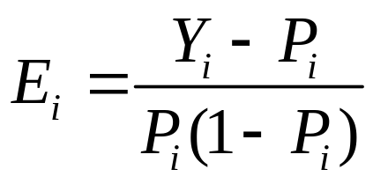
3.4.1 Model Improvement - Residuals
Logit Residual
Almost all plots
show an
independence
of error terms
www.themegallery.com

Slide 43
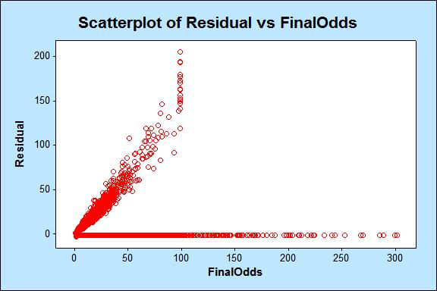
3.4.1 Model Improvement - Residuals
Except plots of residuals against the variables FinalOdds and LogFinalOdds
www.themegallery.com

Slide 44
3.4.1 Model Improvement - Residuals
We have to add the higher order terms of the above two variables
However, the second order terms of the model are all excluded from the stepwise process except for model 1
www.themegallery.com

Slide 45
3.4.1 Model Improvement - Residuals
Hence, we stop adding any higher order terms and find another model improvement strategy
Left behind a better reduced model 1 with a quadratic term FinalOdds^2
www.themegallery.com

Slide 46
3.4.2 Model Improvement - interaction terms
To cater better model for the prediction of matches results
We choose to add interaction terms
But these are so many variables, so…
www.themegallery.com

Slide 47

3.4.2 Model Improvement - interaction terms
Objectively, we choose the 5 variables with the highest values obtained in the reduced models
And subjectively, choose one more variable, the DrawC
www.themegallery.com

Slide 48
3.4.2 Model Improvement - interaction terms
The interaction terms are added using the Hierachy Principle
Hierarchy refers to the requirement that, for any term to be in the model, all effects contained in the term must be present in the model
www.themegallery.com

Slide 49
3.4.2 Model Improvement - interaction terms
For example, in order for the interaction A*B to enter the model, the main effects A and B must be in the model. Likewise, neither effect A nor B can leave the model while the interaction A*B is in the model
www.themegallery.com

Slide 50
4. Application
Outflow of the project
4.1
Simulation in betting and horse racing
4.2
Suggested Capital Optimization Method
www.themegallery.com

Slide 51
5. Conclusion
Outflow of the project
5.1
Conclusion
5.2
Reference
www.themegallery.com

Slide 52
5.2 Reference
Applied logistic regression; David W. Hosmer, Jr. ; Stanley Lemeshow; New York : Wiley, c1989
Fortune's formula : the untold story of the scientific betting system that beat the casinos and Wall Street; William Poundstone; New York : Hill and Wang, 2005.
Logistic regression : a self-learning text; David G. Kleinbaum, Mitchel Klein ; with contributions by Erica Rihl Pryor; New York : Springer, c2002
Applied linear regression models; Kutner, Michael H.; Boston : McGraw-Hill/Irwin, c2004
Applied regression analysis, linear models, and related models; author, John Fox.; Thousand Oaks, Calif. : Sage Publications, c1997
Applied logistic regression analysis; Scott Menard; Thousand Oaks, Calif. : Sage Publications, c1995
A new Interpretation of Information Rate; J.L. Kelly, JR.; 1956
www.themegallery.com

Slide 53
Appendix
Selected variables for fitting model
LogFinalOdds | NG14Chg | DrawC
LogFOddsByNewH | DistTChg | JPP
AveSpeedRating | LWP60 | LastPubLogPP
Brace2race | HAge | LogHWgt12R:Dist
DaySince | LastSpeedRating | LogHWgt12R:Going
LifeHNoRace20 | LogHWgt12R | DrawC:HV
NG14 | WtCarriedChg | DrawC:DistT
NT14 | WtCarried | DrawC:AWT
NS14 | LogClaim
www.themegallery.com

Slide 54
STA0401 - Statistics Project
Thank You !
www.themegallery.com

