Slide 1
Manhattan Property Sales Data Analysis
Kaiyu Yan
12/14/2018

Slide 2
Plan
Dataset from https://www1.nyc.gov/site/finance/taxes/property-annualized-sales-update.page
EDA
Benford Analysis : Price

Slide 3
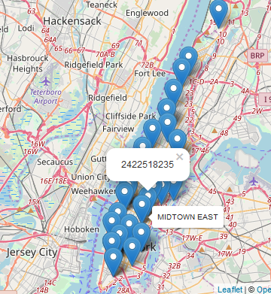
EDA example(details in report)
Each Map marker indicate each neighborhood.
The number represent the total sale price for certain neighborhood.

Slide 4
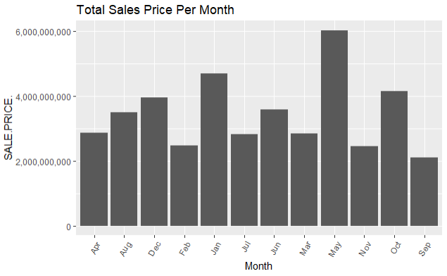
Continued(EDA)

Slide 5
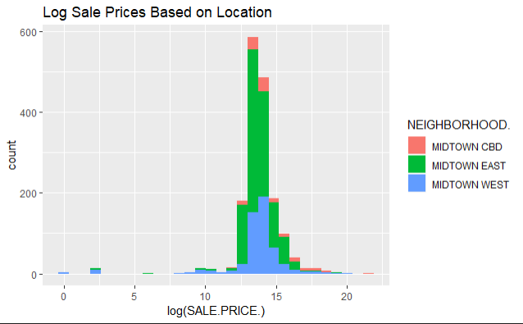
Continued(EDA)

Slide 6
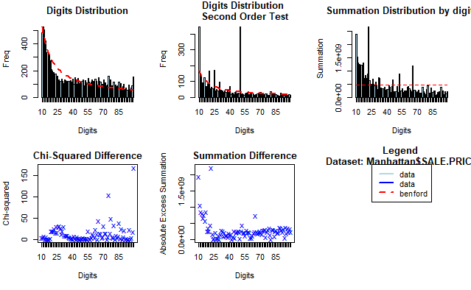
Benford Analysis example(more in report)
The original data is in blue and the expected frequency according to Benford's law is in red.
Most data are following benford distribution.

Slide 7
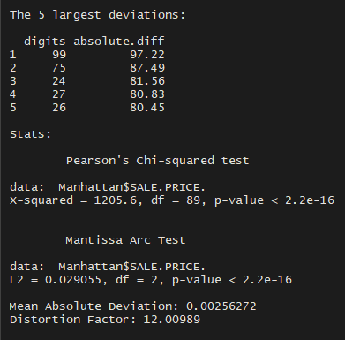
Continued(Benford analysis)
Summary of Benford law Analysis
Include the top 5 deviations
Pearson’s Chi-squared test
Mantissa Arc Test

Slide 8
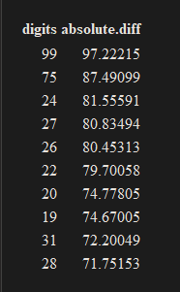
Continued(Benford analysis)
Top Ten suspected two digits that contain most discrepancies from Benford’s law.

Slide 9
Conclusion
EDA part:
Build class of D4 are easier to be sold.
Property with higher land or gross square feet will has higher price.
Location does affect price very much.
Benford analysis part:
Most data following the benford distribution
Digits 99 with high frequency are understandable.

