Slide 1
ACE
a collaborative editor

Slide 2
Vision
ACE will be the first open and platform independent collaborative text editor.

Slide 3
Goals: Semester Project
Know-How CSCW
Evaluation Algorithm
Implemented Algorithm
Testframework
Evaluation Network
Evaluation GUI

Slide 4
Table of Content
Introduction
Selection of Algorithm
Algorithm: Jupiter
Undo/Redo
Testframework
Statistics
Outlook

Slide 5
Introduction

Slide 6
Selection of Algorithm
Selection criteria
  Correctness
  Availability of information
  Algorithm complexity
  Availability of user undo

Slide 7
Selection of Algorithm
2 algorithms pass criteria
  Jupiter
  adOPTed

Slide 8
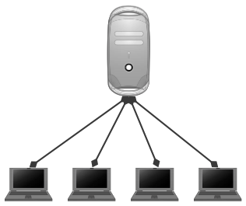
Selection of Algorithm
Jupiter
  Client - server model
  Replicated architecture
  Unicast communication
  Free of TP2
  Inclusion Transformation

Slide 9
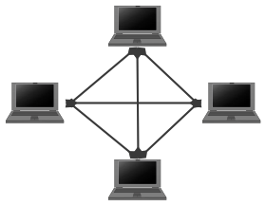
Selection of Algorithm
adOPTed
  Peer-to-peer model
  Replicated architecture
  Multicast communication
  TP2
  Inclusion Transformation

Slide 10
Selection of Algorithm
Justification for Jupiter algorithm
  „Simple“ algorithm (no TP2)
  Better scalability
  Client/Server model closer to CSCW ideology
  Uncertainties in adOPTed

Slide 11
Algorithm: Jupiter
Client and Server algorithm
2 dimensional state space graph
...

Slide 12
Algorithm: Jupiter
2-dimensional state space graph
Example state space
(3,0)
(3,1)
(3,2)
(3,3)
(2,0)
(2,1)
(2,2)
(2,3)
Client
„Hall“
Del(2,c)
„Hallo“
(1,0)
(1,1)
(1,2)
(1,3)
(1,1)
Ins(2,c)
(0,0)
(0,1)
(0,2)
(0,3)
„Hal“
Initial state
Server

Slide 13
Algorithm: Jupiter
Client
Client proxy
Ins(2,c)
Ins(2,b)

Slide 14
Undo/Redo

Slide 15
Testframework
how to test algorithms deterministically?
goals
  exact specification of event order
  testing algorithm implementations
  algorithm implementation independent

Slide 16
Testframework (cont.)
scenario: sequence of events
scenario specification (XML)
processing scenario

Slide 17
Statistics

Slide 18
Outlook
current situation
goals for the diploma project
  collaborative text editor
  network layer
  GUI
open questions
  network technology
  GUI: integrated or standalone application

