Slide 1
CS3225: Combinatorial Methods in Computation Biology
Project:
Genome rearrangement

Slide 2
Evidences of Genome Rearrangement
In 1917, Sturtevant showed that strains of Drosophila melanogaster coming from the same or from distinct geographical localities may differ in having blocks of genes rotated by 180° (reversal).

Slide 3
Evidences of Genome Rearrangement
In 1980s Jeffrey Palmer and co-authors studied evolution of plant organelles by comparing the gene order of mitochondrial genomes
They pioneered studies of the shortest (most parsimonious) rearrangement scenarios between two genomes.
B. oleraca
(cabbage)
+1
-5
+4
-3
+2
Minimum numbers of reversals to transform cabbage to turnip.
+1
-5
+4
-3
-2
+1
-5
-4
-3
-2
B. campestris
(turnip)
+1
+2
+3
+4
+5

Slide 4
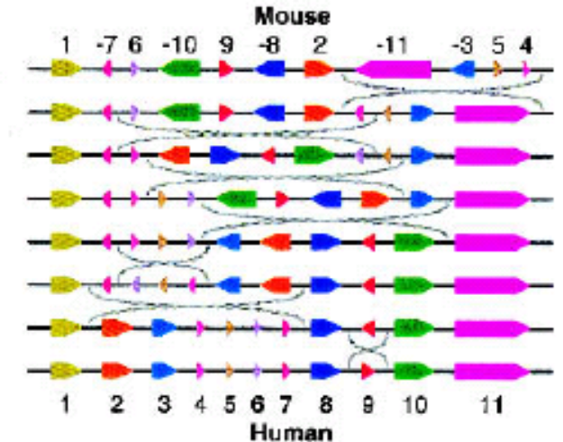
Evidences of Genome Rearrangement
Human and mouse are also highly similarity in DNA sequences (98%).
Moreover, their DNA segments are swapped.
For example, chromosome X of human can be transformed to chromosome X of mouse using 7 reversals.
To transfrom human to mouse, it takes 131 reversals/translocations/fusions/fissions.

Slide 5
Model genome rearrangement by sorting signed permutation
+0,+3,+1,+6,+5,-2,+4,+7
+0,-5,-6,-1,-3,-2,+4,+7
+0,-5,-6,-1,+2,+3,+4,+7
+0,-5,-6,+1,+2,+3,+4,+7
+0,-5,-4,-3,-2,-1,+6,+7
+0,+1,+2,+3,+4,+5,+6,+7

Slide 6
Project requirement
Program 1
  Input: Two gene order sequences A and B
  Output: The steps to perform reversals to transform from A to B
Program 2
  Input: A list of gene order sequences
  Output: All pairs of reversal distances
Program 3
  Reconstruct the phylogenetic tree of the list of species
  If possible, please predict the gene order sequence in the internal nodes
  This is an open-end question. You can decide your own method and the way to present your result.

Slide 7
Three datasets
Chloroplast genome arrangements dataset
  13 gene orders over 105 genes
Mitochondrial dataset
  3 gene orders over 36 genes
Viral genome dataset
  3 gene orders over 24 genes

Slide 8
Input file format
> Herpes simplex virus (HSV)
1, 2, 3, 4, 5, 6, 7, 8, 9, 10, 11, 12, 13, 14, 15, 16, -19, -18, -17, 20, 21, 22, 23, -25, -24
> Epstein-Barr virus (EBV)
1, 2, 3, 4, 5, 6, 7, 8, 9, 10, 11, 12, 13, 14, 15, 16, -20, -19, -18, -17, 21, 22, 23, 24, 25
> Cytomegalovirus (CMV)
1, 2, 3, 4, 5, 6, 7, 8, 9, 10, 11, -13, -12, -16, -15, -14, -25, -24, 17, 18, 19, 20, 21, 22, 23

Slide 9
Program 1 example
Input:
  > A
  3,1,6,5,-2,4
  > B
  1,2,3,4,5,6
Output:
  3,1,6,5,-2,4
  -5,-6,-1,-3,-2,4
  -5,-6,-1,2,3,4
  -5,-6,1,2,3,4
  -5,-4,-3,-2,-1,6
  1,2,3,4,5,6

Slide 10
Program 2 example
Input:
  > A
  3,1,6,5,-2,4
  > B
  1,2,3,4,5,6
  > C
  -5,-6,3,1,-2,4
Output:
A: 0, 5, 2
B: 5, 0, 5
C: 2, 5, 0

Slide 11
Program 3 example
Input:
  > A
  3,1,6,5,-2,4
  > B
  1,2,3,4,5,6
  > C
  -5,-6,3,1,-2,4
A:3,1,6,5,-2,4
  C:-5,-6,3,1,-2,4
  -5,-6,-1,-3,-2,4
  -5,-6,-1,2,3,4
  -5,-6,1,2,3,4
  -5,-4,-3,-2,-1,6
  B:1,2,3,4,5,6

Slide 12
Questions for you to think
Q1: In this exercise, we assume there is a gene order. In general, we only have the genome. Then, how can we study genome rearrangement?
Q2: In the literature, is there any related methods?
Q3: For the real datasets, can you rebuild their phylogenetic tree? Do your trees agree with the known knowledge in the literature?

Slide 13
My expectation
I expect
  good survey
  good algorithms (some new research finding, if possible)
  a good time and space analysis
  a good description of how to use your system
  state any limitations of your solution
Note: I may test your solution with other datasets.

Slide 14
Midterm report (5 Mar)
Email me your progress
Should be less than 3 pages
Guideline for the report:
  Literature survey of related works.
  Your proposed algorithm to solve the problem.
  Current status on the implementation.
  What is your plan for the remaining weeks?

Slide 15
Final report (16 Apr)
Email me your final report (less than 12 pages)
Give a presentation of your approach
Write the report in the paper format:
  Introduction
  Method
  Result
  Discussion
  Conclusion and future works

Slide 16
Project presentation (16 Apr)
Each group needs to give a project presentation of 20 min.
In the presentation, you need to describe:
  Your method
  Your experiment result (or demo)

