Slide 1
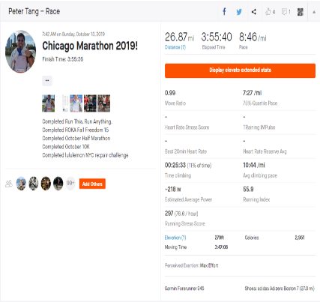
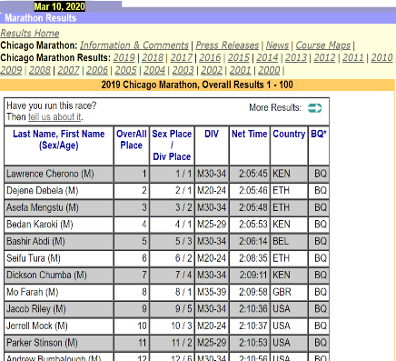
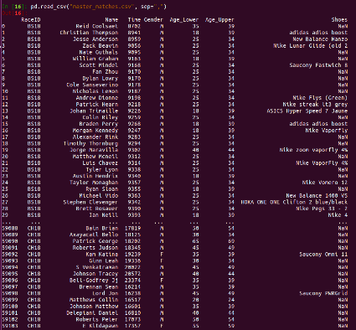
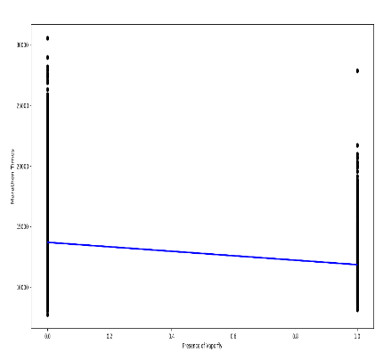
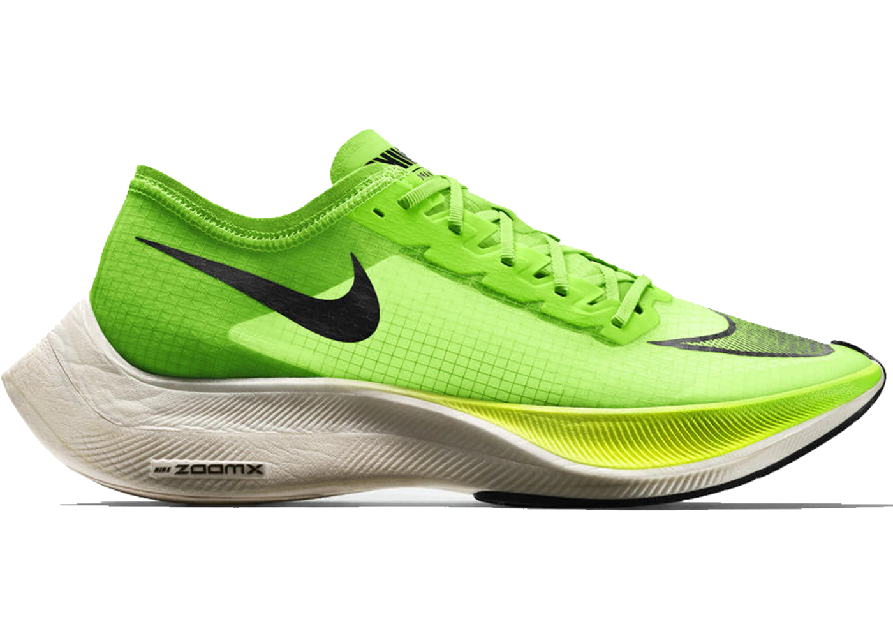
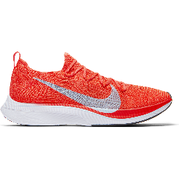
Our goal is to find the correlational effects of wearing Nike’s Vaporfly shoes on marathon finish times. How much faster are you expected to run if you wear these shoes?
3+1: How did we create our final project?
Scraping Strava
We scraped names, finish times, sex, age groups, and the shoes of users from Strava using Chromedriver.
Scraping MarathonGuide
We scraped names, finish times, sex, and age groups from the official race results using BeautifulSoup.
Matches Convergence
We used pandas and Jaro-Winkler scores to record link our Strava and MarathonGuide data.
Regression Analysis
We used matplotlib, sklearn, and pandas to subset our datasets, run linear regressions, and visualize our data.
Joey Cipriano, Peter Tang, Xinyu Wang, Kevin Yan

