Slide 1
Legendary Pokemon Prediction
by
Kai Yao

Slide 2
Task
Goal: predict the whether a pokemon is legendary or not from attributes of each pokemon. From this we can see whether a pokemon is useful.
Examples:
Pikachu Electric '?‘ 320 35 55 40 50 50 90 1 False
Raichu Electric '?‘ 485 60 90 55 90 80 110 1 False
Articuno Ice '?‘ 580 90 85 100 95 125 85 1 True

Slide 3
Dataset
I collected pokemon dataset from kaggle.
This dataset contains 801 pokemons with attributes like name, ids, attack, type 1, type 2, speed and so on.
Because there are some missing values for “Type 2” attribute, so I just use python to clean the data and add “?” for missing values.

Slide 4
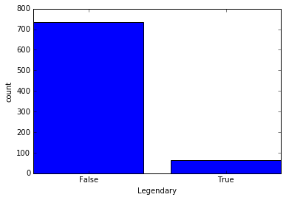
Visualization of the Class
Legendary Pokemon, True or False

Slide 5
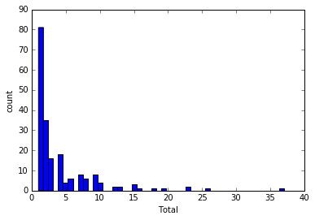
Visualization of one feature
Total

Slide 6
Model Selection Results
We used Accuracy to test different parameters setting and F1 to choose between different models and because There are too many False instances in the dataset, and If we predict all the instances as False, we can get very high accuracy, so we just focus on the instances that are actually Ture and predicted as True.
We performed 5-fold cross validation
Results are one the next slide

Slide 7
Model Selection Results
<here is an example table>
Model | Parameters | Performance
Baseline | Random guess | Acc: 0.473 F1: 0.102
 | Majority guess | Acc: 0.918
Logistic regression | penalty = l1, C=20 | Acc:0.943 F1: 0.508
 | penalty = l2, C=20 | Acc:0.943
 | … | …
SVM | kernel:=“rbf”, C = 100 | Acc:0.943 F1: 0.544
 | kernel:=“rbf”, C = 50 | Acc:0.942
 | kernel:=“rbf”, C = 1 | Acc:0.941
 | … | …
Gaussian NB |  | Acc:0.932 F1: 0.627
Best model and parameter setting was Gaussian NB

Slide 8
Top Features
Based on my model, which is Gaussian NB
Top features are calculated from information gain.
Top features are
Total
Generation
HP
Sp. Atk

Slide 9
Interesting/unexpected cases
Here are two pokemons that are legendary:
'Total', 'HP', 'Attack', 'Defense', 'Sp. Atk', 'Sp. Def', 'Speed', 'Generation'
[ 770. 100. 180. 160. 150. 90. 90. 3.] 1 1
[ 680. 105. 150. 90. 150. 90. 95. 3.] 1 1
Here are two pokemons that are not predicted as legendary but actually legendary
[ 600. 50. 150. 50. 150. 50. 150. 3.] 1 0
[ 600. 50. 180. 20. 180. 20. 150. 3.] 1 0

Slide 10
Interesting/unexpected cases
From the information gain, we can see that the gaussian naive bayes suggest that if 'Total', ' Generation', 'HP‘, 'Sp. Atk' are high, then it is more likely to be legendary pokemons, but if those numbers are low then it is more likely to be common pokemons, so that is why some pokemons are misclassified.

