Slide 1


Computing Maximum Structural Balanced Cliques in Signed Graphs
Kai Yao
The University of Sydney
kyao8420@uni.sydney.edu.au
Lijun Chang
The University of Sydney
lijun.chang@sydney.edu.au
Lu Qin
University of Technology Sydney
lu.qin@uts.edu.au

Slide 2
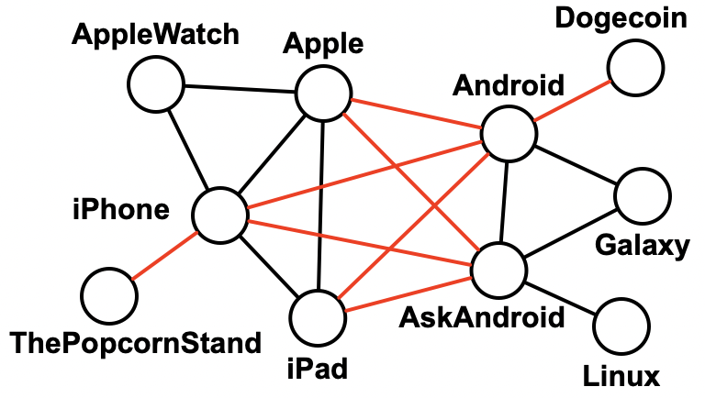
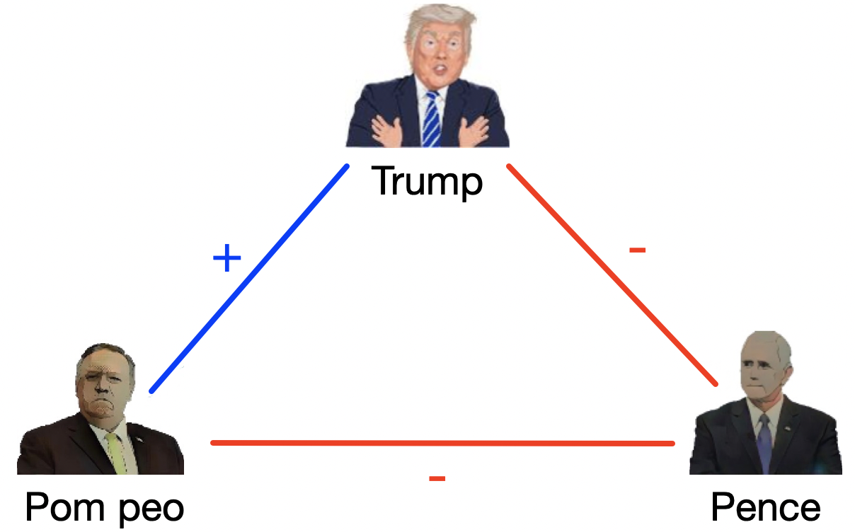
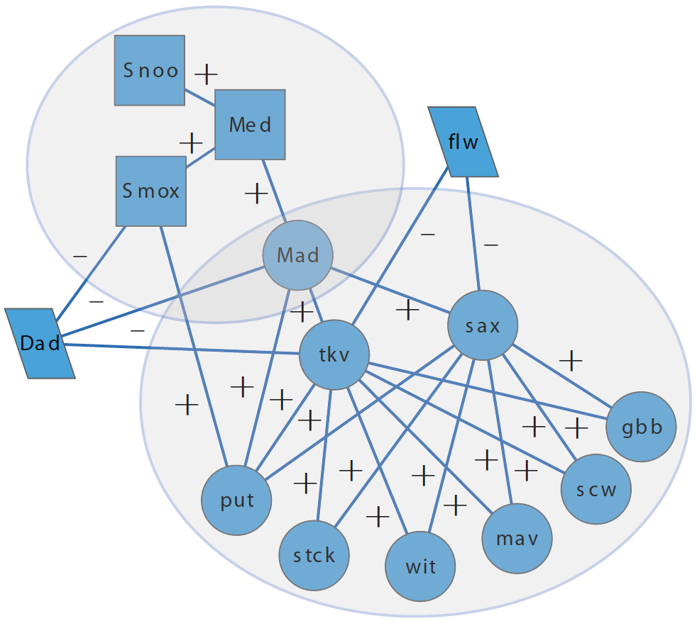
Introduction
Signed graphs capture the polarity of relationships between vertices through positive and negative edge signs.
Friend-foe relationships in social networks
Support-dissent opinions in opinion networks
Activation-inhibition in PPI networks

Slide 3
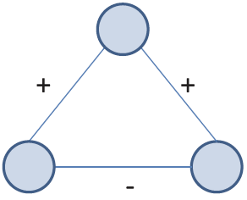
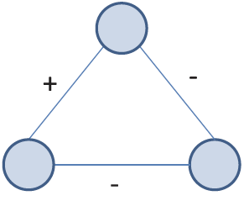
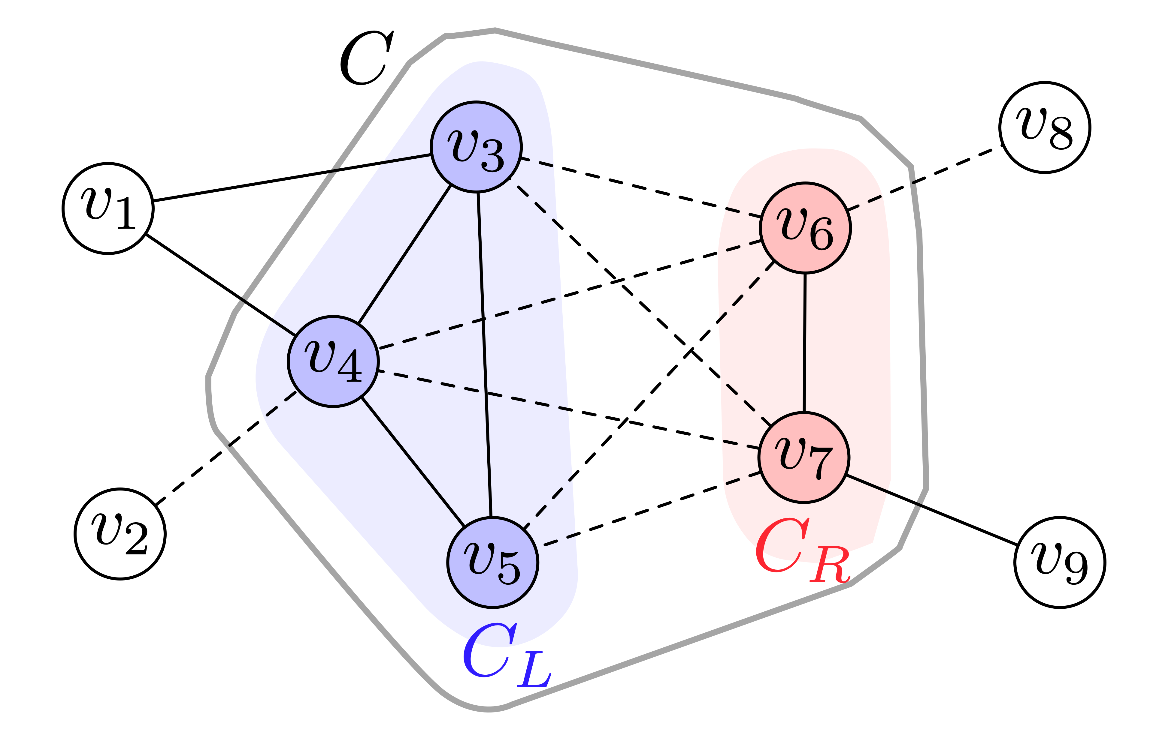
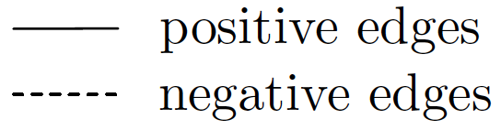
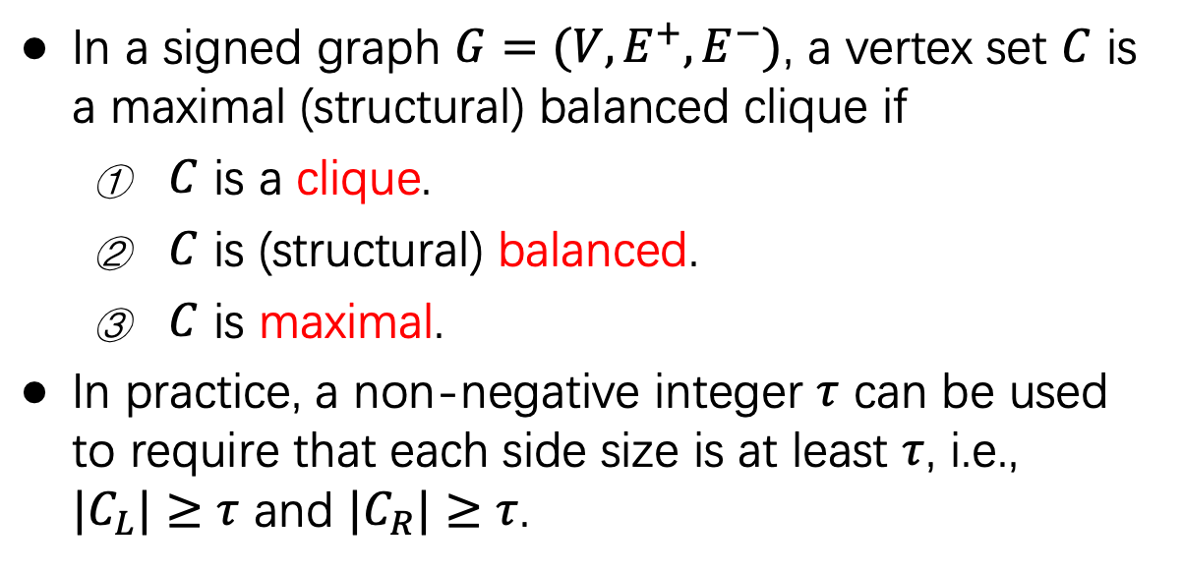
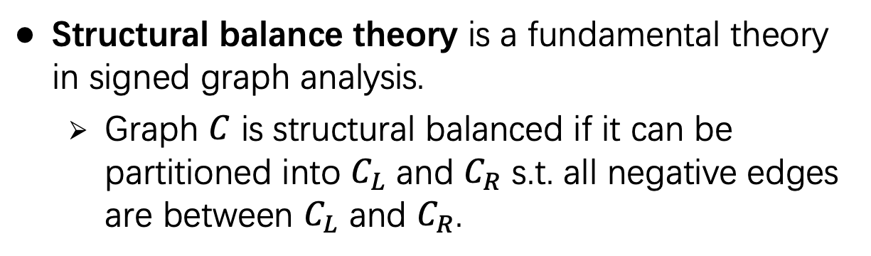
Introduction
Structural balance theory is a fundamental theory in signed graph analysis.
Graph $C$ is structural balanced if it can be partitioned into $C_{L}$ and $C_{R}$ s.t. all negative edges are between $C_{L}$ and $C_{R}$.
Imbalanced
Balanced
In a signed graph $G=(V,E^{+},E^{−})$, a vertex set $C$ is a maximal (structural) balanced clique if
$C$ is a clique.
$C$ is (structural) balanced.
$C$ is maximal.
In practice, a non-negative integer $τ$ can be used to require that each side size is at least $τ$, i.e., $|C_{L}|≥τ$ and $|C_{R}|≥τ$.
Notes:
(i.e., every pair of its vertices is connected by an edge).
(i.e., C can be partitioned into CL and. CR s.t. all negative edges are between CL and CR).
In other words, a signed graph is structural balanced if
its vertices can be partitioned into two sets such that all edges
inside each partition have positive signs and all cross-partition
edges have negative signs.

Slide 4

Motivation
Zi Chen et al., ^{[1]} studied the maximal balanced clique enumeration problem.
However, enumerating all such cliques may overwhelm end-users.
When $τ=3$, over ${10}^{9}$ such cliques on Douban ($|V|=1588455$, $|E|=18709948$).
Another concern: it is unclear how to choose the appropriate $τ$.
A too large $τ$ may lead to no result.
A too small $τ$ may lead to skewed results.
[1]. Zi Chen et al., Efficient maximal balanced clique enumeration in signed networks. WWW 2020.
Notes:
(i.e., every pair of its vertices is connected by an edge).
(i.e., C can be partitioned into CL and. CR s.t. all negative edges are between CL and CR).

Slide 5
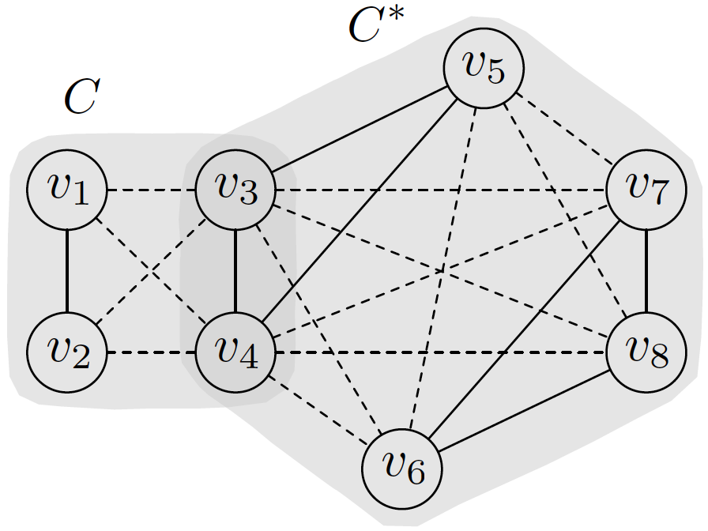
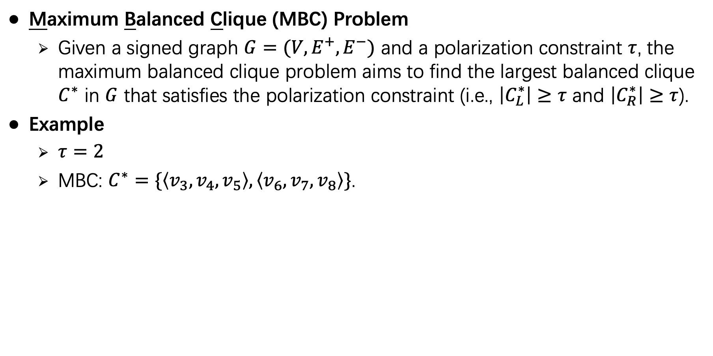
Maximum Balanced Clique Problem
Maximum Balanced Clique (MBC) Problem
Given a signed graph $G=(V,E^{+},E^{−})$ and a polarization constraint $τ$, the maximum balanced clique problem aims to find the largest balanced clique $C^{∗}$ in $G$ that satisfies the polarization constraint (i.e., $\left|C_{L}^{∗}\right|≥τ$ and $\left|C_{R}^{∗}\right|≥τ$).
Example
$τ=2$
MBC: $C^{∗}=\{\left\langle v_{3},v_{4},v_{5}\right\rangle ,\left\langle v_{6},v_{7},v_{8}\right\rangle \}$.

Slide 6
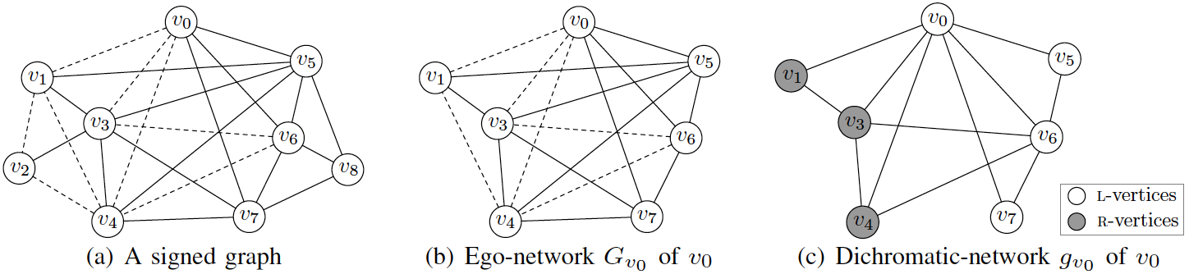
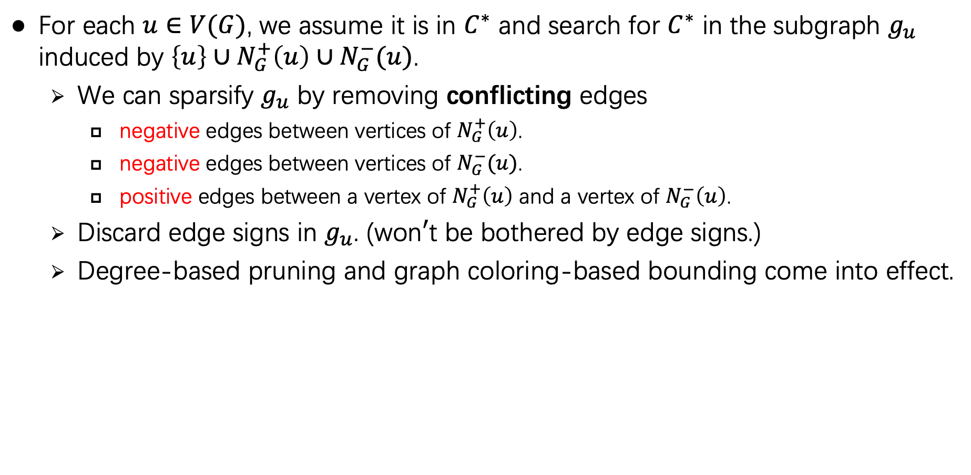
Main Idea of Our Algorithm
For each $u∈V(G)$, we assume it is in $C^{∗}$ and search for $C^{∗}$ in the subgraph $g_{u}$ induced by $\left\{u\right\}∪N_{G}^{+}\left(u\right)∪N_{G}^{−}(u)$.
We can sparsify $g_{u}$ by removing conflicting edges
negative edges between vertices of $N_{G}^{+}\left(u\right)$.
negative edges between vertices of $N_{G}^{−}(u)$.
positive edges between a vertex of $N_{G}^{+}\left(u\right)$ and a vertex of $N_{G}^{−}\left(u\right)$.
Discard edge signs in $g_{u}$. (won$′$t be bothered by edge signs.)
Degree-based pruning and graph coloring-based bounding come into effect.
Notes:
However, we do not know such vertex $u$ in practice. To remedy this, we search for $C^{∗}$ in $g_{u}$ for each $u∈V(G)$.
In this way, we
transform the maximum balanced clique problem over a signed graph G to
a series of maximum clique problems over small unsigned subgraphs of G

Slide 7

Polarization Factor Problem
Polarization Factor (PF) Problem
Given a signed graph $G=(V,E^{+},E^{−})$, the polarization factor problem aims to compute the largest $τ^{∗}$ such that $G$ has a balanced clique satisfying the polarization constraint $τ^{∗}$.
Example
Polarization factor is 3.

Slide 8
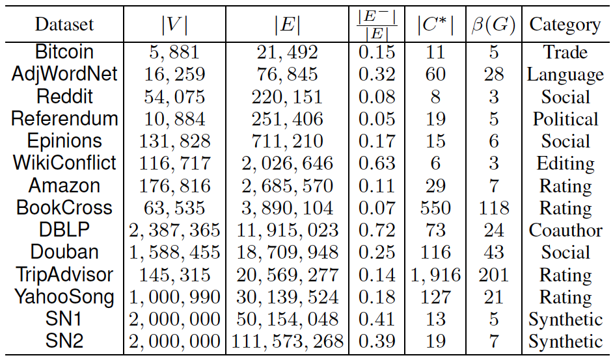
Experiments
Datasets

Slide 9
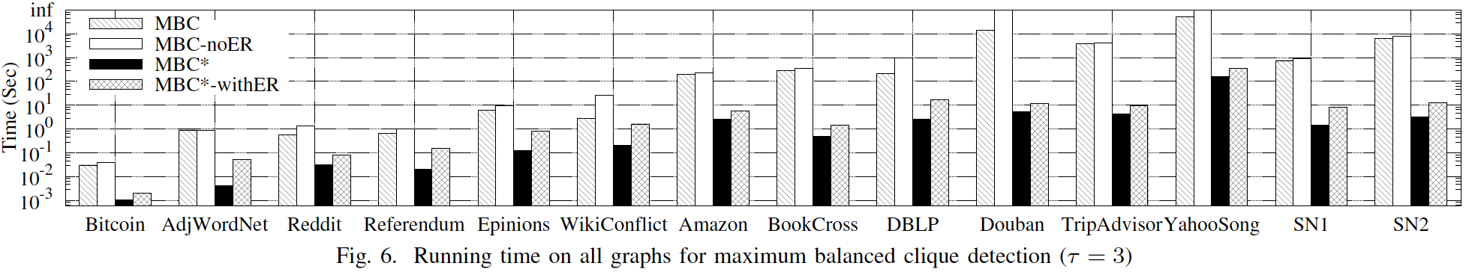
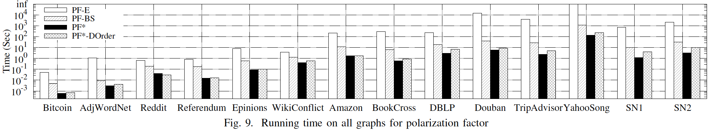
Efficiency Evaluation
MBC problem
PF problem
Notes:
We can clearly see
that MBC significantly outperforms MBC on all datasets,
and the improvement is up-to three orders of magnitude
(e.g., on Douban). This is due to our strategy of transforming
the maximum balanced clique problem to a series of
maximum dichromatic clique problems which remove edge
signs and sparsify the graph.
We can
see that EdgeReduction improves the efficiency for MBC
(compared with MBC-noER), but degrades the performance
for MBC -withER (compared with MBC ). This is because
MBC is very slow and thus EdgeReduction can improve the
efficiency by reducing the graph instance. In contrast, MBC
runs very fast, and thus EdgeReduction incurs a large overhead
for MBC due to having a high time complexity.
We can see that PF outperforms the enumeration-based
baseline algorithm PF-E by several orders of magnitude
on all the graphs. For example, on Douban, PF computes
the polarization factor in 5 seconds, while PF-E takes more
than 4 hours. Our binary search-based algorithm PF-BS is
significantly faster than PF-E, due to our efficient algorithm
MBC for verifying . However, as PF-BS needs to invoke
MBC multiple times, it is almost one order of magnitude
slower than PF . This demonstrates the superiority of PF
that transforms the polarization factor problem to a series of
dichromatic clique checking problems.
In Figure 9, we also report the running time of PF -DOrder,
which is the variant of PF that uses the degeneracy ordering
DOrder instead of the polarization ordering. We see
that PF -DOrder is slower than PF . This demonstrates the
superiority of the polarization ordering for computing the
polarization factor.

Slide 10
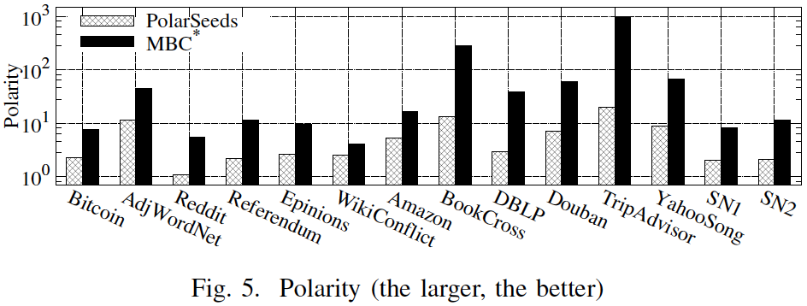
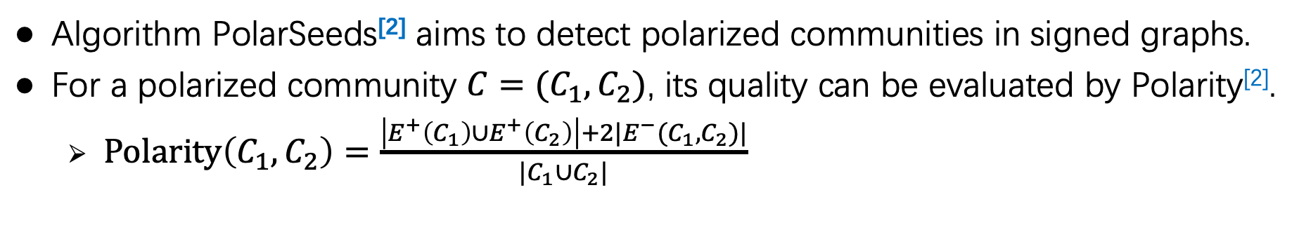
Effectiveness Evaluation
Algorithm PolarSeeds^{[2]} aims to detect polarized communities in signed graphs.
For a polarized community $C=(C_{1},C_{2})$, its quality can be evaluated by Polarity^{[2]}.
$Polarity\left(C_{1},C_{2}\right)=\frac{\left|E^{+}\left(C_{1}\right)∪E^{+}\left(C_{2}\right)\right|+2|E^{−}(C_{1},C_{2})|}{|C_{1}∪C_{2}|}$
[2]. Han Xiao et al., Searching for polarization in signed graphs: a local spectral approach. WWW 2020.
Notes:
We compare the quality
of maximum balanced clique computed by our algorithm
MBC with the polarized community computed by
PolarSeeds [15]. As PolarSeeds has query vertices (i.e., seeds),
we randomly pick 100 pairs of good seeds in the same way
as [15] and report the average result quality.
The result for the quality metric
Polarity [15], [16] is shown in Figure 5. We can see that MBC
produces higher-quality results compared with PolarSeeds on
all datasets. This is mainly because balanced cliques ensure
that all edges agree with the polarized structure, and maximum
balanced clique makes the Polarity even larger.

Slide 11
Thanks!

Slide 12
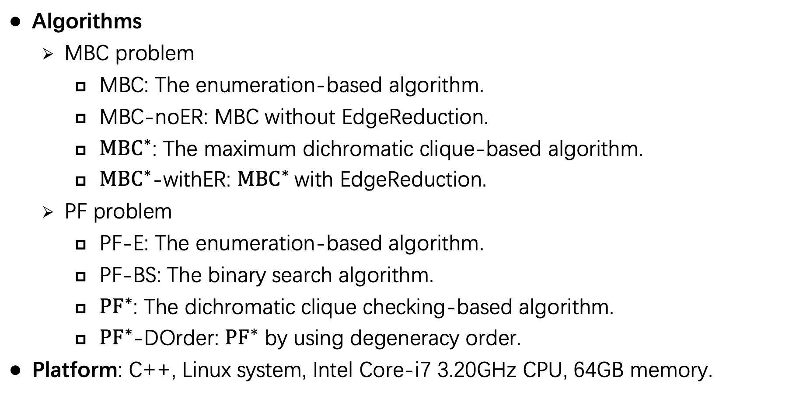
Experiments
Algorithms
MBC problem
MBC: The enumeration-based algorithm.
MBC-noER: MBC without EdgeReduction.
$MBC^{∗}$: The maximum dichromatic clique-based algorithm.
$MBC^{∗}$-withER: $MBC^{∗}$with EdgeReduction.
PF problem
PF-E: The enumeration-based algorithm.
PF-BS: The binary search algorithm.
$PF^{∗}$: The dichromatic clique checking-based algorithm.
$PF^{∗}$-DOrder: $PF^{∗}$ by using degeneracy order.
Platform: C++, Linux system, Intel Core-i7 3.20GHz CPU, 64GB memory.

Slide 13
Conclusion
We studied the maximum balanced clique problem in signed graphs.
We proposed a novel search framework.
We extended our technique to the polarization factor problem in signed graphs.
Experiments demonstrated the efficiency and effectiveness of our algorithms.

